Slide 1
IBM University Engagement Project Submission
“Exploring the Power of Agentic AI with IBM Granite and LangFlow”

Slide 2

Project Title – Interview Trainer Agent
Domain of Project – Artificial intelligence
Student Name | Recent Passport Photo | Email ID | Mobile number [WhatsApp]
Amit Kumar Swain |  | amitkumarswain2005@gmail.com | 9178996612

Slide 3
Problem Statement -
Problem Statement : Interview Trainer Agent
The Challenge :
Preparing for job interviews is a critical yet overwhelming process, as candidates often struggle with question preparation, response structuring, and assessing skill gaps. Role-specific interview questions, industry expectations, and behavioural scenarios are scattered across unreliable sources. Without personalized, real-time guidance, many candidates fail to present their best selves or make confident, informed responses during competitive hiring processes.
The Objective :
Build an AI-powered Interview Trainer Agent that delivers personalized interview preparation and performance coaching for freshers, experienced professionals, and career switchers. The solution should:
Personalized Interview Plans – Recommend question sets based on experience level, job role, technical domain, behavioural traits, and target company culture.
Interview Data RAG Retrieval – Fetch and summarize role-specific questions, model answers, and evaluation rubrics from recruitment portals, professional networks, and company interview databases.
Response Tracking & Feedback – Allow users to input answers via text or voice, and provide instant assessment on clarity, completeness, and confidence.
Preventive Skill Focus – Suggest targeted preparation strategies for skill gaps (e.g., communication-weak or technically-deficient profiles).

Slide 4
Technology Used
I used LangFlow + IBM watsonx.ai + Granite Models
LangFlow – Used to visually design and manage the AI workflow, making it easier to connect
different components such as prompts, models, and APIs without writing complex code.
IBM watsonx.ai – Used as the AI platform to access powerful foundation models,
perform natural language processing, and generate intelligent responses efficiently.
Granite Models – Used as the underlying Large Language Models (LLMs) for understanding user queries,
generating interview questions, evaluating answers, and providing personalized feedback.

Slide 5
Proposed Solution -
Proposed Solution: AI-Powered Interview Trainer Agent
The proposed solution is a multi-agent AI-powered Interview Trainer Agent built using LangFlow, IBM watsonx.ai, and Granite Models to provide personalized, real-time interview guidance. The system addresses challenges in interview preparation, response structuring, and assessing skill gaps through an intelligent, modular architecture.
At its core, the solution uses a Retrieval-Augmented Generation (RAG) pipeline to fetch accurate interview data from trusted sources such as recruitment portals, professional networks, and company interview databases. This data is embedded and stored in a vector database, enabling the system to retrieve and summarize role-specific questions, model answers, and evaluation rubrics using Granite models.
The system consists of four key agents:
Interview Data Retrieval Agent fetches and summarizes role-specific questions and evaluation rubrics using RAG.
Personalized Interview Planner Agent generates customized question sets and preparation plans based on experience
level, job role, technical domain, and target company culture.
Response Tracking & Feedback Agent allows users to input answers via text or voice and delivers instant assessment on clarity, completeness, and confidence.
Preventive Skill Focus Agent provides strategic preparation advice and targeted learning tracks for identified skill gaps (e.g., communication-weak or technically-deficient profiles).
The solution includes a user-friendly dashboard (built with Streamlit or React) that visualizes daily and weekly nutrient intake, highlights deficiencies, and tracks progress toward health goals.
LangFlow is used to orchestrate agent workflows, while watsonx.ai ensures scalable model deployment, embeddings, and AI governance. Granite models power reasoning, summarization, and personalization.
Overall, this solution delivers an end-to-end intelligent interview coach that promotes career readiness through personalized insights, real-time feedback, and targeted skill recommendations.

Slide 6
Langflow component Used -
Chat Input
What it is: The entry point of your workspace. It captures user interaction in real time, typically from a frontend chat interface or a user dashboard.
Role in this flow: It takes the candidate’s typed or recorded text response and directly streams it into the main Large Language Model (LLM) component for processing.
2. IBM watsonx.ai
What it is: The core processing and inference node. This is a custom or integrated LangFlow component designed to communicate directly with IBM’s cloud infrastructure.
Key Configurations visible:
System Message: Stores the base context/rules governing how the AI should behave (e.g., instructing the agent to act strictly as an interview coach).
Model Name: It is specifically configured to run ibm/granite-8b-code-instruct, optimized for following instructions and structural reasoning tasks.
Credentials: It handles the API Endpoint, Project ID, and API Key required to authenticate and securely process the text using IBM's cloud foundation models.
Role in this flow: It takes the text from the Chat Input, parses it through the lens of the System Message instructions, uses the Granite Model to think through a response, and outputs the resulting text.
3. Chat Output
What it is: The final node or endpoint of the pipeline.
Role in this flow: It intercepts the generated Model Response string coming out of the watsonx.ai component and routes it back to the frontend user interface, instantly displaying the interview coach's critique, score, or follow-up question to the user.

Slide 7
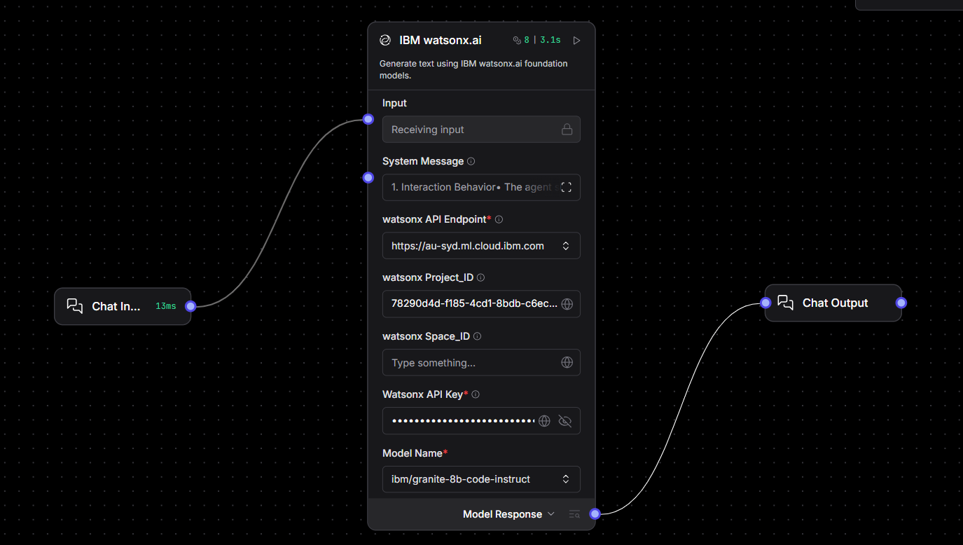
Langflow workflow -

Slide 8

Role of Agentic AI in the solution
Role of Agentic AI in Interview Trainer Agent
Agentic AI enables the Interview Trainer Agent to function as an intelligent, autonomous system rather than a simple chatbot. Using IBM watsonx.ai and IBM Granite models, it coordinates multiple specialized agents to deliver personalized interview guidance.
Each agent performs a specific role—such as retrieving role-specific interview data, generating customized preparation plans, tracking user responses, and analysing communication or technical skill gaps—while working collaboratively. This multi-agent approach ensures efficient task execution and accurate results.
Agentic AI also brings context awareness, understanding user details like experience level, job role, technical domain, and target company culture to generate tailored recommendations. It supports real-time adaptation, continuously updating suggestions based on user inputs like verbal or text-based mock answers. Additionally, agents communicate with each other, enabling better decision-making and improved outcomes.
Overall, Agentic AI makes the system proactive, personalized, and goal-driven, acting like a smart digital interview coach that helps users excel in competitive hiring processes.

Slide 9
Technology Used
Frontend
Next.js 16 – React framework for building the frontend with server-side rendering.
TypeScript – Strongly typed JavaScript for safer and scalable code.
Tailwind CSS – Utility-first CSS framework for styling the UI.
React – Component-based library for building the interactive chat interface.
AI
LangFlow – Visual tool for orchestrating the AI interview trainer workflow.
IBM Watsonx.ai – Platform for model deployment, embeddings, and AI governance.
IBM Granite (granite-4.0-8B-Instruct) – LLM powering question generation and personalization.
RAG – Retrieves role-specific interview content before generating answers.
API
Next.js API Routes – Server-side route handling the LangFlow API communication.
Environment Config (.env.local) – Securely manages API keys and endpoint configuration.
UI Components
shadcn/ui – Pre-built accessible component library used for UI elements.
Custom Components – chat-interface.tsx, chat-message.tsx, profile-form.tsx for core chat features.
Dev Tools
Node.js 18+ – JavaScript runtime environment for running the application.
npm – Package manager for installing and managing dependencies..
Turbopack – Fast Next.js bundler used during development

Slide 10
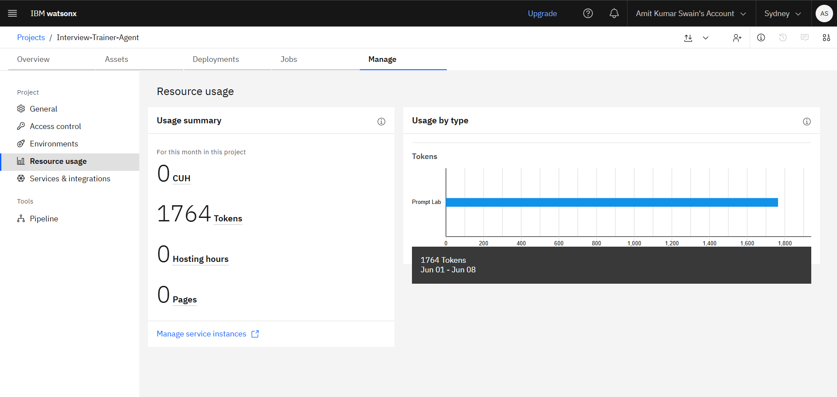
Tokens

Slide 11
Novelty and Uniqueness
The proposed Interview Trainer Agent stands out by combining Agentic AI, RAG, and personalization into a single intelligent system.
Profile-Driven Personalization – Tailors every question set based on the user's name, experience level, and target job role, making prep highly relevant and specific.
RAG-Powered Accuracy – Uses Retrieval-Augmented Generation to fetch real, role-specific interview content before generating answers, reducing generic or irrelevant responses.
Technical + Behavioural Coverage – Goes beyond just technical questions by also covering soft skills and behavioural scenarios for a complete interview prep experience.
Real-Time Conversational Interface – Delivers interview preparation through a live chat UI, making it feel like an actual interview rather than a static Q&A list.
IBM Granite Integration – Leverages IBM's enterprise-grade Granite model for intelligent, context-aware question generation and personalized feedback.
Langflow Workflow Orchestration – Uses a visual AI pipeline via Langflow, making the backend modular, maintainable, and easy to extend with new question sources.
Model Answers & Improvement Tips – Not just asks questions, but also provides sample answers and actionable tips to actively improve user responses.
Scalable & Enterprise-Ready – Built on IBM Watsonx.ai with secure API routes and environment-based config, ensuring reliability and production readiness.
This makes the solution a smart, adaptive, and proactive digital interview coach, not just a static question bank.

Slide 12
Git Hub Link
Please create public GitHub repository (Enable Add README button while creating repository) with format –
Interview-Trainer-Agent
Make sure you have Uploaded following three files into your GitHub repository 1) app.json file , 2) yourproblemstatement.pdf file 3) your projectpresntation.pptx file 4)any other files

Slide 13
Future Scope
AI-Powered Voice Interview Simulation – The system can be enhanced with a voice-enabled interface allowing users to practice speaking answers aloud, simulating a real interview environment. AI can evaluate tone, confidence, and clarity, providing detailed feedback to improve verbal communication skills. This will transform the chatbot from a text-based tool into a fully immersive mock interview experience.
Resume & Job Description Parsing – The system can be extended to automatically parse the user's resume and target job description, extracting key skills and experience gaps. This will enable the Interview Trainer to generate hyper-personalized questions directly aligned with the candidate's profile and the specific role they are applying for. This feature will significantly reduce manual input and deliver a smarter, more targeted preparation experience.

Slide 14


