Slide 1


API Deep Dive: TableViews
Notes:
Module time: 60 mins (30 mins teaching, 30 mins lab)

Slide 2
Agenda
TableView Examples
TableView Basics and Beyond
Headers, Footers, and Sections
Events and Extras
Notes:
In this module, we’ll look at some table examples
review tableview basics then go a bit further into what you can do with tables
we’ll look at headers, footers, and sections
we’ll wrap up with another look at events as well as some cross platform continuous scrolling solution
2

Slide 3

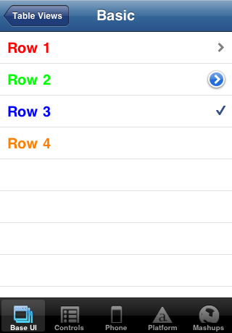
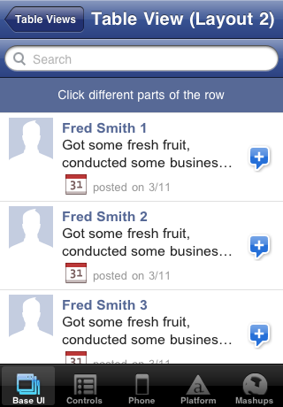
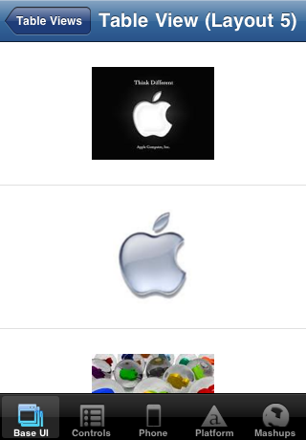
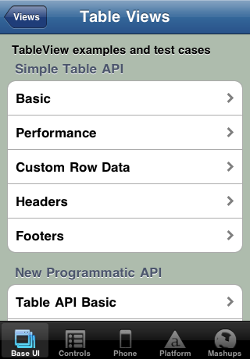
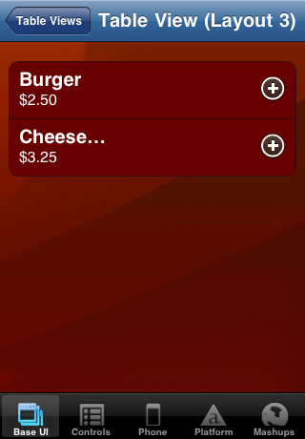
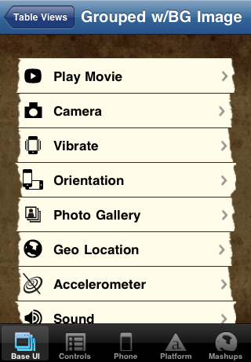
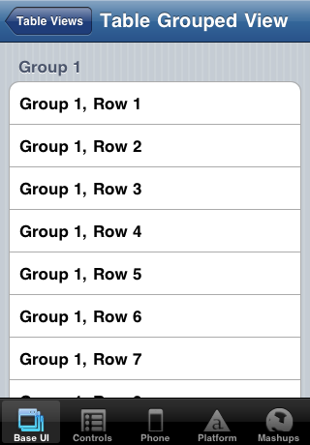
Examples
Notes:
Many options for formatting tables
(seven total shown)

Slide 4
Basic TableView
var table = new Titanium.UI.createTableView({
properties
});
Key table properties:
height / width
top / left
backgroundColor / backgroundImage
rowHeight / minRowHeight / maxRowHeight
headerTitle / headerView
footerTitle / footerView
scrollable
Notes:
This is probably all review from BNAPPs

Slide 5
Table Rows with Anonymous Objects
var tbl_data = [{title:'Row 1'}, {title:'Row 2'}];
var table = new Titanium.UI.createTableView({
data:tbl_data
});
// alternatively
table.setData(tbl_data);
Notes:
One option for adding rows is to use anonymous objects
Useful with JSON data pulled from a web service or database

Slide 6
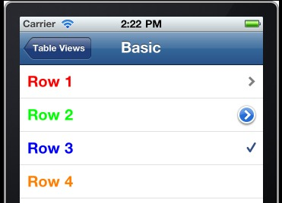
TableViewRow Object
var row = new Titanium.UI.createTableViewRow({
properties
});
table.appendRow(row);
Key properties:
title
height / width / top / left
color / backgroundColor
leftImage / rightImage
Notes:
You can also create TableViewRow objects
Useful when you want to manipulate the row’s properties before/after adding to the table
Saves cumbersome means of accessing the object within the table’s data array

Slide 7
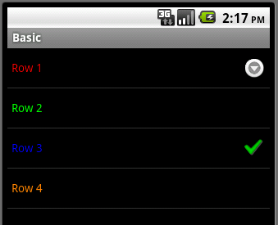
Row Indicators
hasChild
hasDetail
hasCheck
Notes:
hasChild – indicates sub-table or additional rows
hasDetail – indicates a detail view or alert will appear when row is tapped (not supported on Android)
hasCheck – on/off or yes/no indicator

Slide 8
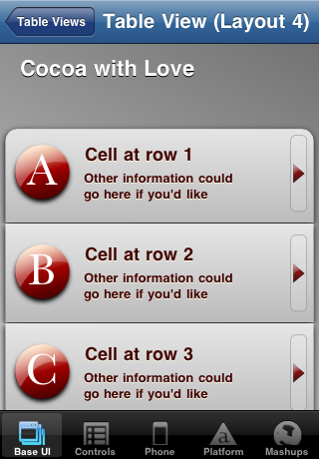
Basic Table and Row Properties
Row: backgroundImage
Table: top
Row: title
Row: leftImage
Row: rightImage
Row: subTitle
Row: backgroundImage
Notes:
Formatting can be done with standard TableViewRow properties
First row has different background image than middle rows
Not labeled, but the row’s foreground (text) color also set

Slide 9
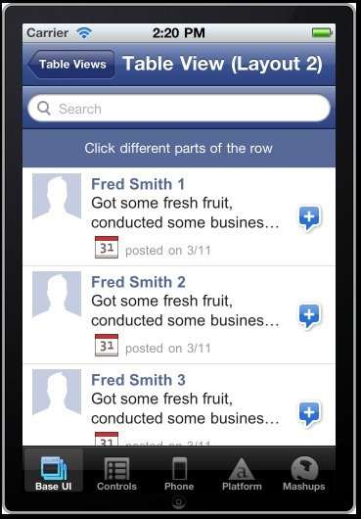
Custom Table Rows
Add labels, views, images to your rows
Positioning: relative to top-left of row
Elements accessible via children[]
Labels
ImageViews
Notes:
You can add labels, views, and images to create custom rows
Point out the three labels
Point out the image views
The “plus” image is set with the row’s rightImage property

Slide 10
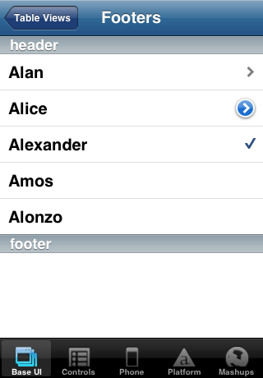
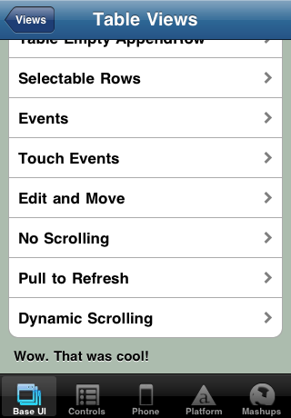
Headers and Footers
Row headers and footers
Table headers and footers
var tableview = Titanium.UI.createTableView ({
data:data,
headerTitle:'TableView examples and test cases',
footerTitle:"Wow. That was cool!",
});
var alanrow = Titanium.UI.createTableViewRow({
title: ‘Alan’,
header: ‘header’
});
var alonzorow = Titanium.UI.createTableViewRow({
title: ‘Alonzo’,
footer: ‘footer’
});

Slide 11
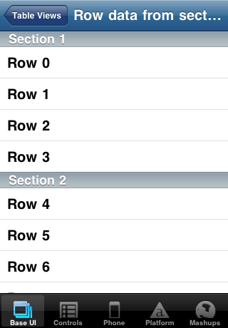
Table Sections
Creating table sections
var section1 = Ti.UI.createTableViewSection({ headerTitle:'Section 1’
});
var section2 = Ti.UI.createTableViewSection({ headerTitle: 'Section 2’ });
section1.add({title:'Row 0'});
...
var tv = Ti.UI.createTableView({
data:[section1,section2]
});
Notes:
Create sections, add rows to them
assign sections to table via an array added to the data property

Slide 12
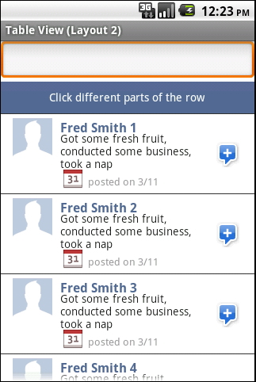

Table Searching
iOS
Android
var searchbar = Titanium.UI.createSearchBar({
barColor:'#385292',
showCancel:false
});
var tableView = Titanium.UI.createTableView({
search:searchbar
});
Notes:
Same code, but different looks

Slide 13
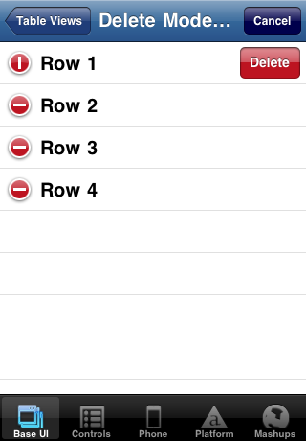
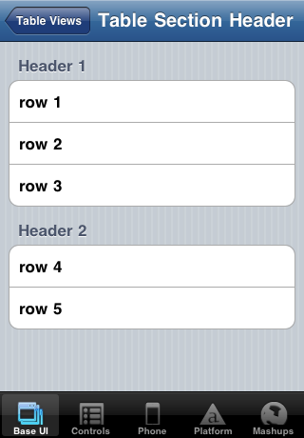
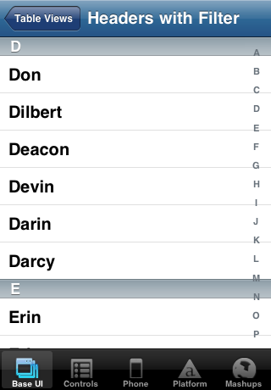
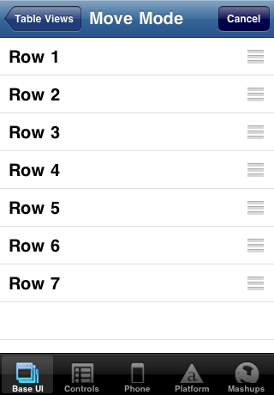
iOS Only Features
Edit / Delete mode
Moving rows
Grouped sections
Filters
var index = [
{title:'A',index:0},
...
{title:'P',index:(data.length -1)}
];
tableview.index = index;
editBtn.addEventListener('click', function() {
tableview.moving = true;
});
tableview.addEventListener('move',function(e) {
...
});
var tableView = Titanium.UI.createTableView({
editable:true
});
tableview.addEventListener('delete',function(e) {
...
});
var tableView = Titanium.UI.createTableView({
style:Titanium.UI.iPhone.TableViewStyle.GROUPED
});

Slide 14
Table events
table.addEventListener('click', function(e){
alert('You clicked row '+e.index);
});
Key events:
click / dblclick
scroll / scrollEnd
touchstart / touchend / touchmove / touchcancel
swipe
move / delete (iOS)
Event object properties:
index
row
rowData
source
section
searchMode
Long-press delete for iOS & Android – https://gist.github.com/1018107

Slide 15
Event Extras
Scroll Events - contentOffset (iOS only)
Scroll Events – firstVisibleItem, visibleItemCount, totalItemCount (Android only)
Dynamic scrolling Android workarounds
https://gist.github.com/903895
https://gist.github.com/810391
Notes:
Use these events to create dynamic scrolling, also called continuous or infinite scrolling
See these gists as well as the Q&A forums for more info on creating cross-platform infinite scrolling solutions

Slide 16

Q&A

Slide 17
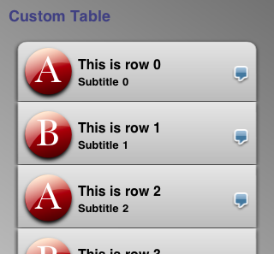
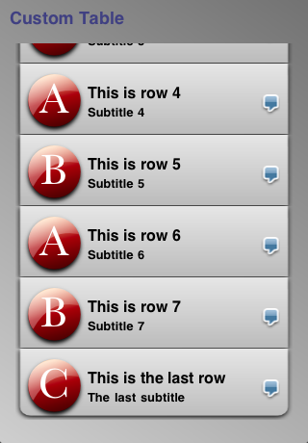
Lab goals
Notes:
Goals:
Gradient background, table that doesn’t fill viewport
Table row backgrounds differ for first, middle, and last rows
Two images and two labels per row
Tap A, B, C and they switch to next “higher”
Tap speech bubble and it swaps blue/red

Slide 18
Lab Exercise

