Slide 1


Advanced Titanium Training
Notes:
Module time: 60 minutes (30 mins teaching, 30 mins lab)

Slide 2
Logistics
Daily Schedule
Facilities Review
Disturbances (phones, etc.)
Notes:
Give the daily schedule: start/stop times, etc.
Review facilities – restrooms, break and lunch rooms, etc.
Phones on vibrate, respect the silence and work needs of the others around you

Slide 3
Rationale
“Advanced” training could mean any number of things
Basis for TCMD certification
We define advanced training as the following:
Exposing developers to the tools, APIs, and platform-specific configurations to deliver “best of breed” native mobile applications
Notes:
“Advanced” is a loaded term – what’s advanced to you might not be what’s advanced to me, so we do the best we can to define what we mean by advanced
As a practical matter, our advanced training is the basis for TCMD
“Best of breed” means delivering the best of the target platform – deep OS integration, solid performance, and polished user interface

Slide 4
Training Roadmap
Day One
Performance Optimization
Mobile UX
Advanced UI
TableView API
Gestures/Orientation
Input Collection
ScrollView API
Animation
Day Two
Android API Deep Dive
iOS API Deep Dive
Extending Titanium
Titanium Plus Integration
TCMD Exam
Office Hours
Notes:
We’ll start by sharing techniques we’ve learned for creating performant apps
Good UX separates average from best of breed apps
Advanced UI digs into creating custom UI components
TableView – dig deep into creating custom tables and rows
Gestures – handle orientation, shakes, and other gestures
Input – mobile devices not optimal for data entry, so we’ll show some tricks and techniques
ScrollView – ScrollView and ScrollableView components, expose functionality over time rather than jamming all your UI into the viewport
Animation – important from a UX standpoint, can add eye-candy to your app also
Android API – dig into some android specific features you can implement
iOS API – dig into iOS specific UI components, add to settings screen
Extending – overview of the plug in architecture and high-level intro to creating modules
Ti+ - look into the modules available and how you could use them in your app
Office Hours – time for looking into your app, your questions

Slide 5
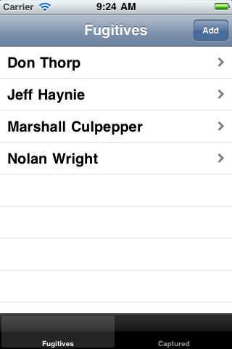
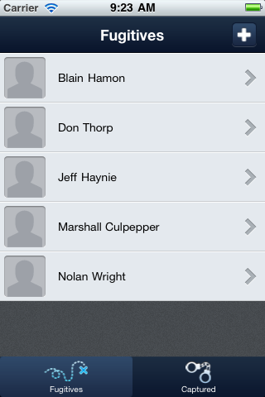
Functional to Fabulous
Notes:
Our first order of business is to take TiBountyHunter and convert it from a novice level application to a polished, professional quality application.
Implement a custom tab bar, cross platform
Custom windowing, better visual assets

Slide 6

Questions?

