Slide 1


Orientation and Gestures
Notes:
Module time: 60 mins (30 mins teaching, 30 mins lab)

Slide 2
Agenda
Device orientation
Gestures
Notes:
In this module, we’ll discuss how to deal with device orientation as well as how to integrate gestures other than taps into your app.
2

Slide 3
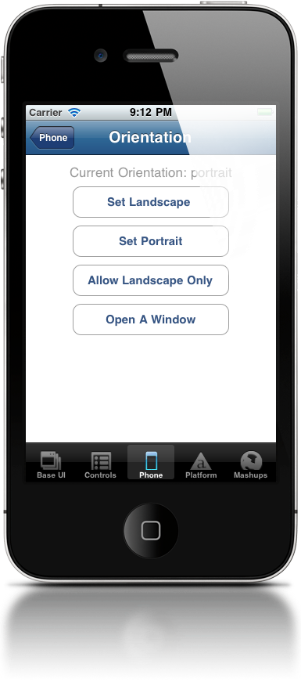
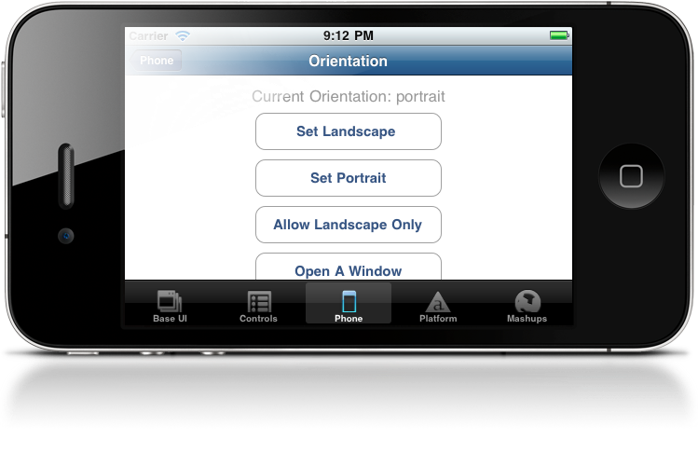
Device orientation
Locking orientation
Fixing orientation per window
Handling orientation events
Notes:
Three ways to deal with orientation:
Lock the orientation for the entire app
Setting a fixed orientation for specific screens within your app (e.g. one screen in portrait and another in landscape, but those are locked)
Actively updating your app’s UI based on the current orientation by handling orientation events
Per Apple’s HIG on iPhone, either:
Lock orientation, or
Support portrait, landscape left & right, but not upside down (to prevent upside down phone during incoming call)
On iPad, you should support all orientations

Slide 4
Locking Orientation - iOS
In tiapp.xml:
<iphone>
<orientations device="iphone">
<orientation>Ti.UI.PORTRAIT</orientation>
<orientation>Ti.UI.UPSIDE_PORTRAIT</orientation>
</orientations>
<orientations device="ipad">
<orientation>Ti.UI.PORTRAIT</orientation>
<orientation>Ti.UI.UPSIDE_PORTRAIT</orientation>
<orientation>Ti.UI.LANDSCAPE_LEFT</orientation>
<orientation>Ti.UI.LANDSCAPE_RIGHT</orientation>
</orientations>
</iphone>
Notes:
For iOS, set supported orientations in tiapp.xml
To lock orientation, just remove the non-supported orientations

Slide 5
Locking Orientation - Android
Option 1 - tiapp.xml:
- Copy code from build/android/AndroidManifest.xml
- Add nested <manifest> tags within <android>
- remove “|orientation” from every node
<android xmlns:android="http://schemas.android.com/apk/res/android">
<manifest>
<activity
android:name="org.appcelerator.titanium.TiActivity"
android:configChanges="keyboardHidden"
android:screenOrientation="portrait”
/>
<activity android:name="ti.modules.titanium.ui.TiTabActivity"
android:configChanges="keyboardHidden"
/>
...
</manifest>
</android>
Notes:
Three options for locking orientation on Android
Make sure to remove the bar and orientation from every node

Slide 6
Locking Orientation - Android
Option 2 - Android manifest file
- Copy build/android/AndroidManifest.xml to
platform/android/AndroidManifest.xml
- remove “|orientation” from every node
<activity
android:name="org.appcelerator.titanium.TiActivity”
android:configChanges="keyboardHidden”
android:screenOrientation="portrait”
/>
<activity android:name="ti.modules.titanium.ui.TiTabActivity"
android:configChanges="keyboardHidden”
/>
Notes:
Option 2 is to create a custom manifest file in the Platform/android folder
The Platform folder doesn’t exist by default
Clean the project before rebuilding to clear out old AndroidManifest.xml file

Slide 7
Locking Orientation - Android
Option 3 - Android manifest file – deprecated
- Copy build/android/AndroidManifest.xml to
build/android/AndroidManifest.custom.xml
- remove “|orientation” from every node
<activity
android:name="org.appcelerator.titanium.TiActivity”
android:configChanges="keyboardHidden”
android:screenOrientation="portrait”
/>
<activity android:name="ti.modules.titanium.ui.TiTabActivity"
android:configChanges="keyboardHidden”
/>
Notes:
This method is deprecated in favor of the Tiapp.xml or platform/android/AndroidManifest (option 2) techniques

Slide 8

Fixed Orientation per Window
Ti.UI.orientation
Supported values include:
PORTRAIT / UPSIDE_PORTRAIT
LANDSCAPE_LEFT / LANDSCAPE_RIGHT
FACE_UP / FACE_DOWN
1
Ti.UI.orientation = Ti.UI.PORTRAIT
2
var win = Ti.UI.createWindow({
orientationModes[
Ti.UI.PORTRAIT,
Ti.UI.UPSIDE_PORTRAIT
]
});
Notes:
You can set orientation on a per window basis within your app
Two options:
Use Ti.UI.orientation statement
set orientationModes when defining the window

Slide 9
Orientation Events
Ti.Gesture.orientationchange
Event properties and methods:
Ti.Gesture.addEventListener('orientationchange',function(e) {
// get current device orientation from
// Titanium.Gesture.orientation
// get orientation from event object
// from e.orientation
// two methods return Boolean
// e.source.isPortrait()
// e.source.isLandscape()
});
Notes:
You can react to orientation change events
Use the Ti.Gesture event listener
On Android, can’t be in a tab group (open ticket TIMOB-4121)
Remove from tab group or use sub-contexts
Test on device to be sure you’re getting/using values you expect
They can differ between iOS and Android

Slide 10
Handling Orientation Changes
React to orientation change via event listener
Use self-contained, self-updating UI components
Move, rotate, and swap UI elements
Take advantage of the orientation
Don’t forget the soft keyboard
Notes:
Unless your UI dictates otherwise, best-practice is to actively react to orientation changes
Self-contained, self-updating is same as we use in TiBountyHunter with the tableview
Components listen for a global orientation event and update themselves
Take advantage – move components to logical location, change size & shape, show different content (as in the Jamie Oliver recipe application that shows longer how-to info in landscape and short text & ingredients in portrait)
Soft keyboard – might cover a lot more of your UI

Slide 11
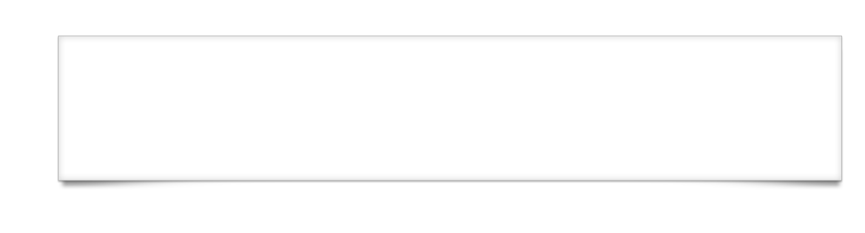
Gestures

Slide 12
Gestures
Shake
Swipe
Touch start, end, move, and cancel
Long press
Pitch, roll, and yaw
Notes:
Other than taps, you can react to …
(don’t go too deep here, there are upcoming slides for that)

Slide 13
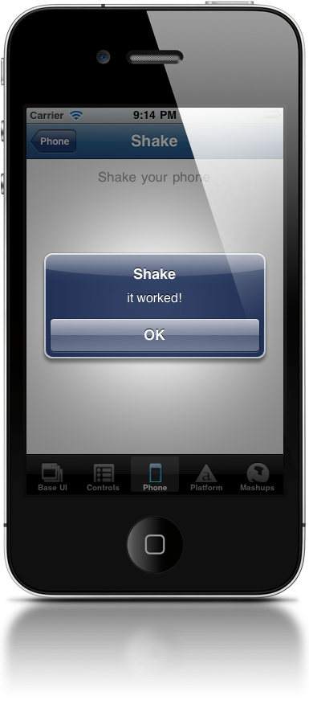
Shake
Ti.Gesture.shake
Event object properties
Ti.Gesture.addEventListener('shake',function(e) {
alert(’it worked!');
});
Notes:
timestamp is useful to track the time since last shake
Useful for not over reacting to shakes (delay before counting as a new shake event)

Slide 14
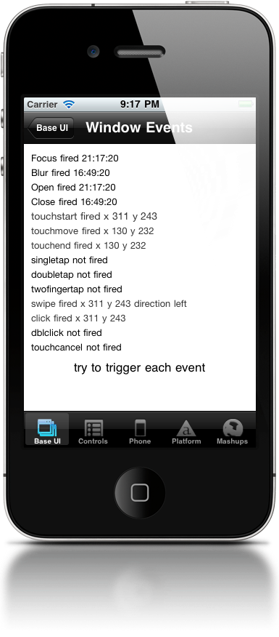




Swipes
Built-in event on most Ti.UI elements
Event object properties:
direction
source
x/y coords
swipe
Notes:
Swipe supported on pretty much all Ti.UI components
Most likely to be used on views, windows, tableviews, imageviews, labels, web views
Key object properties are direction (left or right) and source

Slide 15
Touches
Built-in event on most Ti.UI elements
Subtypes: touchstart, touchmove, touchend, touchcancel
Event object properties:
source
x/y coords
touchmove fires continuously during event
Notes:
touchcancel fired when your app is interrupted (phone call)
Use x/y coordinates to determine direction

Slide 16
Long press
Not natively supported by Titanium APIs
Simulate by tracking touchstart and touchend
https://gist.github.com/1019105
Faking long press in Android
https://gist.github.com/1018107
Long press to delete table row
Keep in mind native UI conventions for long presses
Notes:
Long press events exist in native Oses
You can simulate by tracking touchstart and touchend
A couple of gists show how you could use this
Keep in mind native conventions: e.g. on iOS, magnifies view in some contexts
Long press will be natively supported soon, maybe 1.8

Slide 17
Accelerometer
iOS and Android natively support gyroscope
Titanium APIs don’t support it currently
Not all devices include necessary gyro hardware
Approximation: Use the accelerometer to track pitch, roll, and yaw changes
Kitchen Sink demo
Notes:
Android and iOS support gyroscope APIs to track rotational changes
But not currently supported in Titanium APIs
Use linear acceleration from accelerometer as workaround
Detect 3-axis change values and will probably need some good math to get accurate correspondence to pitch, roll, yaw
Demo must be run on a device
Phone tab > Accelerometer
Resources/examples/accelerometer.js

Slide 18
Q&A

Slide 19
Lab Goals
Update simple app to add orientation support
Update data based on swipe and shake events
Demo & wiki URL
Notes:
In this lab you will create modify a simple UI based on orientation changes and then alter than data based on swipe and shake gesture events. When the phone registers the shake event, it will choose a random photo to display as the album image. When you swipe over the copy, it will choose a random one for display as well. Rotation of device will reorient the content of the window to be more effectively located.

Slide 20
Lab
Notes:
Lab for TiBountyHunter we will redraw and create nice orientation specific layouts for our application windows. This happens here:
Ti.Gesture.addEventListener('orientationchange', function(e) {
container.width = Ti.Platform.displayCaps.platformWidth/2;
});
basically, we listen for orientation change and update our UI to match. You should add orientation change handlers for every component in your UI that needs to be updated based on orientation

