Slide 1


Titanium Studio

Slide 2
Agenda
Intro / Review
Titanium-specific features
Deployment and distribution features
Debugging
Customizing and extending

Slide 3
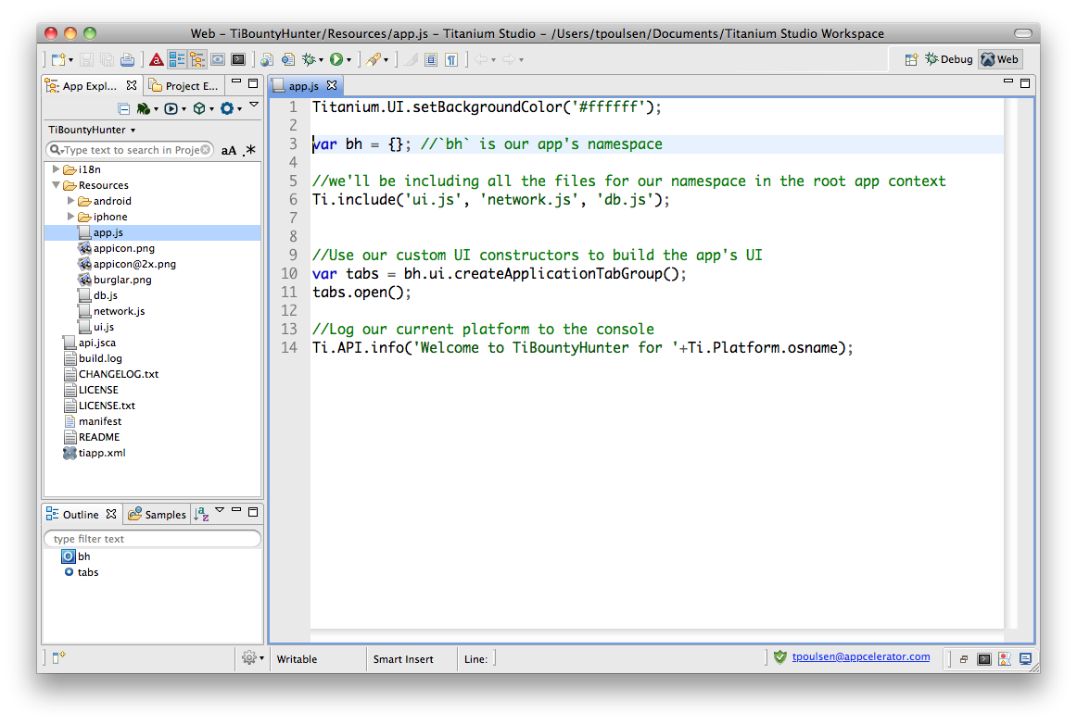
Eclipse concepts
Perspective
View
Editor
Notes:
Based on Eclipse (www.eclipse.org/) – open source software development tools project
Editor = window in which you change code or project parameters
View = hierarchical selector, such as a file tree
Perspective = Editors + Views
Workspace = file location for your project

Slide 4
UI Overview
Coding features
Debug, Run, & Deploy menus
App explorer
Terminal & Console buttons
Notes:
Point out the main UI features
App Explorer (view)
Code editing view & features (editor)
Debug, Run & Deploy menus
New project button
Terminal, Console, and Problems buttons

Slide 5
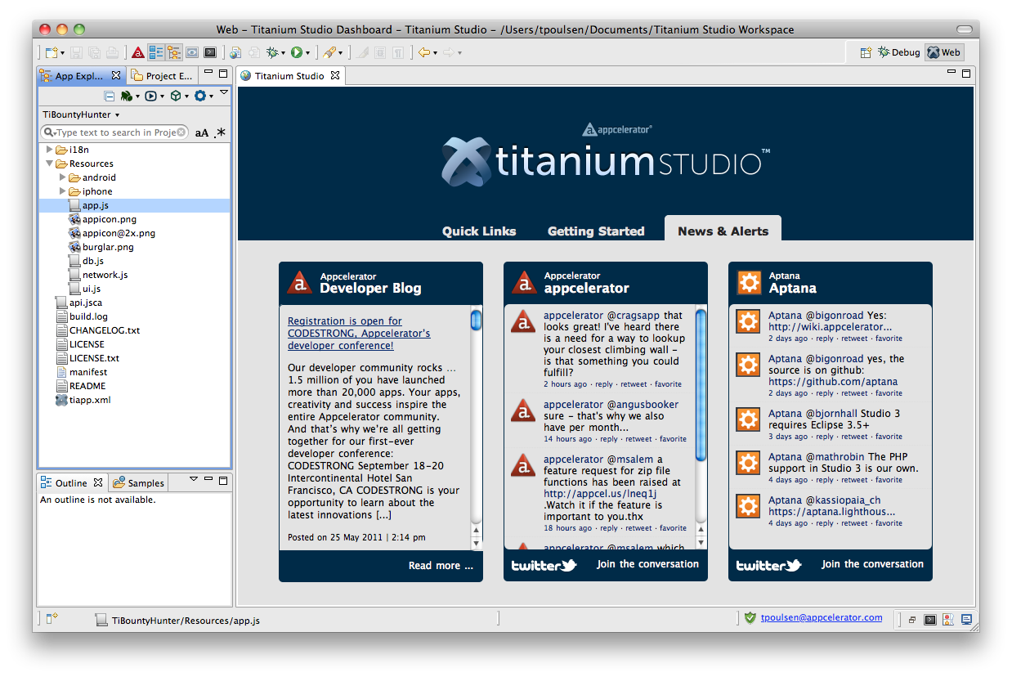
Titanium Dashboard
Dashboard
Notes:
News and notes about Titanium, Appcelerator, and Aptana

Slide 6
Titanium-specific features
Project management – create project wizard, tiapp.xml editor, build cleaning
Project configuration - API level, emulator settings, more
Console output and filtering
Run and Deploy menus
Demo
Notes:
Demo:
show tiapp.xml editor
build cleaning
config project – set api level & android emulator options

Slide 7
Deployment and distribution
Mobile deployment and distribution features
Local web / HTML testing (integrated/system browser)
Web/ HTML / PHP deployment (ftp, sftp, ftps)
PHP, Ruby, etc. deployment and distribution (Engine Yard, RedHat Cloud, Capistrano)
Git integration – pull/push/commit, branching
SVN & other CI system integration (add-ons)

Slide 8
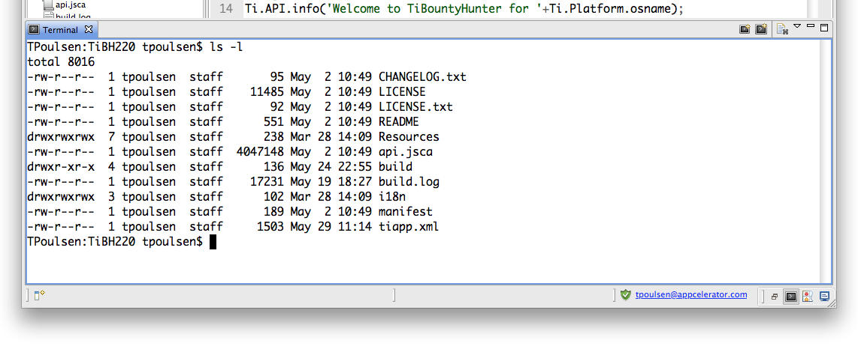
Integrated terminal
click here
Slide notes would cover some common use cases …
Demo – launch FastDev for Android in the terminal?

Slide 9
Debugging
Breakpoints, stepping through code, conditional breakpoints
Variables – examining variable state and affecting run-time variable values
iOS & Android specifics and limitations
Demo

Slide 10
Customizing
Themes & colors
Editor options (line wrapping, numbering, etc.)
“macros” and shortcuts

Slide 11
TextMate compatibility
Importing TextMate themes
Importing TextMate bundles
Demo

Slide 12
Extending and maintaining Ti Studio
Add-ons – e.g. SVN tools
Updates and update checking
Third-party add-ons (do they exist?)

Slide 13

Q&A

Slide 14
Lab
Ideas:
debug a project
import a textmate theme and/or bundle
configure or create a shortcut
configure colors and theme settings
configure Ti Mobile settings (API level, emulator options)

