Slide 1



Titanium Plus Integration Advanced Titanium Mobile Development
Notes:
Module time: 30 mins (10 mins teaching, 20 mins for lab)

Slide 2

Agenda
Titanium Plus Module Overview
Module Install
Lab – Exploring Plus Modules
Notes:
This is basically an overview of being a Ti+ consumer.

Slide 3
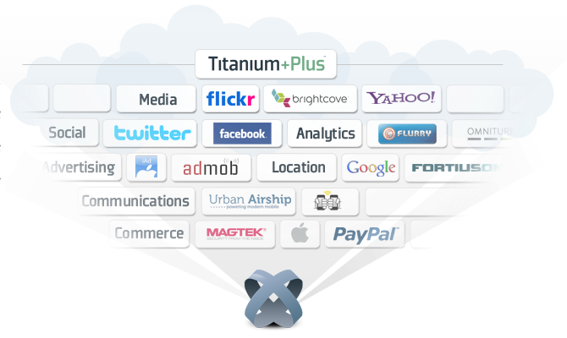
What is Titanium Plus
Value add modules
Narrow use cases
Appcelerator created
Community created
Notes:
titanium plus is a constellation of appc and user created modules
core functionality that is horizontally useful to devs is likely to go into core
specific use cases like barcode scanning, credit card reading, etc. is likely to move into modules

Slide 4
Titanium Plus Access
Titanium Plus available to all subscribers
Currently distributed through Helpdesk
In the future, will be done through tooling
Notes:
Also the new MarketPlace (in beta as of July 2011)

Slide 5
Module Overview

Slide 6

Urban Airship (iOS and Android)
Push notifications service
Titanium deals with the client side only
Urban Airship provides help for the server side, but much of that work is up to you

Slide 7

PayPal (iOS and Android)
Mobile Payments Library
Requires PayPal merchant account
In development, uses sandbox environment, in production uses live servers
Notes:
Useful for physical purchases or donations
Can’t be used for ebooks, unlocking app features, etc. because those uses would run afoul of Apple’s StoreKit rules

Slide 8

Bump (iOS and Android)
Device to device communication
Works over wifi
Uses geolocation and requires close proximity
Requires Bump API key set
Notes:
Have to register for an API key with Bump

Slide 9

SMS (iOS)
Prepare SMS text messages in app
Cannot send via code
Enhanced functionality over launching the SMS app

Slide 10
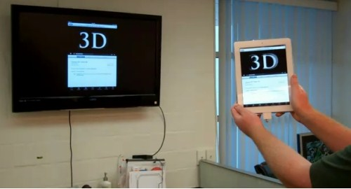
TV Out (iOS)
Display app contents on TV screen with additional cable
Test scaling on TV screen, will vary in quality

Slide 11

StoreKit (iOS)
In App Purchase API
Requires set up through iTunes Connect portal
Can only be tested on device
Will need to follow Apple docs for user and item creation
Notes:
Tied to your iTunes account which is why you have to test on device (that linkage isn’t available in the simulator)

Slide 12
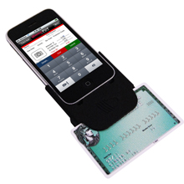
Magtek Credit Card Reader (iOS)
Interface to Magtek hardware
Can process card payments
Requires additional account setup for payments
Can only be tested on device with peripheral

Slide 13
More To Come!
Notes:
Appc has a dedicated module development team now, so this offering will continue to grow

Slide 14
Installing Modules
Download and Unzip from Helpdesk
Copy into modules directory in project root
Declare module dependency in tiapp.xml
require the module in JavaScript
Use module – every one comes with example and doc
Demo: Install and run Ti+ Module
Notes:
PayPal works well for demo since you can do it cross platform and it works on Simulator

Slide 15
Q&A

Slide 16
Lab Goals
Download and install the PayPal module
Include it within an app
Enable sandbox-mode PayPal functionality in your app
Wiki URL
Notes:
Will need to be able to install and demo a module, any module. PayPal works well for demo since you can do it cross platform and it works on Simulator

Slide 17
Lab
Notes:
no TiBountyHunter plug in here – going through the PayPal module.

