Slide 1

iOS Deep Dive Advanced Titanium Mobile Development
Notes:
Module time: 90 mins (60 mins teaching, 30 mins for lab)

Slide 2
Agenda
iOS Platform Characteristics
iOS-specific API Overview
Key APIs
Deep Dive: iOS Properties
Examples in Action
Lab Exercise Overview
Notes:
We will give an overview on the platform characteristics, including basic UI structure. Then we’ll focus on iOS-specific APIs, starting with a high level view of what the key areas are in Titanium.
Let the deep dive begin..

Slide 3
Platform Characteristics
What we are talking about is Cocoa Touch, which provides
the key frameworks for developing applications on devices
running iOS.
Cocoa Touch
Features
Core Animation
Multitasking
Gesture Recognizers
Media / Application Services
Core Services
Core OS Kernel
GPU
Notes:
Cocoa Touch provides the key frameworks for developing applications on devices running iOS. Some of these key frameworks are:
Foundation Kit Framework
UIKit Framework (based on Application Kit)
- Game Kit Framework
- iAd Framework
Map Kit Framework
This may be helpful for developers to understand.

Slide 4
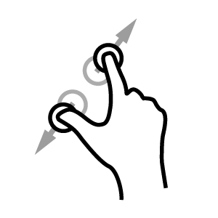




Platform Characteristics
Display Is Paramount, (Regardless of Its Size)
Device Orientation Can Change
P
Apps Respond to Gestures, Not Clicks
People Interact with One App at a Time
Preferences Are Available in Settings
An App Has a Single Window
No hardware buttons (menu, back, keyboard)
Notes:
These are taken from Apple’s HIG (Human Interface Guidelines)
- Single Window = there’s a single UIKit / iOS window object regardless of the number of Titanium windows you create.

Slide 5
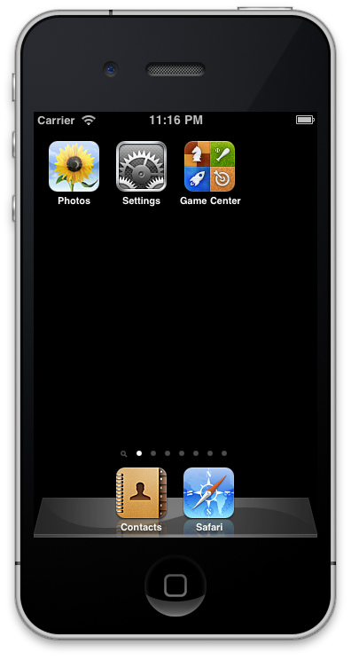
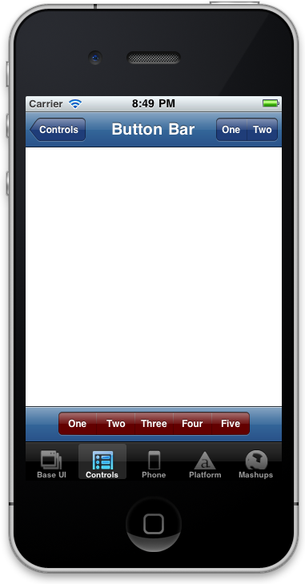


iOS User Interface Basics
Status Bar
App
Badge
Nav Bar
Spring
Board
Window
Tool Bar
Tab
Badge
Tab Bar
Notes:
A tab bar gives people the ability to switch between different subtasks, views, or modes.
Use a tab bar to give users access to different perspectives on the same set of data or different subtasks related to the overall function of your app.

Slide 6
iOS-Specific API Overview
User Interface (UI)
Functionality
Titanium.UI
Titanium.UI.iOS
Titanium.UI.iPad
Titanium.UI.iPhone
Titanium.App.iOS
Titanium.Contacts
Titanium.Media
Titanium.Network
Notes:
iOS-specific APIs can be broken out into 2 segments: form and function.

Slide 7
Key APIs
User Interface
Titanium.UI.iPhone.NavigationGroup
Titanium.UI.iOS.Toolbar
Titanium.UI.iOS.TabbedBar
Titanium.UI.iOS.CoverFlowView
Titanium.UI.DashboardView (not in iOS namespace)
Titanium.UI.iOS.AdView
Notes:
NavigationGroup actually works on iPad and our API should probably be moved out of the iPhone namespace to the iOS namespace
As of SK1.8, Toolbar, TabbedBar, and CoverFlowView were moved to iOS namespace
DashboardView not there yet

Slide 8
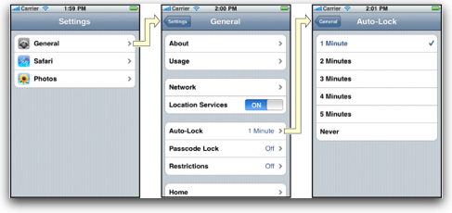
UI: Navigation Group
A Navigation Group implements a specialized view that manages the navigation of hierarchical content.
Notes:
A Navigation Group implements a specialized view that manages the navigation of hierarchical content. A Navigation Group is very similar to Tab Bars with the exception that they do not maintain a group of windows with a interface bar at the bottom.

Slide 9
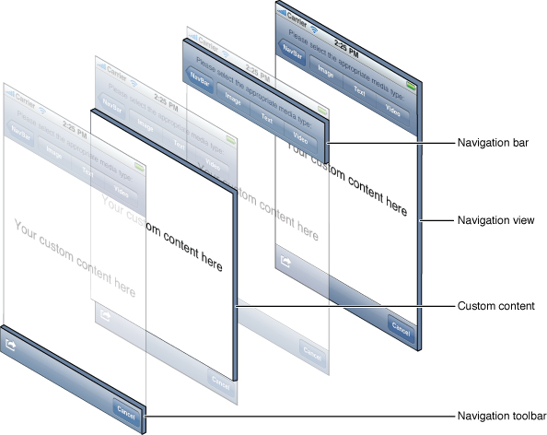
UI: Navigation Group
Similar to a Tab Group…
…but no tab bar!
Instead, windows are added dynamically to a controller.
Notes:
A navigation bar enables navigation through an information hierarchy and, optionally, management of screen contents.

Slide 10
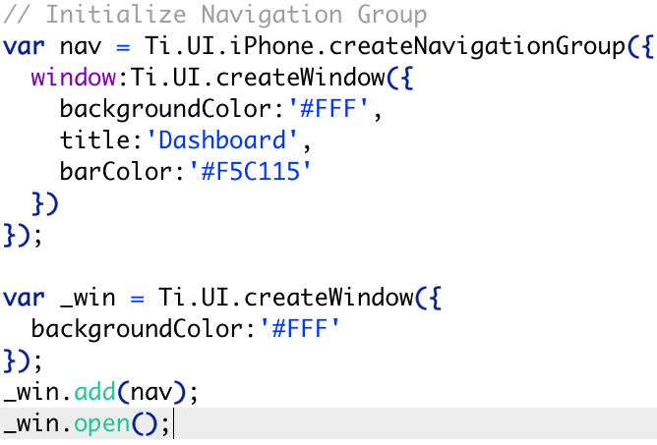
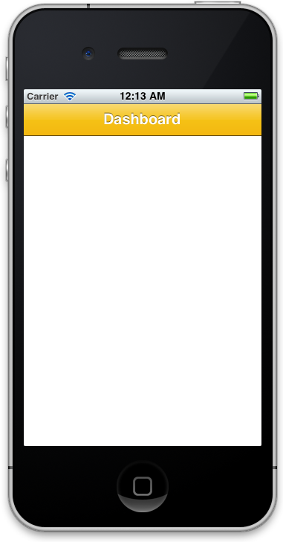
UI: Navigation Group - Example
Notes:
nav.window property defines the “home” window of the NavGroup
Code example doesn’t show additional sub windows to the NavGroup
The NavGroup itself then needs to be added to a window

Slide 11
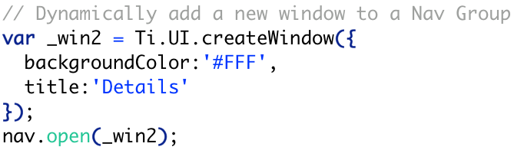
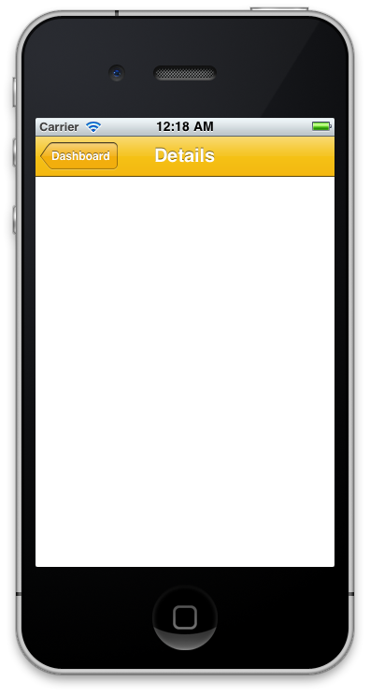

UI: Navigation Group - Example
Notes:
To add another window to the stack, create it and then call open

Slide 12
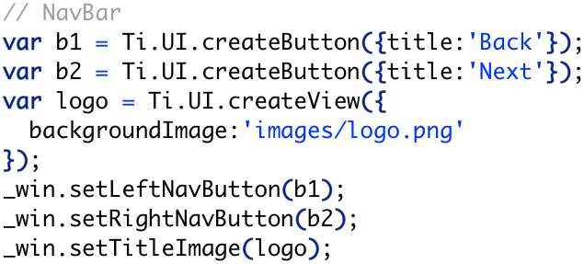
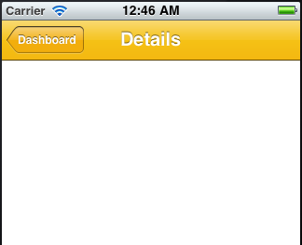

UI: Navigation Bar - Example
Notes:
There are other components that you can set…
setTItleControl()
setTitleImage()
setTitle()

Slide 13
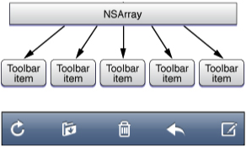
UI: Toolbars
A toolbar contains controls that perform actions related to objects in the screen or view.
Button objects are stored in an array and passed to toolbar object.
Use a toolbar to provide a set of actions users can take in the current context.
Maintain a hit target area of at least 44 x 44 points for each toolbar item.
Notes:
On iPhone, a toolbar appear at the bottom edge of a screen or view, but on iPad it can instead appear at the top edge. Can also appear atop a keyboard.
Toolbar items are displayed equally spaced across the width of the toolbar. The precise set of toolbar items can change from view to view, because the items are always specific to the context of the current view.
On iPhone, changing the device orientation from portrait to landscape can change the height of the toolbar automatically. On iPad, the height and translucency of a toolbar does not change with rotation.

Slide 14
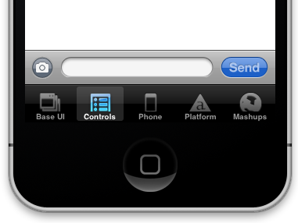
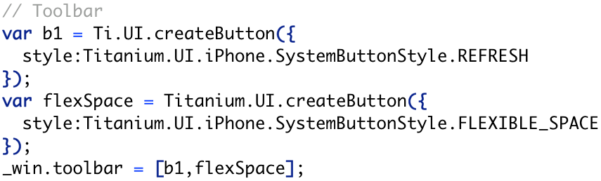
UI: Toolbars
A Toolbar can be placed at the bottom of a window, or navigation group, at any time.
Notes:
win.setToolbar([toolActInd],{animated:true});
Buttons are stored as an array of objects (NSArray)
win.toolbar property – setting that docks the toolbar to the bottom of the window
Otherwise you could position it anywhere (if you do win.add(toolbar))

Slide 15
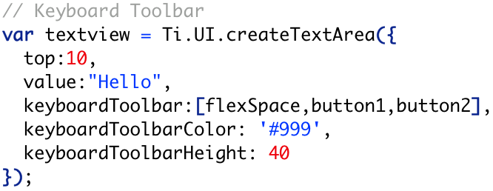
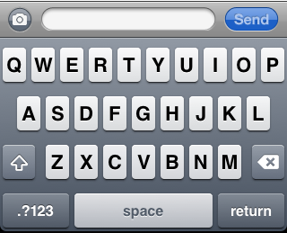
UI: Toolbars
A Toolbar can also be placed on a keyboard…
Notes:
Works with text fields and text areas

Slide 16

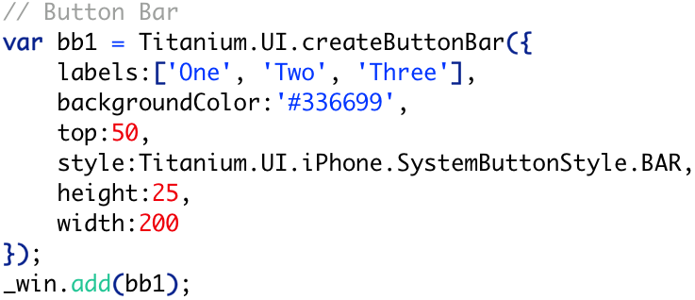
UI: Button Bar
A button bar is a type of segmented control that does not maintain selected state.
Notes:
TabbedBars are also known as segmented controls. A segmented control is a linear set of segments, each of which functions as a button that can display a different view.
The length of a segmented control is determined by the number of its segments; the height of a segmented control is fixed. The width of each segment is proportional, based on the total number of segments. When users tap a segment, the segment displays a selected state.
Use a segmented control to offer closely related, but mutually exclusive choices.
Make sure that each segment is easy to tap. To maintain a comfortable hit region of 44 x 44 points for each segment, you need to limit the number of segments. On iPhone, a segmented control should have five or fewer segments.
As much as possible, maintain consistency in the size of each segment’s contents. Because all segments in a segmented control have equal width, it does not look good if the content fills some segments, but not others.
Avoid mixing text and images in a single segmented control. A segmented control can contain text or images. An individual segment can contain either text or an image, but not both. In general, it’s best to avoid putting text in some segments and images in other segments of a single segmented control.

Slide 17


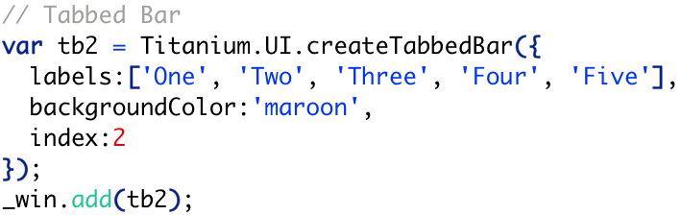
UI: Tabbed Bar
A tabbed bar visually maintains a state (visually distinguished as a pressed or selected look).
Use a tabbed and button bars to offer closely related, but mutually exclusive choices.
Notes:
TabbedBars and button bars are also known as segmented controls. A segmented control is a linear set of segments, each of which functions as a button that can display a different view. If you set a segmented control to have a momentary style, a segment doesn’t show itself as selected (blue background) when the user touches it. The disclosure button is always momentary and doesn’t affect the actual selection.
The length of a segmented control is determined by the number of its segments; the height of a segmented control is fixed. The width of each segment is proportional, based on the total number of segments. When users tap a segment, the segment displays a selected state.
Use a segmented control to offer closely related, but mutually exclusive choices.
Make sure that each segment is easy to tap. To maintain a comfortable hit region of 44 x 44 points for each segment, you need to limit the number of segments. On iPhone, a segmented control should have five or fewer segments.
As much as possible, maintain consistency in the size of each segment’s contents. Because all segments in a segmented control have equal width, it does not look good if the content fills some segments, but not others.
Avoid mixing text and images in a single segmented control. A segmented control can contain text or images. An individual segment can contain either text or an image, but not both. In general, it’s best to avoid putting text in some segments and images in other segments of a single segmented control.

Slide 18
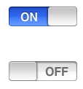
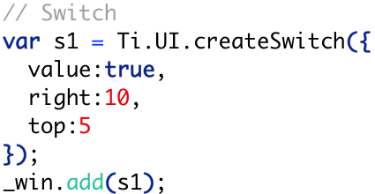
UI: Switch
A switch presents two mutually exclusive choices or states.
Note: A switch displays the value that is currently in effect; users slide the control to select (and reveal) the other value.
Users can also tap the control to switch between choices.

Slide 19

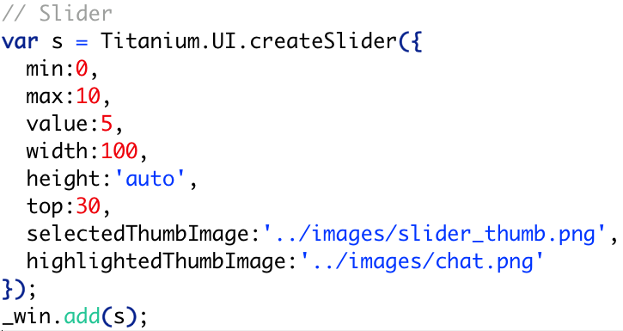
UI: Slider
A slider allows users to make adjustments to a value or process throughout a range of allowed values.
Notes:
A slider consists of a track and a thumb (a circular control that the user can slide) and optional images that convey the meaning of the right and left values. When people drag the thumb along the slider, the value or process is updated continuously and is displayed in the track.

Slide 20
UI: iPad-Specific APIs
Titanium.UI.iPad.Popover
Titanium.UI.iPad.SplitWindow
iPad Views:
Notes:
There are two custom views related to iPad development. We’ll explore these two in detail.

Slide 21
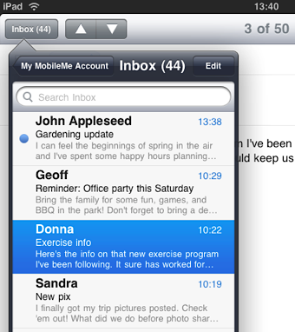
Key APIs - Titanium.UI.iPad.Popover
A popover is a transient view that can be revealed when people tap a control or an onscreen area.
A popover is a self-contained view that hovers above the contents of a screen.
Notes:
A popover is a self-contained view that hovers above the contents of a screen. It always displays an arrow that indicates the point from which it emerged. A popover can contain a wide variety of objects and views, such as:
Table, image, map, text, web, or custom views
Navigation bars, toolbars, or tab bars
Controls or objects that act upon objects in the current application view
In iPad apps, an action sheet always appears inside a popover.

Slide 22
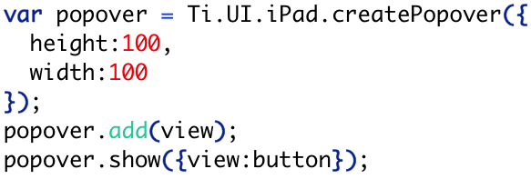
Key APIs - Titanium.UI.iPad.Popover
Notes:
The view:button property designates which UI element the pop over is anchored to. In otherwords, which one the bubble’s triangle points to.

Slide 23
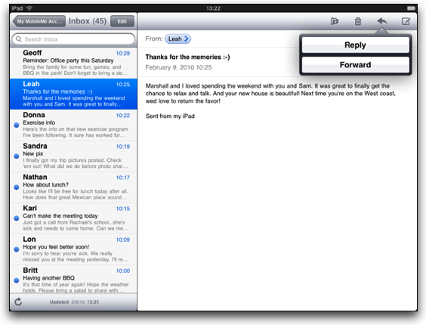
Key APIs - Titanium.UI.iPad.SplitWindow
A split view is a full-screen view that consists of two side-by-side panes.
The width of the left pane of a split view is fixed at 320 points in all orientations. Users cannot resize either pane of a split view.
Notes:
Both panes can contain a wide variety of objects and views, such as:
Table, image, map, text, web, or custom views.
Navigation bars, toolbars, or tab bars.

Slide 24
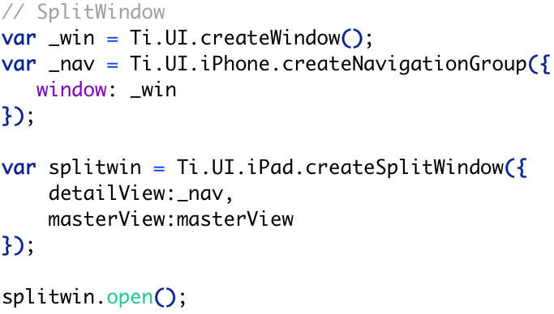
Key APIs - Titanium.UI.iPad.SplitWindow
Notes:
You can use a split view to display persistent information in the left pane and related details or subordinate information in the right pane. In this design pattern, when people select an item in the left pane, the right pane should display the information related to that item. (You’re responsible for making this happen in code.)
In general, when an app uses a split view in landscape, it displays the contents of the left pane in a popover when it rotates to portrait. However, you are not required to follow this pattern. If it makes sense in your app, you can design your UI to display side-by-side views in all orientations.
Avoid creating a right pane that is narrower than the left pane. Although the width of the right pane is up to you, it does not look good to use a width of less than 320 points (which is the width of the left pane).
Avoid displaying a navigation bar in both panes at the same time. Doing this would make it very difficult for users to discern the relationship between the two panes.
In general, indicate the current selection in the left pane in a persistent way. This behavior helps people understand the relationship between the item in the left pane and the contents of the right pane. This is important because the content of the right pane can change, but it should always remain related to the item selected in the left pane.

Slide 25


UI: Tab Badge
A tab can display a badge that communicates app-specific information.
Use this as an status indicator for windows in your app.
Notes:
tab.badge has to be set to a number
Set to NULL to remove

Slide 26

UI: App Badge
An application badge can be set for the application's icon on the springboard.
Notes:
Can be set while the app is running
Or, use a background service to set when the app’s not using

Slide 27
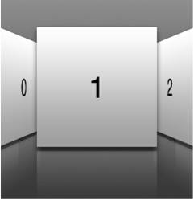
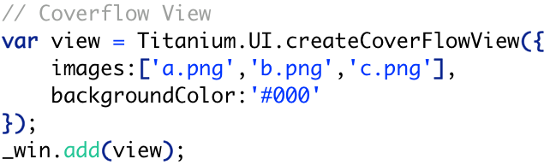
UI: CoverFlow View
The Cover Flow view is container for showing animated, three dimensional images in a nice UI.
Simple 3 image example:
Notes:
If an image is tapped, you can grab an index so you can branch code accordingly

Slide 28
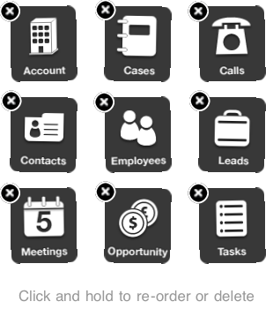
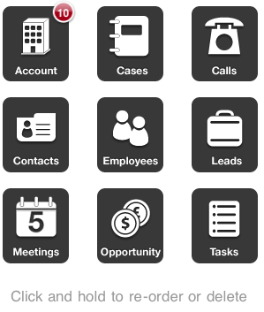
UI: Dashboard View
The Dashboard View provides a view that supports the ability to have Springboard-like view.
This springboard contains icons that can be reordered by dragging in addition to embedded support for scrollable views.
Notes:
This isn’t setting or accessing the actual Springboard
Just presenting a similar view

Slide 29
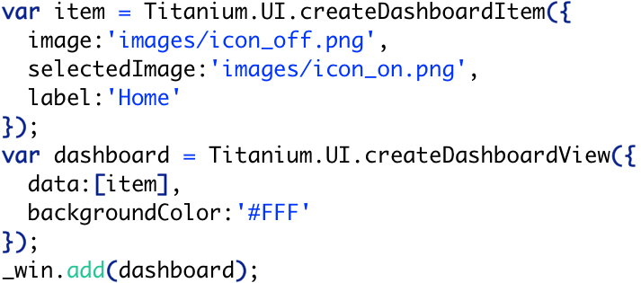

UI: Dashboard View

Slide 30
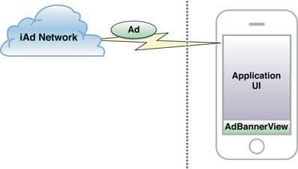
UI: AdView
The iAd advertising platform provides developers new opportunities to generate revenue and promote their apps.
You add banner or full-screen advertisements to your application’s user interface; Apple sells advertising space and delivers ads to fill these spaces.

Slide 31
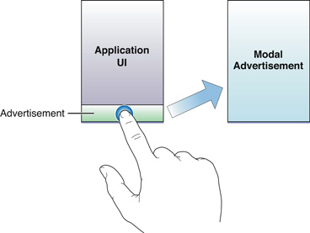

UI: AdView
To Use iAd In Your Application, You Must Join the iAd Network
Use iAds like a fixed (width/height) view.
When developing your app, iAd Network sends test ads.
Notes:
For more information on the iAd Network, see http://developer.apple.com/iad/
While you are developing your application, iAd Network sends test advertisements to your application. To assist you in validating your implementation, the iAd Network occasionally returns errors to test your error handling code. You can also test your error handling support manually by turning your device’s wireless capability off.
iAd Network automatically displays the correct ad depending on the how your application binary was downloaded onto your test device

Slide 32
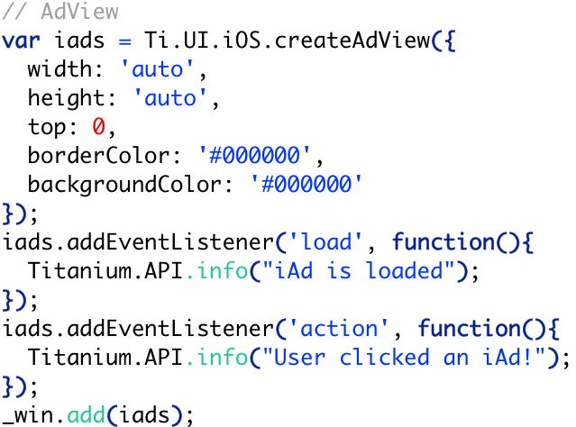
UI: AdView
Notes:
Set bottom:0 to dock the ad to the bottom of your window

Slide 33
Key APIs
Platform Functionality
Titanium.App.iOS
Titanium.Contacts
Titanium.Media
Titanium.Network
Notes:
Platform specific business logic methods are available for iOS.

Slide 34
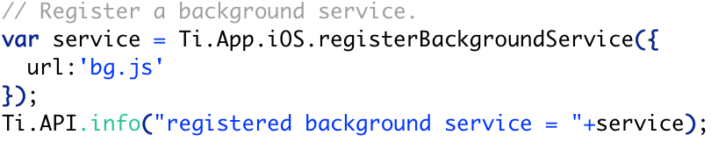
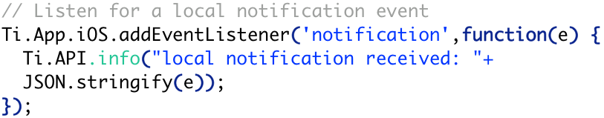
Key APIs – Titanium.App
Background Service
Local Notification
Notes:
This JS will run when the app is paused.
A local notification is local to an application on an iPhone, iPad, or iPod touch. Push notifications—also known as remote notifications—arrive from outside a device.

Slide 35
Key APIs – Contacts, Media, Network
Contacts
Titanium.Contacts.Group
Titanium.Contacts.Person
Media
Titanium.Media.AudioRecorder
Titanium.Media.Item
Titanium.Media.MusicPlayer
Network
Titanium.Network.BonjourBrowser
Titanium.Network.BonjourService
Titanium.Network.TCPSocket (use Titanium.Network.Socket.TCP)
Notes:
Use the newer Titanium.Network.Socket.TCP for sockets rather than the older TCPSocket
Network.Socket is cross-platform

Slide 36
Deep Dive: iOS-Specific Properties
Titanium.UI.iPhone.ActivityIndicatorStyle
Titanium.UI.iPhone.AnimationStyle
Titanium.UI.iPhone.ProgressBarStyle
Titanium.UI.iPhone.RowAnimationStyle
Titanium.UI.iPhone.ScrollIndicatorStyle
Titanium.UI.iPhone.StatusBar
Titanium.UI.iPhone.SystemButton
Titanium.UI.iPhone.SystemButtonStyle
Titanium.UI.iPhone.SystemIcon
Titanium.UI.iPhone.TableViewCellSelectionStyle
Titanium.UI.iPhone.TableViewScrollPosition
Titanium.UI.iPhone.TableViewSeparatorStyle
Titanium.UI.iPhone.TableViewStyle
BIG
DARK
PLAIN
Notes:
Do a quick walk through of the various iPhone related properties. It’s good to point out that these variables exist.

Slide 37
Deep Dive: iOS-Specific Properties
Titanium.UI.iPhone.ActivityIndicatorStyle
Titanium.UI.iPhone.AnimationStyle
Titanium.UI.iPhone.ProgressBarStyle
Titanium.UI.iPhone.RowAnimationStyle
Titanium.UI.iPhone.ScrollIndicatorStyle
Titanium.UI.iPhone.StatusBar
Titanium.UI.iPhone.SystemButton
Titanium.UI.iPhone.SystemButtonStyle
Titanium.UI.iPhone.SystemIcon
Titanium.UI.iPhone.TableViewCellSelectionStyle
Titanium.UI.iPhone.TableViewScrollPosition
Titanium.UI.iPhone.TableViewSeparatorStyle
Titanium.UI.iPhone.TableViewStyle
CURL_DOWN
CURL_UP
FLIP_FROM_LEFT
FLIP_FROM_RIGHT
NONE

Slide 38
Deep Dive: iOS-Specific Properties
Titanium.UI.iPhone.ActivityIndicatorStyle
Titanium.UI.iPhone.AnimationStyle
Titanium.UI.iPhone.ProgressBarStyle
Titanium.UI.iPhone.RowAnimationStyle
Titanium.UI.iPhone.ScrollIndicatorStyle
Titanium.UI.iPhone.StatusBar
Titanium.UI.iPhone.SystemButton
Titanium.UI.iPhone.SystemButtonStyle
Titanium.UI.iPhone.SystemIcon
Titanium.UI.iPhone.TableViewCellSelectionStyle
Titanium.UI.iPhone.TableViewScrollPosition
Titanium.UI.iPhone.TableViewSeparatorStyle
Titanium.UI.iPhone.TableViewStyle
BAR
DEFAULT
PLAIN

Slide 39
Deep Dive: iOS-Specific Properties
Titanium.UI.iPhone.ActivityIndicatorStyle
Titanium.UI.iPhone.AnimationStyle
Titanium.UI.iPhone.ProgressBarStyle
Titanium.UI.iPhone.RowAnimationStyle
Titanium.UI.iPhone.ScrollIndicatorStyle
Titanium.UI.iPhone.StatusBar
Titanium.UI.iPhone.SystemButton
Titanium.UI.iPhone.SystemButtonStyle
Titanium.UI.iPhone.SystemIcon
Titanium.UI.iPhone.TableViewCellSelectionStyle
Titanium.UI.iPhone.TableViewScrollPosition
Titanium.UI.iPhone.TableViewSeparatorStyle
Titanium.UI.iPhone.TableViewStyle
BOTTOM
FADE
LEFT
NONE
RIGHT
TOP

Slide 40
Deep Dive: iOS-Specific Properties
Titanium.UI.iPhone.ActivityIndicatorStyle
Titanium.UI.iPhone.AnimationStyle
Titanium.UI.iPhone.ProgressBarStyle
Titanium.UI.iPhone.RowAnimationStyle
Titanium.UI.iPhone.ScrollIndicatorStyle
Titanium.UI.iPhone.StatusBar
Titanium.UI.iPhone.SystemButton
Titanium.UI.iPhone.SystemButtonStyle
Titanium.UI.iPhone.SystemIcon
Titanium.UI.iPhone.TableViewCellSelectionStyle
Titanium.UI.iPhone.TableViewScrollPosition
Titanium.UI.iPhone.TableViewSeparatorStyle
Titanium.UI.iPhone.TableViewStyle
BLACK
DEFAULT
WHITE
Notes:
Used in conjunction with the ScrollView

Slide 41
Deep Dive: iOS-Specific Properties
Titanium.UI.iPhone.ActivityIndicatorStyle
Titanium.UI.iPhone.AnimationStyle
Titanium.UI.iPhone.ProgressBarStyle
Titanium.UI.iPhone.RowAnimationStyle
Titanium.UI.iPhone.ScrollIndicatorStyle
Titanium.UI.iPhone.StatusBar
Titanium.UI.iPhone.SystemButton
Titanium.UI.iPhone.SystemButtonStyle
Titanium.UI.iPhone.SystemIcon
Titanium.UI.iPhone.TableViewCellSelectionStyle
Titanium.UI.iPhone.TableViewScrollPosition
Titanium.UI.iPhone.TableViewSeparatorStyle
Titanium.UI.iPhone.TableViewStyle
DEFAULT
GRAY
OPAQUE_BLACK
TRANSLUCENT_BLACK
Notes:
Status bar is the top bar that shows battery, wifi state, etc.

Slide 42
Deep Dive: iOS-Specific Properties
Titanium.UI.iPhone.ActivityIndicatorStyle
Titanium.UI.iPhone.AnimationStyle
Titanium.UI.iPhone.ProgressBarStyle
Titanium.UI.iPhone.RowAnimationStyle
Titanium.UI.iPhone.ScrollIndicatorStyle
Titanium.UI.iPhone.StatusBar
Titanium.UI.iPhone.SystemButton
Titanium.UI.iPhone.SystemButtonStyle
Titanium.UI.iPhone.SystemIcon
Titanium.UI.iPhone.TableViewCellSelectionStyle
Titanium.UI.iPhone.TableViewScrollPosition
Titanium.UI.iPhone.TableViewSeparatorStyle
Titanium.UI.iPhone.TableViewStyle
ACTION
ACTIVITY
ADD
BOOKMARKS
CAMERA
CANCEL
COMPOSE
CONTACT_ADD
DISCLOSURE
DONE
EDIT
FAST_FORWARD
FIXED_SPACE
FLEXIBLE_SPACE
INFO_DARK
INFO_LIGHT
ORGANIZE
FIXED_SPACE
FLEXIBLE_SPACE
INFO_DARK
INFO_LIGHT
ORGANIZE
PAUSE
PLAY
REFRESH
REPLY
REWIND
SAVE
SPINNER
STOP
TRASH

Slide 43
Deep Dive: iOS-Specific Properties
Titanium.UI.iPhone.ActivityIndicatorStyle
Titanium.UI.iPhone.AnimationStyle
Titanium.UI.iPhone.ProgressBarStyle
Titanium.UI.iPhone.RowAnimationStyle
Titanium.UI.iPhone.ScrollIndicatorStyle
Titanium.UI.iPhone.StatusBar
Titanium.UI.iPhone.SystemButton
Titanium.UI.iPhone.SystemButtonStyle
Titanium.UI.iPhone.SystemIcon
Titanium.UI.iPhone.TableViewCellSelectionStyle
Titanium.UI.iPhone.TableViewScrollPosition
Titanium.UI.iPhone.TableViewSeparatorStyle
Titanium.UI.iPhone.TableViewStyle
BAR
BORDERED
DONE
PLAIN

Slide 44
Deep Dive: iOS-Specific Properties
Titanium.UI.iPhone.ActivityIndicatorStyle
Titanium.UI.iPhone.AnimationStyle
Titanium.UI.iPhone.ProgressBarStyle
Titanium.UI.iPhone.RowAnimationStyle
Titanium.UI.iPhone.ScrollIndicatorStyle
Titanium.UI.iPhone.StatusBar
Titanium.UI.iPhone.SystemButton
Titanium.UI.iPhone.SystemButtonStyle
Titanium.UI.iPhone.SystemIcon
Titanium.UI.iPhone.TableViewCellSelectionStyle
Titanium.UI.iPhone.TableViewScrollPosition
Titanium.UI.iPhone.TableViewSeparatorStyle
Titanium.UI.iPhone.TableViewStyle
BOOKMARKS
CONTACTS
DOWNLOADS
FAVORITES
FEATURED
HISTORY
MORE
MOST_RECENT
MOST_VIEWED
RECENTS
SEARCH
TOP_RATED
Notes:
Use these with a tab bar or maybe a toolbar

Slide 45
Deep Dive: iOS-Specific Properties
Titanium.UI.iPhone.ActivityIndicatorStyle
Titanium.UI.iPhone.AnimationStyle
Titanium.UI.iPhone.ProgressBarStyle
Titanium.UI.iPhone.RowAnimationStyle
Titanium.UI.iPhone.ScrollIndicatorStyle
Titanium.UI.iPhone.StatusBar
Titanium.UI.iPhone.SystemButton
Titanium.UI.iPhone.SystemButtonStyle
Titanium.UI.iPhone.SystemIcon
Titanium.UI.iPhone.TableViewCellSelectionStyle
Titanium.UI.iPhone.TableViewScrollPosition
Titanium.UI.iPhone.TableViewSeparatorStyle
Titanium.UI.iPhone.TableViewStyle
BLUE GRAY NONE

Slide 46
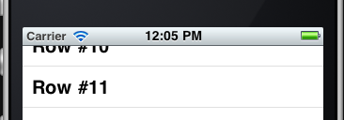
Deep Dive: iOS-Specific Properties
Titanium.UI.iPhone.ActivityIndicatorStyle
Titanium.UI.iPhone.AnimationStyle
Titanium.UI.iPhone.ProgressBarStyle
Titanium.UI.iPhone.RowAnimationStyle
Titanium.UI.iPhone.ScrollIndicatorStyle
Titanium.UI.iPhone.StatusBar
Titanium.UI.iPhone.SystemButton
Titanium.UI.iPhone.SystemButtonStyle
Titanium.UI.iPhone.SystemIcon
Titanium.UI.iPhone.TableViewCellSelectionStyle
Titanium.UI.iPhone.TableViewScrollPosition
Titanium.UI.iPhone.TableViewSeparatorStyle
Titanium.UI.iPhone.TableViewStyle
BOTTOM
MIDDLE NONE
TOP
Notes:
When you programmatically scroll to a row within a tableview, this constant controls what portion of that target row is shown
The screenshot shows using the MIDDLE option

Slide 47
Deep Dive: iOS-Specific Properties
Titanium.UI.iPhone.ActivityIndicatorStyle
Titanium.UI.iPhone.AnimationStyle
Titanium.UI.iPhone.ProgressBarStyle
Titanium.UI.iPhone.RowAnimationStyle
Titanium.UI.iPhone.ScrollIndicatorStyle
Titanium.UI.iPhone.StatusBar
Titanium.UI.iPhone.SystemButton
Titanium.UI.iPhone.SystemButtonStyle
Titanium.UI.iPhone.SystemIcon
Titanium.UI.iPhone.TableViewCellSelectionStyle
Titanium.UI.iPhone.TableViewScrollPosition
Titanium.UI.iPhone.TableViewSeparatorStyle
Titanium.UI.iPhone.TableViewStyle
NONE
SINGLE_LINE
Notes:
Set to none so that you don’t get empty rows & separators showing up when your tableview has fewer rows than will fill the viewport

Slide 48
Deep Dive: iOS-Specific Properties
Titanium.UI.iPhone.ActivityIndicatorStyle
Titanium.UI.iPhone.AnimationStyle
Titanium.UI.iPhone.ProgressBarStyle
Titanium.UI.iPhone.RowAnimationStyle
Titanium.UI.iPhone.ScrollIndicatorStyle
Titanium.UI.iPhone.StatusBar
Titanium.UI.iPhone.SystemButton
Titanium.UI.iPhone.SystemButtonStyle
Titanium.UI.iPhone.SystemIcon
Titanium.UI.iPhone.TableViewCellSelectionStyle
Titanium.UI.iPhone.TableViewScrollPosition
Titanium.UI.iPhone.TableViewSeparatorStyle
Titanium.UI.iPhone.TableViewStyle
GROUPED
PLAIN

Slide 49
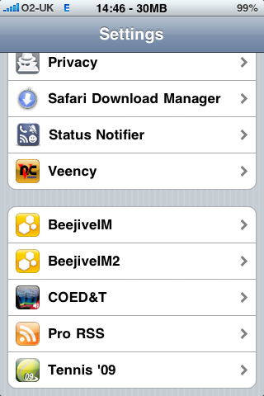
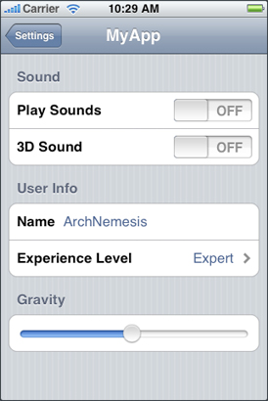
Implementing Application Preferences
Notes:
“The Settings Bundle”

Slide 50
Implementing Application Preferences
Preferences are application-specific settings used to
configure the behavior or appearance of an application.
Applications then have two options for presenting
preferences:
Display preferences inside the application.
Use a Settings bundle to manage preferences from the Settings application.
Notes:
In iOS, the Foundation framework provides the low-level mechanism for storing the actual preference data.
http://developer.apple.com/library/ios/#documentation/iPhone/Conceptual/iPhoneOSProgrammingGuide/Preferences/Preferences.html
Tutorial
http://iphoneincubator.com/blog/tutorial/how-to-create-an-iphone-preferences-file

Slide 51
Settings bundle
Copy KitchenSink/platform/iphone to your project
In Finder, right-click Settings.bundle and choose Show Package Contents
Open Root.plist
Edit as needed and save
Clean build your project
http://iphoneincubator.com/blog/tutorial/how-to-create-an-iphone-preferences-file
Notes:
Settings bundle used to go in project/modules
Now needs to be in project/platform
In iOS, the Foundation framework provides the low-level mechanism for storing the actual preference data.
http://developer.apple.com/library/ios/#documentation/iPhone/Conceptual/iPhoneOSProgrammingGuide/Preferences/Preferences.html
Tutorial
http://iphoneincubator.com/blog/tutorial/how-to-create-an-iphone-preferences-file

Slide 52
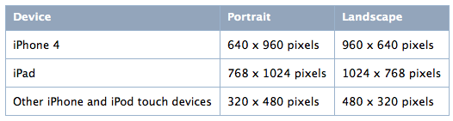
Note: Pixel vs Points
Pixel is the appropriate unit of measurement to use in an image-editing application.
Point is the appropriate unit of measurement to use when discussing the size of an area that is drawn onscreen.
Notes:
iPad 2 is double the pixels of iPad 1

Slide 53
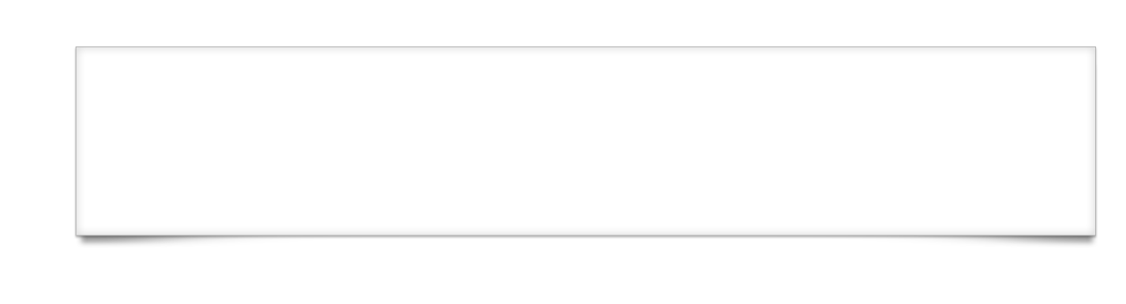
Q&A

Slide 54
Lab Goals
Add settings to an iOS application
Demo and wiki location
Notes:
In this lab, you will create a Settings bundle so that application settings can be changed via the Settings app in the simulator or on a phone. You will then use that setting within the app to control the app's user interface.

Slide 55
Lab
Notes:
There is no specific TiBountyHunter tie-in for this lab

