Slide 1



Extending Titanium Advanced Titanium Mobile Development
Notes:
Module time: 30 mins (10 mins teaching, 20 mins for lab)

Slide 2

Agenda
Basic Titanium Internal Architecture
Object Model
Building Modules
Distributing and Installing Modules
Resources
Notes:
This presentation is intended as a starting point for developers with native development knowledge wishing to get into module development. This is not an extensive tutorial, but rather an introduction to the process.
Basic Arch…
will introduce audience to the basic structure of Titanium in terms of internal implementation, including the Kroll micro kernel
Object Model
will introduce the key objects and vocabulary for building modules, like Proxy objects, and will cover serialization and conversion of values from native types to JS objects
Building modules
will cover how to use titanium SDK to build/package modules
distributing and installing
will cover how to distribute and install a custom module in a titanium app
resources
go over docs and help resources available

Slide 3
Disclaimer!
Notes:
Just so you know, the presenter is not an expert in native development for iOS and Android (probably). The intent of this presentation is to brief you on the basics of how Titanium works and to point you in the right direction for further exploration.

Slide 4
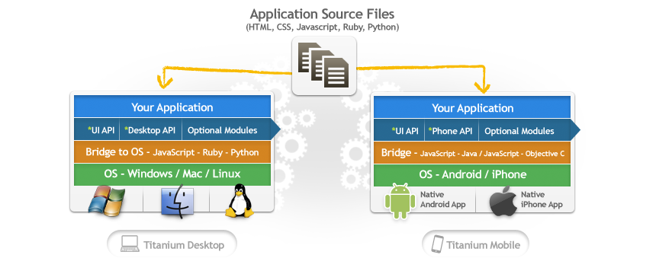
Titanium Architecture
We all know the basics…
Notes:
discuss titanium mobile app architecture – JavaScript files comprise application and communicate with native APIs through a bridge layer

Slide 5
Titanium Architecture
…but now we need to understand the bridge
How is a Titanium app packaged?
How do I create new behaviors in native code?
How do I create a JS API?
Notes:
…but now
in order to extend Titanium, we need to understand the bridge implementation for Titanium Mobile
packaged?
we need to understand how a titanium app is packaged at a high level, and what those python scripts are doing to our JS project to package it up
native code?
we need to understand how native APIs are packed into a Titanium application
JS API?
How do we expose native APIs to JavaScript and pass data between them?

Slide 6
When a Titanium app launches…
Native app starts – activity is launched (Android) or app delegate is run (iOS)
A JavaScript context is created (Rhino/V8 or JSCore)
JS app is evaluated starting with app.js
JS Context communicates with C/Java code
The “bridge” between them is what we call Kroll
Notes:
Take you through the lifecycle in very general terms…

Slide 7
The Kroll Micro Kernel
What is Kroll?
- Metallurgical process by which titanium (the element) is created
- The name given to the plug-in architecture for Titanium (the application platform)
What is a kernel?
- In an OS, it is the bridge between software and hardware
- Kroll is an implementation of a kernel (bridge) architecture for JS to native code
- http://en.wikipedia.org/wiki/Kernel_(computing)
Notes:
Why do we call it kroll
What is a kernel

Slide 8
Titanium Modules
Every Titanium module is plugged into Kroll’s microkernel architecture
iOS Header File
Java Class File
Notes:
Note that even titanium modules for UI, Database, etc have this same structure – as you get into module development, look to core modules to see how things are done in ObjC or Java
Titanium ObjC modules must extend TiModule
Titanium Java modules must extend KrollModule

Slide 9
When in doubt, look at a Titanium Module!
Notes:
Our docs and guides are still somewhat limited covering the full power of the module SDKs. The best source for “how do I…” info is to check an existing titanium module for UI, location, or anything else.

Slide 10
Module Object Model
Proxy
- interface between native code and JavaScript – a module will have at least one proxy
View
- actual native representation of a view object (for UI components)
ViewProxy
contains the actual state for a view (in case a View must be released for memory management)
has public JavaScript API for a View
Notes:
the object model is slightly different between iOS and Android. in iOS, the top level module (i.e. Ti.MyModule) is just a Proxy. In Android, it’s called a “Module”. they both function as top-level, static interfaces to native code
a proxy is an object that interfaces directly with native code – non-visual modules will just use these objects
a visual module will need to implement a view, which is a native representation of a visual component, and a ViewProxy, which contains the state information for a View. The View could be hidden and removed from memory, but the ViewProxy would still contain information about that view (like the title of a window, background color of a view, etc.)
View proxy is a sub class of proxy

Slide 11
Module JavaScript Interfaces
Proxy objects can have public properties:
- Ti.Platform.osname
Proxy objects can have public methods:
- Ti.UI.createWindow
Proxy objects can emit and listen for events:
- Ti.App.addEventListener(‘foo’, function(){});

Slide 12
iOS – Proxy Property
From PlatformModule.m:
JS API:
Notes:
Here’s how you’d create a property on an iOS proxy object

Slide 13
Android – Proxy Property
From PlatformModule.java:
JS API:
Notes:
Must explicitly declare property as public for it to be visible in JavaScript land

Slide 14
iOS – Proxy Method
From PlatformModule.m:
JS API:
Notes:
One or more arguments passed in are all accessible via the single NSArray args array

Slide 15
Android – Proxy Method
From PlatformModule.java:
JS API:

Slide 16
iOS – Event Handlers for Proxy
From GeolocationModule.m:

Slide 17
Android – Event Handlers for Proxy
From GeolocationModule.java:

Slide 18
Adding Event Handlers for Proxy
JS API:
Notes:
This JS api is what corresponds to the native code on the two preceding slides

Slide 19
Firing an Event on a Proxy Object
Both Proxy base classes have a “fireEvent” method
Use this to fire an event back up to a JavaScript object
Any events fired from native land via “fireEvent” can be listened for on a JavaScript object via “addEventListener”

Slide 20
Type Conversions Across The Bridge
Both platforms provide utilities for type conversion, both JS >> Native Classes and Native Classes >> JS
Some simple types like Strings and Booleans auto convert
Check other module implementations for type conversion examples

Slide 21
Building your Module
Creating a module:
TiStudio 1.0.7 – Choose File, New, Ti Mobile Module Project
Command line – use titanium.py in SDK download folder)
Android modules are done in Eclipse
iOS modules are done in Xcode
Packaging a module:
TiStudio 1.0.7 – Click Packaging icon, choose Package
Command line – use titanium.py)
Either builds a package .zip
Notes:
When it comes time to write your own, titanium.py is the tool you’ll use to create your starting Java or Xcode project

Slide 22
Distributing your Module
Once your .zip file is generated for your module, can distribute on disk, over the web, whatever
Explode your module .zip file and copy into <Project Root>/modules/<android or iphone>/<your module name>
Include in tiapp.xml configuration
Include in JS via require()
Notes:
You have to include the JS via CommonJS require()

Slide 23
Resources
Platform specific module dev guides on wiki
github.com/appcelerator/titanium_mobile
Again, best resource is existing core Ti modules
Anything core Titanium does, you can do in your module
Notes:
Guides on our wiki document at least the basics of the process
GitHub is where you’ll find our core Titanium distro which you can examine for techniques and features
For existing modules, the Ti.Platform module is fairly straightforward for basic stuff. Look at the UI widgets to see how you’d make a module with a visual/UI component

Slide 24
Q&A

Slide 25
Lab Goals
Follow the steps in the iOS (or Android) module development wiki guide
Create the sample module that guide describes
Use that module in a Titanium project
Notes:
We will follow along with the module dev guides and try a custom module ourselves. This is a “kick the tires” type exercise.

Slide 26
Lab
Notes:
There is no specific TiBountyHunter tie in here – the exercise is going through the module development guides

