Slide 1


API Deep Dive: Scroll Views
Notes:
Module time: 60 mins (30 mins teaching, 30 mins lab)

Slide 2
Agenda
ScrollViews and ScrollableViews
ScrollViews in depth
ScrollableViews in depth
Web views as scrollable containers
Notes:
In this module, we’ll look at …
2

Slide 3
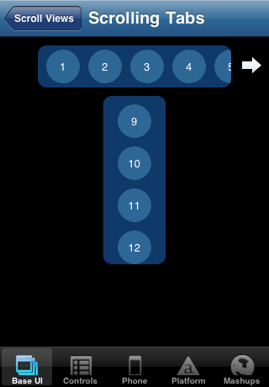
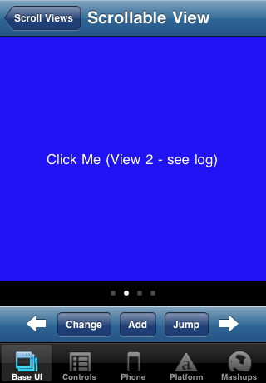
Scroll vs. Scroll
Indicator
ScrollView
ScrollableView
Notes:
ScrollView – scrollable area of content, doesn’t have to fill viewport, scroll in either direction
ScrollableView – screen-size content area with “page” indicator
sort of like a filmstrip of views shown within a container
views snap into place: you can’t end up halfway between views after a swipe

Slide 4
Basic ScrollView
var sv= new Titanium.UI.createScrollView({
properties
});
Key properties:
height / width
contentHeight / contentWidth
showHorizontalScrollIndicator / showVerticalScrollIndicator
scrollType (vertical or horizontal, Android only)
Notes:
Height/width = what’s visible to the user
Content height/width are dimensions of the actual content

Slide 5
Deeper Dive into ScrollViews
Content height & width
Auto vs. specified size
Zooming content
zoomScale
minZoomScale
maxZoomScale
Bounce
horizontalBounce
verticalBounce
Notes:
Set content height to auto and it will scroll just enough to show the content.
Set it to a specific size and that’s all you’ll get. Content could get cut off or scroll could continue well past available content
Users can zoom in/out, which you can control

Slide 6
ScrollView – Platform Differences
Android – scroll horizontal or vertical, not both
iOS – canCancelEvents to block subview events

Slide 7
ScrollView events
sv.addEventListener('scale', function(e){
alert('You zoomed to ' + e.scale * 100 + '%');
});
Key events:
click / dblclick
scroll
scale
touchstart / touchend / touchmove / touchcancel
swipe
Event object properties:
x/y, globalPoint
source
type
decelerating (scroll)
dragging (scroll)
scale (scale)
direction (swipe)
Notes:
Primary difference from other views would be the scale event
Additional event object properties

Slide 8
Basic ScrollableView
var sav= new Titanium.UI.createScrollableView({
properties
});
Key properties:
height / width
views
showPagingControl
currentPage
Notes:
views is an array of standard views that are shown within the ScrollableView
The white-dot paging control is a iOS-specific UI element
currentPage is an integer specifying which view to show when the scrollableview is rendered

Slide 9
Deeper Dive into ScrollableViews
Customize the paging controller
pagingControlColor
pagingControlHeight
scrollToView()
@param = integer or object reference to view
addView(), removeView()
@param = object reference to view

Slide 10
ScrollableView – Platform Differences
iOS – cacheSize (integer) is number of views to prerender
Notes:
This is about the only significant difference between platforms

Slide 11
ScrollableView events
sav.addEventListener('scroll', function(e){
alert('You\'re on page ' + e.currentPage);
});
Key events:
click / dblclick
scroll
touchstart / touchend / touchmove / touchcancel
swipe
Event object properties:
x/y, globalPoint
source
type
currentPage (scroll)
direction (swipe)

Slide 12
WebViews
Scrollable content area
Titanium or Javascript scrolling and touch events, but not both
Caveats:
Don’t put WebViews into other scrollable containers
Resource expense
Notes:
Set scalePageToFit to false so content isn’t scaled, then scrolling should be automatically supported
You can manage Titanium style touch related events, or handle them with Javascript within your HTML content, but not both
You’ll encounter problems if you put web views into other scrollable containers, such as tables, scroll views, etc. Touch related events might not be handled in the way you expect.
Also, remember that web views are among the most resource expensive UI components. Use them with that forethought.

Slide 13

Q&A

Slide 14
Lab Goals
Use both ScrollView and ScrollableView in an app
Use ScrollView as tab-strip style component
It will control what is shown in the ScrollableView
Notes:
In this lab, you will create a scroll view containing a list of baseball players. That list will extend left/right beyond the width of the viewport. When the user taps a player's name, three images of that player will be displayed in a scrollable view located below the scroll view.

Slide 15
Lab
Notes:
In TiBountyHunter, point out the use of the scroll view in DetailWindow.js – it is used to segment detail information about the fugitive, like the fugitive description and their location on a map (unimplemented, but easily could be).

