Slide 1



Extending Titanium Advanced Titanium Mobile Development
Notes:
Module time: 30 mins (10 mins teaching, 20 mins for lab)

Slide 2

Agenda
Basic Titanium Internal Architecture
Object Model
Building Modules
Distributing and Installing Modules
Resources
Notes:
This presentation is intended as a starting point for developers with native development knowledge wishing to get into module development. This is not an extensive tutorial, but rather an introduction to the process.
Basic Arch…
will introduce audience to the basic structure of Titanium in terms of internal implementation, including the Kroll micro kernel
Object Model
will introduce the key objects and vocabulary for building modules, like Proxy objects, and will cover serialization and conversion of values from native types to JS objects
Building modules
will cover how to use titanium SDK to build/package modules
distributing and installing
will cover how to distribute and install a custom module in a titanium app
resources
go over docs and help resources available

Slide 3
Disclaimer!
Notes:
Just so you know, the presenter is not an expert in native development for iOS and Android (probably). The intent of this presentation is to brief you on the basics of how Titanium works and to point you in the right direction for further exploration.

Slide 4
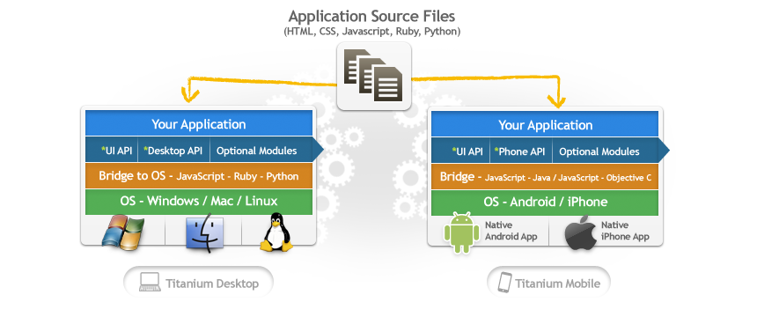
Titanium Architecture
We all know the basics…
Notes:
discuss titanium mobile app architecture – JavaScript files comprise application and communicate with native APIs through a bridge layer

Slide 5
Titanium Architecture
…but now we need to understand the bridge
How is a Titanium app packaged?
How do I create new behaviors in native code?
How do I create a JS API?
Notes:
…but now
in order to extend Titanium, we need to understand the bridge implementation for Titanium Mobile
packaged?
we need to understand how a titanium app is packaged at a high level, and what those python scripts are doing to our JS project to package it up
native code?
we need to understand how native APIs are packed into a Titanium application
JS API?
How do we expose native APIs to JavaScript and pass data between them?

Slide 6
When a Titanium app launches…
Native app starts – activity is launched (Android) or app delegate is run (iOS)
A JavaScript context is created (Rhino/V8 or JSCore)
JS app is evaluated starting with app.js
JS Context communicates with C/Java code
The “bridge” between them is what we call Kroll
Notes:
Take you through the lifecycle in very general terms…

Slide 7
The Kroll Micro Kernel
What is Kroll?
- Metallurgical process by which titanium (the element) is created
- The name given to the “cross-language, cross-platform binding and invocation framework”
- It is a microkernel
What is a kernel?
- In an OS, it is the bridge between software and hardware
- In Titanium, it is the bridge between JavaScript & native code
- https://github.com/appcelerator/kroll
- http://en.wikipedia.org/wiki/Kernel_(computing)
Notes:
Why do we call it kroll
What is a kernel

Slide 8
Titanium Modules
Every Titanium module is plugged into Kroll’s microkernel architecture
iOS Header File
Java Class File
Notes:
Note that even titanium modules for UI, Database, etc have this same structure – as you get into module development, look to core modules to see how things are done in ObjC or Java
Titanium ObjC modules must extend TiModule
Titanium Java modules must extend KrollModule

Slide 9
Module Object Model
Proxy – base class that represents the native binding between your JavaScript and native code (a module will have at least one proxy)
View - actual native representation of a view object (for UI components)
ViewProxy – represents model data (state of the View, in case the View must be released for memory management) and exposes the JavaScript API & events
Module – specialized type of Proxy that describes a specific API set, or namespace
Notes:
the object model is slightly different between iOS and Android. in iOS, the top level module (i.e. Ti.MyModule) is just a Proxy. In Android, it’s called a “Module”. they both function as top-level, static interfaces to native code
a proxy is an object that interfaces directly with native code – non-visual modules will just use these objects
a visual module will need to implement a view, which is a native representation of a visual component, and a ViewProxy, which contains the state information for a View. The View could be hidden and removed from memory, but the ViewProxy would still contain information about that view (like the title of a window, background color of a view, etc.)
View proxy is a sub class of proxy

Slide 10
Module JavaScript Interfaces
Proxy objects can have public properties:
- Ti.Platform.osname
Proxy objects can have public methods:
- Ti.UI.createWindow
Proxy objects can emit and listen for events:
- Ti.App.addEventListener(‘foo’, function(){});

Slide 11
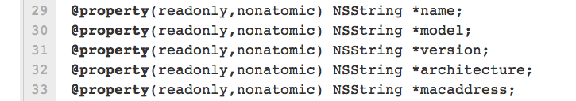
iOS – Proxy Property
To expose a property, simply define an ObjC property:
From PlatformModule.h:
JS API:
var model = Ti.Platform.model;
(Or, create getter/setter methods)
Notes:
Here’s how you’d create a property on an iOS proxy object

Slide 12
Android – Proxy Property
To expose a property, annotate object field with @Kroll.Property:
From PlatformModule.java:
JS API:
var model = Ti.Platform.model;
(Or, create getter/setter methods)
Notes:
Must explicitly declare property as public for it to be visible in JavaScript land

Slide 13
iOS – Proxy Method
To expose a method, simply define an ObjC method:
From PlatformModule.m:
JS API:
Ti.Platform.openURL(‘http://www.google.com’);
Notes:
Must implement one of a couple valid signatures (see the wiki)
One or more arguments passed in are all accessible via the single NSArray args array

Slide 14
Android – Proxy Method
To expose a method, annotate with @Kroll.method:
From PlatformModule.java:
JS API:
Ti.Platform.openURL(‘http://www.google.com’);

Slide 15
iOS – Event Handlers for Proxy
From GeolocationModule.m:
Notes:
To react to the adding or removing of event listeners, override the listenerAdded and listenerRemoved methods
These methods are automatically invoked when a corresponding JavaScript event listener is added or removed

Slide 16
Android – Event Handlers for Proxy
From GeolocationModule.java:

Slide 17
Adding Event Handlers for Proxy
JS API:
Notes:
This JS api is what corresponds to the native code on the two preceding slides

Slide 18
Firing an Event on a Proxy Object
Both Proxy base classes have a “fireEvent” method
Use this to fire an event back up to a JavaScript object
Any events fired from native land via “fireEvent” can be listened for on a JavaScript object via “addEventListener”

Slide 19
Type Conversions Across The Bridge
Both platforms provide utilities for type conversion, both JS >> Native Classes and Native Classes >> JS
Some simple types like Strings and Booleans auto convert
Check other module implementations for type conversion examples

Slide 20
Building your Module
Creating a module:
TiStudio 1.0.7 – Choose File, New, Ti Mobile Module Project
Command line – use titanium.py in SDK download folder)
Android modules are done in Eclipse
iOS modules are done in Xcode
Packaging a module:
TiStudio 1.0.7 – Click Packaging icon, choose Package
Command line – use titanium.py)
Either builds a package .zip
Notes:
When it comes time to write your own, titanium.py is the tool you’ll use to create your starting Java or Xcode project

Slide 21
Distributing your Module
Once your .zip file is generated for your module, can distribute on disk, over the web, whatever
Explode your module .zip file and copy into <Project Root>/modules/<android or iphone>/<your module name>
Include in tiapp.xml configuration
Include in JS via require()
Notes:
You have to include the JS via CommonJS require()

Slide 22
Resources
Platform specific module dev guides on wiki
https://github.com/appcelerator/titanium_modules/ --> see the moddevguide
https://github.com/appcelerator/titanium_mobile
Again, best resource is existing core Ti modules
Anything core Titanium does, you can do in your module
Notes:
Guides on our wiki document at least the basics of the process
The ModDevGuide project on GitHub shows sample code for iOS & Android and includes lots of boilerplate samples to get you started
GitHub is where you’ll find our core Titanium distro which you can examine for techniques and features
For existing modules, the Ti.Platform module is fairly straightforward for basic stuff. Look at the UI widgets to see how you’d make a module with a visual/UI component

Slide 23
Q&A

Slide 24
Lab Goals
Follow the steps in the iOS (or Android) module development wiki guide
Create the sample module that guide describes
Use that module in a Titanium project
Notes:
We will follow along with the module dev guides and try a custom module ourselves. This is a “kick the tires” type exercise.

Slide 25
Lab
Notes:
There is no specific TiBountyHunter tie in here – the exercise is going through the module development guides

