Slide 1


API Deep Dive: TableViews
Notes:
Module time: 60 mins (30 mins teaching, 30 mins lab)

Slide 2
Agenda
Overview of Problem/Opportunity
High Level Concepts and Theory
Demonstration (with Screen Shots for repeatability)
Proposed Solution Details
Code Fragments
Lab Exercise Overview

Slide 3
Outline
Examples
TableView basics
TableViewRows
Event handling
Other??
Notes:
3

Slide 4
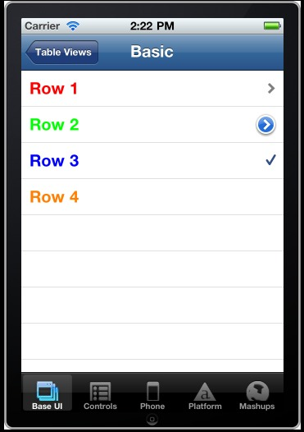
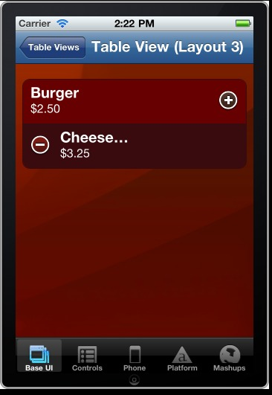
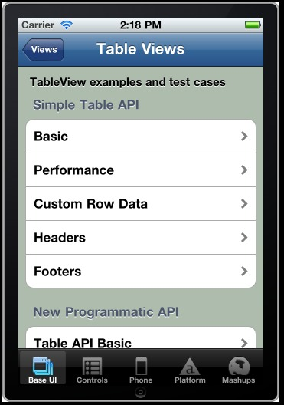
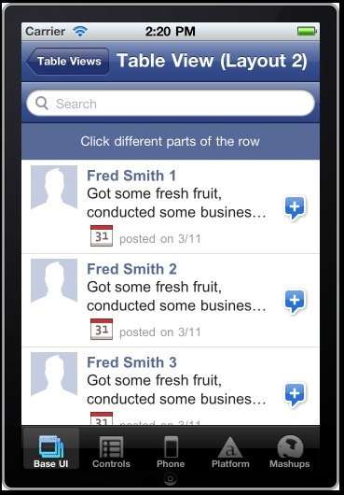
Examples of tables

Slide 5
Basic TableView
var table = new Titanium.UI.createTableView({
properties
});
Key table properties:
height / width
top / left
backgroundColor / backgroundImage
headerTitle

Slide 6
Adding rows
Various means:
Create array of row data, assign to table.data
Create array of row data, assign with table.setData()
Create TableViewRow object, add with appendRow(), insertRowAfter(), or insertRowBefore()

Slide 7
Adding rows – method 1
var tbl_data = [{title:'Row 1'}, {title:'Row 2'}];
tbl_data.push({title:'Row 3'});
var table = new Titanium.UI.createTableView({
data:tbl_data
});

Slide 8
Adding rows – method 2
var tbl_data = [{title:'Row 1'}, {title:'Row 2'}];
tbl_data.push({title:'Row 3'});
var table = new Titanium.UI.createTableView({});
table.setData(tbl_data);

Slide 9
Adding rows – method 3
var tbl_data = [{title:'Row 1'}, {title:'Row 2'}];
var table = new Titanium.UI.createTableView({
data: tbl_data
});
var row = new Titanium.UI.createTableViewRow({
title:'My new row'
});
table.appendRow(row);

Slide 10
TableViewRow
var row = new Titanium.UI.createTableViewRow({
properties
});
table.appendRow(row);
Key properties:
title
height / width / top / left
color / backgroundColor
hasChild / hasDetail / hasCheck
leftImage / rightImage

Slide 11
Custom table rows
Add labels, views, images to your rows
Positioning: relative to top-left of row
Elements accessible via children[]

Slide 12
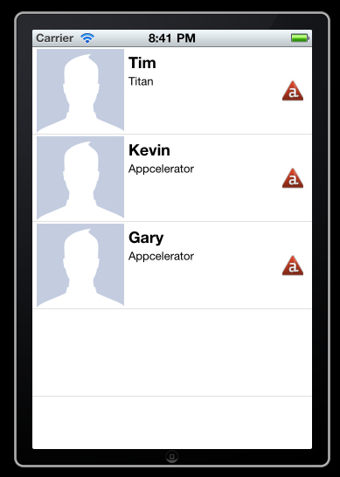
Custom table rows
var row = Ti.UI.createTableViewRow({
height:'auto',
rightImage:'images/appcelerator_small.png'
});
var mugshot = Ti.UI.createImageView({
image:'images/user.png',
height:100,
width:100,
left:5,
top:2
});
row.add(mugshot);
...

Slide 13
Table events
table.addEventListener('click', function(e){
alert('You clicked row '+e.index);
});
Key event object properties:
index
row
rowData
source

Slide 14
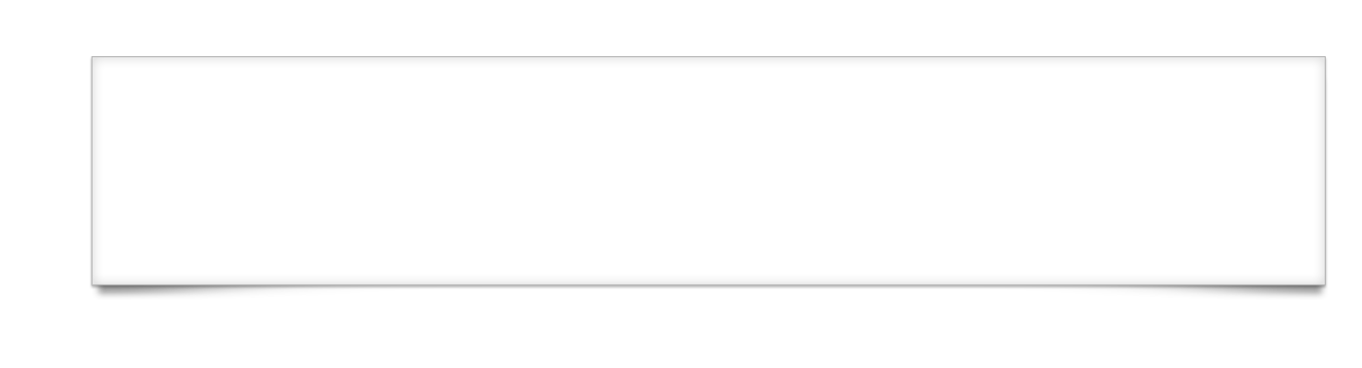
Q&A

Slide 15
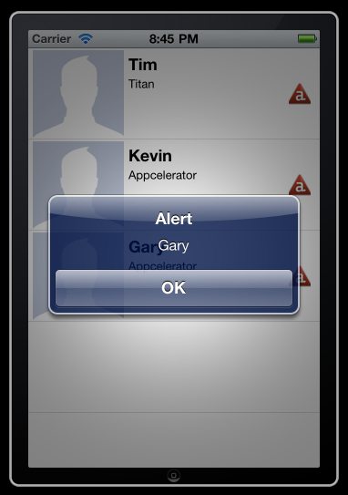
Lab goals
Notes:
In this lab, you'll add an event listener. You'll define that listener to show an alert with the row's text. That means you'll have to take special steps for the row containing the image and label.

Slide 16
Lab Exercise

