Slide 1


Titanium Studio
Notes:
Module time: 60 minutes (30 mins teaching, 30 mins lab)

Slide 2
Agenda
Intro / Review
Titanium-specific features
Deployment and distribution features
Debugging
Customizing and extending

Slide 3
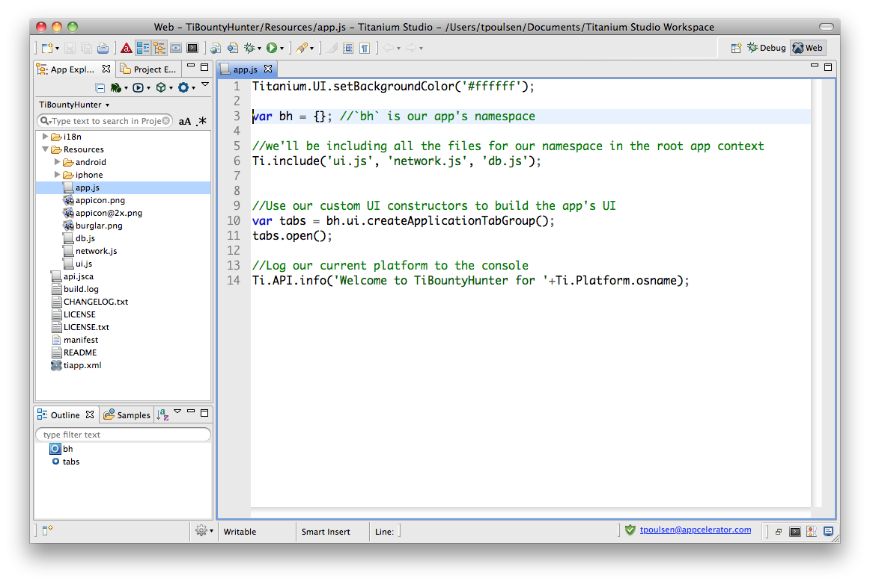
Eclipse concepts
Perspective
View
Editor
Notes:
Based on Eclipse (www.eclipse.org/) – open source software development tools project
Editor = window in which you change code or project parameters
View = hierarchical selector, such as a file tree
Perspective = Editors + Views
Workspace = file location for your project

Slide 4
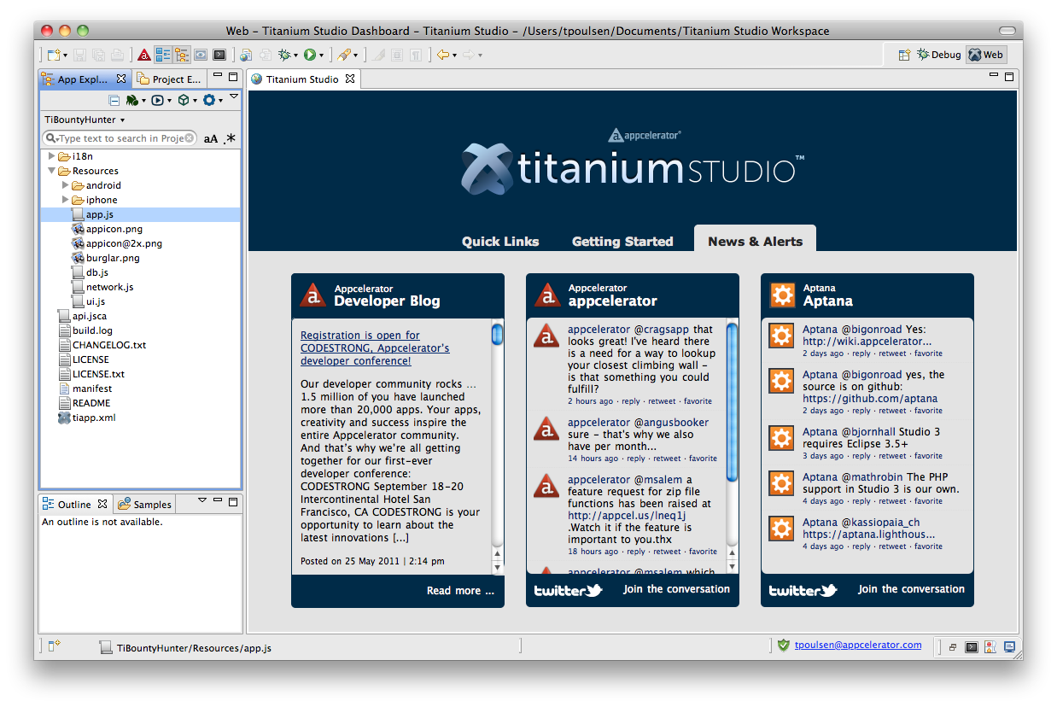
Titanium Dashboard
Dashboard
Notes:
First perspective you see when you open Titanium Developer
News and notes about Titanium, Appcelerator, and Aptana

Slide 5
UI Overview
New project button
Coding features
Project selector
App explorer
Terminal & Console buttons
Notes:
Point out the main UI features
App Explorer (view)
Code editing view & features (editor)
New project button
Terminal, Console, and Problems buttons

Slide 6

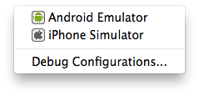
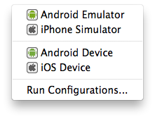
Debug, Deploy, Distribute menus
Notes:
Debug, deploy, and distribute (left-to-right order)

Slide 7


Coding tools
Code completion
Code assist
Custom code assist
/**
* Gets the current foo
* @param {String} fooId Unique ID for foo
* @return {Object} Returns the current foo.
*/
function getFoo(fooID){
}
https://aptanastudio.tenderapp.com/kb/using-code-assist/documenting-code
Notes:
Use ScriptDoc notation to document your functions
Code assist will then pick up your documentation and provide custom code assistance
Notations should be added in specific order, see wiki for full details

Slide 8
Titanium-specific features
Project management – create project wizard, tiapp.xml editor, build cleaning
Project configuration - API level, emulator settings, more
Console output and filtering
Demo
Notes:
Demo:
show tiapp.xml editor
build cleaning
config project – set api level & android emulator options

Slide 9
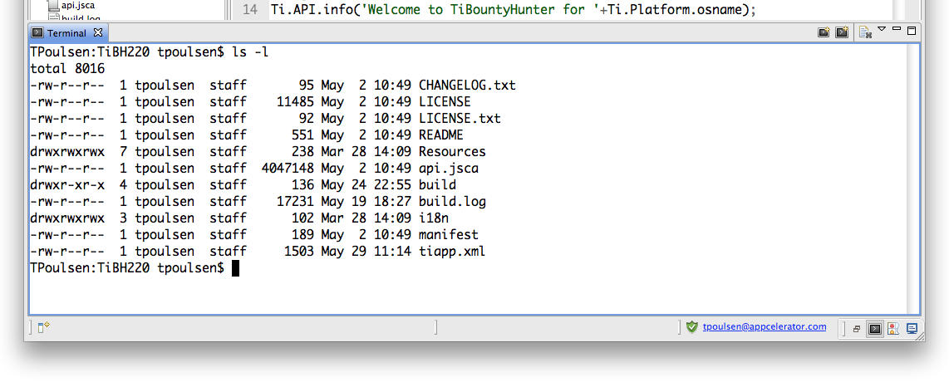
Integrated terminal
click here
Slide notes would cover some common use cases …
Demo – launch FastDev for Android in the terminal?

Slide 10
Deployment and distribution
Mobile deployment and distribution features
Local web / HTML testing (integrated/system browser)
Web/ HTML / PHP deployment (ftp, sftp, ftps)
PHP, Ruby, etc. deployment and distribution (Engine Yard, RedHat Cloud, Capistrano)
Git integration – pull/push/commit, branching
SVN & other CI system integration (add-ons)
Notes:
You can use Titanium Studio for all your mobile and web development
Deployment options go beyond mobile

Slide 11

Debugging

Slide 12
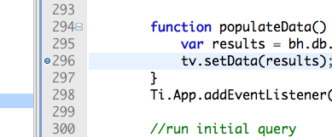
Breakpoints
Double-click to set
Build via Debug menu
Debug perspective
breakpoint
Notes:
Set by double-clicking line
Clear by double-clicking
Use Debug menu to build

Slide 13
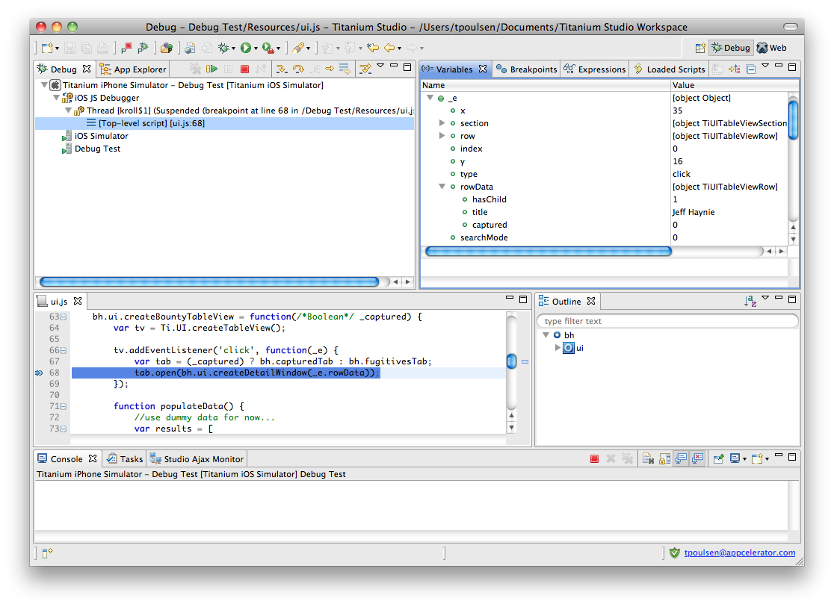
Debug perspective
Stop, Step buttons
Variables
Breakpoint
Notes:
Overview of main debug UI elements
More info on next slide, so don’t go too deep here

Slide 14
Variables state
Examining variable state
Affecting run-time variable values
Conditional breakpoints
Demo
Notes:
You can examine variables
Set in-memory variables
Manage breakpoint conditions

Slide 15
Customization

Slide 16
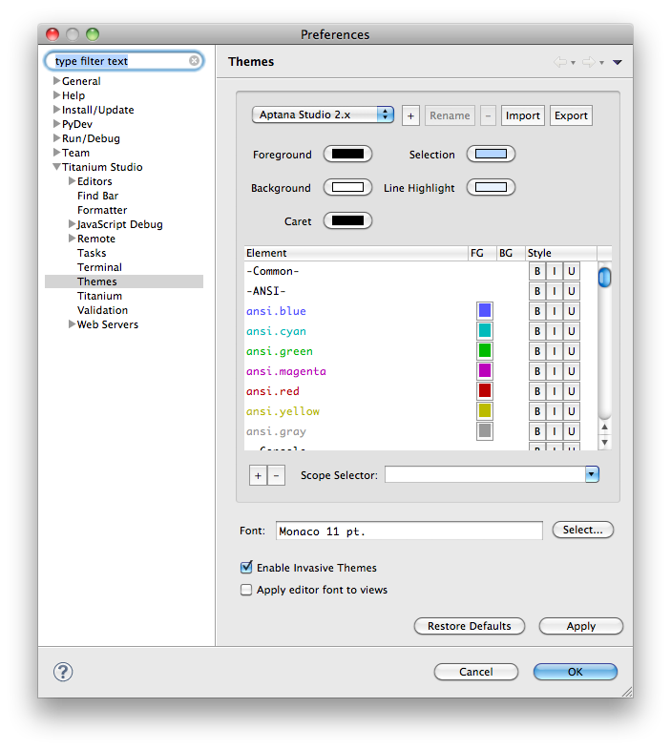
Themes
Notes:
Access from Preferences menu
Compatible with TextMate themes
Download themes from http://wiki.macromates.com/Themes/UserSubmittedThemes

Slide 17
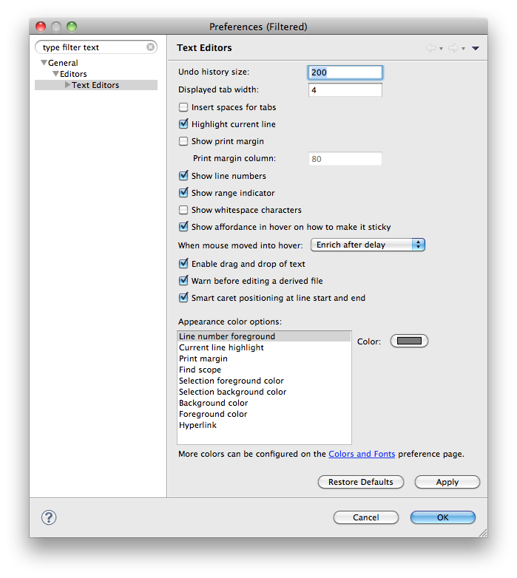
Editor preferences
Notes:
Right-click in editor, choose Preferences
Line numbering, highlight color, etc.
Right-click in editor, choose Word Wrap

Slide 18

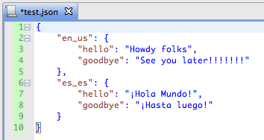
Keyboard shortcuts and commands
Built-in commands
- Code formatting
- Commenting
- Deploying
- much more
To see available shortcuts:
Help, Key Assist…
Right-click, choose Commands and explore submenus
Formatting: before & after
Notes:
Command-Shift-F to reformat code
Command-/ to comment out the current line
Command-Option-/ to comment out the selected block

Slide 19
Extending and maintaining Ti Studio
Titanium API updates:
(Released APIs) Help > Check for Titanium SDK Updates
(CI builds) Help > Install Titanium SDK from URL
Titanium Studio updates:
Help > Check for Updates
Add-ons – e.g. SVN tools:
Help > Install New Software Click Available Sites, enable download sites
Download and install via the wizard
Notes:
Three main types of updates:
API updates – to get new Titanium APIs
Ti Studio updates
Install add-ons, such as SVN support

Slide 20
Q&A

Slide 21
Lab
Notes:
Ideas:
debug a project
import a textmate theme and/or bundle
configure or create a shortcut
configure colors and theme settings
configure Ti Mobile settings (API level, emulator options)

