Slide 1

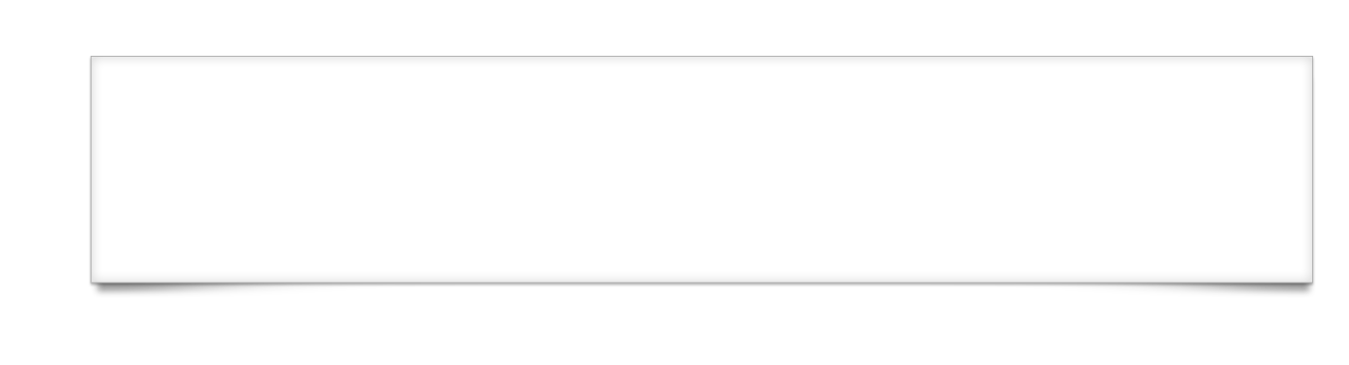

Animation
Notes:
Module time: 30 mins (10 mins teaching, 20 mins for lab)

Slide 2

Agenda
Animation Key Concepts
Basic property animation
2d and 3d Matrix Animations
Lab

Slide 3
Animation Overview
Animations can help a user visually pick up on application state changes
Can help make your app more engaging and dynamic (read: look cool)
Essential for games (a less often used application of Titanium, but becoming more popular)

Slide 4
Basic Animation
For simple property animations, we use obj.animate()
Notes:
almost any UI component can be animated in this way

Slide 5
Basic Animation with Object
Hash of properties are properties of a Ti.UI.Animation object
To reuse animations, create an object which can be passed to animate():
Notes:
almost any UI component can be animated in this way

Slide 6
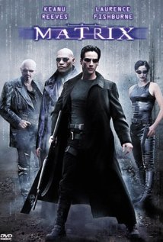
Matrix Animations
What is a matrix?
http://en.wikipedia.org/wiki/Matrix_(mathematics) if you care
For animations, it’s a set of properties describing a transformation of an object in a way a computer can process and execute
Provides more options for animation
Notes:
almost any UI component can be animated in this way

Slide 7
2D Matrix Animations
Transform objects in 2D Space
Rotate
Scale
Skew
Associated with Animation object
Notes:
almost any UI component can be animated in this way

Slide 8
2D Matrix Animation Example
Notes:
almost any UI component can be animated in this way

Slide 9
3D Matrix Animations
Transform objects in 3D Space
Rotate
Scale
Skew
Associated with Animation object
Notes:
almost any UI component can be animated in this way

Slide 10
3D Matrix Animation Example
Notes:
almost any UI component can be animated in this way

Slide 11
Using Opacity
Opacity is an important property in animation
Values:
0 is invisible
1 is totally opaque
Dimming objects indicates they are unavailable
Fading in/out views makes UI state changes less jarring
Demo: animating the opacity property

Slide 12
Transitions
iOS allows for animated transitions between views and windows
Can open window with a transition
Can transition between child views
Demo: Using transitions on iOS

Slide 13
Common Animation Uses
Window Transitions (already demoed)
View opacity (already demoed)
Slide – Demo
Bounce/Grow/Shrink – Demo
Drag and Drop - Demo

Slide 14
Q&A

Slide 15
Lab
Notes:
Let’s enhance our tab view component to animate the tranisition between two tabs, sliding back and forth.

