Slide 1


API Deep Dive: TableViews
Notes:
Module time: 60 mins (30 mins teaching, 30 mins lab)

Slide 2
Agenda
TableView Examples
TableView Basics and Beyond
Event Handling
Special Features (?)
Notes:
2

Slide 3

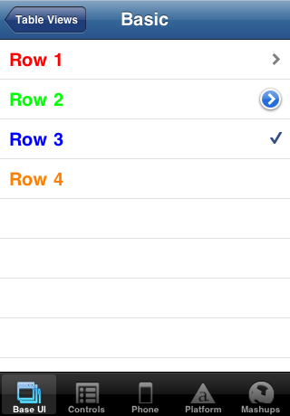
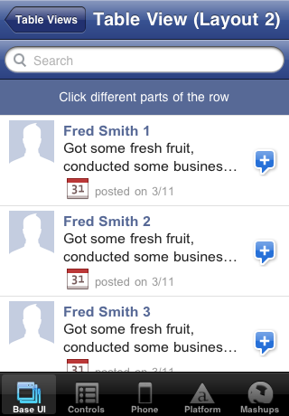
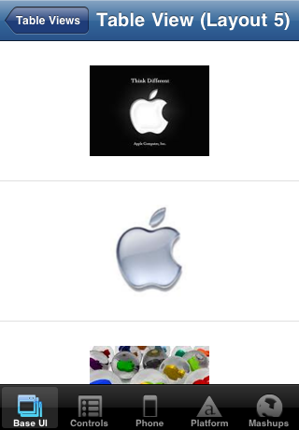
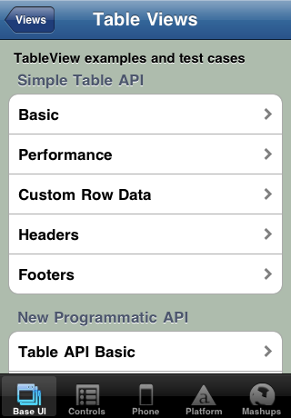
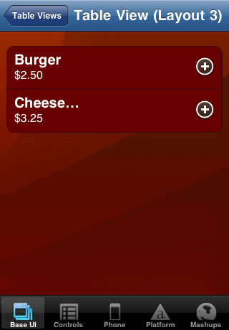
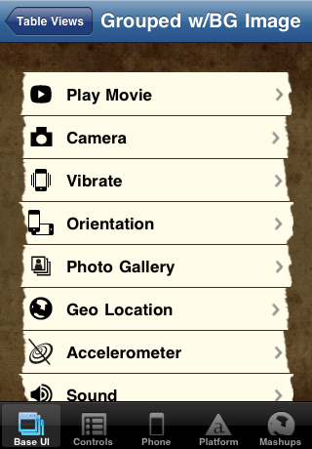
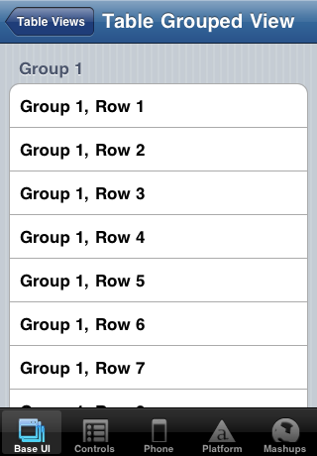
Examples
Notes:
Many options for formatting tables
(seven total shown)

Slide 4
Basic TableView
var table = new Titanium.UI.createTableView({
properties
});
Key table properties:
height / width
top / left
backgroundColor / backgroundImage
headerTitle

Slide 5
Table Rows with Anonymous Objects
var tbl_data = [{title:'Row 1'}, {title:'Row 2'}];
var table = new Titanium.UI.createTableView({
data:tbl_data
});
// alternatively
table.setData(tbl_data);
Notes:
One option for adding rows is to use anonymous objects
Useful with JSON data pulled from a web service or database

Slide 6
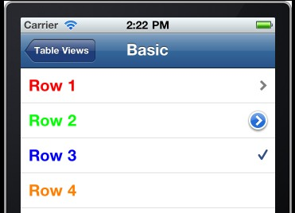
TableViewRow Object
var row = new Titanium.UI.createTableViewRow({
properties
});
table.appendRow(row);
Key properties:
title
height / width / top / left
color / backgroundColor
leftImage / rightImage
Notes:
You can also create TableViewRow objects
Useful when you want to manipulate the row’s properties before/after adding to the table
Saves cumbersome means of accessing the object within the table’s data array

Slide 7
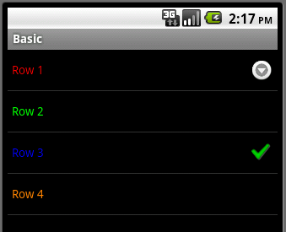
Row Indicators
hasChild
hasDetail
hasCheck
Notes:
hasChild – indicates sub-table or additional rows
hasDetail – indicates a detail view or alert will appear when row is tapped (not supported on Android)
hasCheck – on/off or yes/no indicator

Slide 8
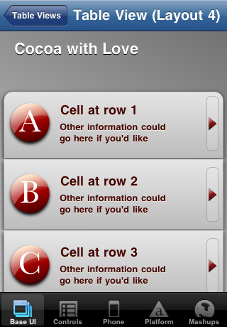
Basic Table and Row Properties
Row: backgroundImage
Table: top
Row: title
Row: leftImage
Row: rightImage
Row: subTitle
Row: backgroundImage
Notes:
Formatting can be done with standard TableViewRow properties
First row has different background image than middle rows
Not labeled, but the row’s foreground (text) color also set

Slide 9
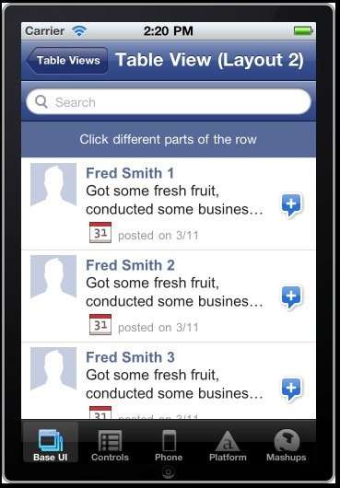
Custom Table Rows
Add labels, views, images to your rows
Positioning: relative to top-left of row
Elements accessible via children[]
Labels
ImageViews
Notes:
You can add labels, views, and images to create custom rows
Point out the three labels
Point out the image views
The “plus” image is set with the row’s rightImage property

Slide 10
Headers and Footers

Slide 11
Table Sections
Creating table sections

Slide 12
Table Searching
iOS specifics
Android specifics

Slide 13
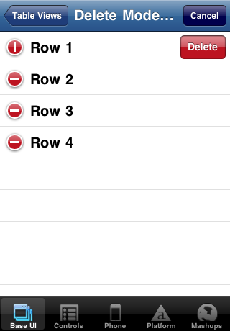
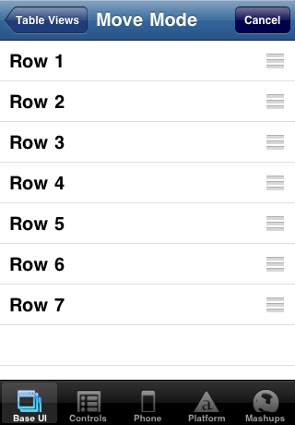
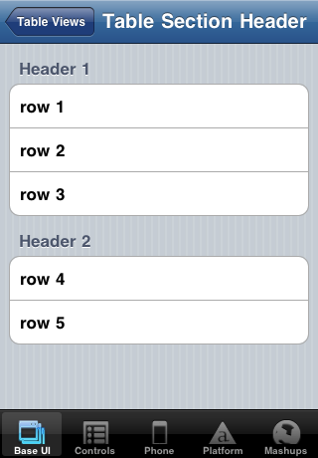
iOS Only Features
Edit mode
Moving rows
Grouped sections
editBtn.addEventListener('click', function() {
tableview.moving = true;
});
tableview.addEventListener('move',function(e) {
...
});
var tableView = Titanium.UI.createTableView({
editable:true
});
tableview.addEventListener('delete',function(e) {
...
});
var tableView = Titanium.UI.createTableView({
style:Titanium.UI.iPhone.TableViewStyle.GROUPED
});

Slide 14
TableView Methods
Key methods of tables:
setData
insertRowBefore / insertRowAfter / appendRow
deleteRow
show / hide
scrollToIndex
scrollToTop
selectRow / deselectRow

Slide 15
TableViewRow methods
Key methods of table rows:
method A
method B

Slide 16
Table events
table.addEventListener('click', function(e){
alert('You clicked row '+e.index);
});
Key event object properties:
index
row
rowData
source

Slide 17
Table Extras
Pull to refresh
Dynamic scrolling

Slide 18

Q&A

Slide 19
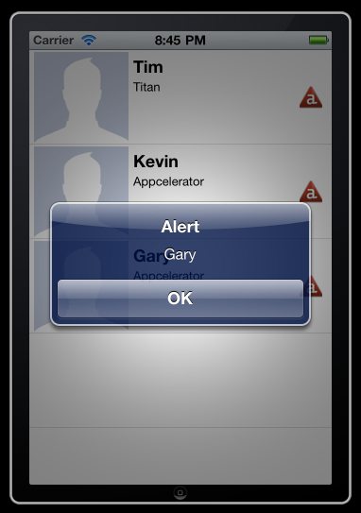
Lab goals
Notes:
In this lab, you'll add an event listener. You'll define that listener to show an alert with the row's text. That means you'll have to take special steps for the row containing the image and label.

Slide 20
Lab Exercise

