Slide 1


Titanium Studio
Notes:
Module time: 60 minutes (30 mins teaching, 30 mins lab)

Slide 2
Agenda
Intro / Review
Titanium-specific features
Deployment and distribution features
Debugging
Customizing and extending

Slide 3
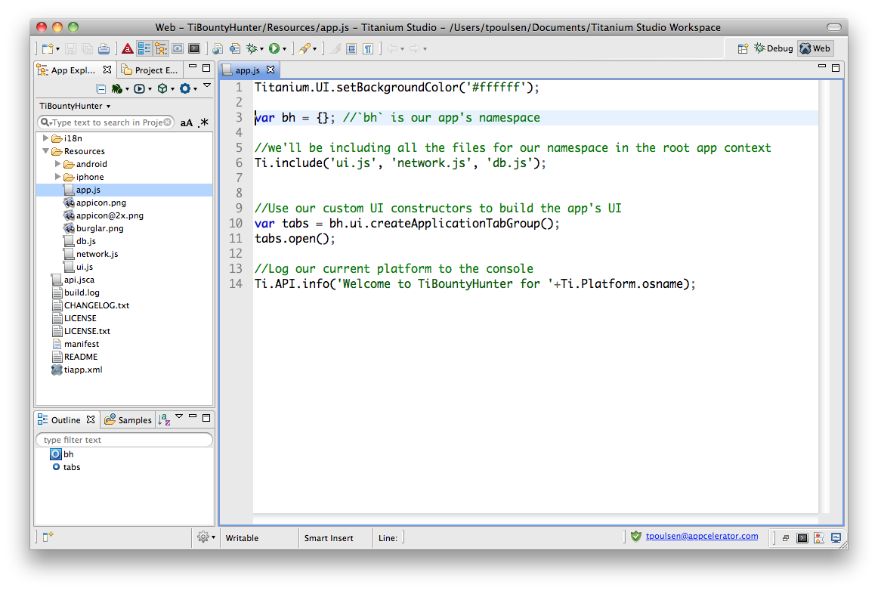
Eclipse Concepts
Perspective
View
Editor
Notes:
Based on Eclipse (www.eclipse.org/) – open source software development tools project
Editor = window in which you change code or project parameters
View = hierarchical selector, such as a file tree
Perspective = Editors + Views
Workspace = file location for your project

Slide 4
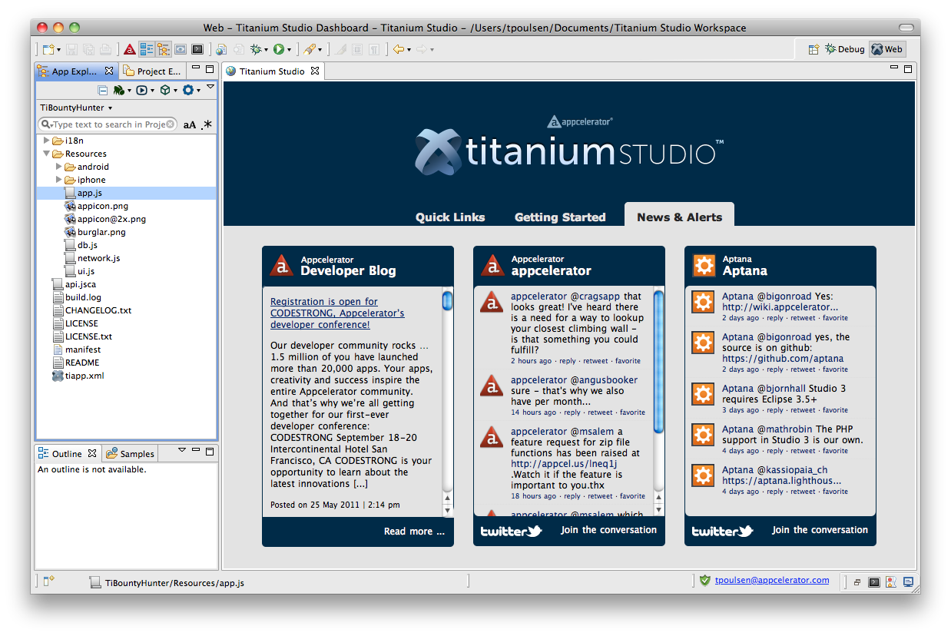
Titanium Dashboard
Dashboard
Notes:
First perspective you see when you open Titanium Developer
News and notes about Titanium, Appcelerator, and Aptana

Slide 5
UI Overview
New project button
Coding features
Project selector
App explorer
Terminal & Console buttons
Notes:
Point out the main UI features
App Explorer (view)
Code editing view & features (editor)
New project button
Terminal, Console, and Problems buttons

Slide 6

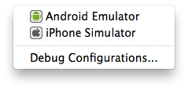
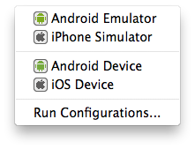
Debug, Deploy, Distribute Menus
Notes:
Debug, deploy, and distribute (left-to-right order)

Slide 7


Coding Tools
Code completion
Code assist
Custom code assist
/**
* Gets the current foo
* @param {String} fooId Unique ID for foo
* @return {Object} Returns the current foo.
*/
function getFoo(fooID){
}
https://aptanastudio.tenderapp.com/kb/using-code-assist/documenting-code
Notes:
Code completions offers “content assist proposals”
Code assist displays “context information” pop-ups with arguments and parameters
Custom code assist:
Use ScriptDoc notation to document your functions
Notations should be added in specific order, see wiki for full details

Slide 8
Titanium-specific Features
Project management – create project wizard, tiapp.xml editor, build cleaning
Project configuration - API level, emulator settings, more
Console output and filtering
Demo
Notes:
Demo:
show tiapp.xml editor
build cleaning
config project – set api level & android emulator options

Slide 9
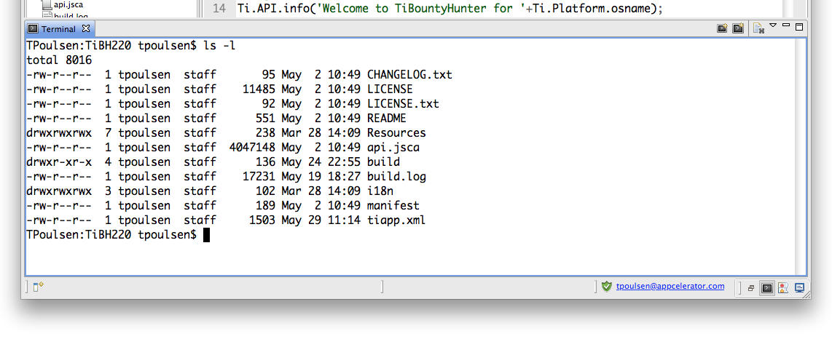
Integrated Terminal
click here
Notes:
Common use cases include:
Launching Android debug tools (ddms)
Copying files
Pushing a CI build to your repository

Slide 10
Deployment and Distribution
Mobile deployment and distribution features
Local web / HTML testing (integrated/system browser)
Web/ HTML / PHP deployment (ftp, sftp, ftps)
PHP, Ruby, etc. deployment and distribution (Engine Yard, RedHat Cloud, Capistrano)
Git integration – pull/push/commit, branching
SVN & other CI system integration (add-ons)
Notes:
You can use Titanium Studio for all your mobile and web development
Deployment options go beyond mobile

Slide 11

Debugging

Slide 12

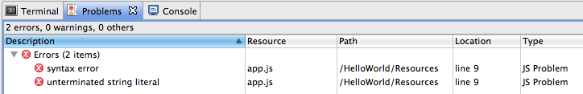
Code Validation
Inline Validation
Problems Console
Validation Preferences
Preferences > Titanium Studio > Validation > JavaScript
Notes:
Not really debugging, but Studio provides code validation
Inline – red x in the margin
Problems console shows JSLint and other errors
Set preferences to enable or disable validators

Slide 13
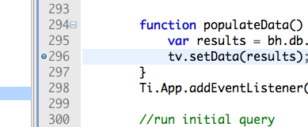
Breakpoints
Double-click to set
Build via Debug menu
Debug perspective
breakpoint
Notes:
Set by double-clicking line
Clear by double-clicking
Use Debug menu to build

Slide 14
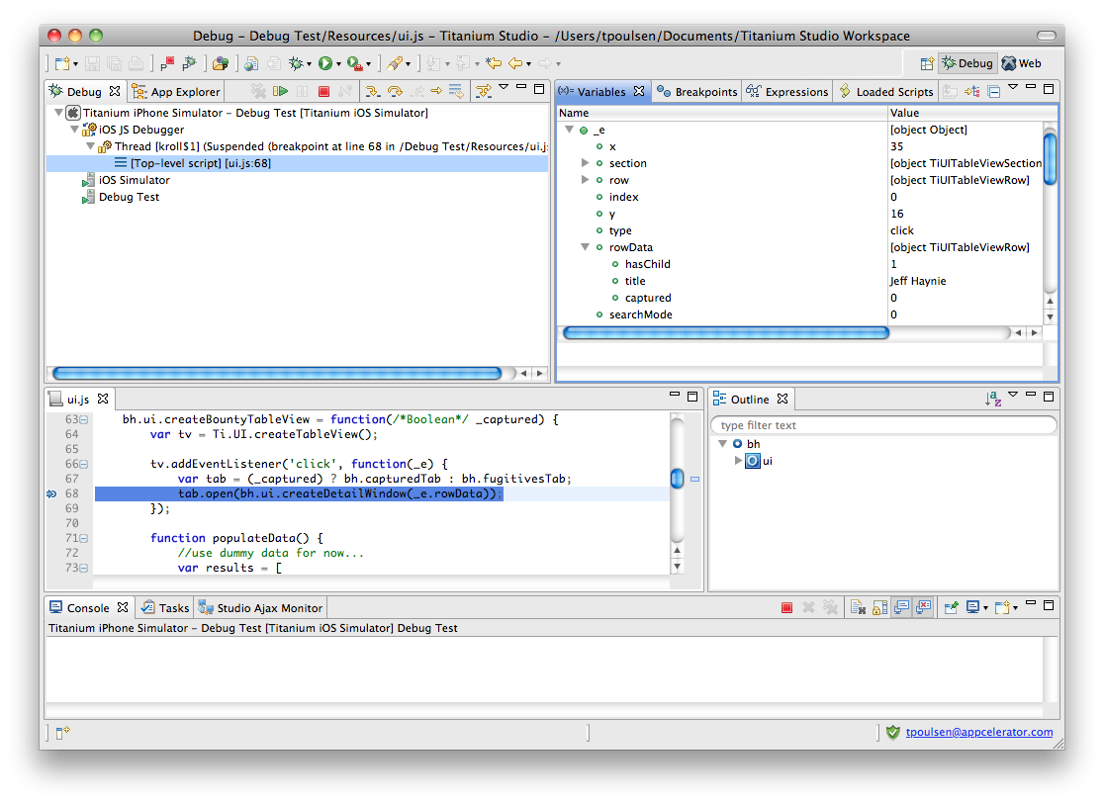
Debug Perspective
Stop, Step buttons
Variables
Breakpoint
Notes:
Overview of main debug UI elements
More info on next slide, so don’t go too deep here

Slide 15
Variables State
Examining variable state
Affecting run-time variable values
Conditional breakpoints
Demo
Notes:
You can examine variables
Set in-memory variables
Manage breakpoint conditions

Slide 16
Customization

Slide 17
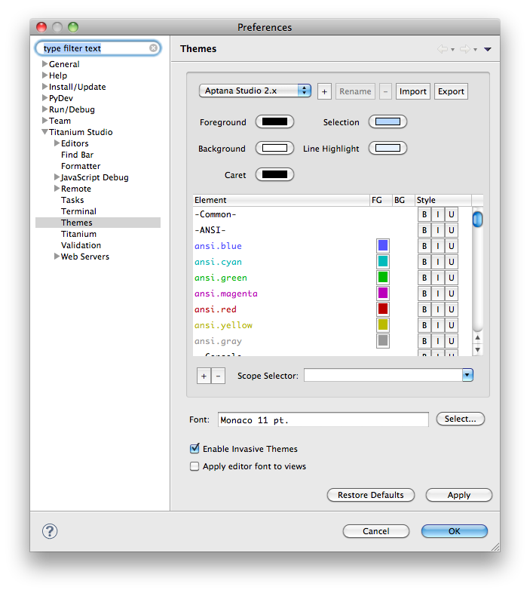
Themes
Select and modify via Preferences menu
Compatible with TextMate themes
Download themes from wiki.macromates.com/Themes/UserSubmittedThemes
Notes:
Themes control colors and fonts for perspectives
Many built in
You can download and install additional themes

Slide 18

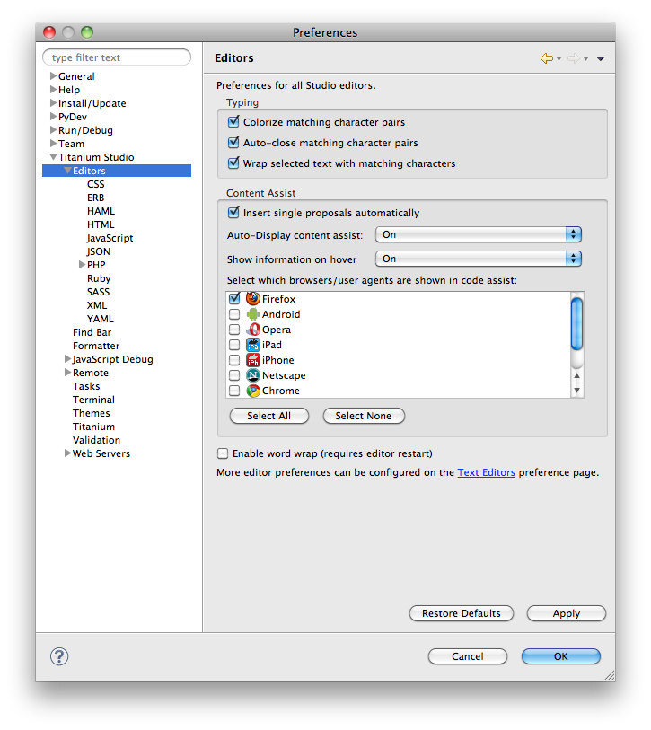
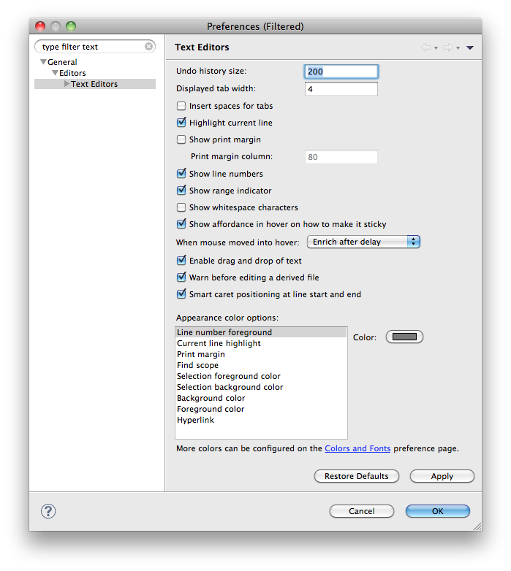
Editor Preferences
Editor-Specific Preferences
Preferences > Titanium Studio > Editors
General Editor Preferences
Right-click, choose Preferences
Word wrap:
Right-click, choose Word Wrap
Notes:
Editor is window in which you change code or project parameters
Editor-specific preferences
Code assist on/off, tab handling, code folding
General editor prefs include:
Line numbering, highlight color

Slide 19
Customization Concepts
Commands
Snippets
Bundles
Rubles
Shortcut keys
Commands
User-defined scripts interpreted by the system’s shell or interpreter
- access environment variables - modify and re-insert text
- create or display a file
Snippet
Text inserted into the document
- common code blocks - comment placeholder blocks
Bundle
A grouping of commands, snippets, templates, etc. that can be associated with a scope (HTML or JavaScript documents, for example)
Ruble = Ruby Bundle
A bundle written with Ruby rather than another scripting language.
Initiate a command or snippet
Provided by Eclipse or added via user-definition, bundle, or ruble
Notes:
Bundles and Rubles are basically identical, except that Rubles are written in Ruby while Bundles could be written with other scripting languages.

Slide 20

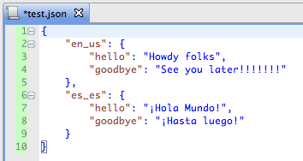
Commands
Built-in commands
- Code formatting
- Commenting
- Deploying
- much more
To see available commands:
Right-click, choose Commands and explore submenus
Many have shortcuts
See more by choosing Help, Key Assist…
Formatting: before & after
Notes:
Examples include:
Command-Shift-F to reformat code
Command-/ to comment out the current line
Command-Option-/ to comment out the selected block

Slide 21
Snippets
“Templates” of code to insert
Show up within code assist
Need to create a bundle to contain your snippet
Wiki for how-to info:
http://wiki.appcelerator.org/display/tis/Creating+a+new+snippet

Slide 22
Bundles and Rubles
Rubles == Bundles (written with Ruby)
Importing Rubles
“Official” web oriented rubles - https://github.com/aptana
Writing your own, see the wiki
http://wiki.appcelerator.org/display/tis/Creating+a+new+Ruble
Importing TextMate bundles
http://manual.macromates.com/en/bundles
http://svn.textmate.org/trunk/Bundles/
Notes:
Rubles and Bundles are the primary way to extend Ti Studio (without writing Java code)
Many are included
You can download web dev oriented bundles from GitHub
There aren’t currently any Titanium-specific Rubles published, maybe someday
Studio supports and can import TextMate bundles

Slide 23
Extending and Maintaining Ti Studio
Titanium API updates:
(Released APIs) Help > Check for Titanium SDK Updates
(CI builds) Help > Install Titanium SDK from URL
Titanium Studio updates:
Help > Check for Updates
Add-ons – e.g. SVN tools:
Help > Install New Software Click Available Sites, enable download sites
Download and install via the wizard
Notes:
Three main types of updates:
API updates – to get new Titanium APIs
Ti Studio updates
Install add-ons, such as SVN support

Slide 24
Q&A

Slide 25
Lab
Notes:
Ideas:
debug a project
import a textmate theme and/or bundle
configure or create a shortcut
configure colors and theme settings
configure Ti Mobile settings (API level, emulator options)

