Slide 1

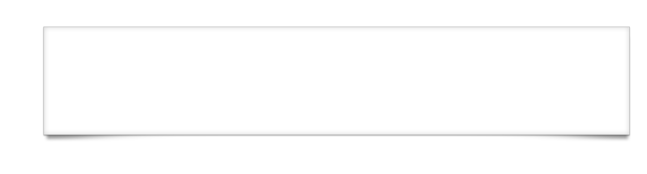
User Input Collection Advanced Titanium Mobile Development
Notes:
Module time: 60 mins (30 mins teaching, 30 mins lab)
Data entry in a mobile application is much different than sitting at a keyboard with a desktop computer. In this module, developers will learn how to collect data from users in a streamlined way.

Slide 2
Agenda
Skin and style native components
Handle keyboard and layout issues
Keyboard customization
Using Web Views and HTML forms for input collection
Notes:
2

Slide 3
Styling Input Components
Sizing input elements
Positioning input elements
hintText
clearOnEdit
Autocorrection and autocapitalization
Notes:
You can set all the usual width and height values
Keep in mind that text sizes differ across platforms, so size text accordingly
Position with top, left, right, bottom as usual
Hint text shows in empty text fields and text areas, removed when user focuses on the field
Clear on edit removes contents on focus
Turn off autocorrection and autocapitalization by setting to false in field’s properties

Slide 4


Styling Input Components, continued
Background colors and gradients
Background graphics
backgroundLeftCap, backgroundTopCap
backgroundLeftCap
Center 1px stretched
Notes:
Set normal, selected, and disabled background colors
Gradients on iOS only
Set normal, selected, and disabled background graphics on most fields
backgroundLeftCap / top cap define an area that won’t be stretched
specifies a size in pixels that is the left/right or top/bottom non-stretched area
middle is stretched to fill size of element
background right cap is calculated as width – left cap – center 1px

Slide 5
Soft Keyboard and Layout Issues
Hiding the keyboard – blur()
Suppressing the return key
Preventing the keyboard from covering an input
1
Put input fields into a scroll view
2
Android-only:
Ti.UI.createWindow({
softInputMode:(Ti.UI.Android) ? Ti.UI.Android.SOFT_INPUT_ADJUST_PAN : ‘’
});
Notes:
Hide keyboard with input.blur() or show with input.focus()
There’s a native Android-only way to hide the keyboard programmatically, see the Kitchen Sink
No way to tell if the keyboard is showing – native OS limitation
Suppressing return – to get new lines in textarea
Add suppressReturn:false to field
Prevent keyboard covering input:
Put input fields into a scroll view
Android only: use the SOFT_INPUT_ADJUST_PAN constant

Slide 6
Keyboard Customization
Keyboard Type
Set with textfield.keyboardType
Assigning the Return key
Set with textfield.returnKeyType
Keyboard Toolbars
Notes:
Agenda type slide
Details on upcoming slides

Slide 7
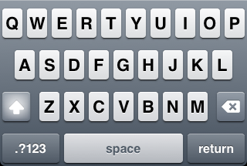
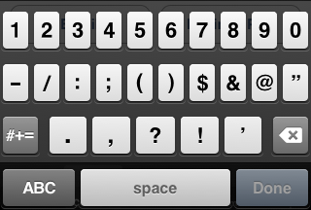
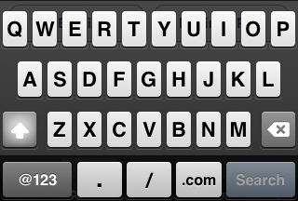
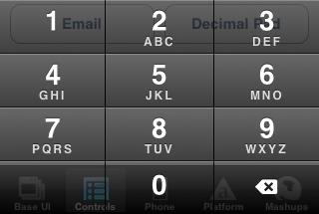
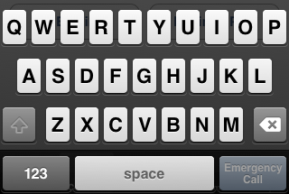
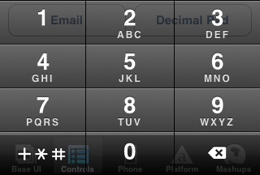
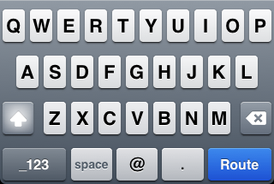
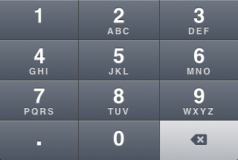
Keyboard Types - iOS
KEYBOARD_DEFAULT
KEYBOARD_NUMBERS_PUNCTUATION
KEYBOARD_URL
KEYBOARD_NUMBER_PAD
KEYBOARD_NAMEPHONE_PAD
KEYBOARD_PHONE_PAD
KEYBOARD_EMAIL
KEYBOARD_DECIMAL_PAD
Notes:
Keyboard types
Set on text field or text area with keyboardType = Ti.UI.type_name

Slide 8
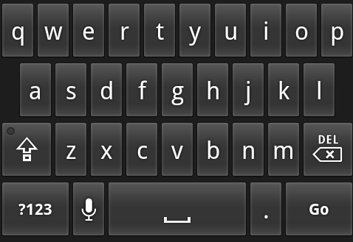
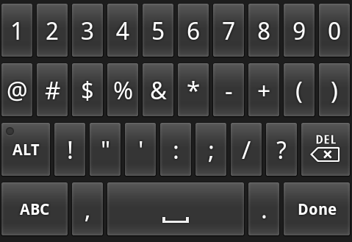
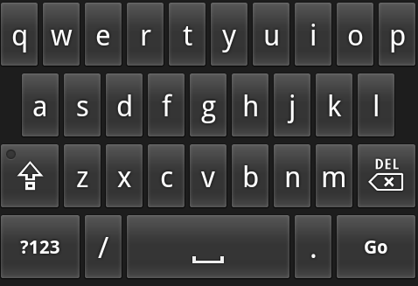
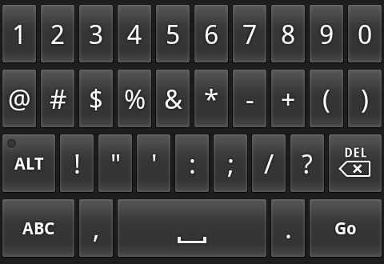
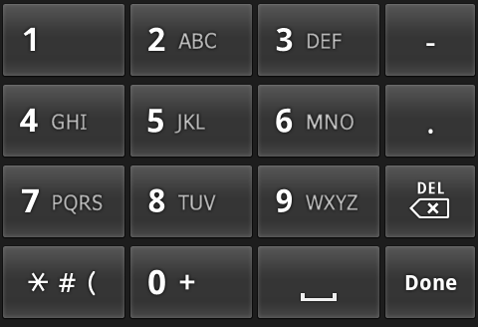
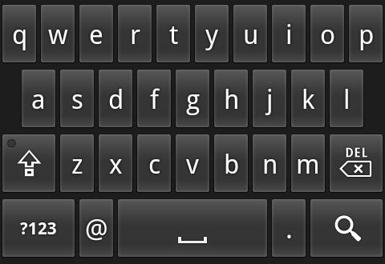
Keyboard Types - Android
KEYBOARD_DEFAULT
KEYBOARD_NUMBERS_PUNCTUATION
KEYBOARD_URL
KEYBOARD_NUMBER_PAD
KEYBOARD_NAMEPHONE_PAD
KEYBOARD_PHONE_PAD
KEYBOARD_EMAIL
KEYBOARD_DECIMAL_PAD
Notes:
Differences are subtle
Numbers_Punctuation and Namephone_Pad are the same
Decimal_Pad not supported
Carrier themes will likely change the appearance of these

Slide 9
Return Key Options
supported returnKeyTypes
Titanium.UI.RETURNKEY_DEFAULT
Titanium.UI.RETURNKEY_GO
Titanium.UI.RETURNKEY_GOOGLE
Titanium.UI.RETURNKEY_JOIN
Titanium.UI.RETURNKEY_NEXT
Titanium.UI.RETURNKEY_ROUTE
Titanium.UI.RETURNKEY_SEARCH
Titanium.UI.RETURNKEY_SEND
Titanium.UI.RETURNKEY_YAHOO
Titanium.UI.RETURNKEY_DONE
Titanium.UI.RETURNKEY_EMERGENCY_CALL
Notes:
field.returnKeyType = Ti.UI.RETURNKEY_type
Return key options
Changes label and user expectation
When button is tapped, the return event of the input field is fired
Hint: you could capture return event and move focus to next field in a long form

Slide 10
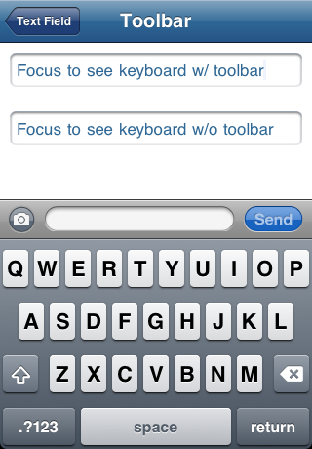
Keyboard Toolbars
iOS only feature
var textfield = Titanium.UI.createTextField({
color:'#336699',
value:'Focus to see keyboard w/ toolbar',
height:35,
width:300,
top:10,
borderStyle:Titanium.UI.INPUT_BORDERSTYLE_ROUNDED,
keyboardToolbar:[flexSpace,camera, flexSpace, tf,
flexSpace, send,flexSpace],
keyboardToolbarColor: '#999',
keyboardToolbarHeight: 40
});
Notes:
Define buttons separately prior
Assign object references to keyboardToolbar property
Add event listeners to those individual buttons

Slide 11
Using Web Views and HTML Forms
HTML is built for forms
Great automatic support for scrolling and “tabbing” between fields
HTML 5 forms:
Keyboard types set with <input type=type> www.w3.org/TR/html5/the-input-element.html#attr-input-type
Controlling the “viewport” http://bit.ly/sxiFMK
Form validation support
Notes:
HTML 5 includes many form-related additions
Keyboard types
Control size of page via the meta tag
HTML 5 form validation not fully supported across platforms

Slide 12
Q&A

Slide 13
Lab Goals
Use an HTML form and a WebView for data entry
Set appropriate keyboard types for each field
Transmit collected data back to native land so data can be saved to a database
Demo & Wiki URL
Notes:
We want to add additional fields to the TiBountyHunter fugitive object. Let’s use a web view to create a nicer input form.
Demo: finished BountyHunter, new bounty form is built with HTML
Fields auto-scroll to remain visible
Next/previous buttons
13

Slide 14
Lab
Notes:
In TiBountyHunter, the add window is implemented as a web view. The lone HTML file in resources is used for the web view, and we use custom messages to pass data between the web view and the “native wrapper”. Show how we create the web view with the HTML page, and then how data is transferred back and forth from the web view. Also point out that fields are automatically scrolled about in the web view.

