Slide 1


Orientation and Gestures
Notes:
Module time: 60 mins (30 mins teaching, 30 mins lab)

Slide 2
Agenda
Device orientation
Gestures
Notes:
2

Slide 3
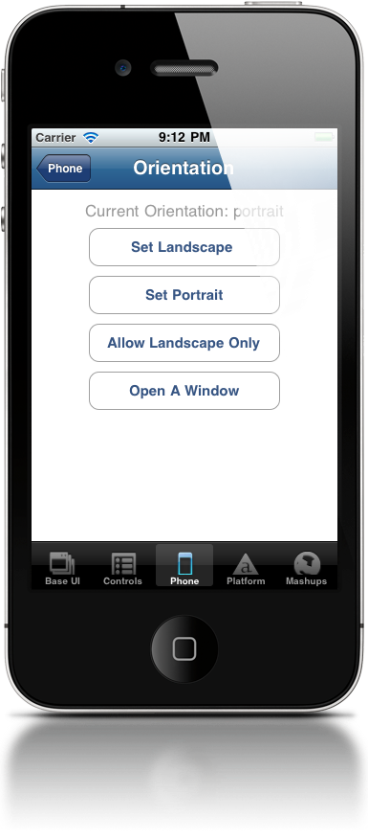
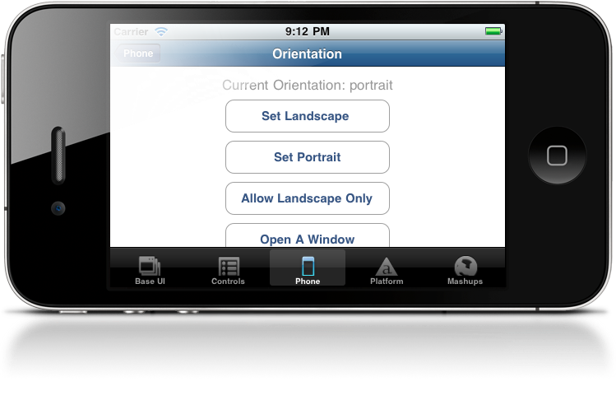
Device orientation
Locking orientation
Fixing orientation per window
Handling orientation events
Notes:
Three ways to deal with orientation:
Lock the orientation for the entire app
Setting a fixed orientation for specific screens within your app (e.g. one screen in portrait and another in landscape, but those are locked)
Actively updating your app’s UI based on the current orientation by handling orientation events

Slide 4
Locking orientation
iOS – tiapp.xml
Android – three options
Support upside-down and left/right
Notes:
Demo / sample code on next slides, this is just an intro slide
Consider supporting upside down with portrait orientations
and both landscape left and right

Slide 5
Locking Orientation - iOS
In tiapp.xml:
<iphone>
<orientations device="iphone">
<orientation>Ti.UI.PORTRAIT</orientation>
<orientation>Ti.UI.UPSIDE_PORTRAIT</orientation>
</orientations>
<orientations device="ipad">
<orientation>Ti.UI.PORTRAIT</orientation>
<orientation>Ti.UI.UPSIDE_PORTRAIT</orientation>
<orientation>Ti.UI.LANDSCAPE_LEFT</orientation>
<orientation>Ti.UI.LANDSCAPE_RIGHT</orientation>
</orientations>
</iphone>

Slide 6
Locking Orientation - Android
Option 1 - tiapp.xml:
- Copy code from build/android/AndroidManifest.xml
- Add <android> and nested <manifest> tags
- remove “|orientation” from every node
<android xmlns:android="http://schemas.android.com/apk/res/android">
<manifest>
<activity
android:name="org.appcelerator.titanium.TiActivity"
android:configChanges="keyboardHidden"
android:screenOrientation="portrait”
/>
<activity android:name="ti.modules.titanium.ui.TiTabActivity"
android:configChanges="keyboardHidden"
/>
</manifest>
</android>

Slide 7
Locking Orientation - Android
Option 2 - Android manifest file
- Copy build/android/AndroidManifest.xml to
Resources/android/AndroidManifest.xml
- remove “|orientation” from every node
<activity
android:name="org.appcelerator.titanium.TiActivity”
android:configChanges="keyboardHidden”
android:screenOrientation="portrait”
/>
<activity android:name="ti.modules.titanium.ui.TiTabActivity"
android:configChanges="keyboardHidden”
/>

Slide 8
Locking Orientation - Android
Option 3 - Android manifest file – deprecated
- Copy build/android/AndroidManifest.xml to
build/android/AndroidManifest.custom.xml
- remove “|orientation” from every node
<activity
android:name="org.appcelerator.titanium.TiActivity”
android:configChanges="keyboardHidden”
android:screenOrientation="portrait”
/>
<activity android:name="ti.modules.titanium.ui.TiTabActivity"
android:configChanges="keyboardHidden”
/>
Notes:
This method is deprecated in favor of the Resources/android/AndroidManifest (option 2) technique
However it is the most sure-fire method

Slide 9
Fixed Orientation
Per “screen” basis
Use Ti.UI.orientation = orientation
Supported values include:
PORTRAIT / UPSIDE_PORTRAIT
LANDSCAPE_LEFT / LANDSCAPE_RIGHT
FACE_UP / FACE_DOWN
For example:
Ti.UI.orientation = Ti.UI.PORTRAIT
Notes:
You can set orientation on a per window basis within your app

Slide 10
Orientation Events
Ti.Gesture.orientationchange
Event properties and methods:
Ti.Gesture.addEventListener('orientationchange',function(e) {
// get current device orientation from
// Titanium.Gesture.orientation
// get orientation from event object
// from e.orientation
// two methods return Boolean
// e.source.isPortrait()
// e.source.isLandscape()
});

Slide 11
Handling Orientation Changes
React to orientation change via event listener
Move and rotate UI elements
Might swap graphics and elements

Slide 12

Gestures

Slide 13
Gestures
Shake
Swipe
Touch start, end, move, and cancel
Long press
Pitch, roll, and yaw

Slide 14
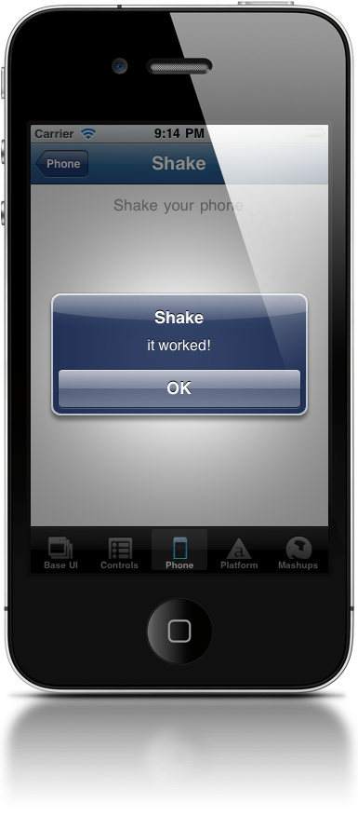
Shake
Ti.Gesture.shake
Event object properties
Ti.Gesture.addEventListener('shake',function(e) {
alert(’it worked!');
});
Notes:
timestamp is probably the only useful property
It notes time since last shake
Useful for not over reacting to shakes (delay before counting as a new shake event)

Slide 15
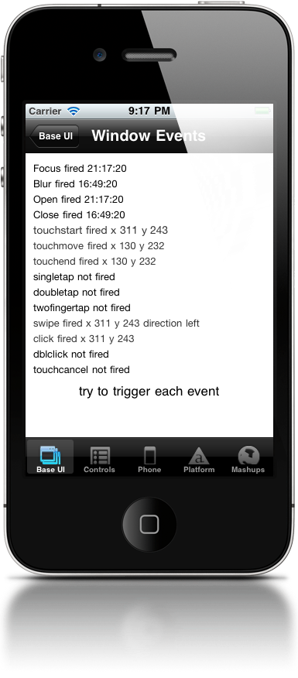




Swipes
Built-in event on most Ti.UI elements
Event object properties:
direction
source
x/y coords
swipe
Notes:
Swipe supported on pretty much all Ti.UI components
Most likely to be used on views, windows, tableviews, imageviews, labels, web views
Key object properties are direction (left or right) and source

Slide 16
Touches
Built-in event on most Ti.UI elements
Subtypes: touchstart, touchmove, touchend, touchcancel
Event object properties:
source
x/y coords
touchmove fires continuously
Notes:
touchcancel fired when your app is interrupted (phone call)
Use x/y coordinates to determine direction

Slide 17
Long press
Not natively supported
Simulate by tracking touchstart and touchend
https://gist.github.com/1019105
Faking long press in Android
https://gist.github.com/1018107
Long press to delete table row

Slide 18
Accelerometer
Use accelerometer to track pitch, roll, and yaw
Not all devices include necessary hardware
Kitchen Sink demo
Notes:
Demo must be run on a device
Phone > Accelerometer
Resources/examples/accelerometer.js

Slide 19
Q&A

Slide 20
Lab Exercise

