Slide 1
Claims Auto-Adjudication Engine
7
A hybrid rule-engine and LLM system for ReAssure 3.0 health claims
gates
[YOUR NAME] · [ROLL NUMBER]
Industrial training at [ORGANISATION NAME] · [INTERNSHIP DATES]
Mentor: [INDUSTRY MENTOR NAME] · Guide: [FACULTY GUIDE NAME]
Notes:
Introduce yourself and the organisation. One-line summary: I built an engine that reads a health-insurance claim and decides what is payable under the ReAssure 3.0 policy, using exact rules for the money and an LLM only where clinical language must be understood, with humans handling anything uncertain.

Slide 2
Why claims need automating
2,600+
92
3 + 7
lines of policy wording a processor must apply correctly
product rules across covers, exclusions, waiting periods and money
variants and optional covers, plus lifetime features that carry state between claims
Today a processor reads each claim against the wording by hand
Slow: tight regulatory timelines for cashless decisions
Inconsistent: two processors can decide the same claim differently
Hard to explain: reasons are not recorded step by step
Error-prone arithmetic: pro-rata, stacked co-pays, waterfalls across three SI pools
Notes:
Set up the problem. ReAssure 3.0 is a feature-rich product: Classic, Select and Elite variants, riders like Borderless and Tiered Network, and features like ReAssure Forever and Lock the Clock that depend on earlier claims. Manual adjudication is slow, inconsistent and hard to audit.

Slide 3
What I set out to build
1
2
3
Rules as data
Exact money
LLM for language
Encode the policy wording as 92 versioned rule blueprints
Deterministic, property-tested calculators for every rupee
Clinical judgement only, with validated JSON output
4
5
6
Safe routing
Full audit trail
Usable product
Uncertain or incomplete claims go to the right human queue
Every rule, tool call, prompt and reply recorded
Streaming API and a console a claims team can demo
Notes:
Six objectives. Emphasise the split: money and dates are computed exactly; the LLM only judges language; anything uncertain goes to a person.

Slide 4
Where the engine sits in a claim's life
Intimation
Documents
Adjudication
Settlement
Hospital or member raises the claim
→
Bills, discharge summary; extracted upstream
→
This project: admissibility and payable amount
→
Policy Administration System revalidates and pays
Input: one claim line item plus policy, member, history, porting, network, balances, lifetime state and endorsements (assembled from 8 upstream APIs). Output: approve, partially approve, reject or refer, with every step explained.
Notes:
Scope: the product, policy and member validation layer. Extraction of bills and medical coding happen upstream; PAS is the final authority. The engine takes one context object and returns one decision object.

Slide 5
Hybrid approach: each part does what it is good at
1
2
3
Deterministic rules
Language model
Human reviewer
Eligibility, dates, waiting periods, room-rent pro-rata, co-pay, deductible, sum-insured waterfall
Reads diagnosis and discharge summary: is it cosmetic? maternity? diagnostic-only? rest cure?
Low confidence, invalid AI output, missing data or conflicting rules
Exact · auditable · testable
Structured JSON · confidence score
Four review queues
Money is never computed by the LLM; the LLM never has the final word when it is unsure.
Notes:
Explain why hybrid. A pure rule engine cannot read a discharge summary. A pure LLM can be confidently wrong and cannot be trusted with exact arithmetic. So the LLM only answers language questions, and humans take anything uncertain.

Slide 6
Execution: phased, specification-driven, test at every step
LATE MAY
WEEK 1
WEEK 2
WEEK 3
Domain study
Deterministic core
AI layer
Hardening
Policy wording, TSD, rule JSON
Schemas, 8 calculators, 7 gates
Product memory, DAG planner, LLM agent
Logger, telemetry, property tests
WEEK 4
WEEK 5
WEEK 6–7
FINAL
Integration
Product UI
Refactor & state
Hardening
8 gateways, PostgreSQL, Docker
Live SSE, OCR upload, AI summaries
Gate modules, Forever state, handover
Groq, batching, 10 scenarios, fixes
Every rule, every phase:
Analyse clause
→
Encode as data
→
Implement
→
Test
→
Read the trace & fix
Notes:
Execution methodology, the 20-mark component. Phase 1 was deliberately AI-free so the numbers could be checked by hand; AI came in Phase 2. Each rule went through the same loop: analyse the clause, encode it as data, implement, test, then read the trace. The last phase, final hardening, ran ten scenarios on the live LLM and fixed what they exposed.

Slide 7
From policy clause to rule blueprint
Field | Value
rule_id | R3_EXCL_007
gate | exclusion_validation (Gate 5)
execution_type | HYBRID: keyword check, then LLM
variants | Classic · Select · Elite
depends_on | waiting-period rules
prompt | rule + exceptions + claim facts
output | status · reasoning · confidence
Policy wording, clause 5.1.7
“Expenses for cosmetic or plastic surgery or any treatment to change appearance unless for reconstruction following an Accident, Burn(s) or Cancer or as part of medically necessary treatment to remove a direct and immediate health risk to the insured.”
→
Exceptions are where manual and naive keyword processing go wrong; a rhinoplasty after an accident must be paid.
Notes:
Show how one clause becomes data. The rule's exceptions go into the prompt; the dependencies place it in the DAG. Keeping rules as data means a product change ships as a new versioned JSON file, not a code change.

Slide 8
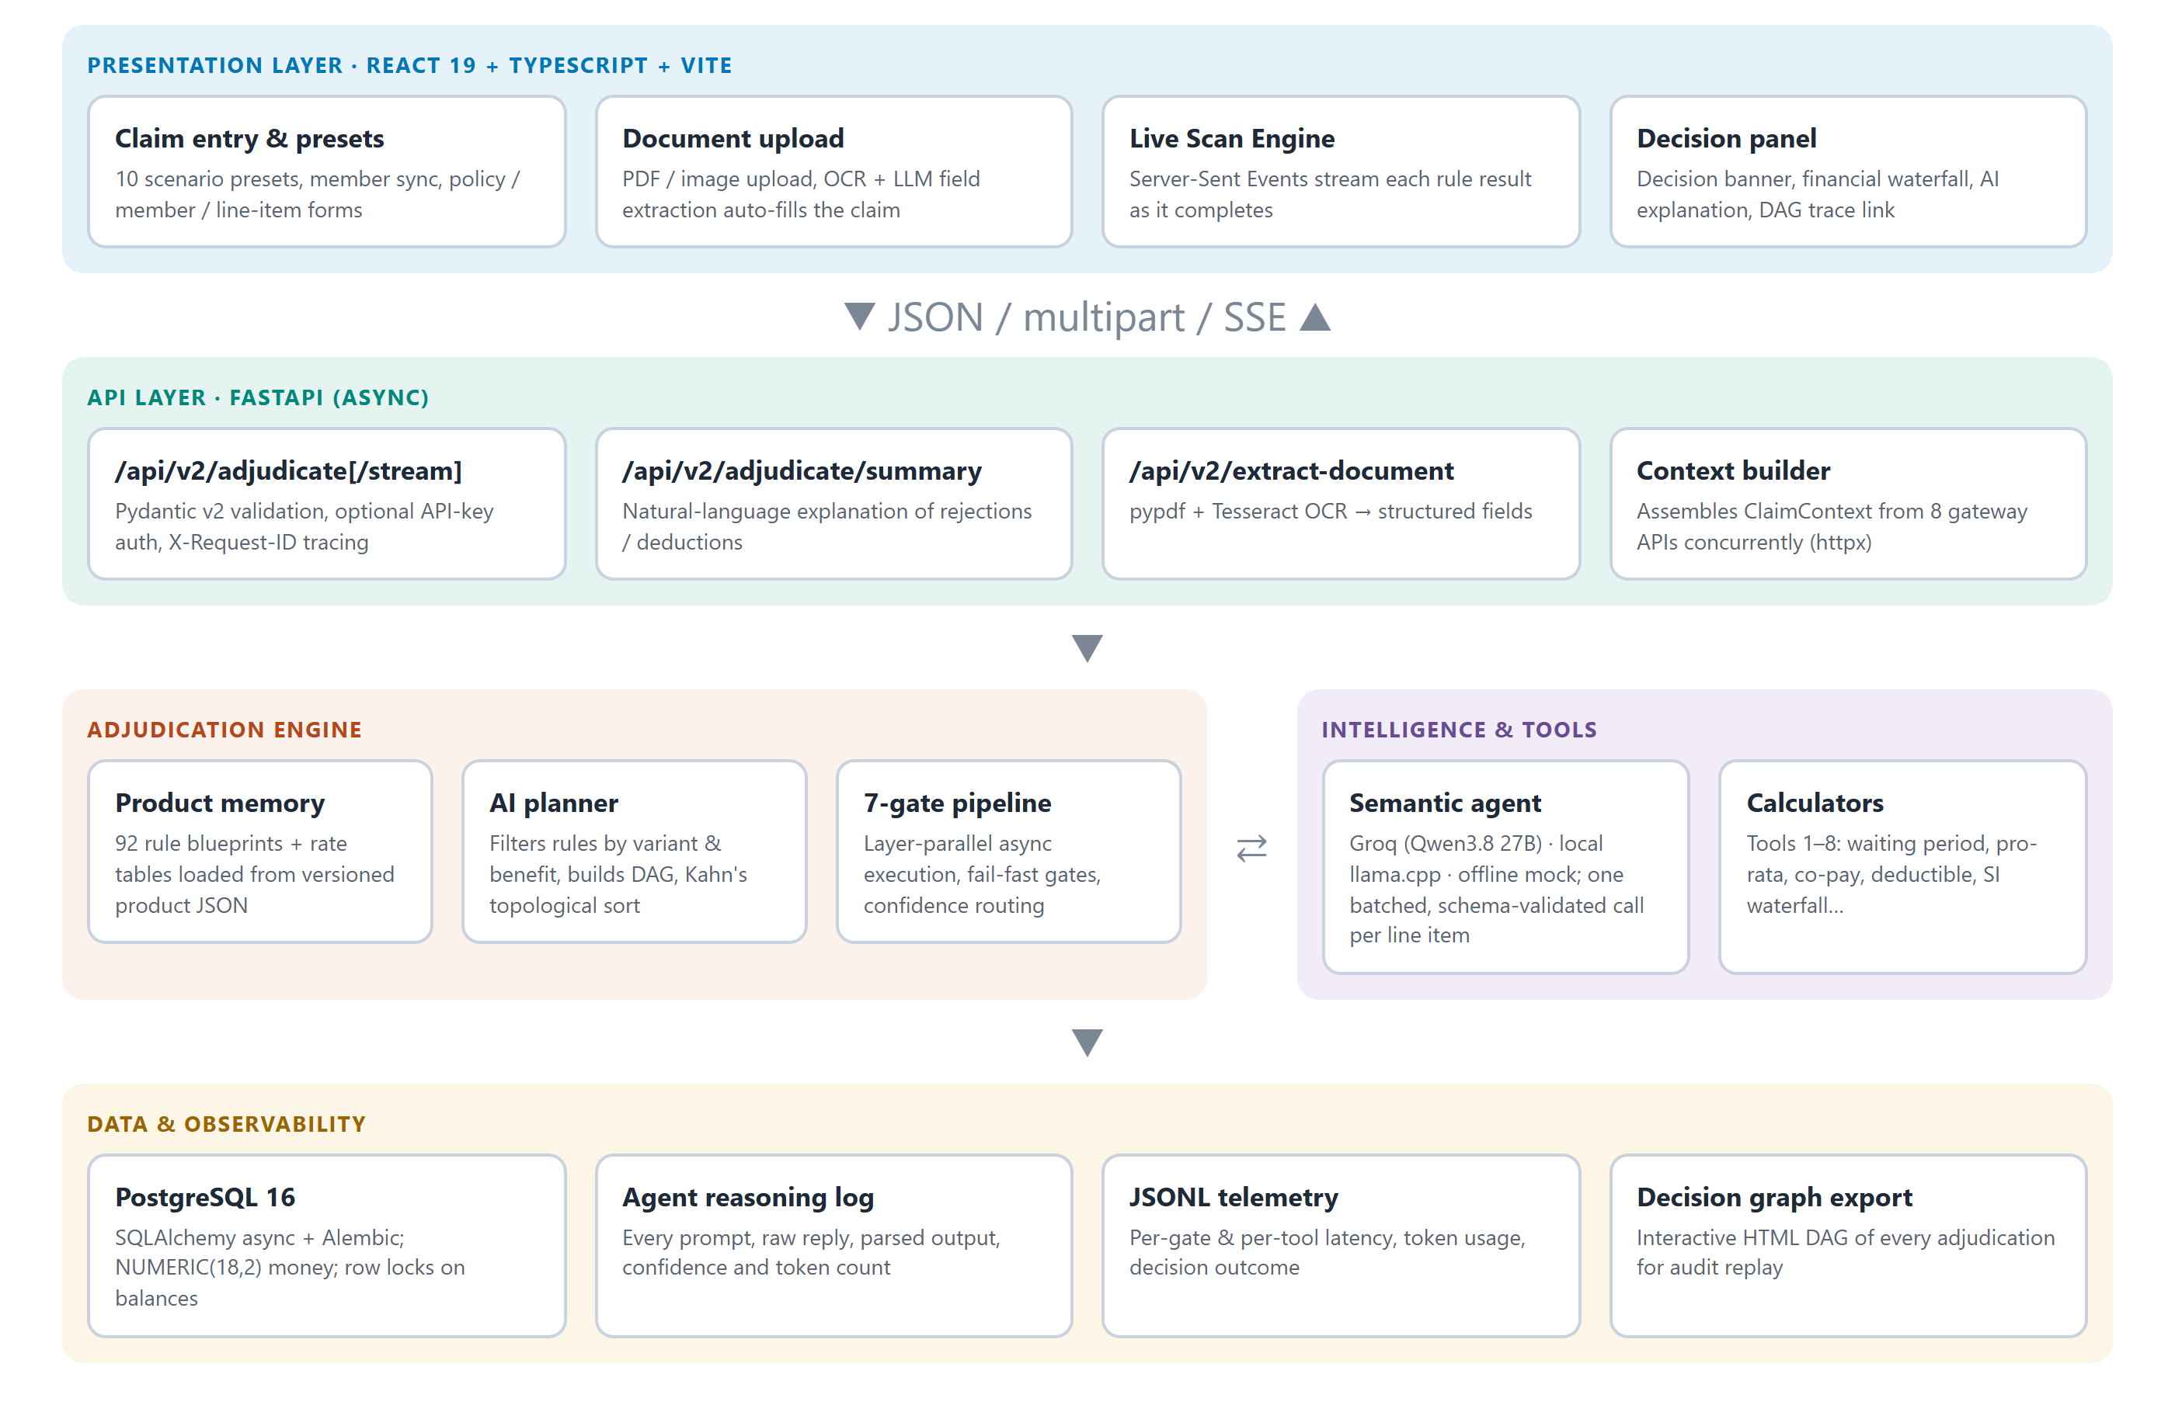
System architecture
Notes:
Walk top to bottom: React console; FastAPI with SSE streaming; the engine (product memory, planner, pipeline); the semantic agent and calculators; PostgreSQL plus the audit and telemetry records.

Slide 9
AI planner: the right rules, in the right order
Layer 1
Layer 2
Layer 3
Layer 4
Layer 5
Layer 6
Layer 7
How it works
Keep rules for this variant and benefit; drop riders not bought
depends_on links become graph edges
Kahn's topological sort with a priority queue (gate, priority, id): same claim, same plan
Group by DAG depth; run each layer with asyncio.gather and stream results live
Cosmetic
Initial wait
Policy
Member
Coverage
Maternity
Pro-rata
Co-pay
PED wait
Rest cure
Steps in the same layer run concurrently
Notes:
The planner turns the rule set into an execution plan per line item. Kahn's algorithm gives a valid order; the priority queue makes it deterministic so the audit can be replayed. Independent rules at the same depth run in parallel.

Slide 10
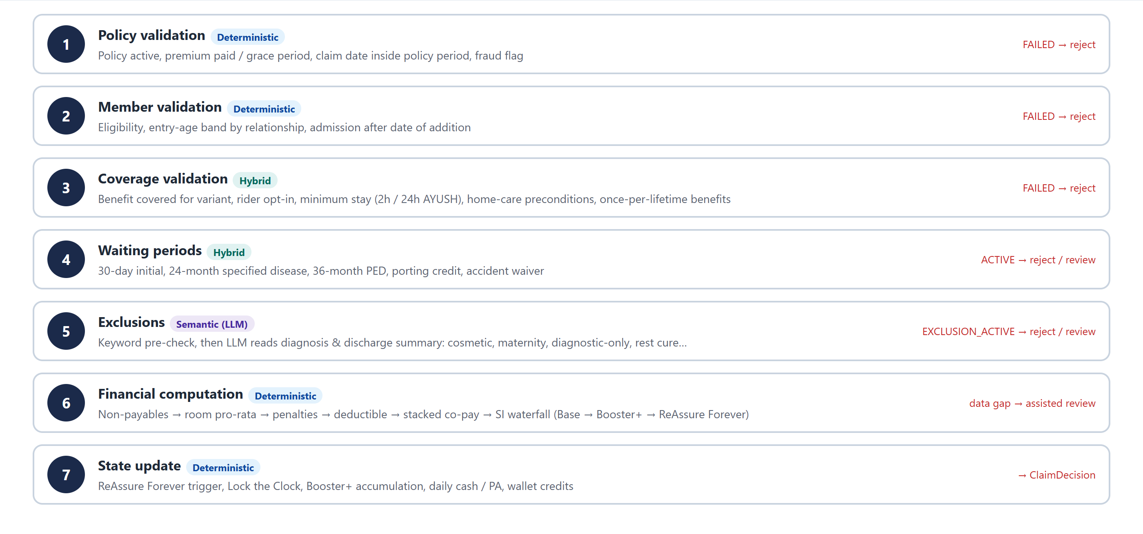
The seven-gate pipeline: fail fast, compute exactly
Notes:
Each gate can stop the claim with a reason. Gates 1 and 2 run before anything else, so a lapsed policy is rejected immediately. Gate 6 computes the money in the order the design specifies: non-payables, room pro-rata, penalties, deductible, stacked co-pay, then the sum-insured waterfall.

Slide 11
Using the LLM safely
1
Strict contract
Rule, exceptions and claim facts in the prompt; JSON-mode reply with status, reasoning and confidence
Batched screening
11 → 1
2
Validate everything
Pydantic checks the reply; anything invalid becomes a review, never a decision
Repeatable
LLM calls per line item. All exclusion rules are judged in one call; any rule the batch misses falls back to its own call. A claim now takes about 1.5–3.5 s on the free tier.
3
Temperature 0, fixed seed, full prompt-and-reply log
4
Three providers
Groq Qwen3.8 27B (cloud) · llama.cpp Gemma 4 (on-premise) · offline mock
Notes:
The LLM is treated as an unreliable component behind a strict contract. The batching change came from final testing: Groq's free tier allows 8,000 tokens per minute and one call per exclusion rule hit the limit, sending claims to review. One batched call per line item fixed it without changing the rest of the pipeline.

Slide 12
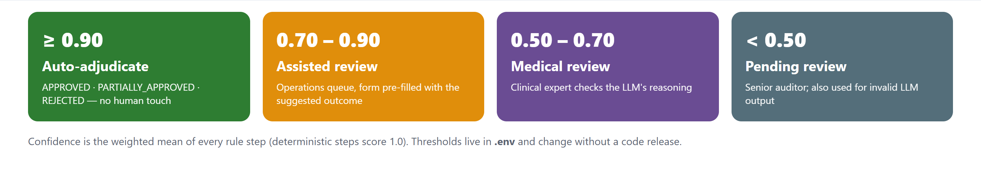
Confidence decides who decides
Gate 6 can also refer a claim directly when data needed for the maths is missing, e.g. the hospitalisation dates for a post-hospitalisation window. Thresholds live in .env and change without a release.
Notes:
Every step has a confidence; deterministic steps score 1.0. The weighted mean decides the queue. Automation handles clear cases and people get the rest, pre-filled with the suggested outcome.

Slide 13
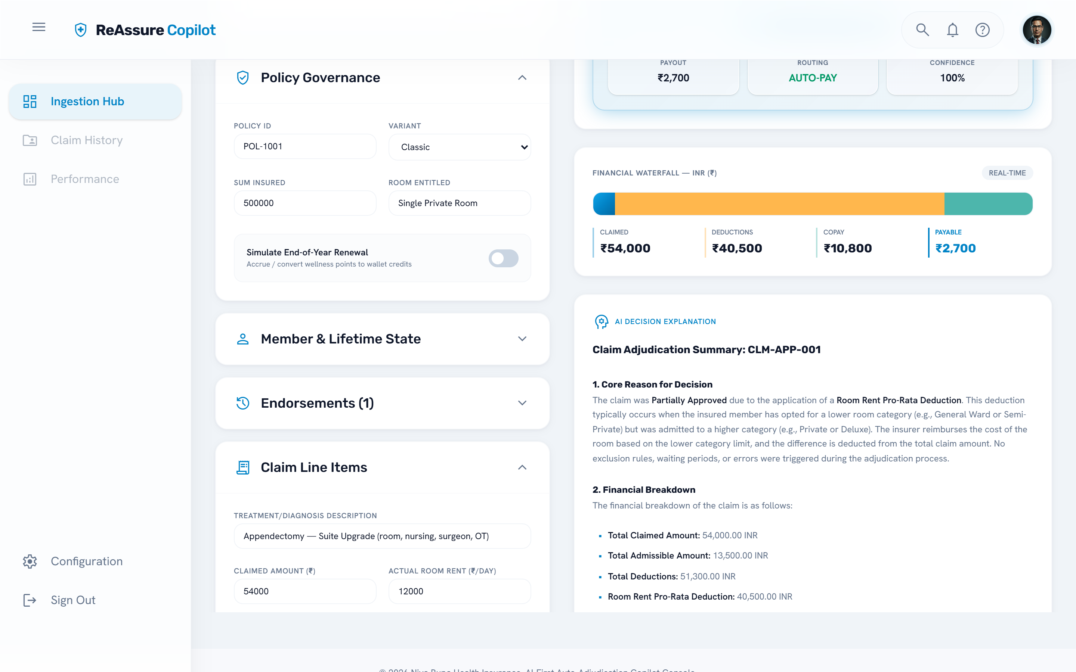
Demo: room-rent breach on the live LLM
Classic member, entitled to a single room, took a suite
Claimed ₹54,000
Pro-rata 3,000/12,000 = 0.25 → ₹40,500 deducted
Co-pay 80% stacked: 10% base + 50% room category + 20% tiered network
Payable ₹2,700, explained in plain language by the LLM
Notes:
If running live: start the backend with LLM_PROVIDER=groq, open the console, choose Case 1 and click Initiate Adjudication. Point out the live trace, the waterfall and the explanation. Offline fallback: LLM_PROVIDER=mock gives the same decision.

Slide 14
Ten scenarios, end to end, on the live LLM
Scenario | Decision | Claimed | Payable
Room-rent pro-rata breach | PARTIALLY APPROVED | ₹54,000 | ₹2,700
Lapsed policy | REJECTED | ₹80,000 | ₹0
Post-hospitalisation, missing dates | ASSISTED REVIEW | ₹8,000 | ₹0
ReAssure Forever waterfall | APPROVED | ₹12,00,000 | ₹12,00,000
Clean approval | APPROVED | ₹1,00,000 | ₹1,00,000
Multi-line, one item excluded | PARTIALLY APPROVED | ₹1,72,500 | ₹1,54,500
Deductible applied | PARTIALLY APPROVED | ₹50,000 | ₹40,000
Suite upgrade + co-pay | PARTIALLY APPROVED | ₹2,50,000 | ₹41,670
Porting credit waiver | APPROVED | ₹60,000 | ₹60,000
Tiered network penalty | PARTIALLY APPROVED | ₹1,20,000 | ₹96,000
77
automated tests passing, incl. property-based tests of the money
10/10
scenarios match the deterministic offline mode
~3 s
per claim on the free cloud tier
Notes:
All ten scenarios complete on Groq and give the same decisions as offline mode, so the LLM changed no outcome where the facts were clear. Scenario 3 shows the safety design: missing data means referral, not rejection.

Slide 15
Testing found what unit tests missed
Unit
calculators, gates
Fixed in final testing
Pro-rata deduction could exceed the claim → negative admissible, wrong rejection
Missing-data review request lost → ₹0 auto-rejection instead of referral
LLM cache keyed on a prompt prefix could reuse one claim's verdict for another
One LLM call per rule hit free-tier limits → batched screening
Repeated trace rows, misleading UI labels, a flaky test
Each fix has a regression test that fails on the old code
Property
Hypothesis: money conserved, ratios bounded, pools never negative
Scenario
whole claims, offline LLM
API / provider
endpoints, SSE, Groq, batching fallback
End to end
10 presets in a real browser on the live LLM
Notes:
Most defects were found by running full scenarios and reading the traces, not by assertions. Mention the pro-rata bug concretely: itemised expenses of 54,000 against a 34,000 claim gave a 40,500 deduction and a negative admissible amount.

Slide 16
Challenges and what I learnt
1
Prose to rules
2
Taming the LLM
Clauses have exceptions and cross-references; each needed careful reading and mentor review
Output contracts, validation and fallbacks matter more than the prompt wording
3
State and concurrency
4
Test like a user
Lifetime features need persisted state; parallel rules exposed shared-state bugs
End-to-end scenarios and trace reading caught what unit tests missed
Notes:
Keep this personal: what was hard and what you would do the same way again. The biggest lesson: decide what not to give the AI.

Slide 17
Conclusion and next steps
Delivered
92 rules, 7 gates, exact money, LLM only for language
Safe routing to four human queues; full audit trail
Cloud, on-premise and offline modes; live streaming console
77 tests; 10 scenarios verified on the live LLM
Next
Connect to live policy and member systems
Finish PAS reconciliation
Measure agreement with human processors on historical claims; calibrate thresholds
Reviewer workbench feeding decisions back
Host the model in-house on a GPU server
Notes:
Summarise what was delivered and what a production rollout would need next.

Slide 18
Thank you
?
Questions and live demo
Notes:
Invite questions. Have the console open with the backend running on Groq, and LLM_PROVIDER=mock ready as a fallback if the network fails.

