Slide 1
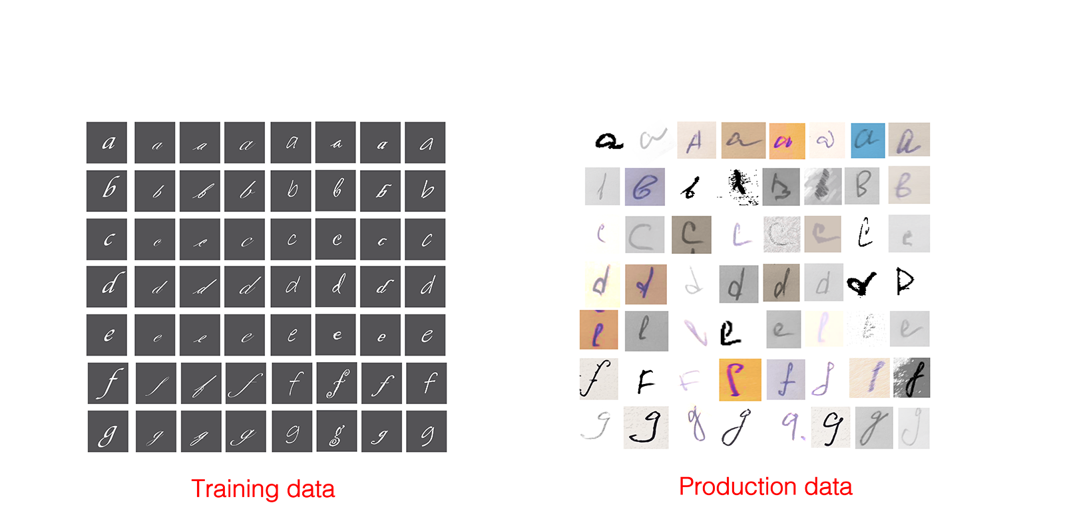
Why ? Model Monitoring
Train-serving skew: Model performing well during development but poorly after production
Training-serving skew

Slide 2
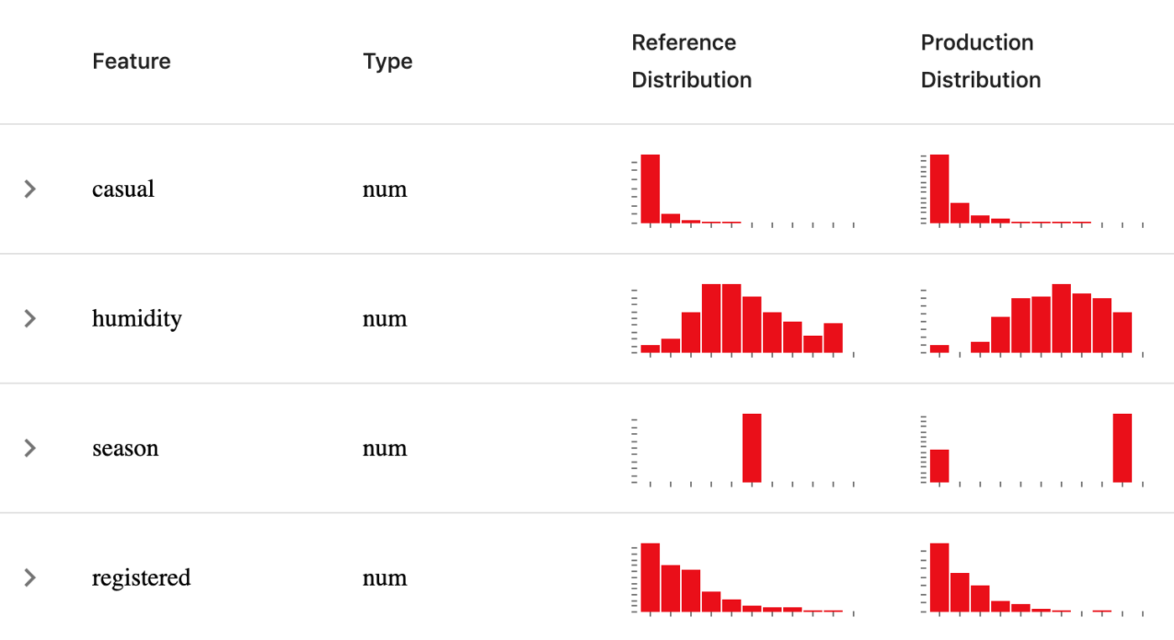
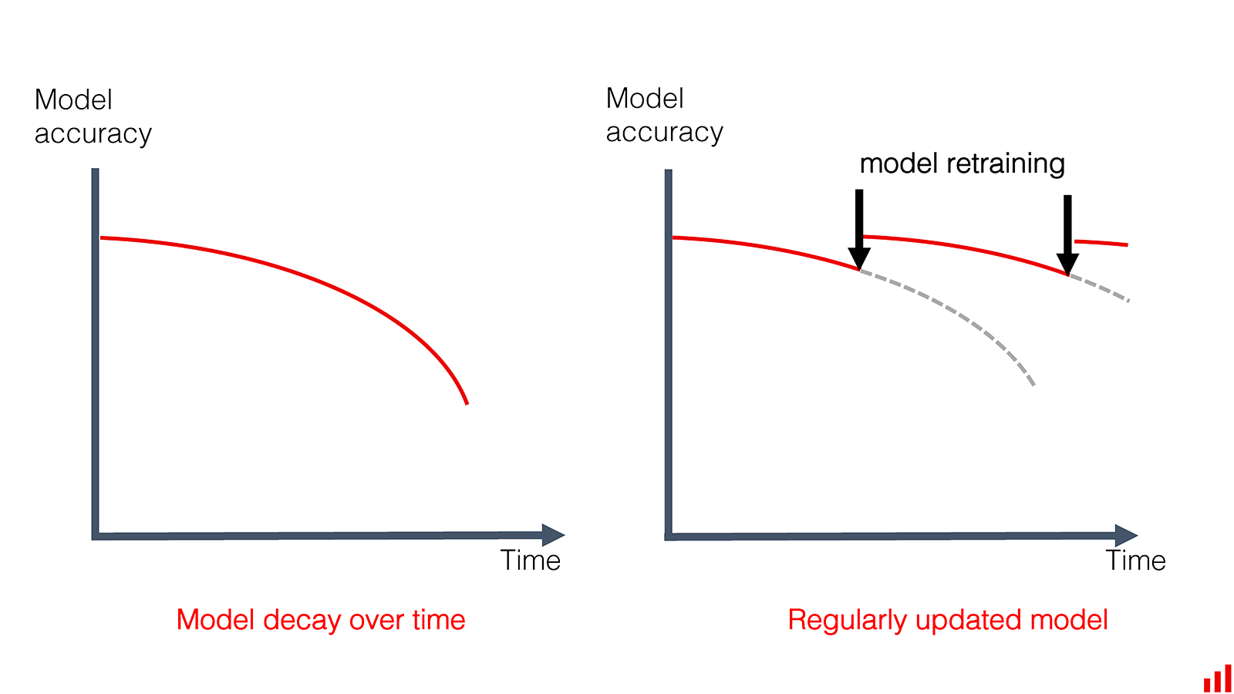
Why ? Model Monitoring
Train-serving skew: Model performing well during development but poorly after production
Data Distribution shifts: Model performing well when first deployed, but poorly over time
Covariate shift: input distribution shift
Label shift: prediction output distribution shift
Concept drift: the patterns the model learned no longer hold
Feature distribution in training and production
Model performance over time

Slide 3
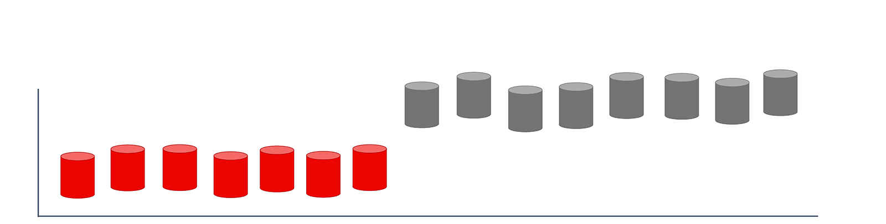
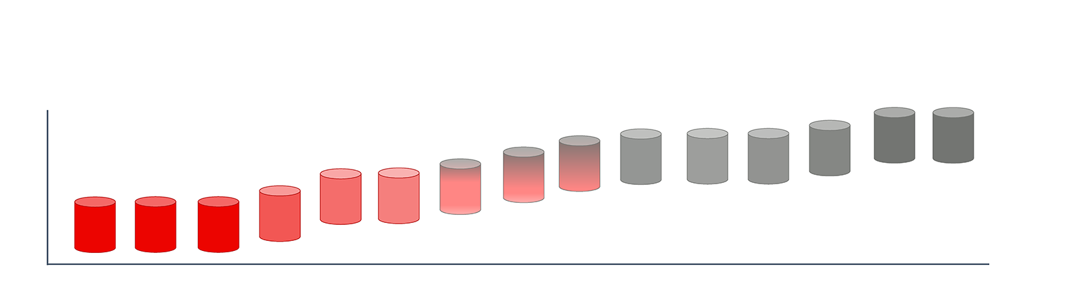
Why ? Model Monitoring
Type of Shift/Drifts
Sudden Shifts vs Gradual Shifts
Sudden shifts are easier to detect than gradual shifts
Spatial Shifts vs. Temporal Shifts
Spatial shift: application gets a new group of user, or your application is now served on a different type of device.
Temporal shift: same users, same devices, but behaviors change over time
Sudden Concept Drift
Gradual Concept Drift

Slide 4





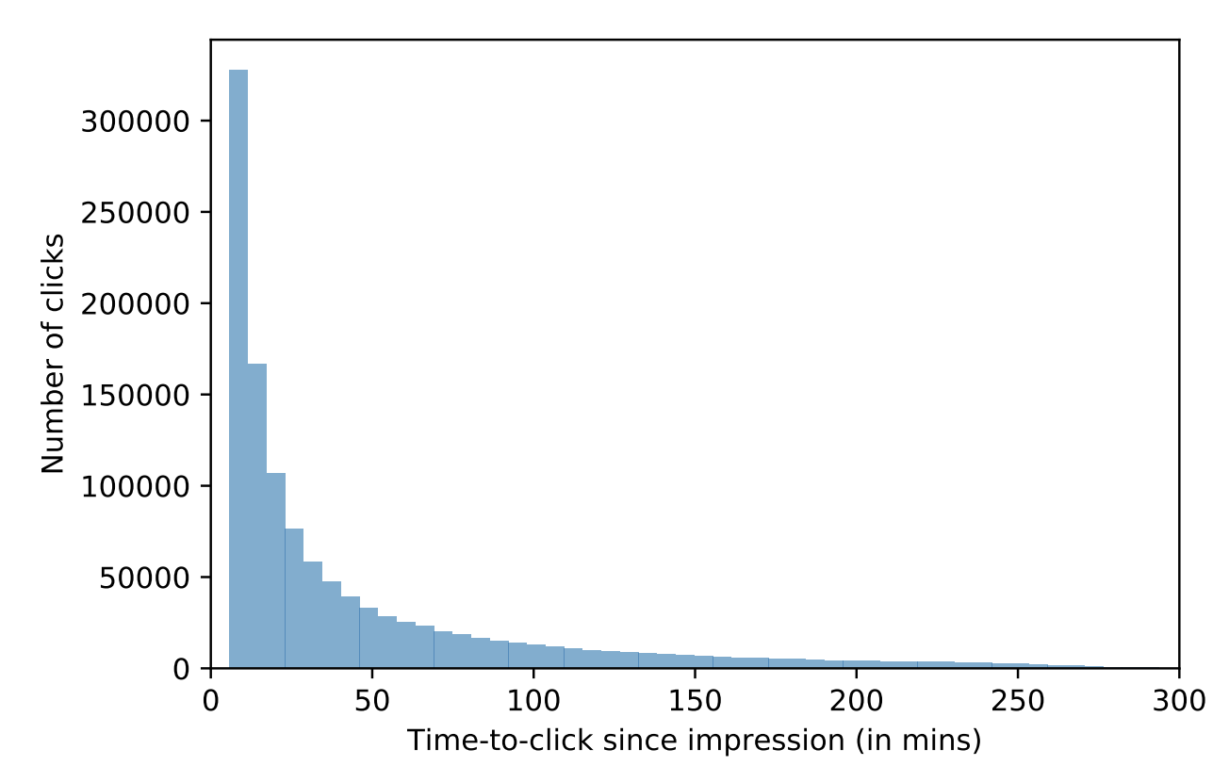
Method #1: Ground Truth Labels
Accuracy-related metrics to measure model performance work by comparing the model’s predictions to ground truth (GT) Labels
Model Version | Precision | Recall | F1 | ROC AUC
1
2
Alert policy: condition for alert
Notification channels
Description
Data Scientist
Relational
Non-Relational
Schema-less
Log & track user feedback for the predictions: click through, upvote, downvote, duration watch, etc.
For example – Recommender System:
Click → good rec
After X minutes, no click → bad rec

Slide 5
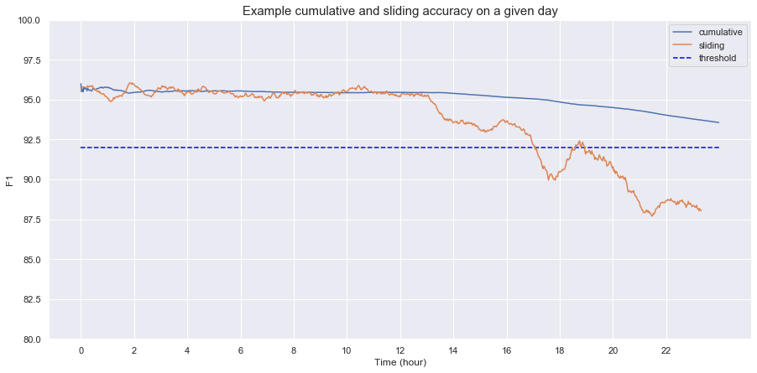
Method #1: Ground Truth Labels
Concern #1: Cumulative and Sliding statistics
Cumulative statistics contain information from previous time windows, they might obscure what happens in a specific time window
Cumulative accuracy hides the sudden dip in accuracy
Concern #2: GT labels might be unavailable or too delayed to be useful
Prediction is served
E.g. Transactions in 30 Nov will be roll-overed or not
GT Label is generated
20 Nov
Feedback loop length
30 Nov

Slide 6

Method #2: Statistical Methods
Methods to detect whether 2 distributions are the same/shifted:
Data Quality Test
Feature Space:
Numerical: mean, median, variance, quantiles
Categorical: unique, most common & most common value’s frequency, new/missing categories
Label Space:
Regression output → numerical
Classification output → categorical
Distribution Drift Test
Hypothesis Algorithms to determine whether the difference between two populations (two sets of data) is statistically significant.
It is highly recommended to reduce the dimensionality of the data before performing a two-sample test
Training Data
train
Test Data
test
Prediction
AC
OC
Day 1
inference
Prediction
Day 2
inference
Prediction
Feature Shift
Monitoring
Label Shift Monitoring

Slide 7
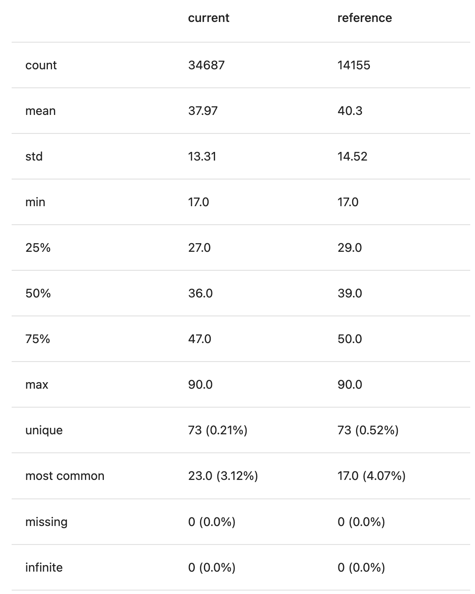
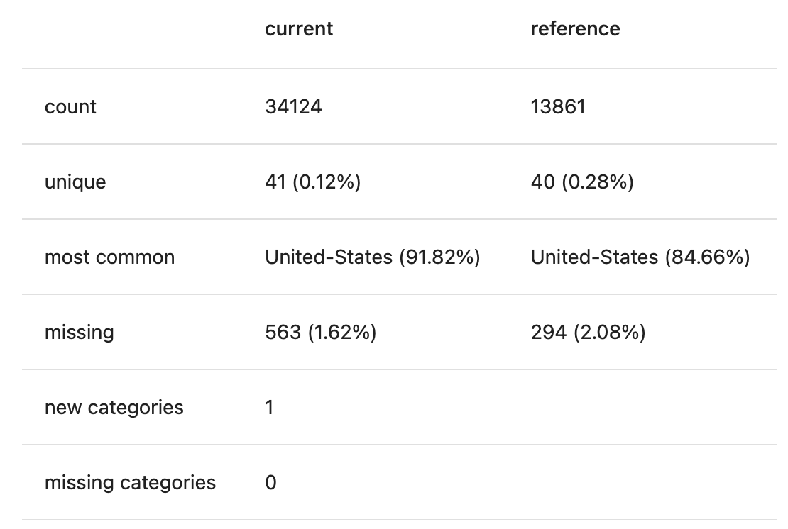
Method #2: Data Quality Test
Numerical Feature/Label
Categorical Feature/Label
E.g., Age feature
E.g., Country feature
Week 2
Week 1

Slide 8
Method #2: Distribution Drift Test
Algorithms | Categorical | Numerical
Kullback-Leibler Divergence (Relative Entropy) | ✓
Population Stability Index (PSI) | ✓ | ✓
Chi-square Small data with <= 1000 observations | ✓ n_unique > 2
Jensen–Shannon divergence Large data with > 1000 observations | ✓
Kolmogorov–Smirnov test Small data with <= 1000 observations | ✓ | ✓
Wasserstein distance Larger data with > 1000 observations |  | ✓
n_unique: the number of unique values in the feature
Notes:
KL: https://towardsdatascience.com/light-on-math-machine-learning-intuitive-guide-to-understanding-kl-divergence-2b382ca2b2a8
JS: https://medium.com/datalab-log/measuring-the-statistical-similarity-between-two-samples-using-jensen-shannon-and-kullback-leibler-8d05af514b15
W distance: https://towardsdatascience.com/earth-movers-distance-68fff0363ef2
Categorical: https://www.giskard.ai/knowledge/how-to-test-ml-models-2-n-categorical-data-drift?fbclid=IwAR1zkImItrAktMi8wNLq2vp8ShYpoZly5uX3YBILMln62lx-hS_r-otlE_8#kullback-leibler-divergence-relative-entropy

Slide 9
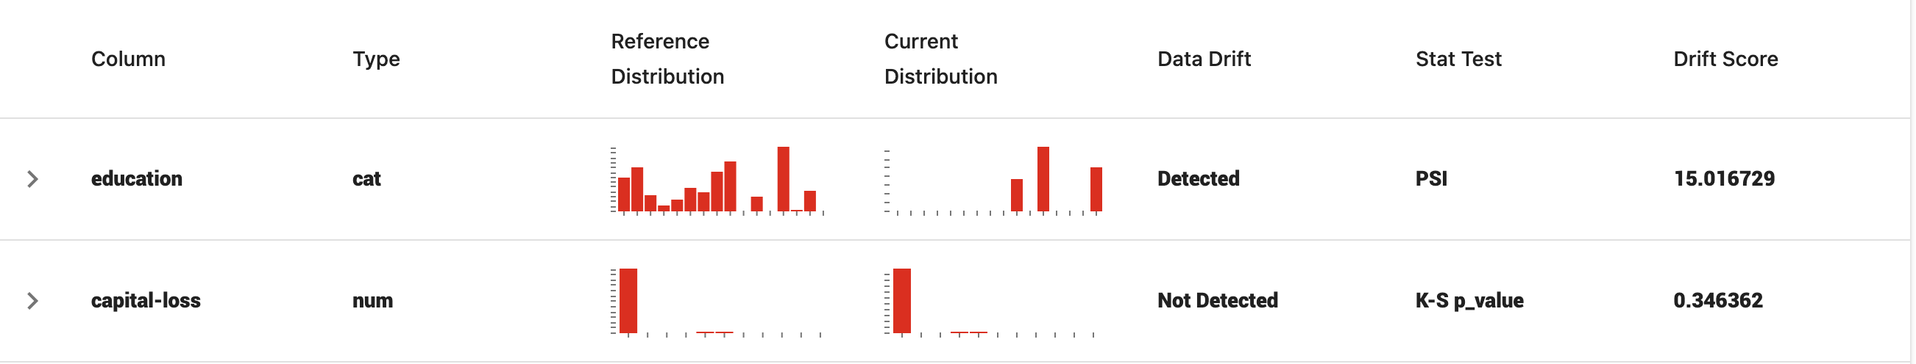
Method #2: Distribution Drift Test
Notes:
KL: https://towardsdatascience.com/light-on-math-machine-learning-intuitive-guide-to-understanding-kl-divergence-2b382ca2b2a8
JS: https://medium.com/datalab-log/measuring-the-statistical-similarity-between-two-samples-using-jensen-shannon-and-kullback-leibler-8d05af514b15
W distance: https://towardsdatascience.com/earth-movers-distance-68fff0363ef2
Categorical: https://www.giskard.ai/knowledge/how-to-test-ml-models-2-n-categorical-data-drift?fbclid=IwAR1zkImItrAktMi8wNLq2vp8ShYpoZly5uX3YBILMln62lx-hS_r-otlE_8#kullback-leibler-divergence-relative-entropy

Slide 10
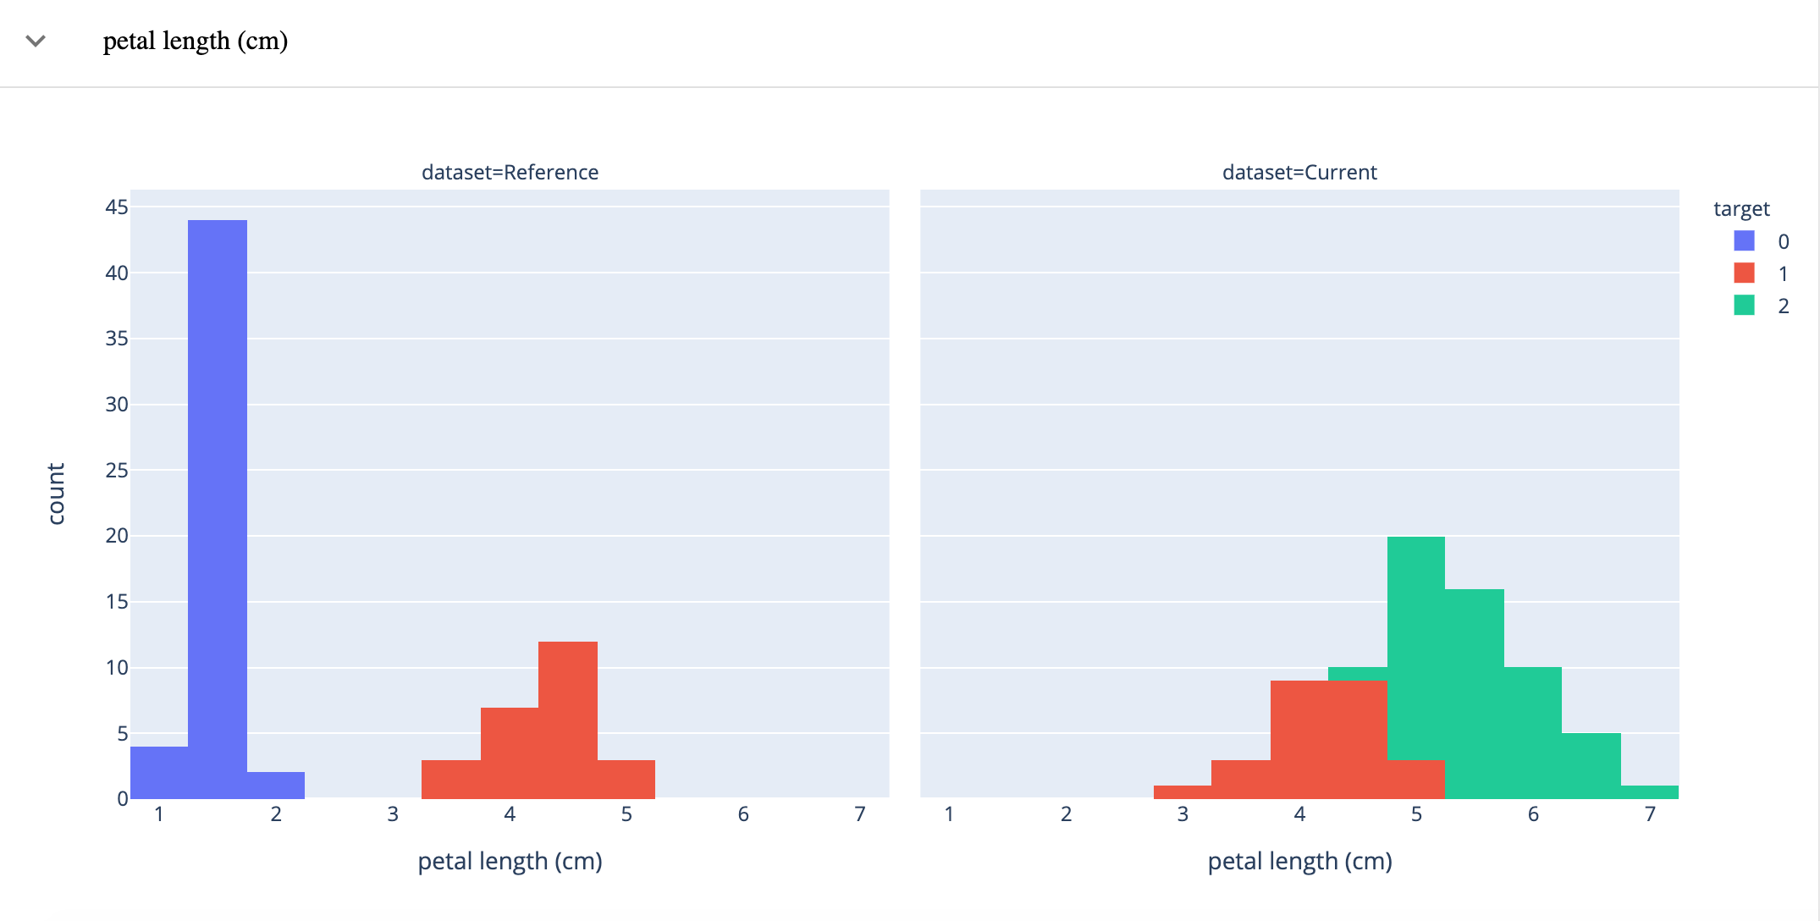
Method #2: Distribution Drift Test
How feature values relate to the target labels and identify the differences between the datasets
Recommend paying attention to the behaviour of the most important features since significant changes might confuse the model and cause higher errors.

Slide 11
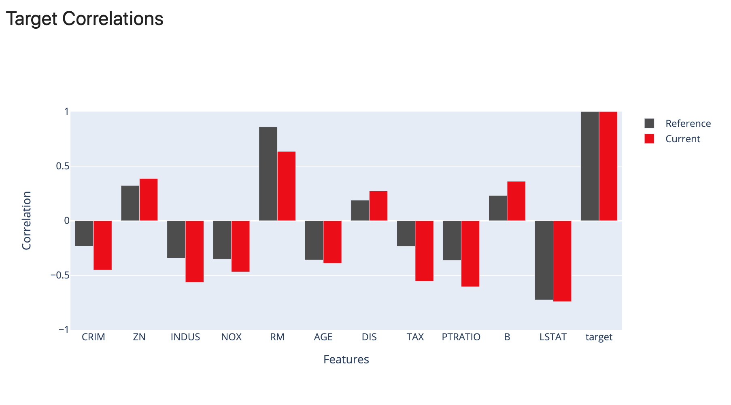
Method #2: Distribution Drift Test
How feature values relate to the target labels and identify the differences between the datasets
Recommend paying attention to the behaviour of the most important features since significant changes might confuse the model and cause higher errors.
Notes:
Reference: https://docs.evidentlyai.com/reports/num-target-drift

Slide 12
Method #2: Statistical Methods
Major concerns for Feature Monitoring
Concern #1: Expensive Computing
Hundreds of models in production, and each model uses hundreds of features
Concern #2: Tracking features is useful for debugging purposes, but not very useful for detecting model performance degradation
In practice, an individual feature’s minor changes might not harm the model’s performance at all
The problem of feature monitoring becomes the problem of trying to decide which feature shifts are critical and which are not → Feature Importance
Concern #3: Feature Generation is performed in multiple steps (ETL, Feature Engineering)
Hard to root-cause harmful change in a feature caused by a change in the underlying input distribution or by an error in one of the multiple processing steps.
Concern #4: Difference in Data Availability for Each Category is misled as Feature Shift
For example, in batch prediction, Product A has ~300 transactions per day, but in Day 100th, Product A is only traded 10 times only, so this might cause the difference in the overall statistic between Day 99th & Day 100th input batches
Day 99
inference
Prediction
Day 100
inference
Prediction

Slide 13
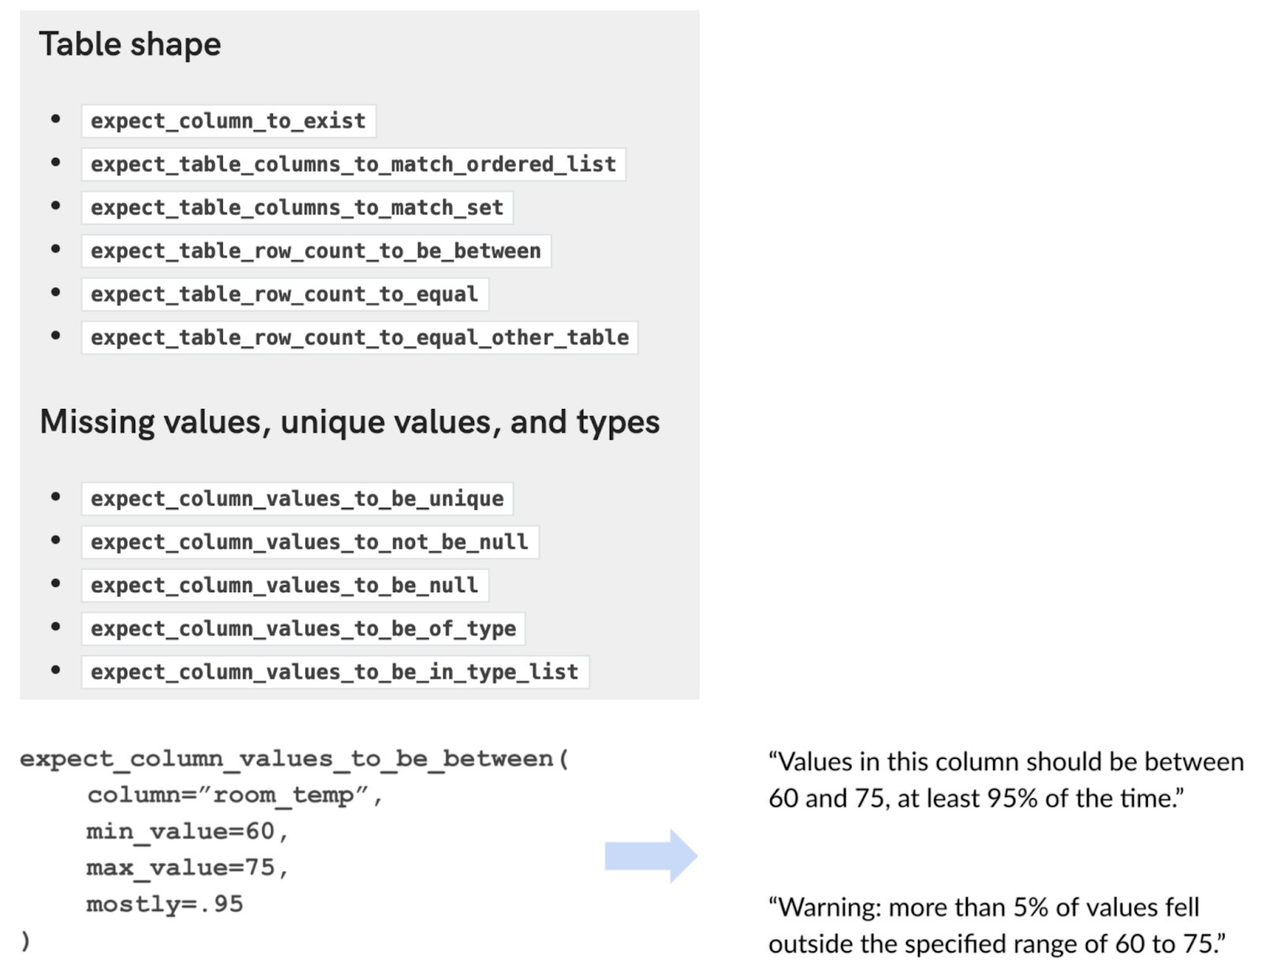
Method #3: Feature Validation
Feature validation: ensuring that your features follow an expected schema.
If these expectations are violated, there might be a shift in the underlying distribution.
For example, for a given feature, we can define Feature schema expectations:
If the min, max, or median values of a feature are within an acceptable range
If the values of a feature satisfy a regex format
If all the values of a feature belong to a predefined set
If the values of a feature are always greater than the values of another feature

Slide 14
Hay qua ong oi

