Slide 1



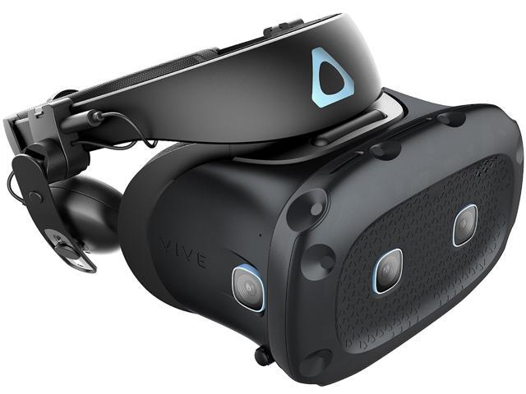
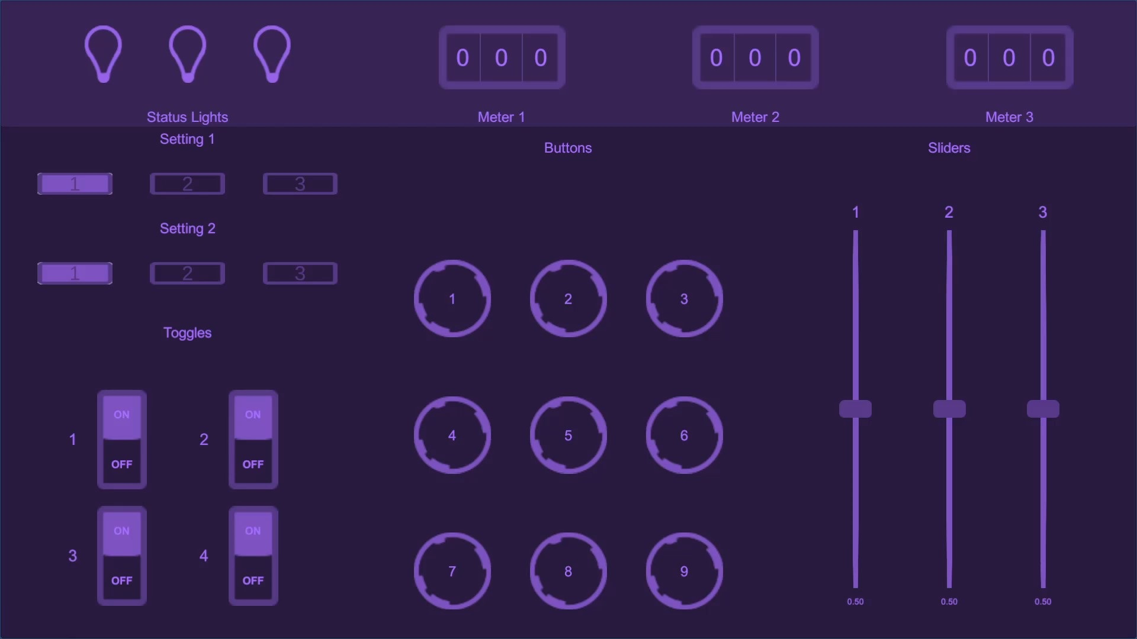
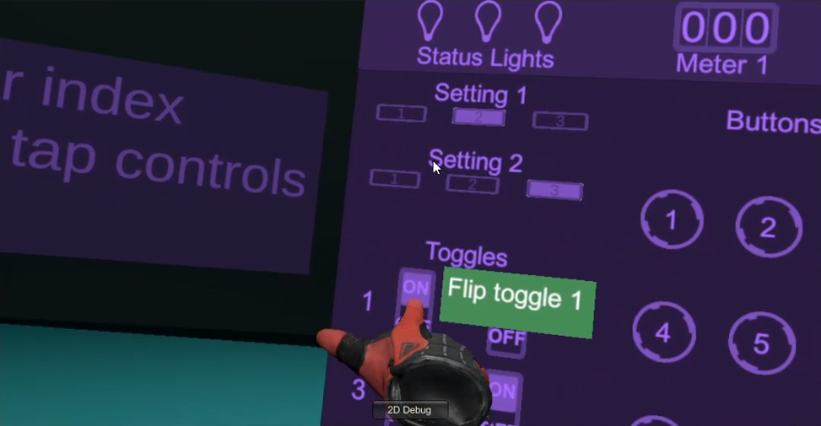
Optimized Learning
with Virtual Reality
Codey Winslow
Dr. Philip Howard
Oregon Institute of Technology
Project Goal
What is Virtual Reality?
The goal of the Optimized Learning with Virtual Reality project was to gather evidence on whether skills can be better learned using virtual reality technology over conventional media.
Virtual reality (VR) is a technology that allows a user to view a virtual world in 3D using a stereoscopic display headset with motion and position tracking
Users feel immersed in the environment
Hand tracking using VR controllers allow a higher degree of interaction with the virtual world
Project Process
Touchscreen Interface
Discussed and planned project scope and expectations, and designed experiment
Researched technologies and previous studies in the field
Designed application used in experiment
Prototyped, tested, and refined application
Refine experiment design
Acquire IRB approval for experiment
In progress: perform experiment and gather data
In progress: analyze and interpret data
Touchscreen in VR
Experiment
3 procedures for participants to learn
Experimental group learns using VR application
Control group learns by watching video
Participants must perform procedures by memory on touchscreen
Contact
Codey Winslow | codey.winslow@oit.edu
Dr. Phil Howard | phil.howard@oit.edu

