Slide 1



Day2
29-8-2020
Quantum Computation Community IISER-K

Slide 2

Topics
Vector Space
Qubit
Quantum Gates
Creating Classical Logical Gates.

Slide 3
Vector Space
A vector space is a set that is closed under finite vector addition and scalar multiplication.
vector addition:
If v, u ∈ V then v+u ∈ V where V is Vector Space
scalar multiplication:
If v ∈ V and c ∈ F then c*v ∈ V

Slide 4
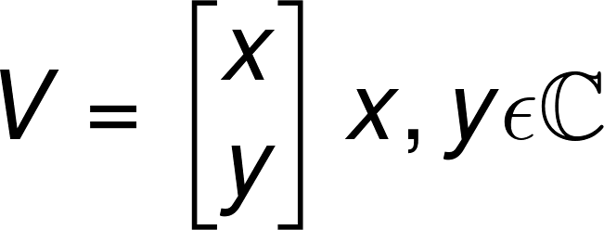

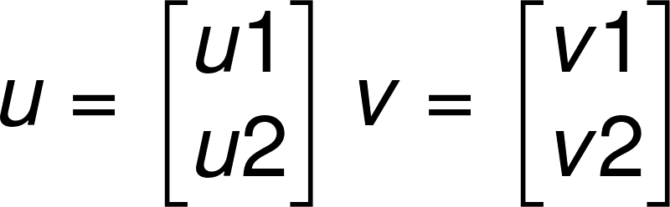


Vector Space
Let's see for a special vector space V defined as:

Slide 5
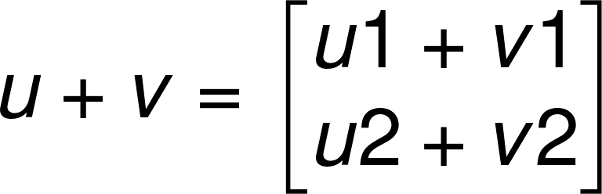
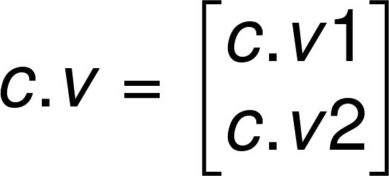
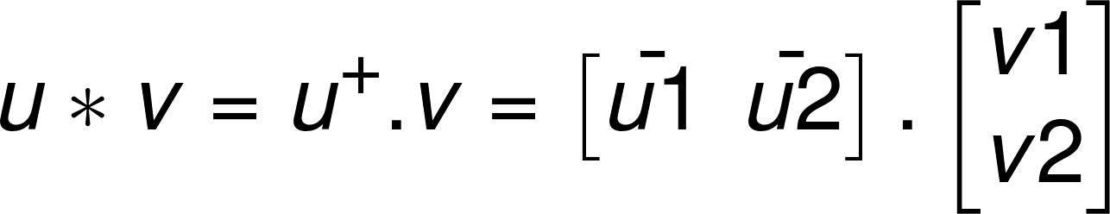

Vector Space

Slide 6
Vector Space
Find the basis set for V

Slide 7
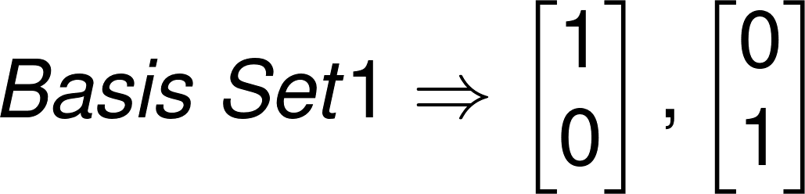
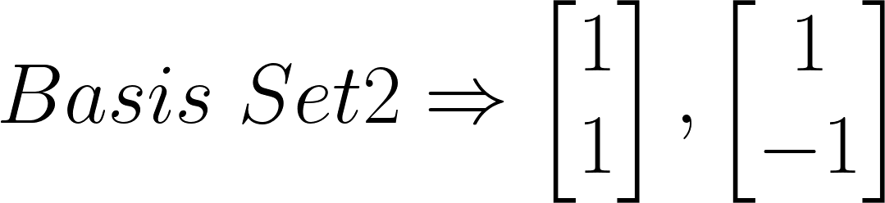
Vector Space
Find the basis set for V

Slide 8
Vector Space
Let's take a subset of V,
So Q⊆ V
Now, Q is defined as:
Q = {q | q∈ V , q*q = 1}
What's its BASIS set?
Is it the same of something different?

Slide 9
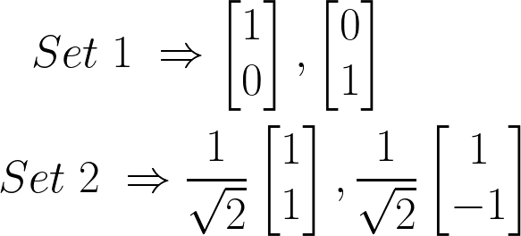
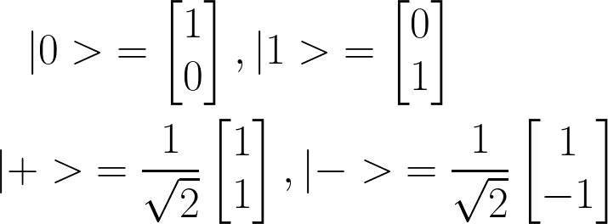
Vector Space
Basis of Q
Notation:

Slide 10
Qubit
More than the classical bit, qubit can stay in 1 or 0 and even in the combination of the two, aka superposition state.
What's a superposition state?
Representation of qubit.
Classical 0 is mapped to |0> and 1 to |1>
And the whole set Q is the set of all superposition state of qubit.

Slide 11
Qubit
Intresting videos on formation and working on qubits.
https://www.youtube.com/watch?v=zNzzGgr2mhk&t=329s
https://www.youtube.com/watch?v=ZuvK-od647c
https://www.youtube.com/watch?v=QuR969uMICM
https://www.youtube.com/watch?v=jDW9bWSepB0

Slide 12
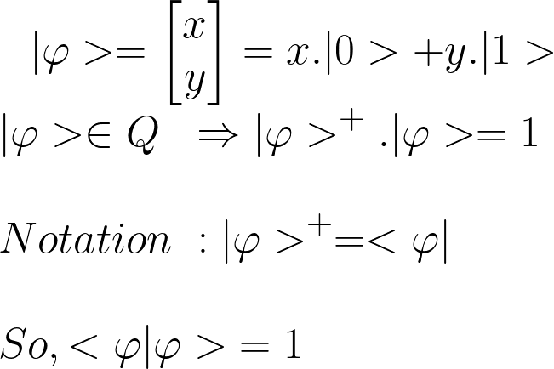
Qubit
Visualizing the state vector of qubit.

Slide 13
Qubit
Points to remember :
If Ψ(x) is the wave function of the quantum state and the probabity amplitude of the quantum state will be mod(Ψ(x)) ^2.
Here our |Ψ> is given by:
|Ψ> = x*|0>+y*|1>
So probability amplitude will be
For |0> Ψ(|0>) is x making probability of |0> to be x^2
For |0> Ψ(|1>) is y making probability of |1> to be y^2

Slide 14
Qubit
Points to remember :
If Ψ(x) is the wave function of the quantum state and the probabity amplitude of the quantum state will be mod(Ψ(x)) ^2.
Here our |Ψ> is given by:
|Ψ> = x*|0>+y*|1>
So probability amplitude will be
For Ψ(|0>) is x making probability of |0> to be x^2
For Ψ(|1>) is y making probability of |1> to be y^2

Slide 15
Qubit
So qubit can take any state from the set Q but a classical bit has only 2 states to be in. You can clearly see the advantage of working with the qubit.
In simple words a single qubit compared to classical bit has a huge computational advantage because of that.
Now with a bunch of qubits which can interact together these superposition states can interact in a constructive or destructive manner and we use these for our advantage.

Slide 16
How to manipulate Qubit
We do this using Quantum Gates.
There are bunch of gates for different types of interaction and change of state.

Slide 17
How to manipulate Qubit
We will start with some simpler ones and then get into the complex gates.
X Gate
CX Gate
CCX Gate
Then we will try to replicate classical gates on qubits.

Slide 18

X Gate
Let's start with the most basic gate : X Gate
Apply the X gate and the qubit state gets flipped.
|1> to |0> and |0> to |1>
If we start with a state |Ψ> = a*|0> +b*|1>
Applying X gate will change the state to
|Ψ>new = b*|0> +a*|1>

Slide 19
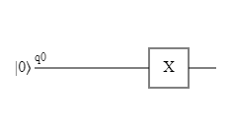
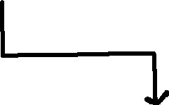




X gate

Slide 20
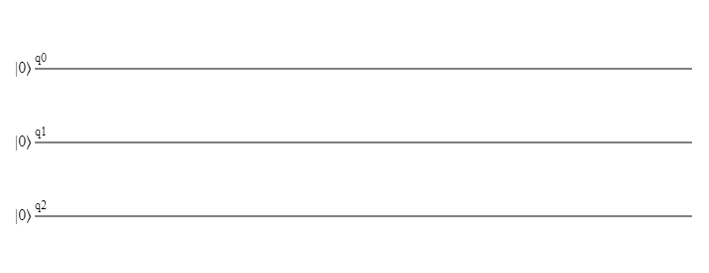
Multiple Qubits
How to represent multiple qubit.
We write the qubits together as |q2q1q0>

Slide 21
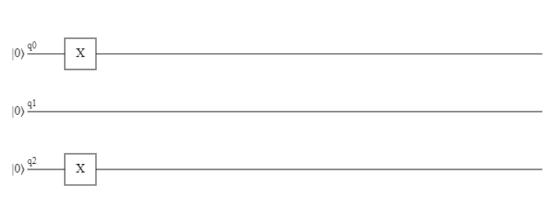
Multiple Qubits
How to represent multiple qubit.
|q2q1q0> gives us |101>

Slide 22
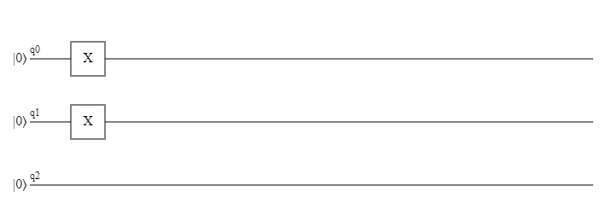
Multiple Qubits
How to represent multiple qubit.
|q2q1q0> gives us |011>

Slide 23

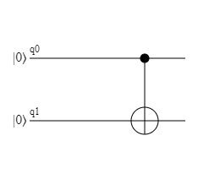

Cx gate
CX Gate is Controlled X gate. It has a control qubit and a target qubit.
Control Qubit
Target Qubit

Slide 24
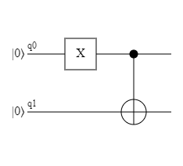
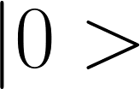
Cx gate
Whenever control qubit is in |1> state it flips the target qubit.
If the control qubit is |0> state, then it just leaves the target qubit as it was.
Target Qubit is not |1> so the control doesn't get activated
Target Qubit is in |1> so the control gets activated flipping the target qubit to |1>

Slide 25

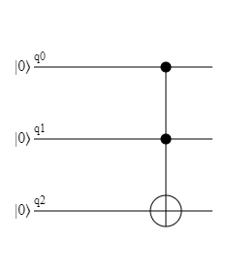
CCX gate
CCX is Controlled Controlled X Gate aka Double Control X Gate.
It has 2 control qubits and 1 target qubit.
When both the control qubits are in |1> state only then it flipes the target qubit.
Control qubit 1
Control qubit 2
Target qubit

Slide 26
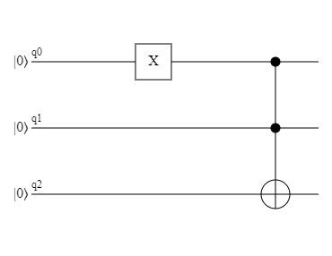
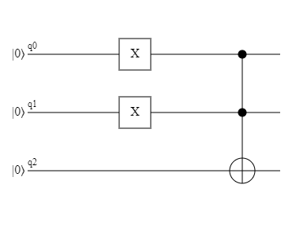
CCX gate
In this only one control qubit is activated and the other one is not. So the target qubit is not flipped.
We started with |001> ended up as |001>
In this both control qubit has been activated resulting in the flip of the target qubit.
We started with |011> ended up as |111>

Slide 27
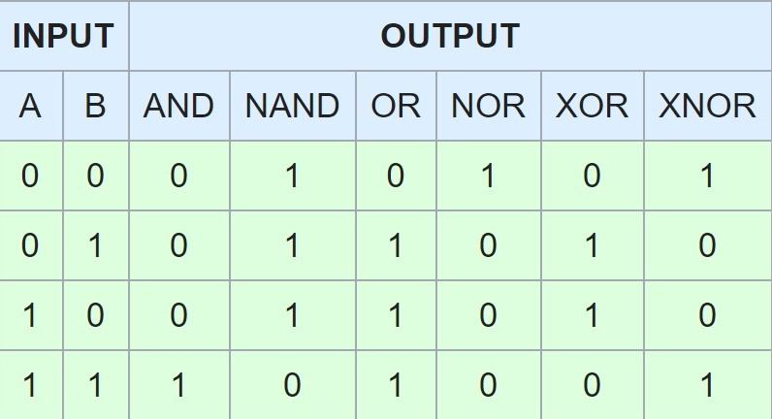
Logic Gates
NOT
AND
OR
NAND
NOR
XOR
XNOR

Slide 28
And gate
If we take q0 and q1 as the input and q3 as out output, we have :
You can simply see that it's just a CCX gate.
Input_Qubits |  | Input_State | Output_Qubit | Output_State
Qubit(0) | Qubit(1) | |q2q1q0> | Qubit(2) | state
|0> | |0> | |000> | |0> | |000>
|0> | |1> | |010> | |0> | |010>
|1> | |0> | |001> | |0> | |001>
|1> | |1> | |011> | |1> | |111>

Slide 29
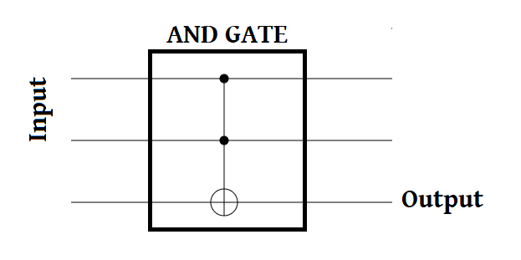
And Gate

Slide 30
OR gate
Taking q0 and q1 as inputs and q2 as output, we have:
Looks a bit complicated, so let's work on it.
Input_Qubits |  | Input_State | Output_Qubit | Output_State
Qubit(0) | Qubit(1) | |q2q1q0> | Qubit(2) | state
|0> | |0> | |000> | |0> | |000>
|0> | |1> | |010> | |1> | |110>
|1> | |0> | |001> | |1> | |101>
|1> | |1> | |011> | |1> | |111>

Slide 31
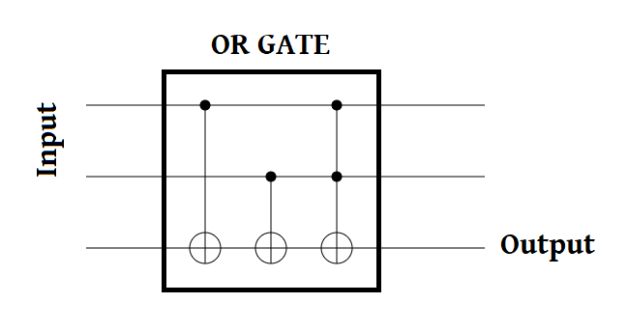
Or gate
There are other circuits that can do the same thing.
Let's see if you guys find any.

Slide 32
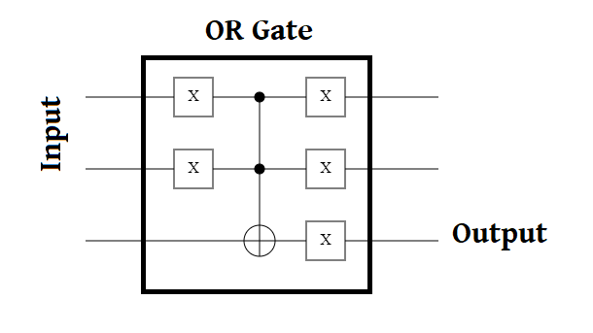
Or gate

Slide 33
HOmework
Build the rest of the LOGIC GATES.
NAND
NOR
XOR
XNOR

Slide 34
THANK YOU !
Let's meet tomorrow with the circuits of the other 4 gates and I will give you new problems to play with.

