Slide 1

Day 4
QUANTUM COMPUTATION COMMUNITY
IISER-K

Slide 2
Topics
Vector space Transformation
Unitary Transformation
Gates

Slide 3
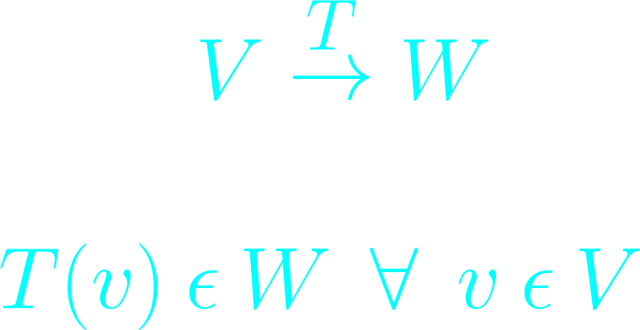
Transformation
Vector space Transformation

Slide 4
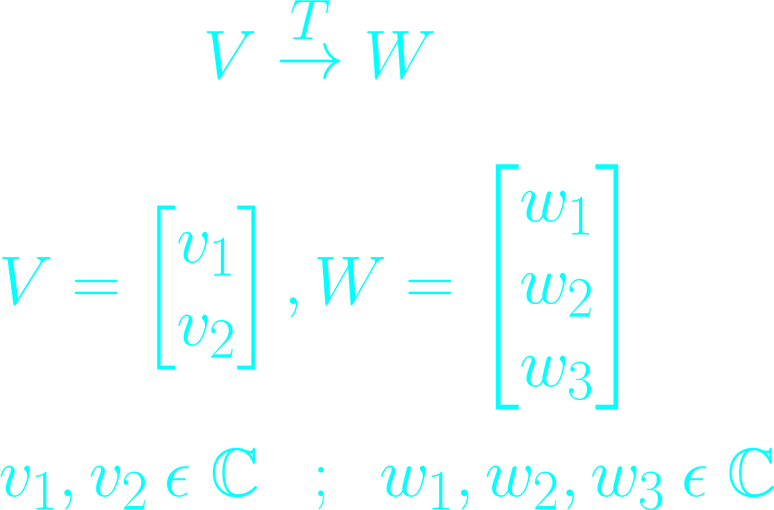
Transformation
Defining Vectorspace
Transformation: "T"

Slide 5
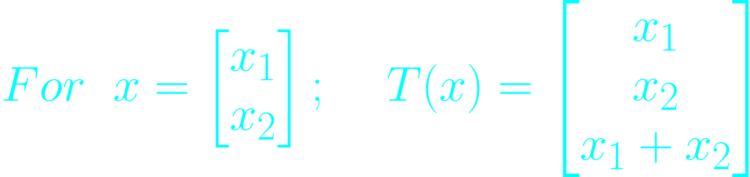
Transformation
Transformation Defined

Slide 6
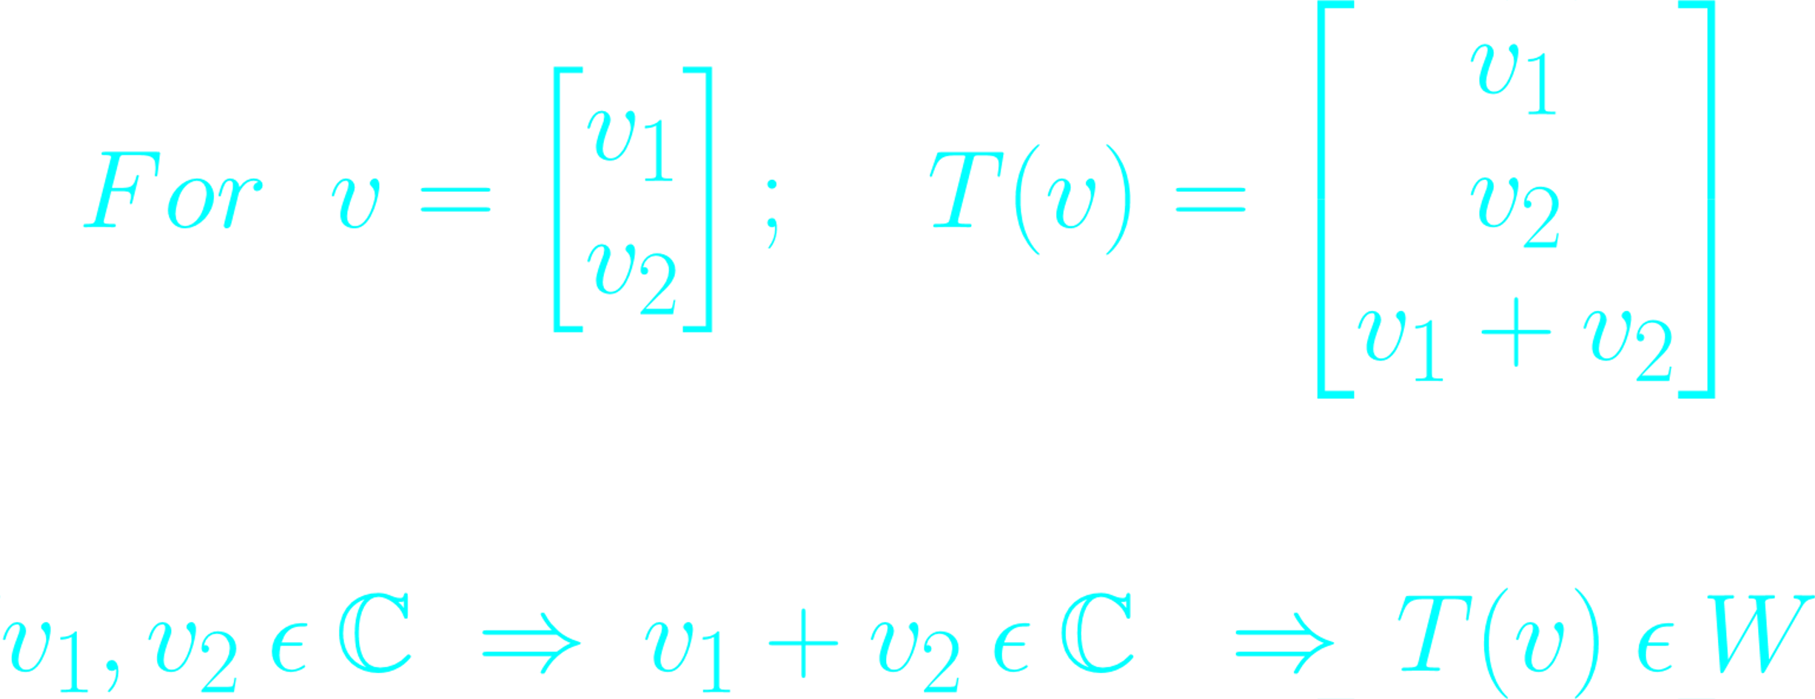
Transformation
Checking for the transformation

Slide 7
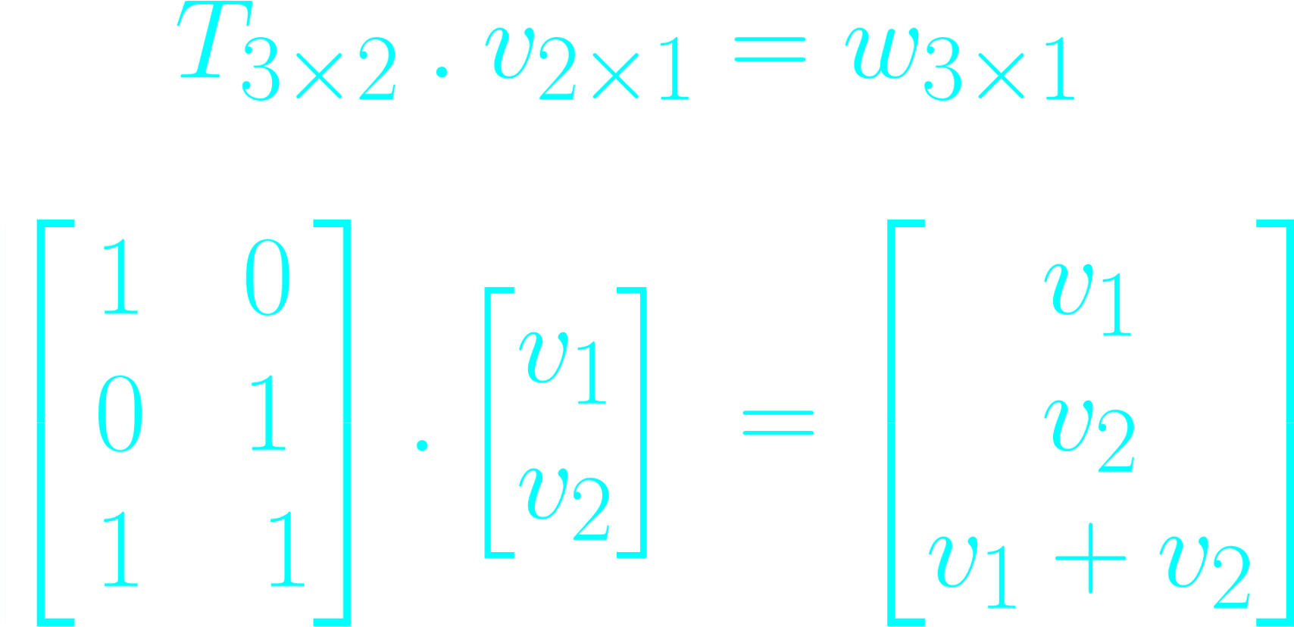
Transformation
Matrix of the transformation

Slide 8

Transformation
T has been written as a matrix and it operates on v as
Not all transformation can be written as a matrix.

Slide 9
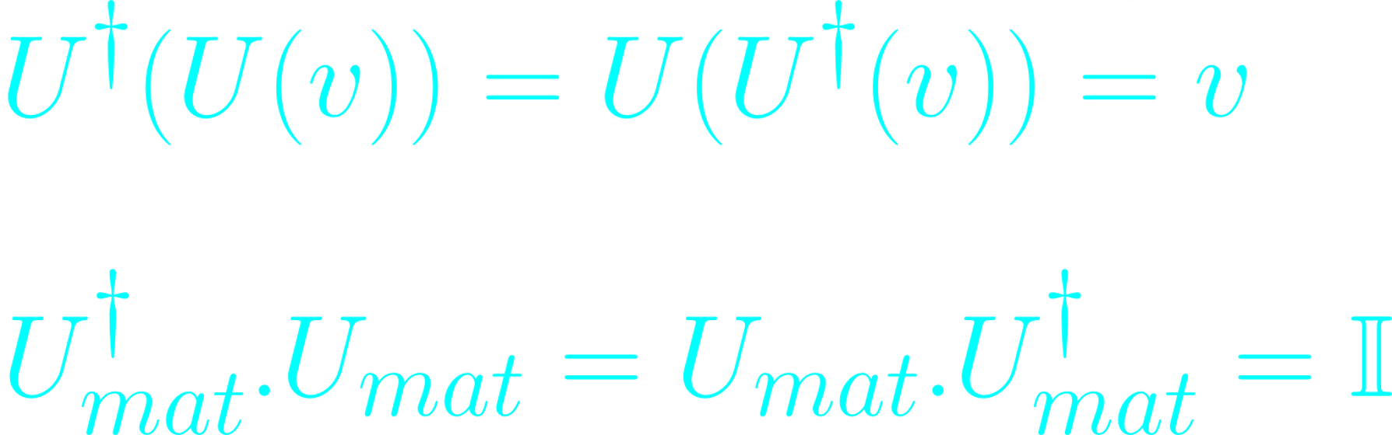
Unitary Transformation
In QC we work with Unitary Transformation
Properties of Unitary Transformation
It conserves magnitude.
It conserves angle between vectors.

Slide 10
Gates
In QM we call the transformations as Operator acting on a Quantum state.
In QC we use the Gates for the transformation of one state to another.
Each Gate is a separate and unique transformation

Slide 11
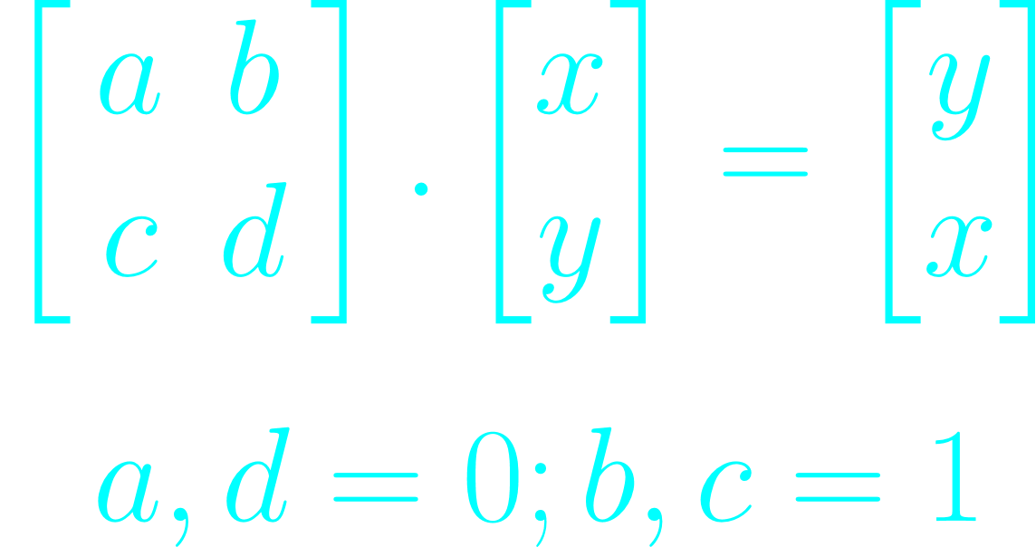

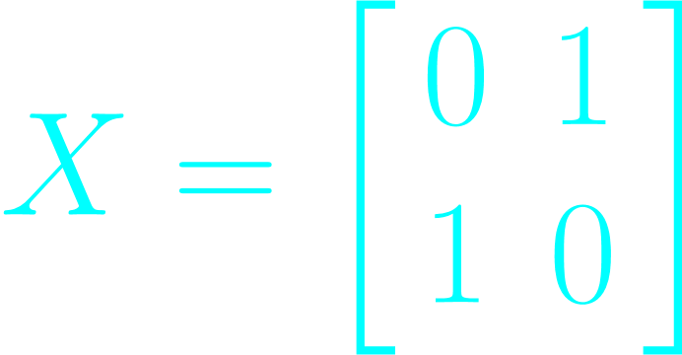
X Gate
What a X Gate does:

Slide 12
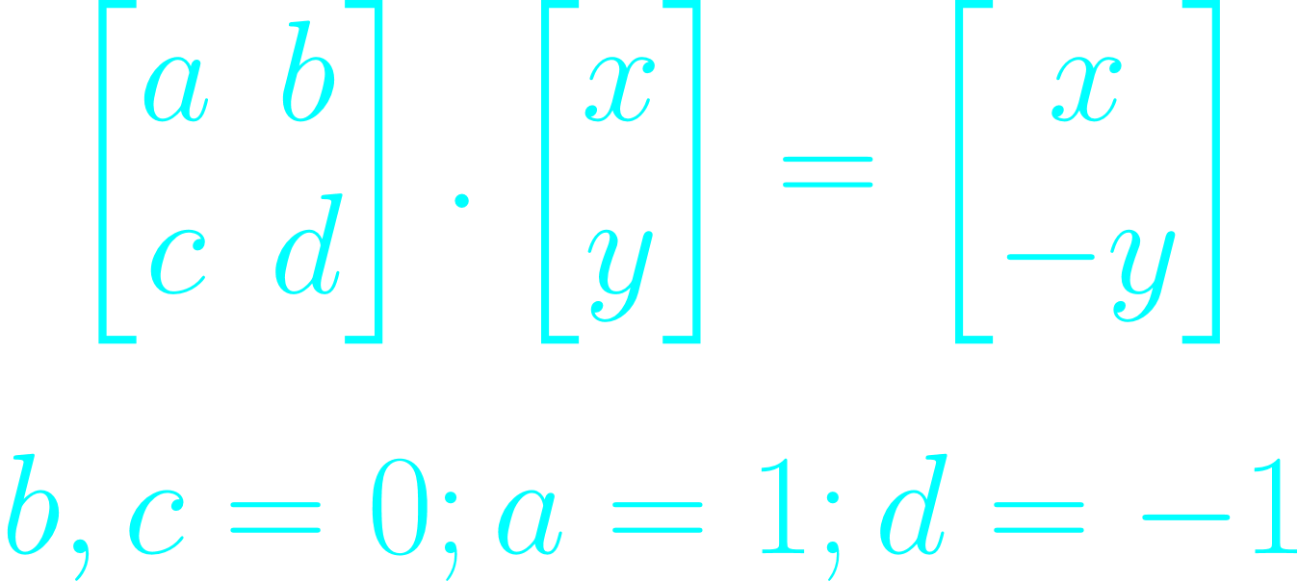
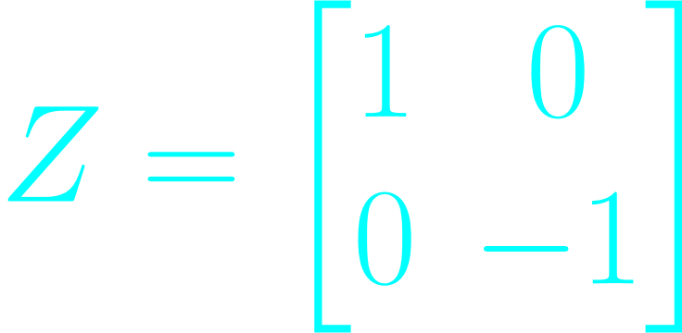
Z Gate
What a Z Gate does:

Slide 13
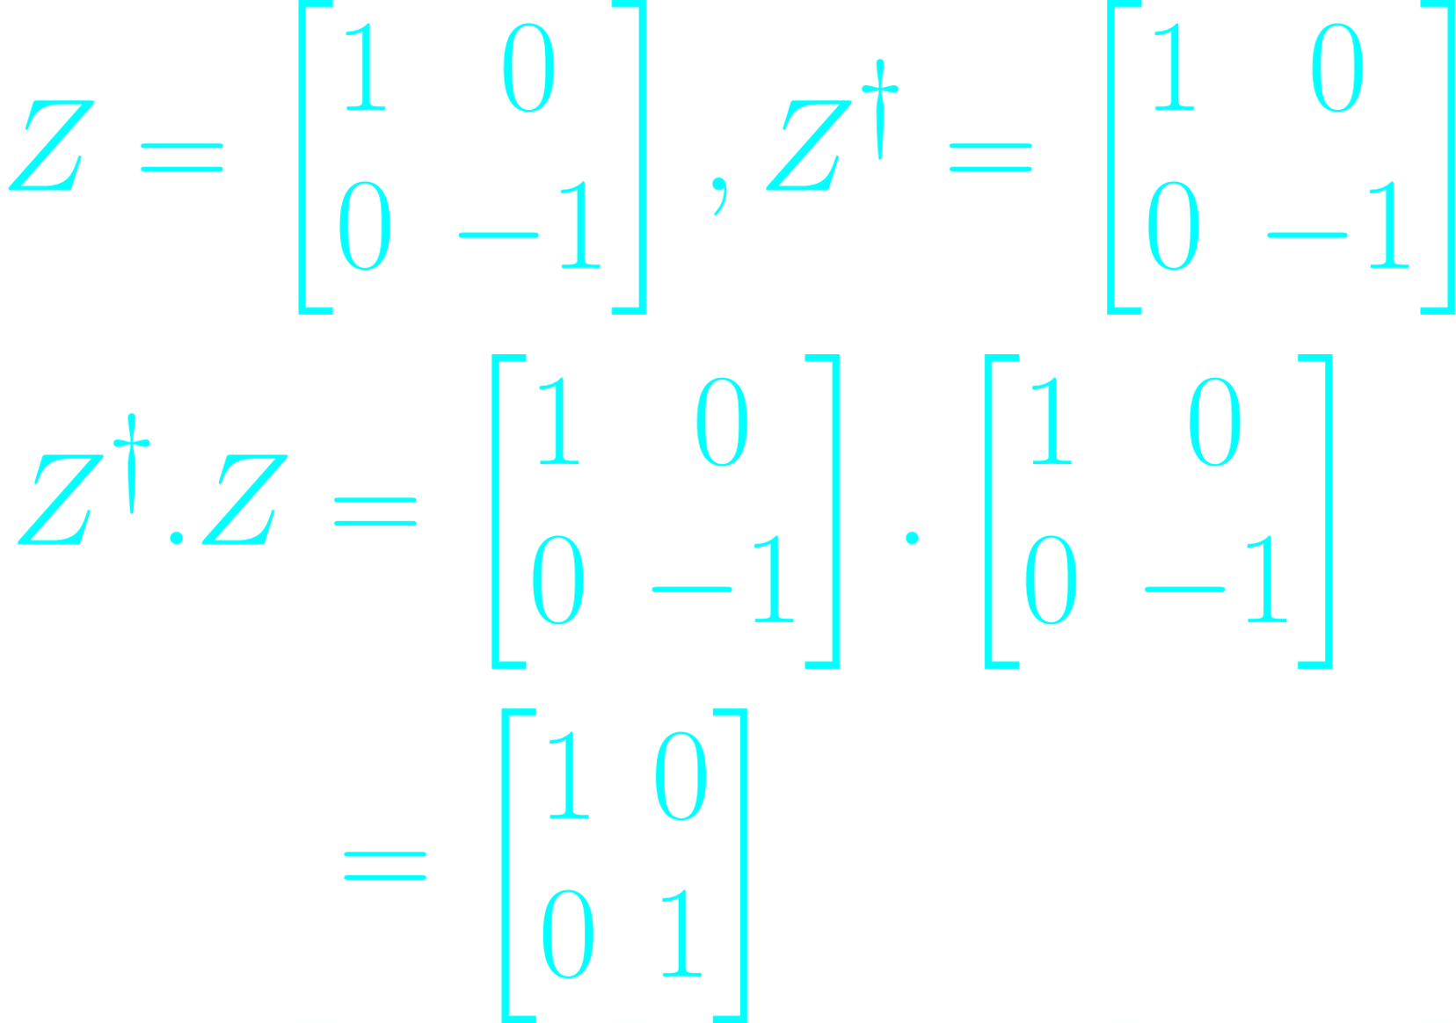
Checking for Unitary
Z Gate

Slide 14
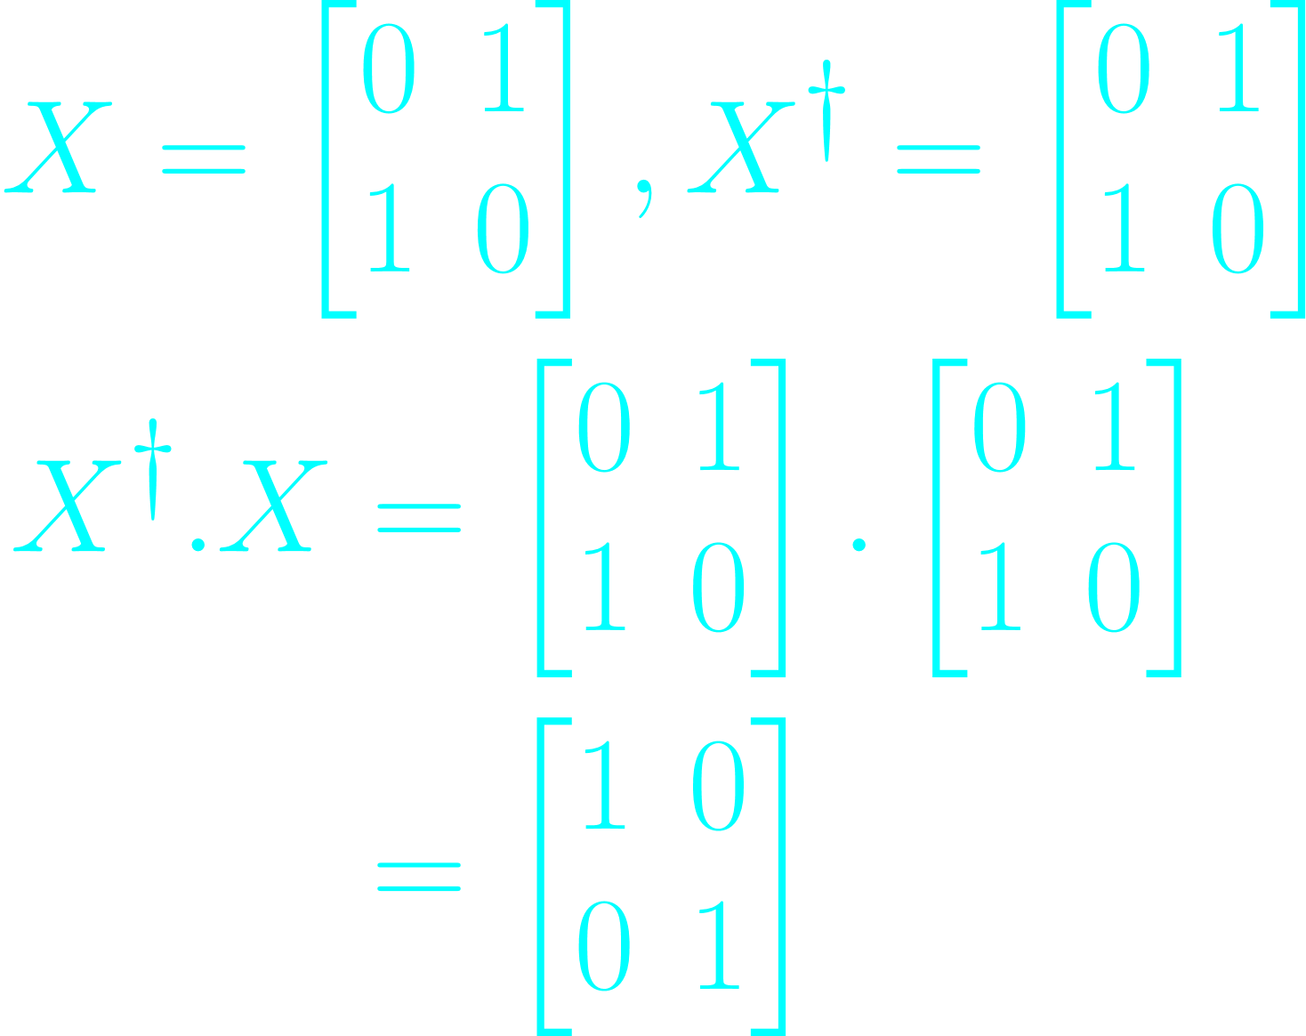
Checking for Unitary
X Gate

Slide 15
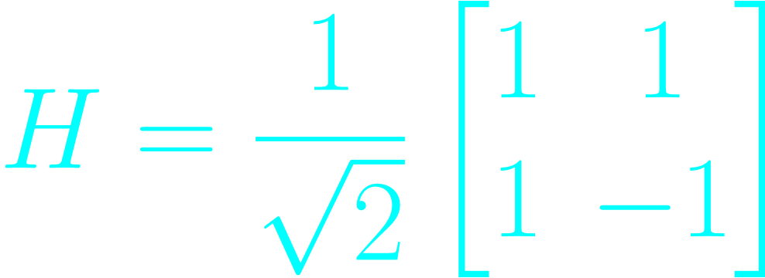
Let's see some new Gates
Hadamard Gate

Slide 16
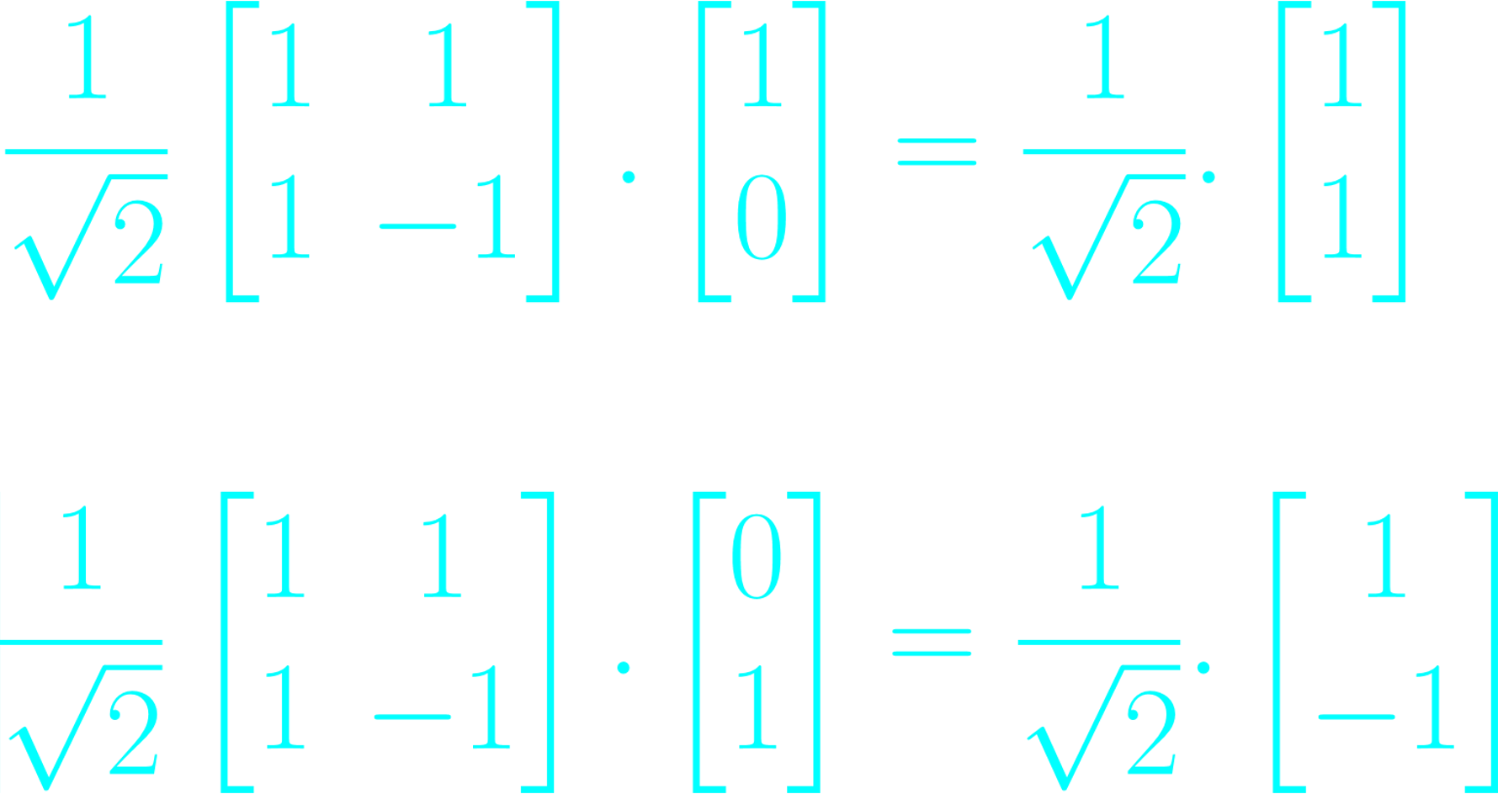
Let's see some new Gates
Hadamard Gate

Slide 17
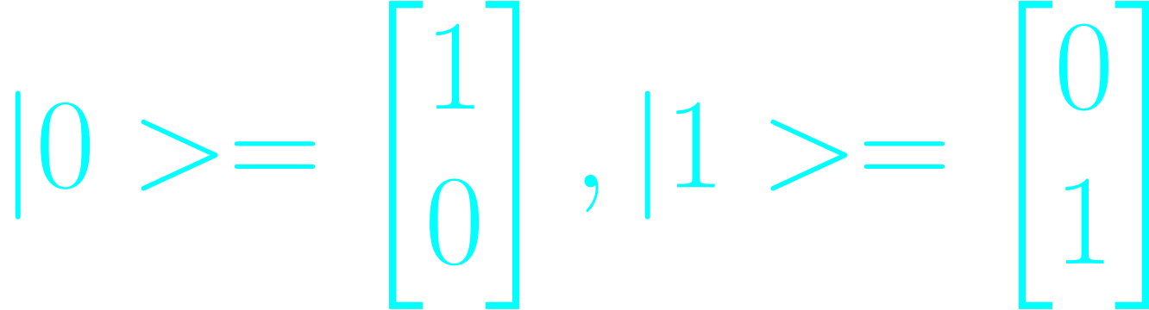
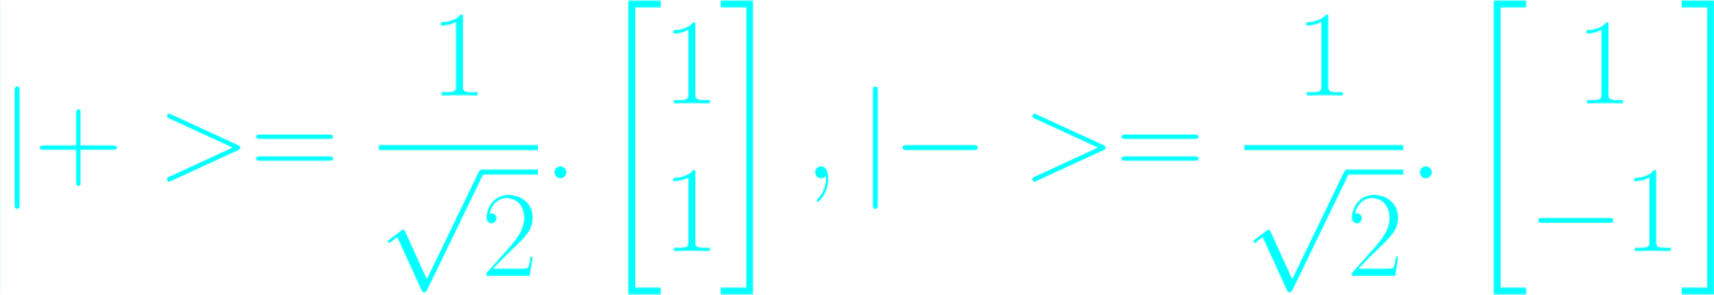
Basis Vector
|0>,|1> can act as basis vector;
|+>,|-> can too

Slide 18
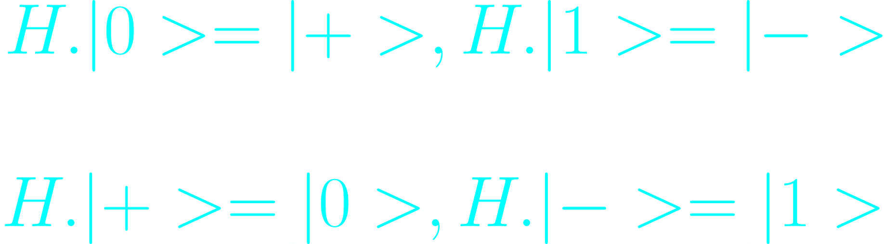
Basis Vector Transformation
H Gate acts as the transformation between the two basis.

Slide 19
END
We would be lerarning about representation of qubit states on bloch sphere in the next session.

