Slide 1
John Bells’ Experiment
Bell tests are experiments that test whether the theory of Quantum mechanics satisfies the concept of local realism, which requires the presence of hidden variables.

Slide 2
Apparatus
spin detectors that can measure the spin of a particle in three directions.
The direction of measurement is chosen randomly.
We record whether the result of measurement of the spin of the particles is same, or different.

Slide 3
Case I : Hidden variable exists
The result of the measurement along each direction is pre-decided. There can only be 8 different combinations of 4 types:
3 × ( 1 up and 2 down )
3 × ( 1 down and 2 up )
1 × ( all up )
1 × ( all down )
Since the particles are entangled, the second particle will have opposite spin to the first particle corresponding to any given direction.

Slide 4
Type : 1 up and 2 down
Direction of detector #1 #2 |  | outcome
1 | 1 | different
1 | 2 | same
1 | 3 | same
2 | 1 | same
2 | 2 | different
2 | 3 | different
3 | 1 | same
3 | 2 | different
3 | 3 | different
Possible combination :
Particle 1
1
Particle 2
2
3
Now there are 9 different ways in which the direction of measurement of both the detectors can be chosen :
Probability of getting different outcomes in this combination = 5/9
Type : all ups
Since all of first particle’s chosen orientations are different that the orientations of second particle. All measurements should yield different results.
Probability of getting different outcomes in this combination = 1

Slide 5
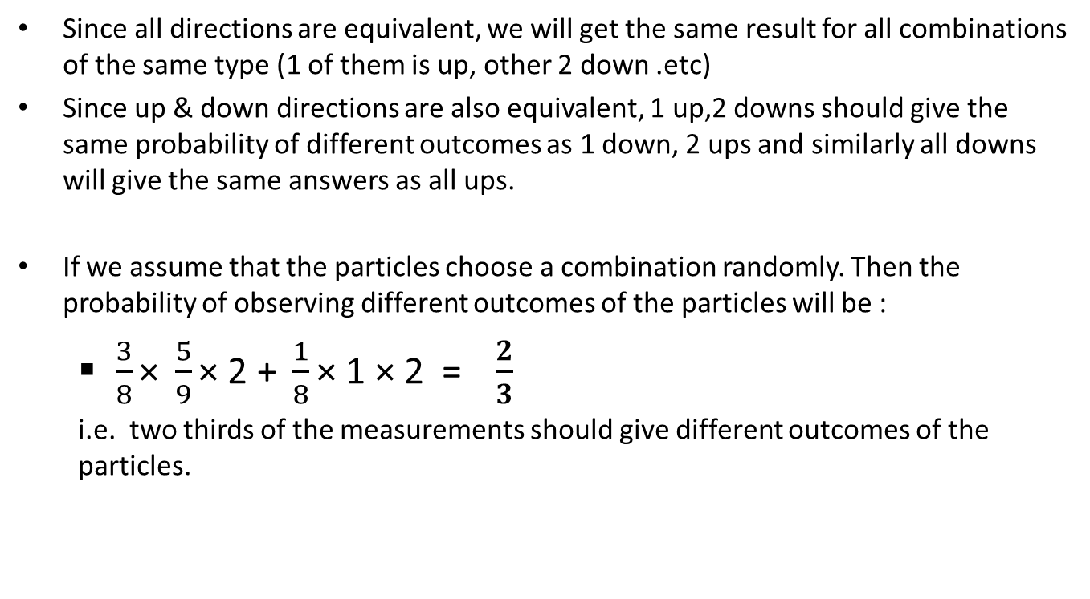
Since all directions are equivalent, we will get the same result for all combinations of the same type (1 of them is up, other 2 down .etc)
Since up & down directions are also equivalent, 1 up,2 downs should give the same probability of different outcomes as 1 down, 2 ups and similarly all downs will give the same answers as all ups.
If we assume that the particles choose a combination randomly. Then the probability of observing different outcomes of the particles will be :
$\frac{3}{8}\text{×} \frac{5}{9}\text{×}\text{ 2 + }\frac{1}{8}\text{×}\text{ 1 }\text{×}\text{ 2 = }\frac{2}{3}$
i.e. two thirds of the measurements should give different outcomes of the particles.

