Slide 1
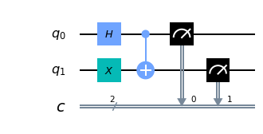
Bell State
First we need to make a state that’s in Superposition of state |01> and |10>.
Which can be achieved using H, X and CX gate.

Slide 2
Different State of measurment.
We are randomly choosing from 3 directions for each particle to be detected.
We keep the direction 1 to be 0 degree wrt z axis in Hilbert space.
2nd direction is taken to be at 2pi/3.
And the 3rd one at –2pi/3.
So we get a total ordered combination of 9.
[0,0], [0,2pi/3], [0,-2pi/3], [2pi/3,0], [2pi/3,2pi/3], [2pi/3,-2pi/3], [-2pi/3,0], [-2pi/3,2pi/3], [-2pi/3,-2pi/3]

Slide 3
For set [0,0]
For this we just need to measure it it in bell state.

Slide 4
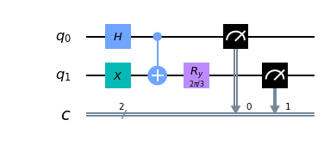
For set [0,2pi/3]
We need to measure first particle in 0 direction and second in 2pi/3 which we do by rotating the vector space by –2pi/3 along Y axis.

Slide 5

For state [0,-2pi/3]
For this we need to rotate the second measurment direction by –2pi/3 which we do by rotating the vector space by –2pi/3 along Y axis.

Slide 6
Now Similarities
We can clearly see that [0,0], [2pi/3,2pi/3] and [-2pi/3,-2pi/3] are similar under rotation of n*2pi/3.
So are [0,2pi/3],[2pi/3,4pi/3] = [2pi/3,-2pi/3] and [-2pi/3,0] under rotation of n*2pi/3.
Same for [0,-2pi/3],[2pi/3,0] and [-2pi/3,-4pi/3] = [-2pi/3,2pi/3].

Slide 7

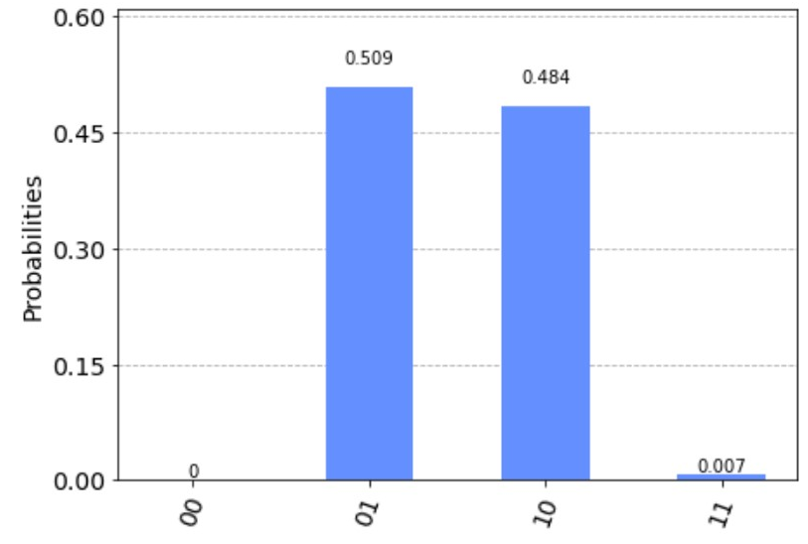
For [0,0]
We got the probability of opposit spin to be equal to 0.509+0.484 = 0.993

Slide 8
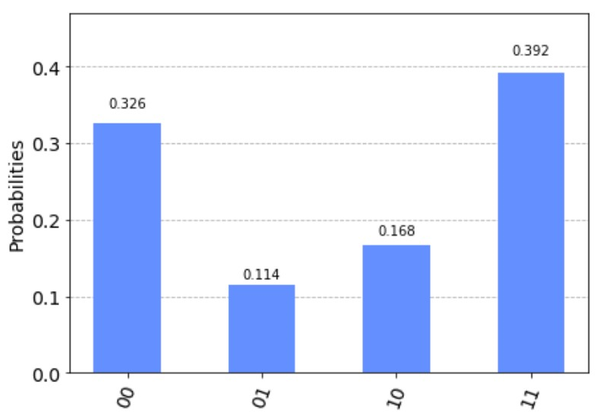
For [0,2pi/3]
We got the probability of opposit spin to be equal to 0.114+0.168 = 0.282

Slide 9
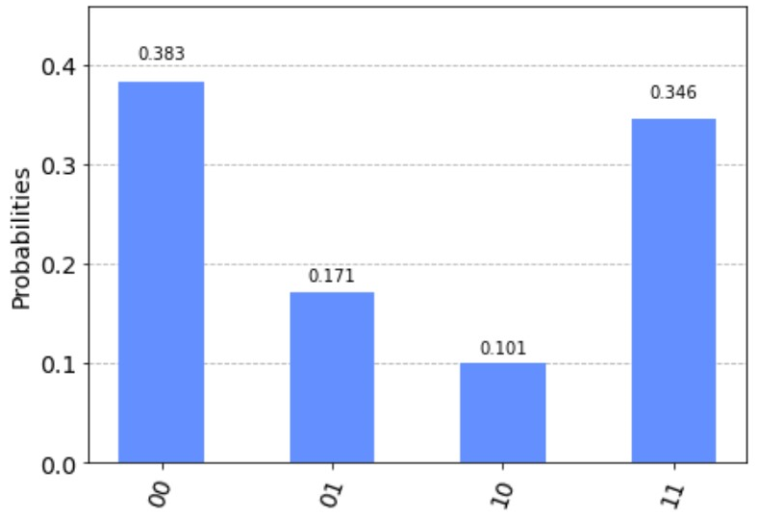
For [0,-2pi/3]
We got the probability of opposit spin to be equal to 0.171+0.101 = 0.272

Slide 10
Calculating Total Probablity.
We have P[0,0] = 0.993, P[0,2pi/3] = 0.282 , P[0,-2pi/3] = 0.272.
Giving us P = 1/3*0.993+1/3*0.282+1/3*0.272
P = 0.517
So P is around 0.5

Slide 11
What Did We Find
We got the Probability of Particle Spins being in opposite directions for 2 randomly chosen direction to be 0.5 (approx.).
We expected it to be around 2/3 = 0.66 .
We tried with total 24000 trials. So, the Prob. should be more or less accurate.

Slide 12
Why Probability = 0.5
The First thing it suggest that the theory of Hidden Variables is not correct.
Let's, See for an explanation for the Probability to be 0.5 .

Slide 13


2 Different cases
So, In this case Our measurment will so both in opposite spin all the time. So, P = 1
In this case we will have ¼ Probability of getting them in opposite spin

Slide 14
Total Probability of getting opposit spin.
P(opposite) = 3/9 x P(same direction) + 6/9 x P(different direction)
P(same) = 1
P(different) = 0.25
P(opposite) = 3/9+6/9x0.25
= 0.5
Which We got From the Experiment.

