Slide 1
Quick-Sort
Presentation for use with the textbook, Algorithm Design and Applications, by M. T. Goodrich and R. Tamassia, Wiley, 2015
7 4 9 6 2 → 2 4 6 7 9
4 2 → 2 4
7 9 → 7 9
2 → 2
9 → 9

Slide 2
Quick-Sort
Quick-sort is a sorting algorithm based on the divide-and-conquer paradigm:
Divide: pick a random element x (called pivot) and partition S into
L elements less than x
E elements equal x
G elements greater than x
Recur: sort L and G
Conquer: join L, E and G
x
x
L
G
E
x

Slide 3
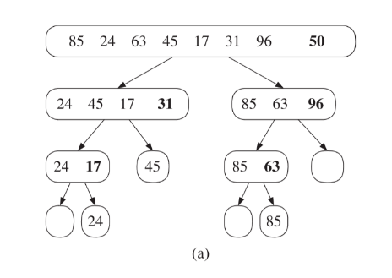
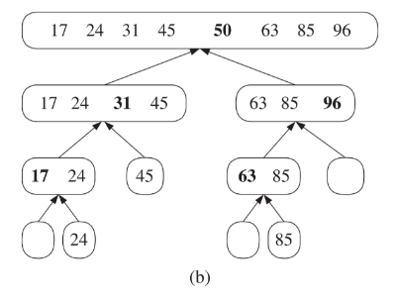
Quick Sort idea

Slide 4
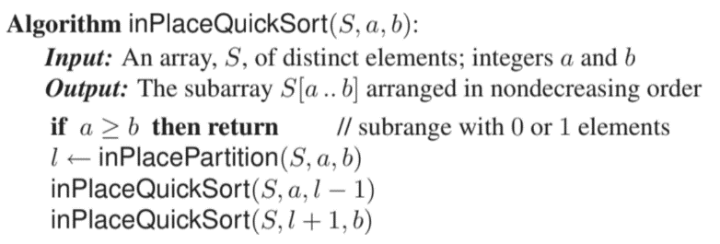
In-Place Quick-Sort
Quick-sort can be implemented to run in-place

Slide 5
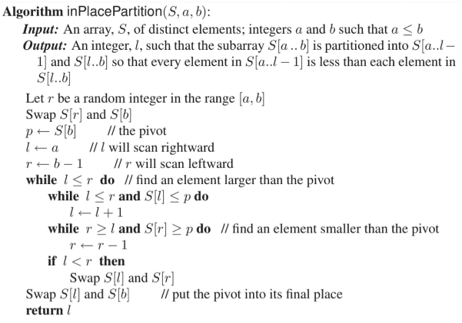
In-Place Quick-Sort
Quick-sort can be implemented to run in-place

Slide 6
In-Place Quick-Sort
To follow the working of this algorithm, please see “Quick Sort example” posted on Canvas

Slide 7
Worst-case Running Time
The worst case for quick-sort occurs when the pivot is the unique minimum or maximum element (input array is already sorted)
One of L and G has size n − 1 and the other has size 0
The running time is proportional to the sum
n + (n − 1) + … + 2 + 1
Thus, the worst-case running time of quick-sort is O(n²)
depth | time
0 | n
1 | n − 1
… | …
n − 1 | 1
…

Slide 8
Worst-case Running Time
Subarrays are completely unbalanced
Recurrence relation
T(n) = T(n-1) + O(n)
= O(n²)
… More on solving recurrence relations later

Slide 9
Best-case Running Time
Subarrays are completely balanced
If the partitioning procedure produces two regions of size n/2, quicksort runs much faster. The recurrence is then:
T(n) = 2T(n/2) + O(n)
= O(n log n)
… We already saw why this is
…. More on solving recurrence relations later

Slide 10
Randomized vs Deterministic Quicksort
Choice of pivot element:
Randomized quicksort chooses a random index in the array;
i.e. Randomized quicksort chooses a random element as the pivot
Deterministic quicksort always chooses a particular index (e.g. “rightmost”); i.e. Deterministic quicksort chooses the pivot deterministically (e.g., always the last element)
Running behavior based on input:
Randomized quicksort runs differently in different runs on the same input
Deterministic quicksort runs the same in different runs on the same input

Slide 11
Expected Running Time
Consider a recursive call of quick-sort on a sequence of size s
Good call: the sizes of L and G are each less than 3s/4
Bad call: one of L and G has size greater than 3s/4
A call is good with probability 1/2
1/2 of the possible pivots cause good calls:
7 2 9 4 3 7 6 1 9
7 2 9 4 3 7 6 1
2 4 3 1
7 9 7 1 → 1
1
7 2 9 4 3 7 6
Good call
Bad call
1 2 3 4 5 6 7 8 9 10 11 12 13 14 15 16
Bad pivots
Good pivots
Bad pivots

Slide 12
Expected Running Time, Part 2
Probabilistic Fact: The expected number of coin tosses required in order to get k heads is 2k
For a node of depth i, we expect
i/2 ancestors are good calls
The size of each input sequence for the current call is at most (3/4)^{i}n
Therefore, we have
For a node of depth 2log_{4/3}n, the expected input size is one
The expected height of the quick-sort tree is O(log n)
The amount or work done at the nodes of the same depth is O(n)
Thus, the expected running time of quick-sort is O(n log n)

