Slide 1

Bucket-Sort and Radix-Sort
Presentation for use with the textbook, Algorithm Design and Applications, by M. T. Goodrich and R. Tamassia, Wiley, 2015
USGS NEIC. Public domain government image.

Slide 2
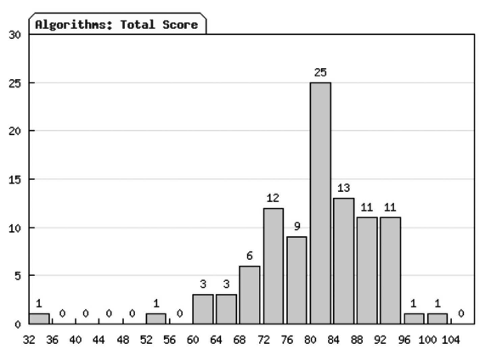
Application: Constructing Histograms
One common computation in data visualization and analysis is computing a histogram.
For example, n students might be assigned integer scores in some range, such as 0 to 100, and are then placed into ranges or “buckets” based on these scores.
A histogram of scores from a recent Algorithms course taught by one of the authors (with extra credit included).

Slide 3
Application: An Algorithm for Constructing Histograms
When we think about the algorithmic issues in constructing a histogram of n scores, it is easy to see that this is a type of sorting problem.
But it is not the most general kind of sorting problem, since the keys being used to sort are simply integers in a given range.
So a natural question to ask is whether we can sort these values faster than with a general comparison-based sorting algorithm.
The answer is “yes.” In fact, we can sort them in O(n) time.
A histogram of scores from a recent Algorithms course taught by one of the authors (with extra credit included).

Slide 4
Bucket-Sort
Let be S be a sequence of n (key, element) items with keys in the range [0, N − 1]
Bucket-sort uses the keys as indices into an auxiliary array B of sequences (buckets)
Phase 1: Empty sequence S by moving each entry (k, o) into its bucket B[k]
Phase 2: For i = 0, …, N − 1, move the entries of bucket B[i] to the end of sequence S
Analysis:
Phase 1 takes O(n) time
Phase 2 takes O(n + N) time
Bucket-sort takes O(n + N) time
^{Algorithm bucketSort(S):}
Input: Sequence S of entries with integer keys in the range [0, N − 1] Output: Sequence S sorted in nondecreasing order of the keys
let B be an array of N sequences, each of which is initially empty
^{for each entry e in S do}
^{k = the key of e}
^{remove e from S}
insert e at the end of bucket B[k]
^{for i = 0 to N−1 do}
^{for each entry e in B[i] do}
^{remove e from B[i]}
^{insert e at the end of S}

Slide 5
Example
Key range [0, 9]
7, d
1, c
3, a
7, g
3, b
7, e
Phase 1
1, c
3, a
3, b
7, d
7, g
7, e
B
0
1
2
3
4
5
6
7
8
9
∅
∅
∅
∅
∅
∅
∅
Phase 2
1, c
3, a
3, b
7, d
7, g
7, e

Slide 6
Properties and Extensions
Key-type Property
The keys are used as indices into an array and cannot be arbitrary objects
No external comparator
Stable Sort Property
The relative order of any two items with the same key is preserved after the execution of the algorithm
Extensions
Integer keys in the range [a, b]
Put entry (k, o) into bucket B[k − a]
String keys from a set D of possible strings, where D has constant size (e.g., names of the 50 U.S. states)
Sort D and compute the rank r(k) of each string k of D in the sorted sequence
Put entry (k, o) into bucket B[r(k)]

Slide 7
Lexicographic Order
A d-tuple is a sequence of d keys (k₁, k₂, …, k_{d}), where key k_{i} is said to be the i-th dimension of the tuple
Example:
The Cartesian coordinates of a point in space are a 3-tuple
The lexicographic order of two d-tuples is recursively defined as follows
(x₁, x₂, …, x_{d}) < (y₁, y₂, …, y_{d}) ⇔ x₁ < y₁ ∨ x₁ = y₁ ∧ (x₂, …, x_{d}) < (y₂, …, y_{d})
I.e., the tuples are compared by the first dimension, then by the second dimension, etc.

Slide 8
Lexicographic-Sort
Let C_{i} be the comparator that compares two tuples by their i-th dimension
Let stableSort(S, C) be a stable sorting algorithm that uses comparator C
Lexicographic-sort sorts a sequence of d-tuples in lexicographic order by executing d times algorithm stableSort, one per dimension
Lexicographic-sort runs in O(dT(n)) time, where T(n) is the running time of stableSort
Algorithm lexicographicSort(S)
Input sequence S of d-tuples Output sequence S sorted in lexicographic order
for i ← d downto 1
stableSort(S, C_{i})
Example:
(7,4,6) (5,1,5) (2,4,6) (2, 1, 4) (3, 2, 4)
(2, 1, 4) (3, 2, 4) (5,1,5) (7,4,6) (2,4,6)
(2, 1, 4) (5,1,5) (3, 2, 4) (7,4,6) (2,4,6)
(2, 1, 4) (2,4,6) (3, 2, 4) (5,1,5) (7,4,6)

Slide 9
Radix-Sort
Radix-sort is a specialization of lexicographic-sort that uses bucket-sort as the stable sorting algorithm in each dimension.
Radix-sort is applicable to tuples where the keys in each dimension i are integers in the range [0, N − 1]
Radix-sort runs in time O(d( n + N))
If d is constant and N is O(n), then this is O(n).
Algorithm radixSort(S, N)
Input sequence S of d-tuples such
that (0, …, 0) ≤ (x₁, …, x_{d}) and (x₁, …, x_{d}) ≤ (N − 1, …, N − 1) for each tuple (x₁, …, x_{d}) in S Output sequence S sorted in lexicographic order
for i ← d downto 1
bucketSort(S, N)

