Slide 1
SHIKSHA EKIKARAN
Atharva Tiwari(21BD1A056A)

Slide 2
INDEX
Functional requirements
Type of users
Design of the website
PRESENTATION TITLE

Slide 3
Functional requirements

Slide 4
Functional requirements of the website
Website's main objective would be to provide user with the information they want regarding various levels of education in India under various sub categories under it.
To govt. officials, this website should provide enough information for them to implement existing policy or make new policies.
User should be able to navigate across various sections of website by using navigation bar at the top.
Every section should provide distinct information to the user, which includes a Home page, information page, agency contact page, policy page and developer contact page.
Website will provide visualized information ,i.e., using graphs and charts, making it simpler for the user to understand.
PRESENTATION TITLE

Slide 5
TYPES OF USERS FOR THE WEBSITE:
Educational Institutes
Govt Officials
General public
PRESENTATION TITLE

Slide 6
DESIGN OF THE WEBSITE

Slide 7
WEEK 1

Slide 8
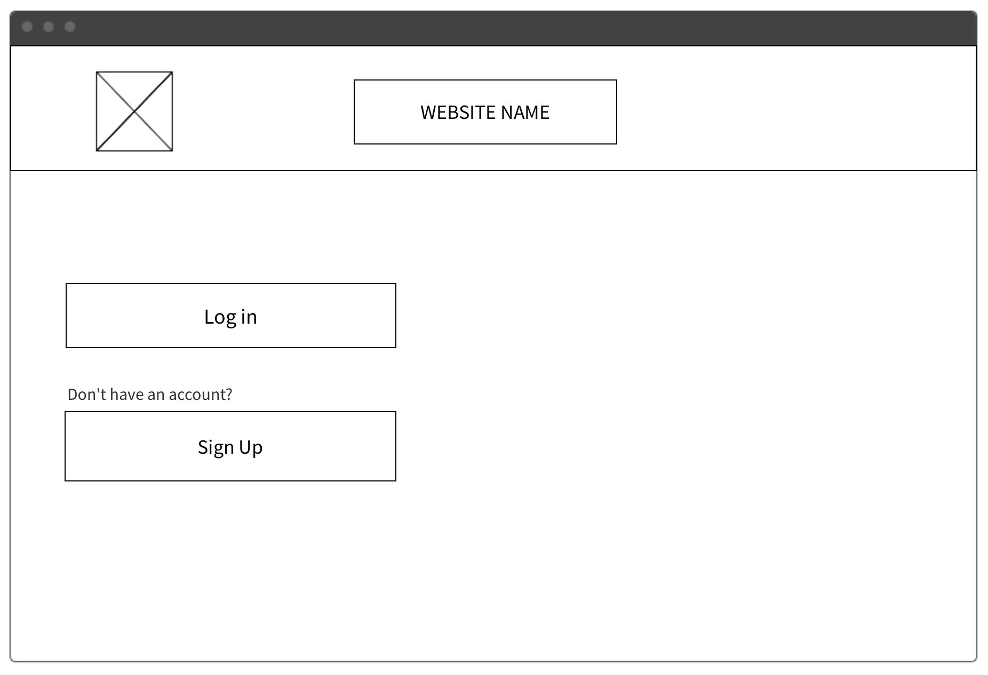
Login PAGE
PRESENTATION TITLE

Slide 9
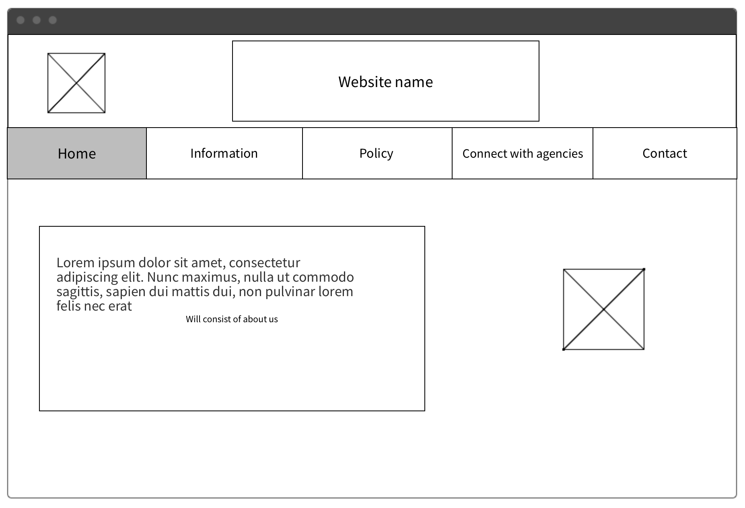
Home page
PRESENTATION TITLE

Slide 10
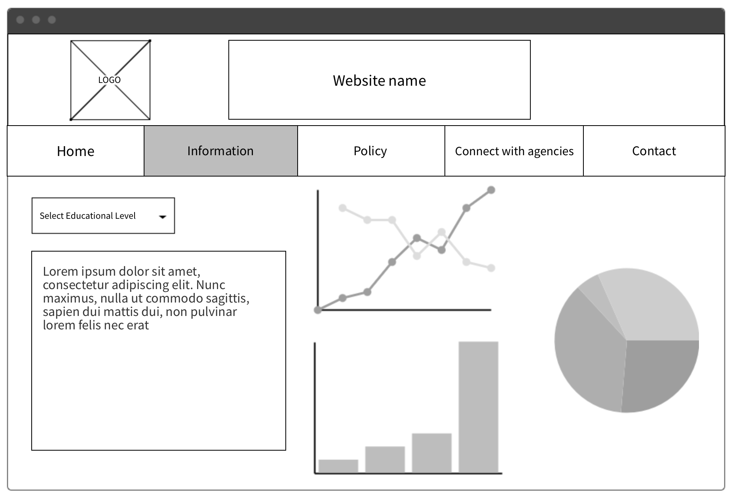
INFORMATION PAGE
PRESENTATION TITLE

Slide 11
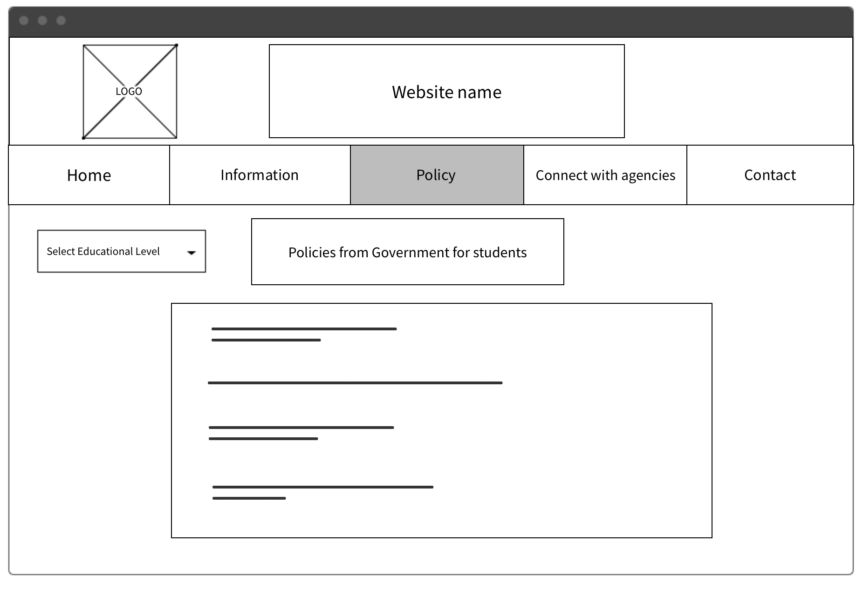
POLICY PAGE
PRESENTATION TITLE

Slide 12
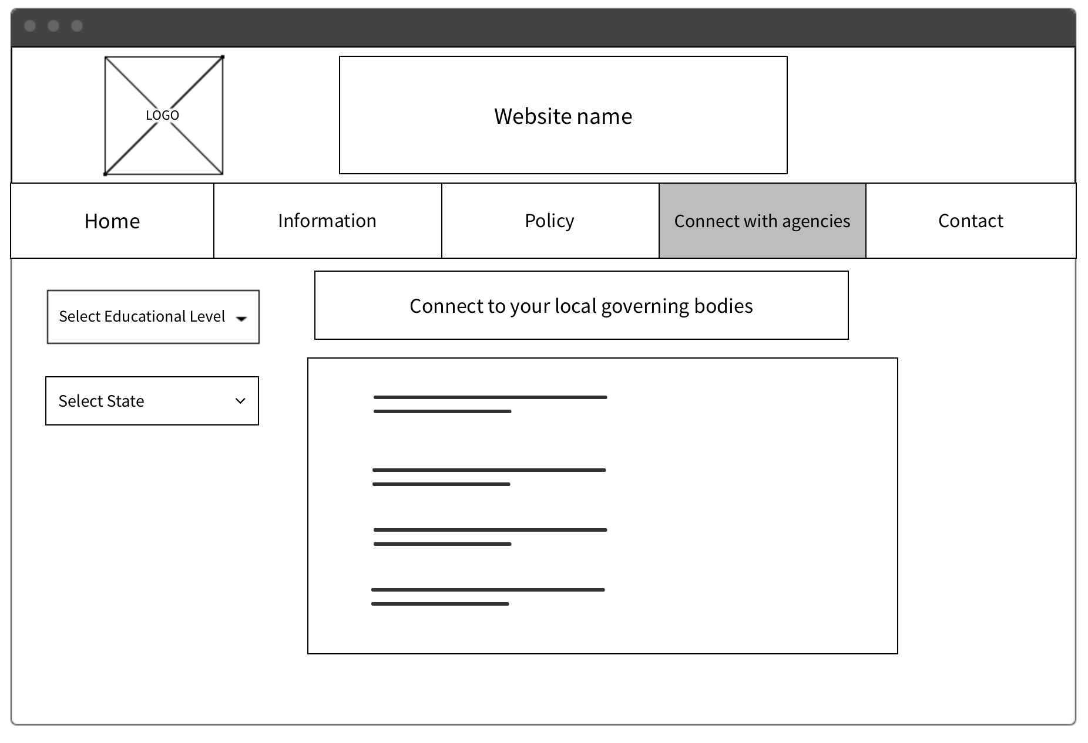
AGENCY CONTACT PAGE
PRESENTATION TITLE

Slide 13
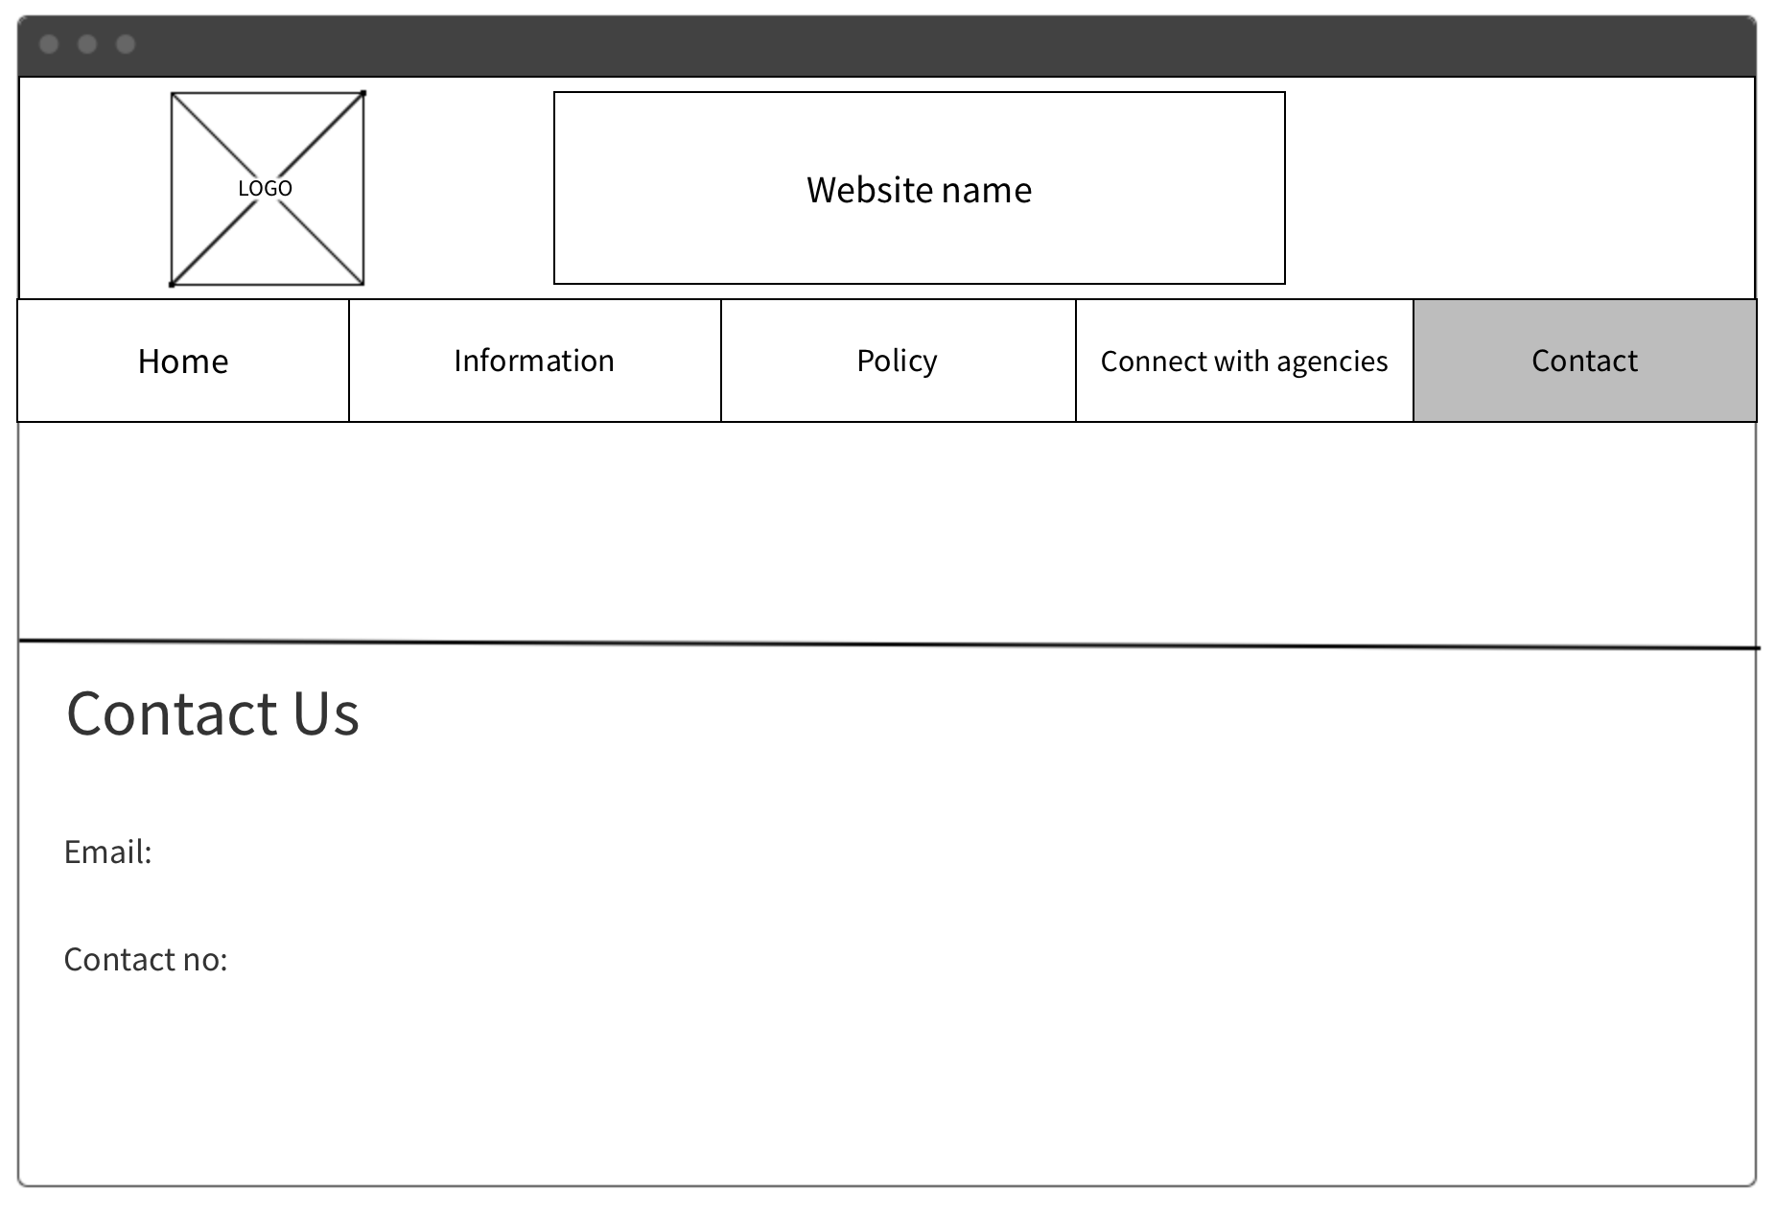
CONTACT PAGE
PRESENTATION TITLE

Slide 14
WEEK 2
PRESENTATION TITLE

Slide 15
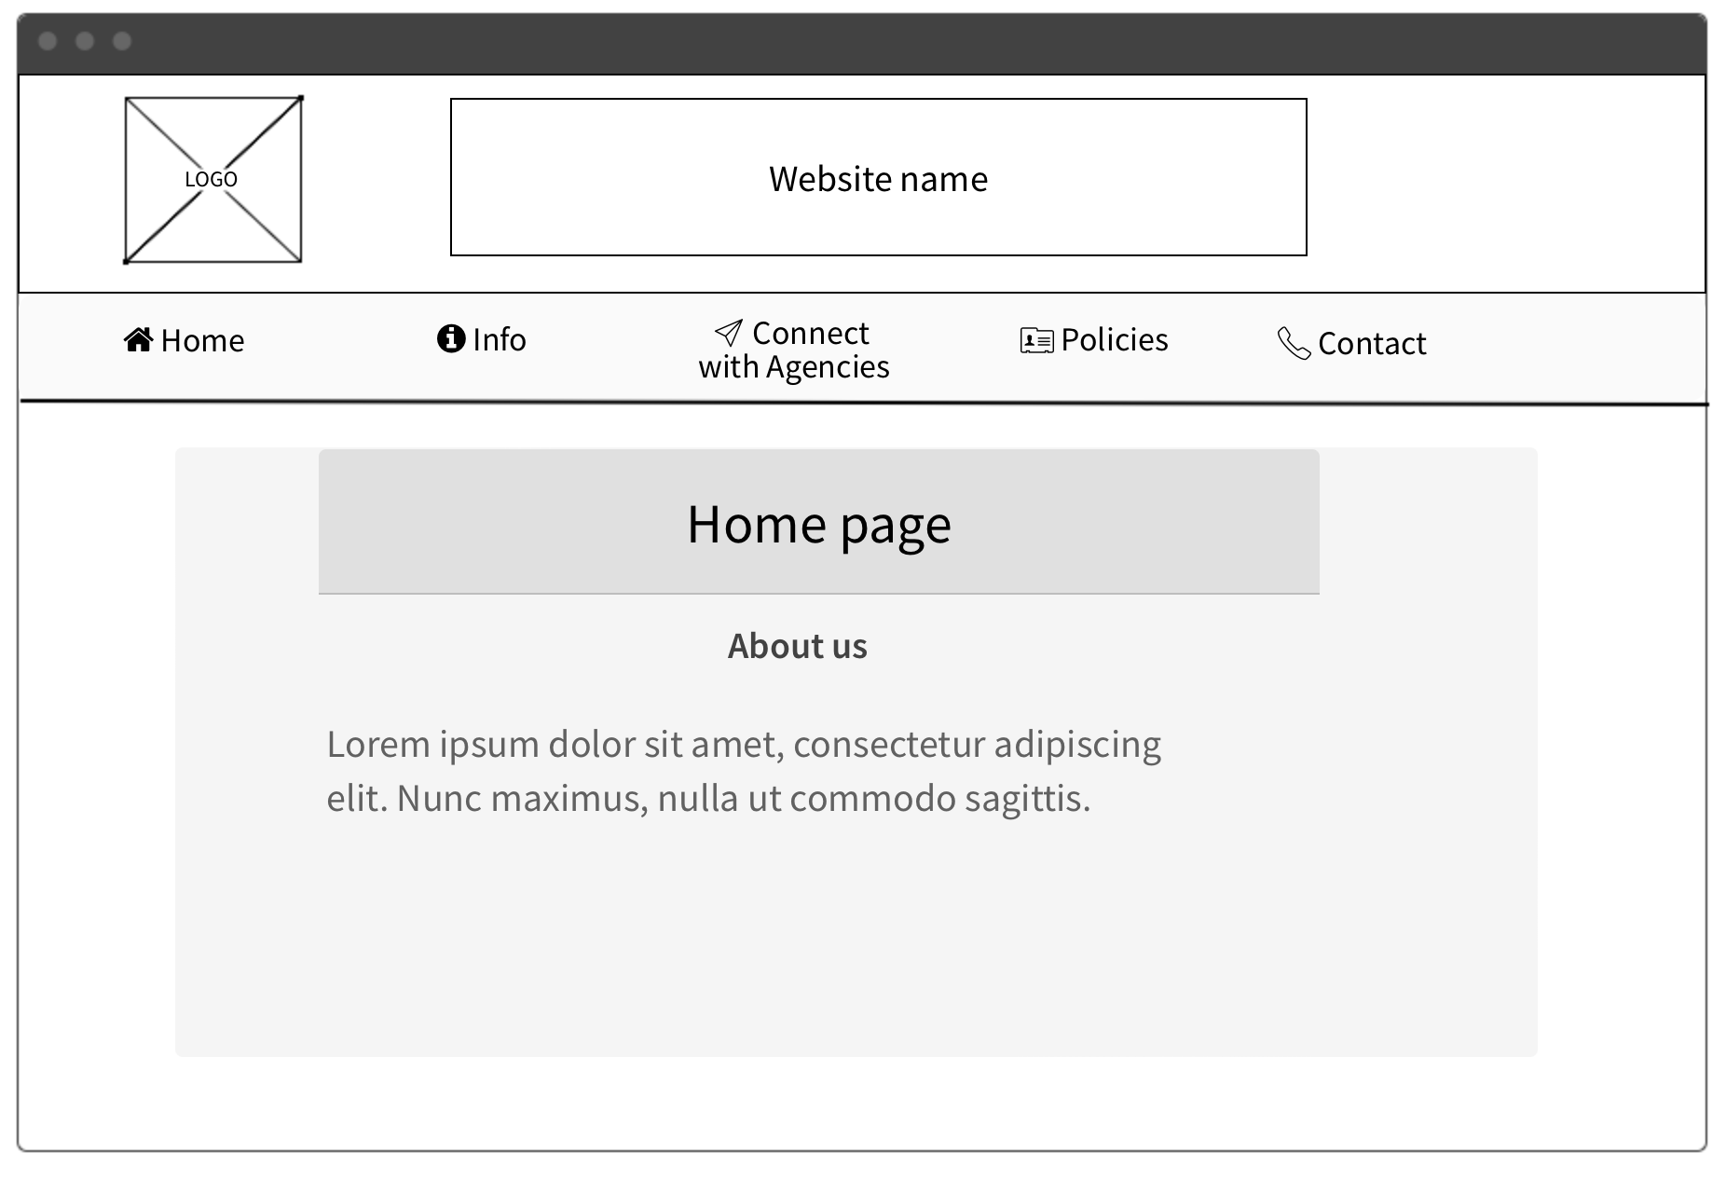
Home page
PRESENTATION TITLE

Slide 16
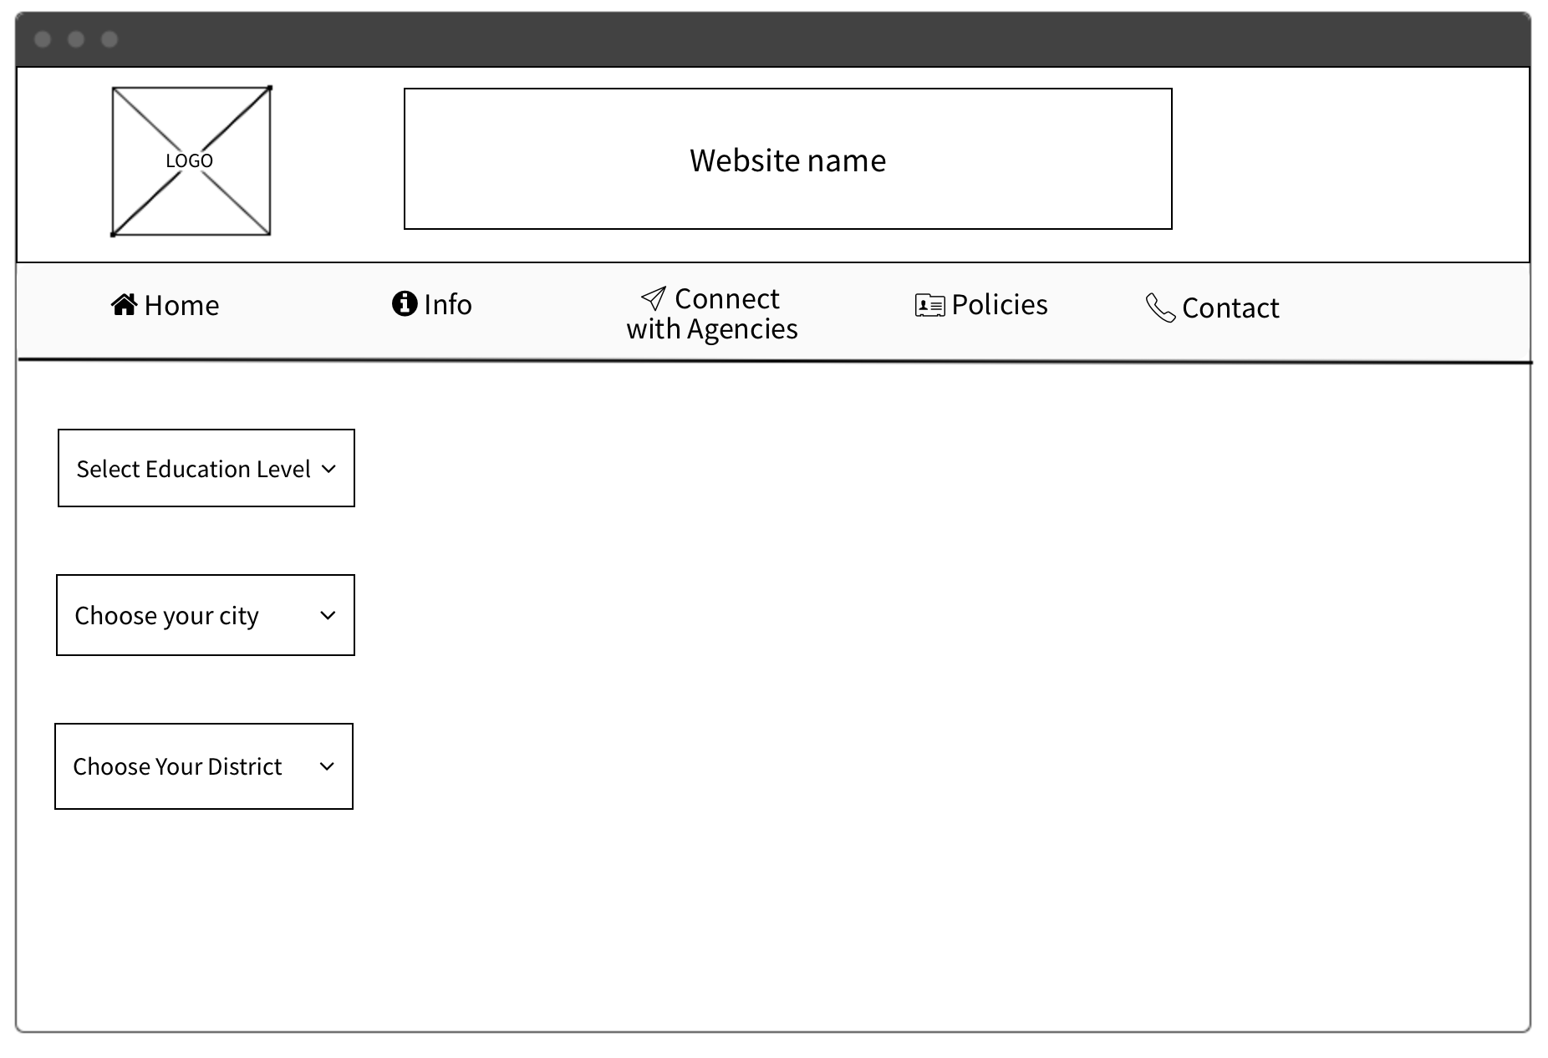

INFORMATION PAGE
Place for content and visualized data
PRESENTATION TITLE

Slide 17
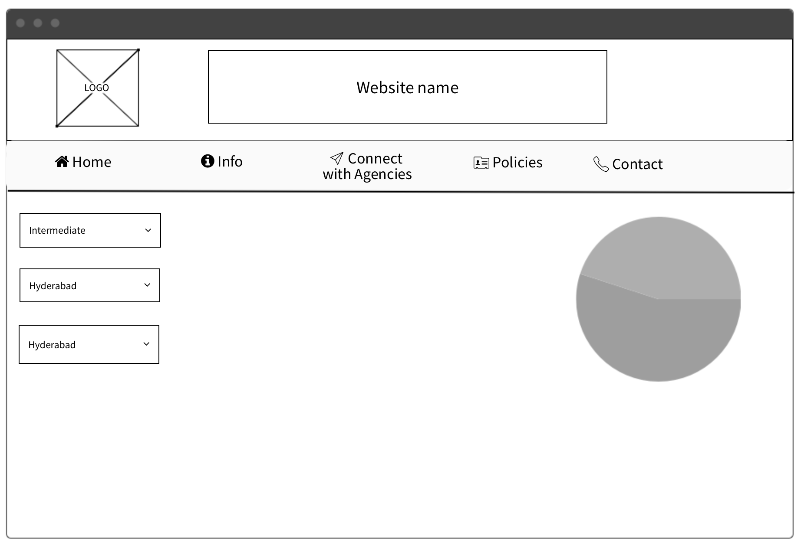
Example
Data On Intermediate Level Education
Girls
Ratio of students(gender wise)
Boys | Girls
51% | 49%
Boys
Hyderabad is currently having 51/49 (100) gender ratio among the students opting for Intermediate Education.
PRESENTATION TITLE

Slide 18
MVP slide
PRESENTATION TITLE
MVP slide will contain data with a graphical representation.
This will let user to understand the data in a visualised and will give a better understanding of it.
Like in the previous slide, Gender wise data was provided for students enrolled in Intermediate level education.
Data will be provided with the help of normal charts(pie, bar graph, etc) and user interactive charts

Slide 19
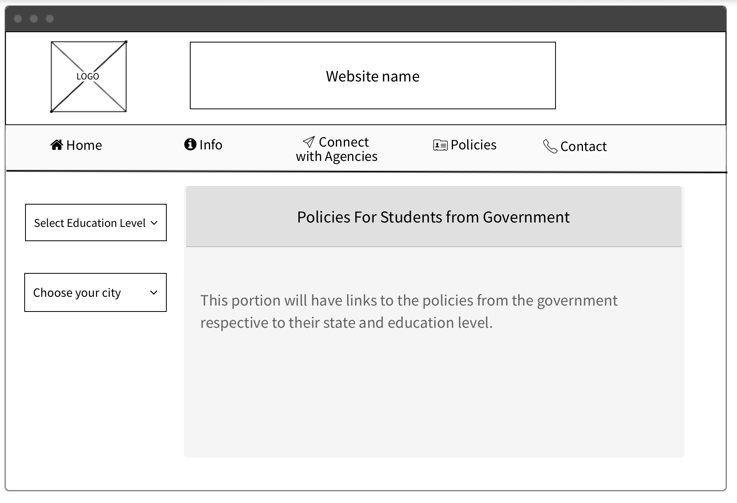
POLICY PAGE
PRESENTATION TITLE

Slide 20
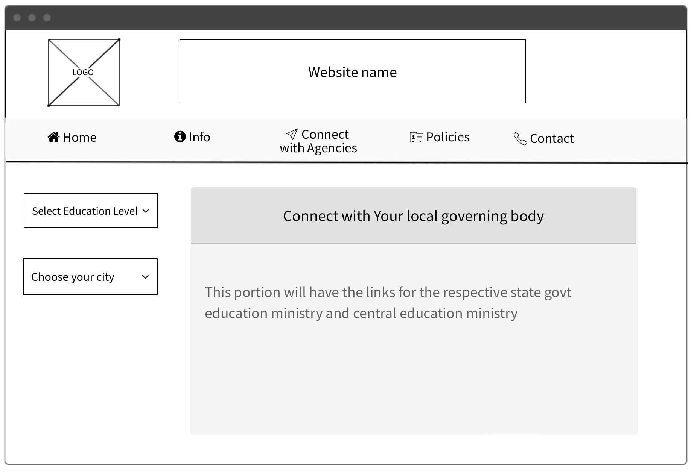
AGENCY CONTACT PAGE
PRESENTATION TITLE

Slide 21
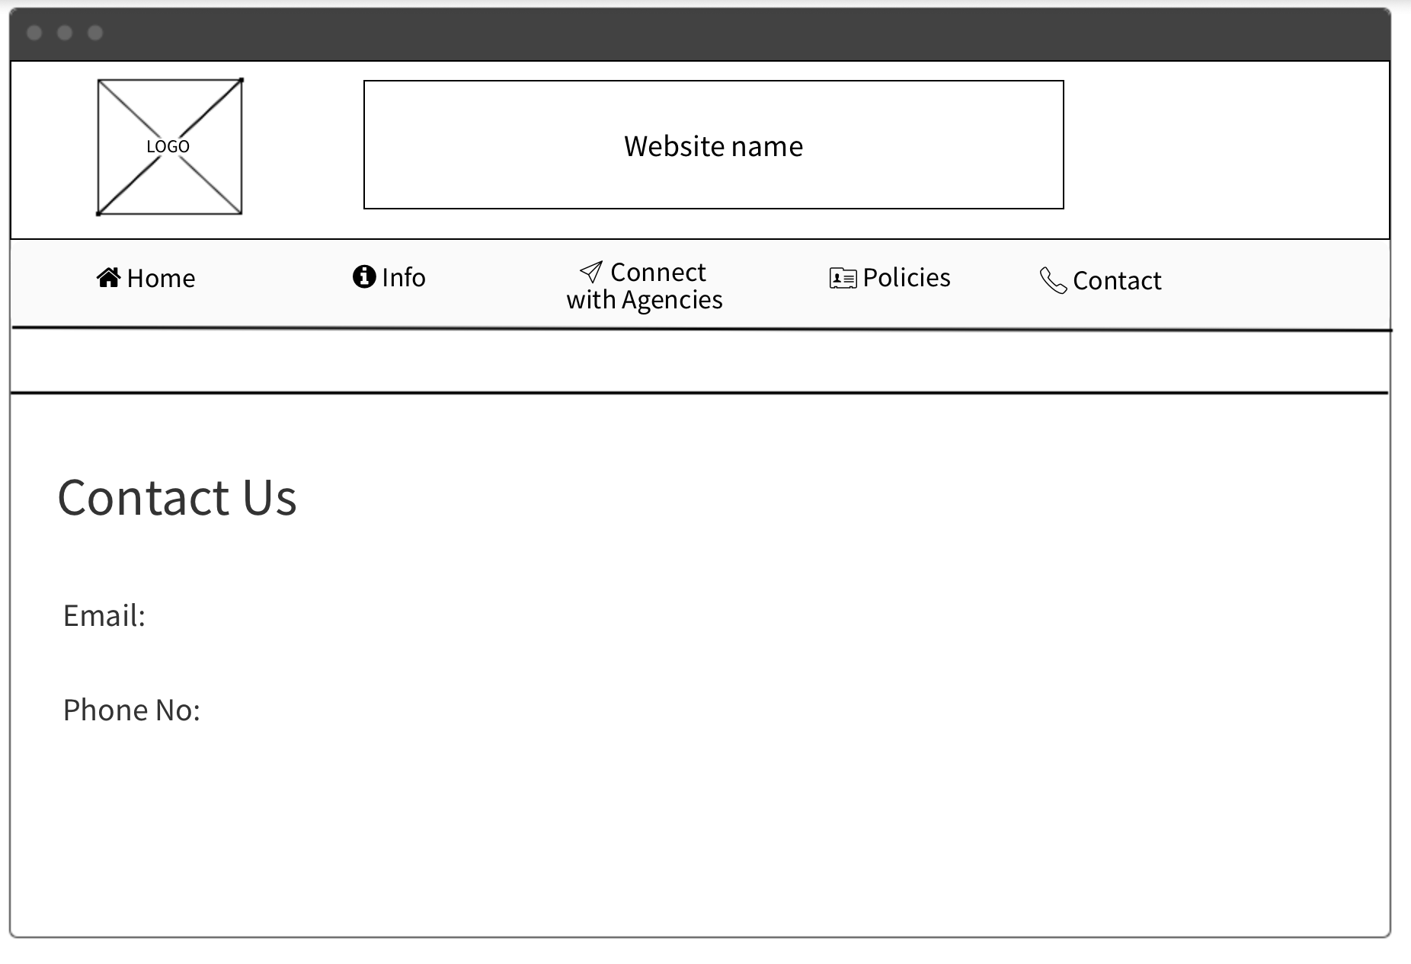
CONTACT PAGE
PRESENTATION TITLE

Slide 22
The end
PRESENTATION TITLE

