Slide 1


Kisan Vetan Vridhi
Ministry/ Organization name : CDK GLOBAL
Problem Statement :Portal for farmers to sell the produce at a better rate (RA27).
Team Name : BrainDead Zombies Team Leader Name: Rachit Srivastava
College Code: 1-3688291341
Notes:
Picture:
https://unsplash.com/photos/tMI2_-r5Nfo
https://unsplash.com/photos/hpjSkU2UYSU

Slide 2

Our Idea
h
STACKS
An e-commerce integrated portal that provides an easily accessible interface for Kisaans to help them get good money for their crop.
1.NodeJs
2.ReactJs
3.ExpressJs
4.Blockchain
5.MongoDB
6.HTML CSS
7.VanillaJs
8.Jquery
9.OAuth
10.React Native
11.GraphQL
12.Webpack
13.Machine Learning
(SkLearn ,Linear Regression)
14.Django
Bridging the gap between buyers and farmers to eliminate middle man in a way to increase the earning of farmer.
www.website.com
Providing a friendly interface for farmers to sell their products using easily accessible facilities like SMS irrespective of their literacy level.
Farmers will sell to the buyers on the basis of the highest bid placed decided using Ethereum Blockchain.
Notes:
Picture:
https://unsplash.com/photos/3V8xo5Gbusk
https://unsplash.com/photos/Zlli7ptD8fg

Slide 3

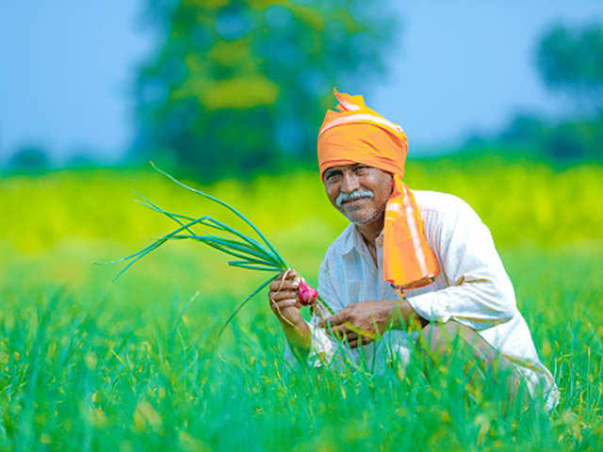
Use Cases
rrrrr
1.This will benefit both buyers and farmers.
2.Farmers will be benefitted since our platform removes the involvement of middleman.
3.Farmers will be able to make additional income which will help the to live a life with pride.
4.Transparency in production as well as supply which will help to differentiate between poor and rich farmers that will help the government to sanction loans or provide monetary support to needy ones.
5.Excludes additional cost in marketing and delivery of goods.
6.Better all round access to all farmers as SMS will be sent regarding all buyers for verification.
7.Maximum price will be decided on basis of bidding that will include blockchain technology.
8.Finally it will help to upgrade all current conditions of Farmer and profitting them that will also decrease number of suicides due to debt.
Dependencies
1.Smart Contract
2.Aadhar Number Verification
3.Availaiblility of the crop.
4.Transfer of all money in Jan Dhan Yojana account using integrated payment gateway .
5.Linking of Private Delivery services like DTDC by linking COD With Jan Dhan account.
Notes:
Pictures:
https://unsplash.com/photos/Nv4QHkTVEaI
https://unsplash.com/photos/D4jRahaUaIc
https://unsplash.com/photos/IwVRO3TLjLc

