Slide 1
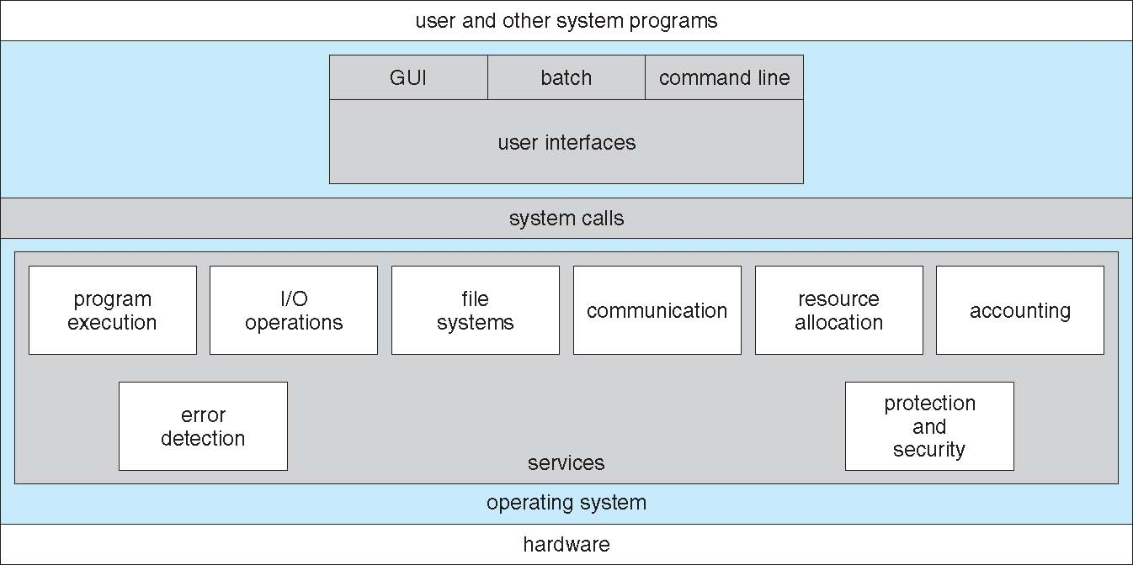
System structure
2.1 Operating system services
An operating system provides an environment for the execution of programs. It provides certain services to programs and to the users of those programs. The specific services provided, of course, differ from one operating system to another, but we can identify common classes. Following figure shows one view of the various operating-system services and how they interrelate

Slide 2
Continued….
User interface. Almost all operating systems have a user interface. This interface can take several forms. One is a DTrace command line interface(CLI) which uses text commands and a method for entering them(say, a program to allow entering and editing of commands). Another is a batch interface in which commands and directives to control those commands are entered into files, and those files are executed. Most commonly, a graphical user interface is used.
Program execution. The system must be able to load a program into memory and to run that program. The program must be able to end its execution, either normally or abnormally (indicating error).
I/O operations. A running program may require I/0, which may involve a file or an I/0 device. For specific devices, special functions may be desired (such as recording to a CD or DVD drive or blanking a display screen). For efficiency and protection, users usually cannot control I/0 devices directly. Therefore, the operating system must provide a means to do I/0.
File-system manipulation. The file system is of particular interest. Obviously, programs need to read and write files and directories. They also need to create and delete them by name, search for a given file, and list file information. Finally, some programs include permissions management to allow or deny access to files or directories based on file ownership.

Slide 3
Continued….
Communications. There are many circumstances in which one process needs to exchange information with another process. Such communication may occur between processes that are executing on the same computer or between processes that are executing on different computer systems tied together by a computer network. Communications may be implemented via shared memory or through message passing.
Error detection. The operating system needs to be constantly aware of possible errors. Errors may occur in the CPU and memory hardware (such as a memory error or a power failure), in I/0 devices (such as a parity error on tape, a connection failure on a network, or lack of paper in the printer), and in the user program (such as an arithmetic overflow, an attempt to access an illegal memory location). For each type of error, the operating system should take the appropriate action to ensure correct and consistent computing.

Slide 4
Continued…
Another set of operating-system functions exists not for helping the user but rather for ensuring the efficient operation of the system itself.
Resource allocation: When there are multiple users or multiple jobs running at the same time, resources must be allocated to each of them. Many different -types of resources are managed by the operating system such as CPU cycles, main memory, and file storage.
Accounting: we want to keep track of which users use how much and what kinds of computer resources. This record keeping may be used for accounting or simply for accumulating usage statistics.
Security of the system from outsiders is also important. Such security starts with requiring each user to authenticate himself or herself to the system, usually by means of a password, to gain access to system resources.

Slide 5
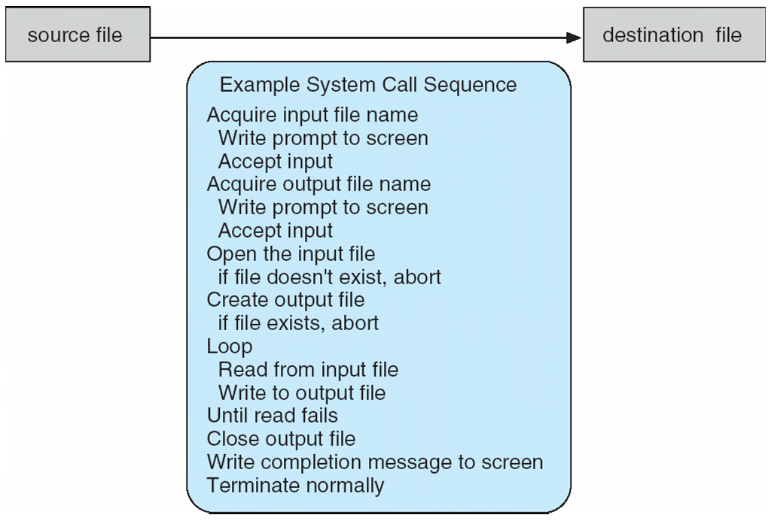
2.3 system call
System calls provide an interface to the services made available by an operating system. These calls are generally available as routines written in C and C++.
System call sequence to copy the contents of one file to another file.

Slide 6
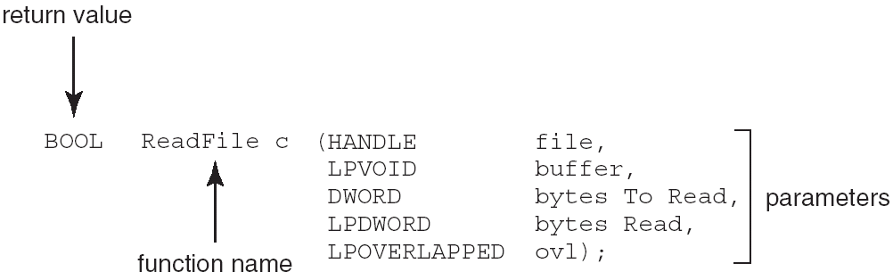
Continued….
Application programming interface(API) : specifies a set of functions that are available to application programmer, including the parameters that are passed to each function and the return values the programmer can expect.
Example of Standard API
Consider the ReadFile() function in the
Win32 API—a function for reading from a file
A description of the parameters passed to ReadFile()
HANDLE file—the file to be read
LPVOID buffer—a buffer where the data will be read into and written from
DWORD bytesToRead—the number of bytes to be read into the buffer
LPDWORD bytesRead—the number of bytes read during the last read
LPOVERLAPPED ovl—indicates if overlapped I/O is being used

Slide 7
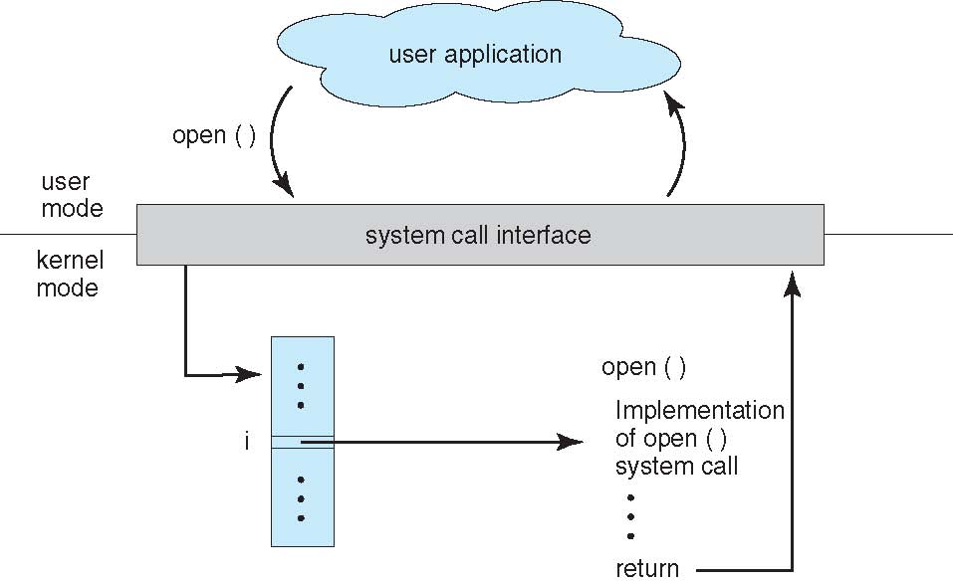
Continued…
The relationship between an API, the system-call interface, and the operating system is shown in Figure 2.6, which illustrates how the operating system handles a user application invoking the open() system call.

Slide 8
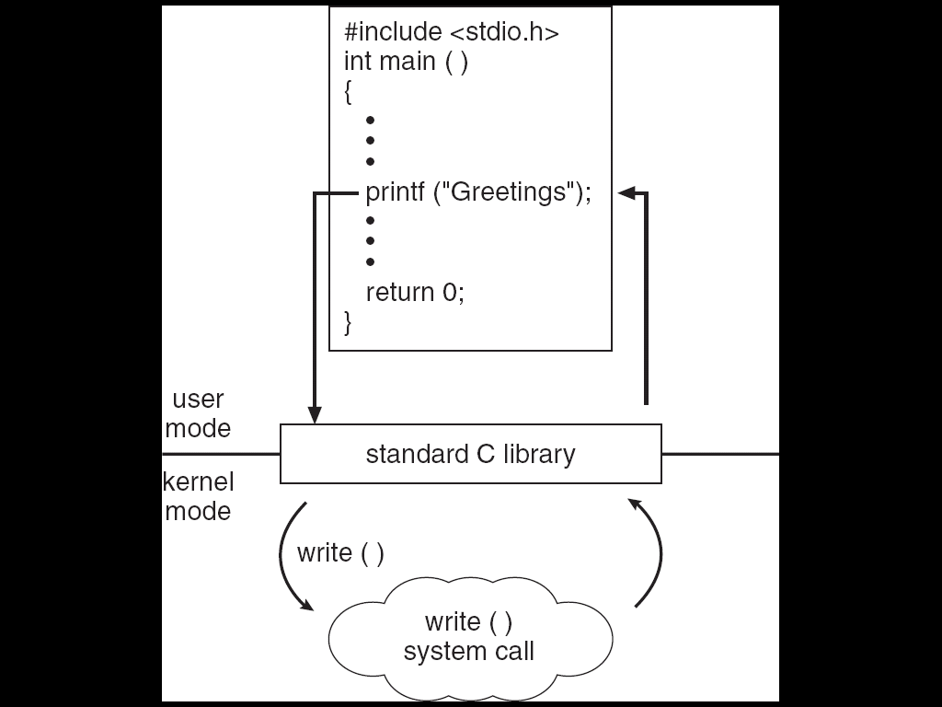
C program invoking printf() library call, which calls write() system call.

Slide 9
2.4 Types of system calls
System calls can be grouped roughly six major categories:
Process control
file manipulation
Device manipulation
information maintenance
Communication
Protection

Slide 10
Continued…
Process control
End process, abort process
Load process, execute process
create process, terminate process
get process attributes, set process attributes
wait for time
wait event, signal event
allocate and free memory
File management
create file, delete file
open, close file
read, write, reposition
get and set file attributes

Slide 11
Continued…
Device management
request device, release device
read, write, reposition
get device attributes, set device attributes
logically attach or detach devices
Information maintenance
get time or date, set time or date
get system data, set system data
get and set process, file, or device attributes
Communications
create, delete communication connection
send, receive messages
transfer status information
attach and detach remote devices

Slide 12
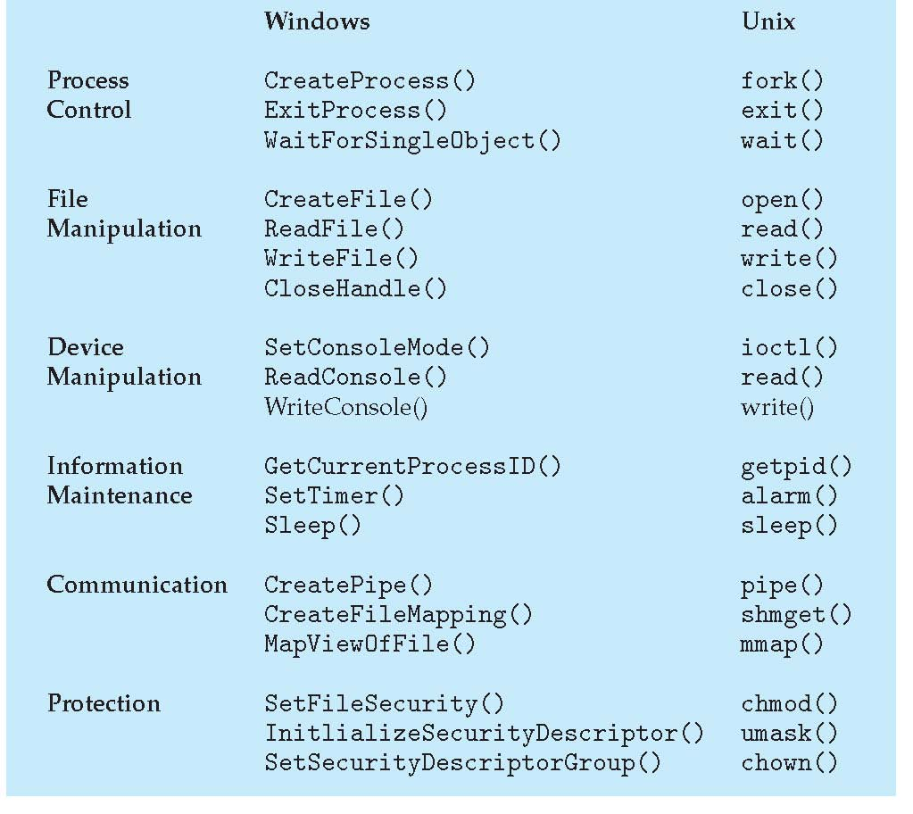
Continued….
Examples of Windows and Unix System Calls

Slide 13
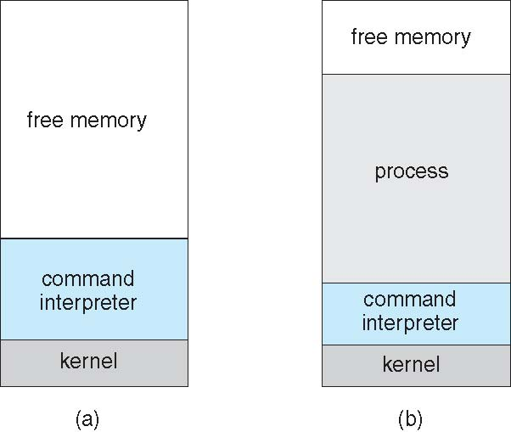
Continued….
Example: MS-DOS
Single tasking operating system.
Simple method to run program
MS-DOS execution

Slide 14
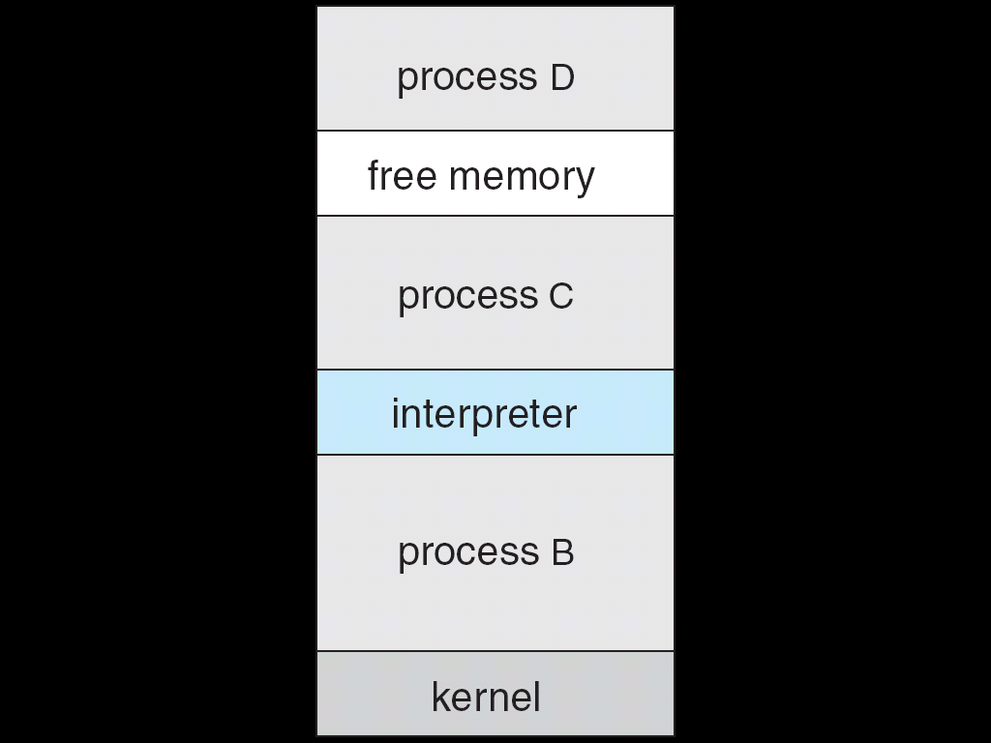
Continued…..
FreeBSD
Unix variant
Multitasking
User login -> invoke user’s choice of shell
Shell executes fork() system call to create process
FreeBSD Running Multiple Programs

Slide 15
2.6 Operating system design and implementation
In this section, we discuss problems we face in designing and implementing an operating system. There are, of course, no complete solutions to such problems, but there are approaches that have proved successful.
2.6.1 Design Goals
The first problem in designing a system is to define goals and specifications. At the highest level, the design of the system will be affected by the choice of hardware and the type of system: batch, time shared, single user, multiuser, distributed, real time, or general purpose.
The goals can be user goals and system goals.
Users desire certain obvious properties in a system. The system should be convenient to use, easy to learn and to use, reliable, safe, and fast.
A similar set of requirements can be defined by those people who must design, create, maintain, and operate the system. The system should be easy to design, implement, and maintain.
Specifying and designing an operating system is a highly creative task. Although no textbook can tell you how to do it, general principles have been developed in the field of software engineering.

Slide 16
Continued…
2.6.2 Mechanisms and Policies
Mechanism specifies how to do something and policies determine what will be done.
For example, the timer construct is a mechanism for ensuring CPU protection, but deciding how long the timer is to be set for a particular user is a policy decision.
Policies are likely to change across places or over time. In worst case, each change in policy would require a change in the underlying mechanism.
Policy decisions are important for all resource allocation. Whenever it is necessary to decide whether or not to allocate a resource, a policy decision must be made.

Slide 17
Continued…
2.6.3 Implementation
Once an operating system is designed, it must be implemented
Now, however, they are most commonly written in higher-level languages such as C or C++.
The Linux and Windows XP operating systems are written mostly in C, although there are some small sections of assembly code for device drivers and for saving and restoring the state of registers.
The advantages of using a higher-level language are the code can be written faster, is more compact, and is easier to understand ,debug and easy to port.
The only possible disadvantages of implementing an operating system in a higher-level language are reduced speed and increased storage requirements.
As is true in other systems, major performance improvements in operating systems are more likely to be the result of better data structures and algorithms than of excellent assembly-language code.

Slide 18
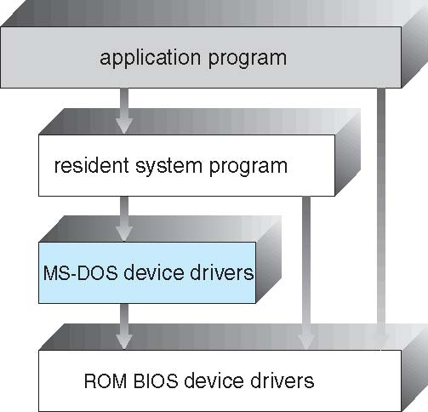
Operating system structure
A system as large and complex as a modern operating system must be engineered carefully if it is to function properly and be modified easily. A common approach is to partition the task into small components rather than have one monolithic system.
2.7.1 simple structure
Many commercial operating systems do not have well-defined structures. Frequently, such systems started as small, simple, and limited systems and then grew beyond their original scope.
MS-DOS is an example of such a system.
It was written to provide the most functionality in the least space, so it was not divided into modules carefully. Following figure shows its structure.

Slide 19
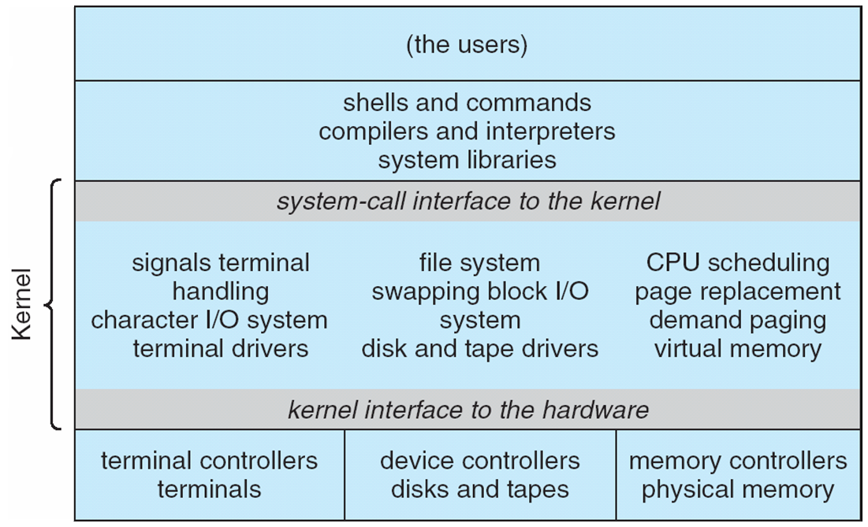
Continued….
Another example of limited structuring is the original UNIX operating system. Like MS-DOS, UNIX initially was limited by hardware functionality.
It consists of two separate parts the kernel and system programs.
Figure shows Traditional UNIX System Structure.

Slide 20
Continued….
Disadvtages of simple structure
In MS-DOS, the interfaces and levels of functionality are not well separated. For instance, application programs are able to access the basic I/O routines to write directly to the display and disk drives.
Such freedom causes entire system to crash when user programs fail.
No hardware protection and no dual mode operation.

Slide 21
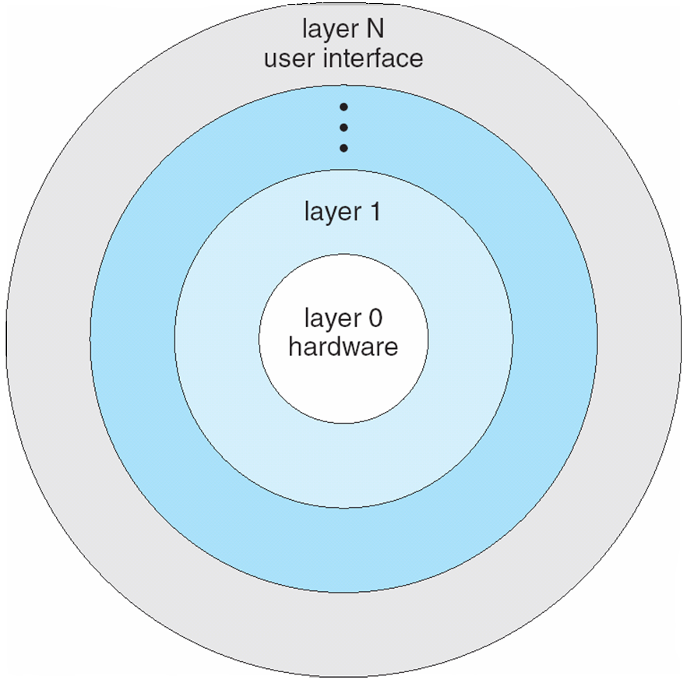
2.7.2 Layered approach
With proper hardware support, operating systems can be broken into pieces that are smaller and more appropriate than MS-DOS and UNIX.
In layered approach, the operating system is broken into a number of layers(levels).
The bottom layer is hardware (layer 0) and highest layer(layer N) is user interface. The following figure shows layered structure.
An operating-system layer is an implementation of an abstract object made up of data and the operations that can manipulate those data.

Slide 22
Continued….
Advantages of layered approach
Simple to construct and debug.
The operating system can then retain much greater control over the computer and over the applications that make use of that computer.
The layers are selected so that each uses functions (operations) and services of only lower-level layers. This approach simplifies debugging and system verification.
Provides information hiding.
Disadvantages of layered approach
The major difficulty with the layered approach involves appropriately defining the various layers. Because a layer can use only lower-level layers, careful planning is necessary.
they tend to be less efficient than other types. For instance, when a user program executes an I/0 operation, it executes a system call that is trapped to the I/0 layer, which calls the memory-management layer which in turn calls the CPU-scheduling layer, which is then passed to the hardware.

Slide 23
2.7.3 Microkernels
We have already seen that as UNIX expanded, the kernel became large and difficult to manage.
University developed an operating system called Mach that modularized the kernel using the microkernel approach.
This method structures the operating system by removing all nonessential components from the kernel and implementing them as system and user level programs. The result is smaller kernel called microkernel.
Microkernel provides minimal process and memory management.
The main function of the micro kernel is to provide a communication facility between the client program and the various services that are also running in user space.
Advantages:
Easy to extend operating system.
Easy to port operating system from one hardware design to other.
It provides more security and reliability.
Disadvantages
decreased performance due to increased system function overhead.

Slide 24
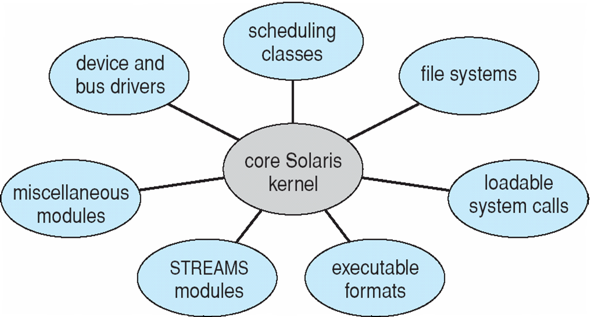
2.7.4 Modules (modular approach)
Perhaps the best current methodology for operating-system design involves using object-oriented programming techniques to create a modular kernel.
Here, the kernel has a set of core components and links in additional services either during boot time or during run time.
For example, the Solaris operating system structure, shown in Figure, is organized around a core kernel with seven types of loadable kernel modules:
Scheduling classes
File systems
Loadable system calls
Executable formats
STREAMS modules
Miscellaneous
Device and bus drivers

Slide 25
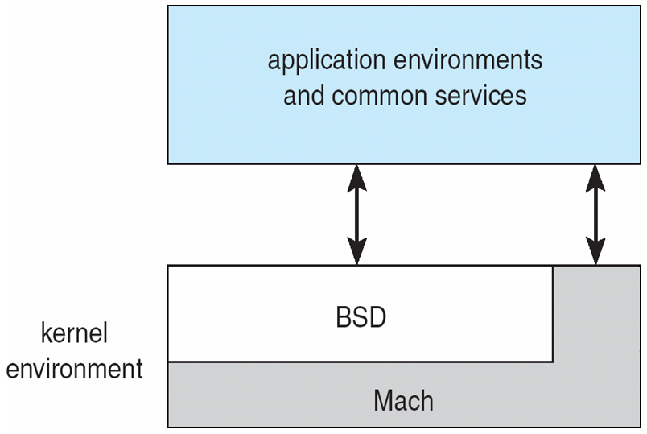
Continued….
The overall result resembles a layered system in that each kernel section has defined, protected interfaces; but it is more flexible than a layered system in that any module can call any other module.
Furthermore, the approach is like the microkernel approach in that the primary module has only core functions and knowledge of how to load and communicate with other modules; but it is more efficient, because modules do not need to invoke message passing in order to communicate.
The Apple Mac OS X operating system in following figure uses a hybrid structure. It is a layered system in which one layer consists of the Mach microkernel.
The top layers include application environments and a set of services providing a graphical interface to applications. Below these layers is the kernel environment, which consists primarily of the Mach microkernel and the BSD kernel.
Mach provides memory management; support for remote procedure calls (RPCs) and interprocess communication (IPC) facilities, including message passing.
The BSD component provides a BSD command line interface,
support for networking and file systems.

Slide 26
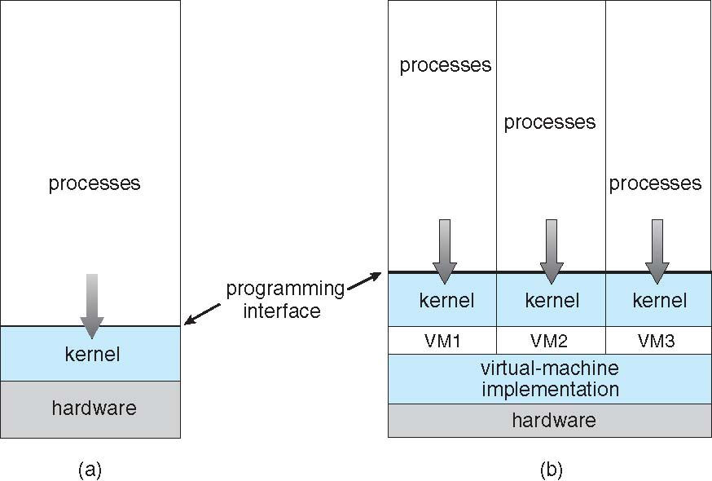
2.8 Virtual machine
The fundamental idea behind a virtual machine is to abstract the hardware of a single computer (the CPU, memory, disk drives, network interface cards, and so forth) into several different execution environments, thereby creating the illusion that each separate execution environment is running its own private computer.
By using CPU scheduling and virtual-memory techniques an operating system can create the illusion that a process has its own processor with its own (virtual) memory.
system models (a) nonvirtual (b)virtual

Slide 27
Continued….
Benefits of virtual machine
One important advantage is that the host system is protected from the virtual machines, just as the virtual machines are protected from each other. Because each virtual machine is completely isolated from all other virtual machines, there are no protection problems.
A virtual-machine system is a perfect vehicle for operating-systems research and development.
Another advantage of virtual machines for developers is that multiple operating systems can be running on the developer's workstation concurrently.
A major advantage of virtual machines in production data-center use is system consolidation which involves taking two or more separate systems and running them in virtual machines on one system.
Switching between operating systems is easy and faster.

Slide 28
2.8.3 Simulation
Simulation is one in which the host system has one system architecture and the guest system was compiled for a different architecture.
For example, suppose a company has replaced its outdated computer system with a new system but would like to continue to run certain important programs that were compiled for the old system.
The programs could be run in an emulator that translates each of the outdated system's instructions into the native instruction set of the new system.
Emulation can increase the life of programs and allow us to explore old architectures without having an actual old machine, but its major challenge is performance.

Slide 29
2.8.5 Implementation of virtual machine
Although the virtual-machine concept is useful it is difficult to implement.
the underlying machine typically has two modes (i) user mode and (ii) kernel mode.
The virtual-machine software can run in kernel mode, since it is the operating system. The virtual machine itself can execute in only user mode.
Consequently, we must have a virtual user mode and a virtual kernel mode, both of which run in a physical user mode.
Those actions that cause a transfer from user mode to kernel mode on a real machine must also cause a transfer from virtual user mode to virtual kernel mode on a virtual machine.

Slide 30
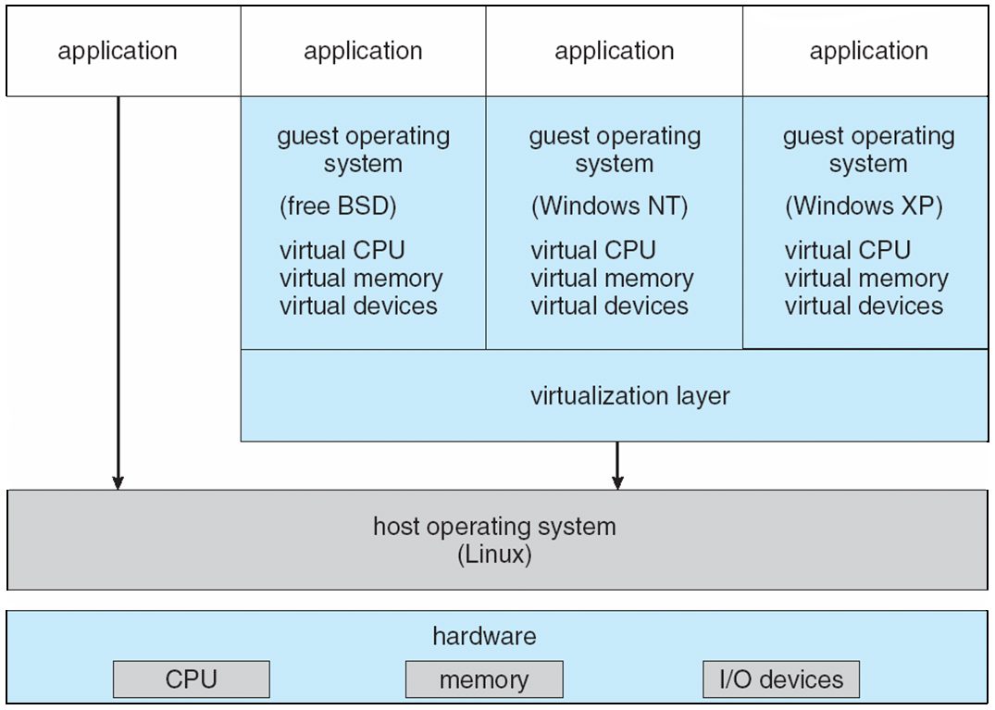
2.8.6 Examples
2.8.6.1 Vmware
Vmware Workstation runs as an application on a host operating system such as Windows or Linux and allows this host system to concurrently run several different guest operating systems as independent virtual machines.
The architecture of such a system is shown in Figure 2.19. In this scenario, Linux is running as the host operating system; and FreeBSD, Windows NT, and Windows XP are running as guest operating systems.
The virtualization layer is the heart of VMware, as it abstracts the physical hardware into isolated virtual machines running as guest operating systems. Each virtual machine has its own virtual CPU, memory, disk drives, network interfaces, and so forth.

Slide 31
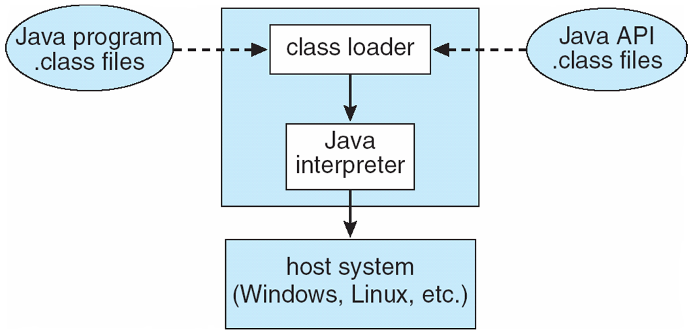
2.8.6.2 The Java Virtual Machine
Java is a popular object-oriented programming language introduced by Sun Microsystems in 1995.
Java objects are specified with the class construct; a Java program consists of one or more classes. For each Java class, the compiler produces an architecture-neutral bytecode output (.class) file that will run on any implementation of the JVM.
It consist of mainly two components I,e class loader and java interpreter.
The class loader loads the compiled . Class files from both the Java program and the Java API for execution by the Java interpreter.
After a class is loaded, the verifier checks that the . class file is valid Java bytecode.
Java interpreter interprets the bytecode operations one at a time. A faster software technique is to use a just-in-time (JIT) compiler which converts bytecode into native machine language.
The JVM also automatically manages memory by performing garbage collection.

