Slide 1
Database Normalization

Slide 2
Introduction to Normalization
Normalization: Process of decomposing unsatisfactory "bad" relations by breaking up their attributes into smaller relations
Normal form: Condition using keys and FDs of a relation to certify whether a relation schema is in a particular normal form
  2NF, 3NF, BCNF based on keys and FDs of a relation schema
  4NF based on keys, multi-valued dependencies

Slide 3
Need for normalization
.
A properly normalized database should have the following characteristics
  Scalar values in each fields
  Absence of redundancy.
  Minimal use of null values.
  Minimal loss of information.

Slide 4
Levels of Normalization
Levels of normalization based on the amount of redundancy in the database.
Various levels of normalization are:
  First Normal Form (1NF)
  Second Normal Form (2NF)
  Third Normal Form (3NF)
  Boyce-Codd Normal Form (BCNF)
  Fourth Normal Form (4NF)
  Fifth Normal Form (5NF)
  Domain Key Normal Form (DKNF)
Redundancy
Number of Tables
Complexity
Most databases should be 3NF or BCNF in order to avoid the database anomalies.

Slide 5
Levels of Normalization
1NF
2NF
3NF
4NF
5NF
DKNF
Each higher level is a subset of the lower level

Slide 6
First Normal Form (1NF)
A table is considered to be in 1NF if all the fields contain
only scalar values (as opposed to list of values).
Example (Not 1NF)
ISBN
Title
AuName
AuPhone
PubName
PubPhone
Price
0-321-32132-1
Balloon
Sleepy, Snoopy, Grumpy
321-321-1111, 232-234-1234, 665-235-6532
Small House
714-000-0000
$34.00
0-55-123456-9
Main Street
Jones, Smith
123-333-3333, 654-223-3455
Small House
714-000-0000
$22.95
0-123-45678-0
Ulysses
Joyce
666-666-6666
Alpha Press
999-999-9999
$34.00
1-22-233700-0
Visual Basic
Roman
444-444-4444
Big House
123-456-7890
$25.00
Author and AuPhone columns are not scalar
Notes:
Having scalar values also means that all instances of a record type must contain the same number of fields.
A table not in first normal form is called un normalized

Slide 7
1NF - Decomposition
Place all items that appear in the repeating group in a new table
Designate a primary key for each new table produced.
Duplicate in the new table the primary key of the table from which the repeating group was extracted or vice versa.
Example (1NF)
ISBN
AuName
AuPhone
0-321-32132-1
Sleepy
321-321-1111
ISBN
Title
PubName
PubPhone
Price
0-321-32132-1
Snoopy
232-234-1234
0-321-32132-1
Balloon
Small House
714-000-0000
$34.00
0-321-32132-1
Grumpy
665-235-6532
0-55-123456-9
Main Street
Small House
714-000-0000
$22.95
0-55-123456-9
Jones
123-333-3333
0-123-45678-0
Ulysses
Alpha Press
999-999-9999
$34.00
0-55-123456-9
Smith
654-223-3455
1-22-233700-0
Visual Basic
Big House
123-456-7890
$25.00
0-123-45678-0
Joyce
666-666-6666
1-22-233700-0
Roman
444-444-4444
Notes:
1. The designated key will be the primary key of the original table concatenated with one or more data items from the new table.
For the first table the primary key is ISBN
For the second table the primary key is ISBN + Author Name

Slide 8
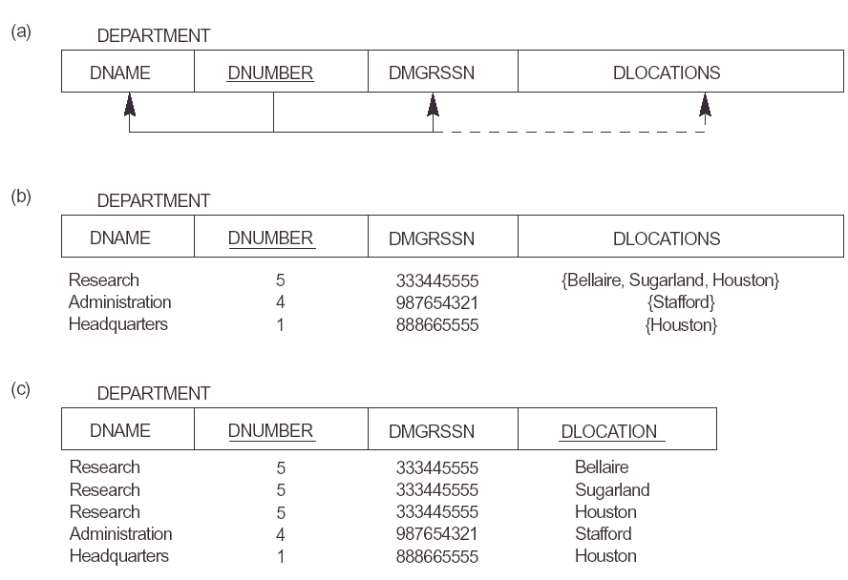

Slide 9
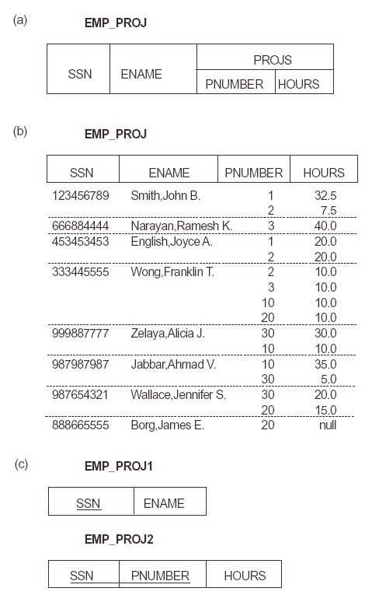

Slide 10
Is the following relation in 1NF?
USN | NAME | GENDER | CITY | HOBBIES
Notes:
Notes to Instructor: Need more rigor in the functional dependencies. With a few examples. May be create a class assignment for functional dependencies.

Slide 11
Is the following relation in 1NF?
USN | NAME | GENDER | CITY | HOBBIES
NO
Since hobbies will be multiple values !!!!!!!
Notes:
Notes to Instructor: Need more rigor in the functional dependencies. With a few examples. May be create a class assignment for functional dependencies.

Slide 12
Is the following relation in 1NF?
USN | NAME | GENDER | CITY | HOBBIES
NO
Since hobbies will be multiple values !!!!!!!
Can you convert it into 1NF???
Notes:
Notes to Instructor: Need more rigor in the functional dependencies. With a few examples. May be create a class assignment for functional dependencies.

Slide 13
Is the following relation in 1NF?
USN | NAME | GENDER | CITY | HOBBIES
NO
Since hobbies will be multiple values !!!!!!!
Can you convert it into 1NF???
YES
Notes:
Notes to Instructor: Need more rigor in the functional dependencies. With a few examples. May be create a class assignment for functional dependencies.

Slide 14
Is the following relation in 1NF?
USN | NAME | GENDER | CITY | HOBBIES
First way:
USN | NAME | GENDER | CITY
USN | HOBBIES
Notes:
Notes to Instructor: Need more rigor in the functional dependencies. With a few examples. May be create a class assignment for functional dependencies.

Slide 15
Is the following relation in 1NF?
USN | NAME | GENDER | CITY | HOBBIES
First way:
Second way:
USN | NAME | GENDER | CITY
USN | HOBBIES
USN | NAME | GENDER | CITY | HOBBIES
Notes:
Notes to Instructor: Need more rigor in the functional dependencies. With a few examples. May be create a class assignment for functional dependencies.

Slide 16
Is the following relation in 1NF?
USN | NAME | GENDER | CITY | HOBBIES
First way:
Second way:
Third way:
USN | NAME | GENDER | CITY
USN | HOBBIES
USN | NAME | GENDER | CITY | HOBBIES
USN | NAME | GENDER | CITY | Hobby1 | Hobby 2 | Hobby 3
Notes:
Notes to Instructor: Need more rigor in the functional dependencies. With a few examples. May be create a class assignment for functional dependencies.

Slide 17
Second Normal Form (2NF)
For a table to be in 2NF, there are two requirements
  The database is in first normal form
  All nonkey attributes in the table must be functionally dependent on the entire primary key
Note: Remember that we are dealing with non-key attributes

Slide 18
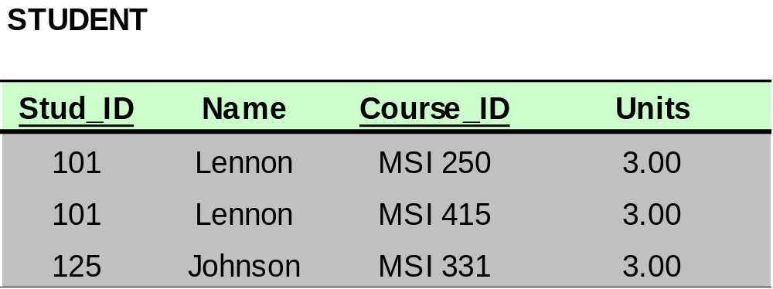
Bringing a Relation to 2NF
Composite Primary Key

Slide 19
Bringing a Relation to 2NF
Goal: Remove Partial Dependencies
Partial Dependencies
Composite Primary Key

Slide 20
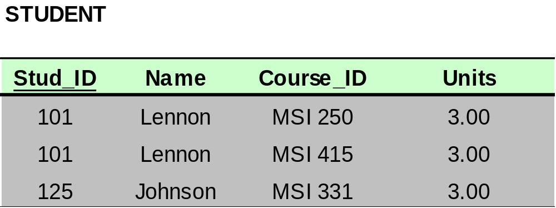
Bringing a Relation to 2NF
Remove attributes that are dependent from the part but not the whole of the primary key from the original relation. For each partial dependency, create a new relation, with the corresponding part of the primary key from the original as the primary key.

Slide 21
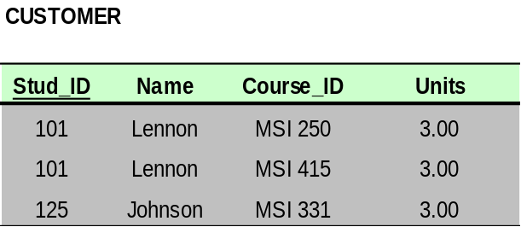
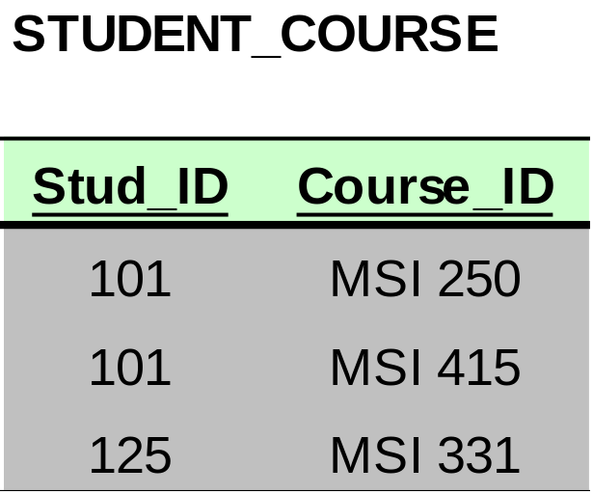
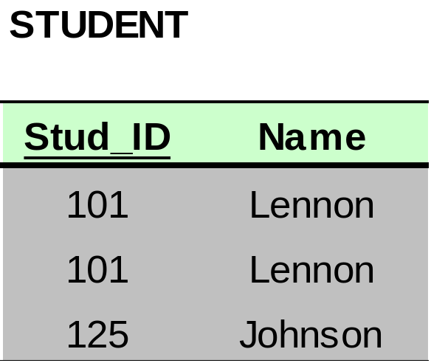
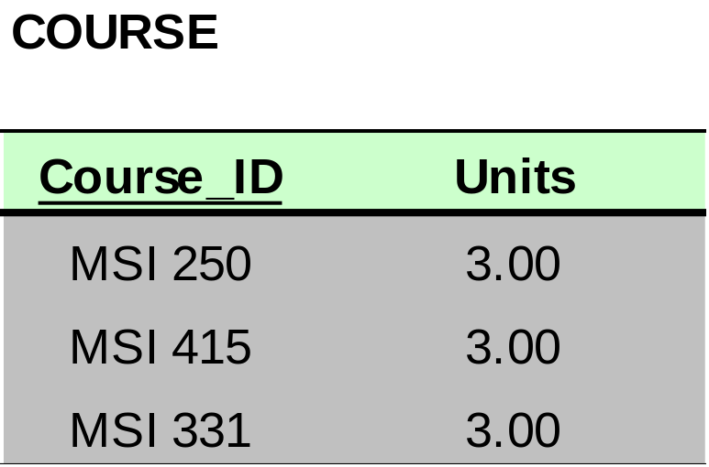
Bringing a Relation to 2NF

Slide 22
2NF - Decomposition
If a data item is fully functionally dependent on only a part of the primary key, move that data item and that part of the primary key to a new table.
If other data items are functionally dependent on the same part of the key, place them in the new table also
Make the partial primary key copied from the original table the primary key for the new table. Place all items that appear in the repeating group in a new table

Slide 23
Example 1 (Not 2NF)
Scheme → {Title, PubId, AuId, Price, AuAddress}
  Key → {Title, PubId, AuId}
  {Title, PubId, AuID} → {Price}
  {AuID} → {AuAddress}
  AuAddress does not belong to a key
  AuAddress functionally depends on AuId which is a subset of a key
Title
PubId
Auid
Price
Au_addr

Slide 24
Converting into 2 NF
Example 1 (Convert to 2NF)
  Old Scheme → {Title, PubId, AuId, Price, AuAddress}
  New Scheme → {Title, PubId, AuId, Price}
  New Scheme → {AuId, AuAddress}
Title
PubId
Auid
Price
Auid
Au_addr

Slide 25
Example 2 (Not 2NF)
Scheme → {City, Street, HouseNumber, HouseColor, CityPopulation}
  key → {City, Street, HouseNumber}
  {City, Street, HouseNumber} → {HouseColor}
  {City} → {CityPopulation}
  CityPopulation does not belong to any key.
  CityPopulation is functionally dependent on the City which is a proper subset of the key
City
Street
HoNumber
Ho_colour
City_population
Notes:
Let us consider the problems with the movie studio database:
Redundancy – City Population is repeated many times
Insertion anomaly – Whenever we add a new record we have to add unnecessary information. We can not add record until we know information about the city population
Deletion anomaly – Whenever we delete a record, useful information is deleted.
Update anomaly – The City Population needs to be updated in more than one location if it changes.

Slide 26
Converting into 2NF
Example 2(Convert to 2NF)
Old Scheme → {City, Street, HouseNumber, HouseColor, CityPopulation}
  New Scheme → {City, Street, HouseNumber, HouseColor}
  New Scheme → {City, CityPopulation}
City
Street
HoNumber
Ho_colour
City
City_population

Slide 27
Second Normal Form (2NF)
Example 3 (Not 2NF)
Scheme → {studio, movie, budget, studio_city}
  Key → {studio, movie}
  {studio, movie} → {budget}
  {studio} → {studio_city}
  studio_city is not a part of a key
  studio_city functionally depends on studio which is a proper subset of the key
Studio
Movie
Budget
Studi_city
Notes:
Let us consider the problems with the movie studio database:
Redundancy – City Population is repeated many times
Insertion anomaly – Whenever we add a new record we have to add unnecessary information. We can not add record until we know information about the city population
Deletion anomaly – Whenever we delete a record, useful information is deleted.
Update anomaly – The City Population needs to be updated in more than one location if it changes.

Slide 28
Converting to 2 NF
Example 3 (Convert to 2NF)
  Old Scheme → {Studio, Movie, Budget, StudioCity}
  New Scheme → {Movie, Studio, Budget}
  New Scheme → {Studio, City}
Studio
Movie
Budget
Studio
Studi_city

Slide 29
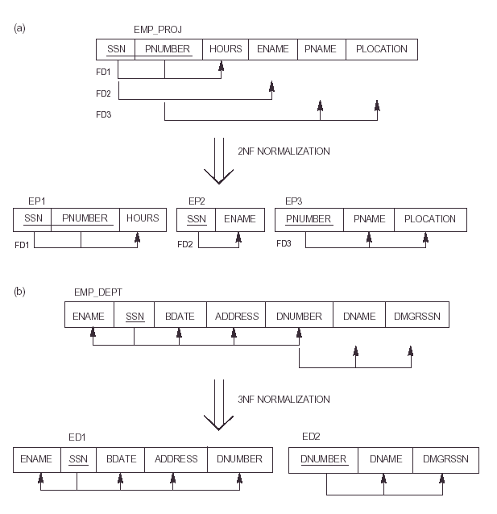

Slide 33
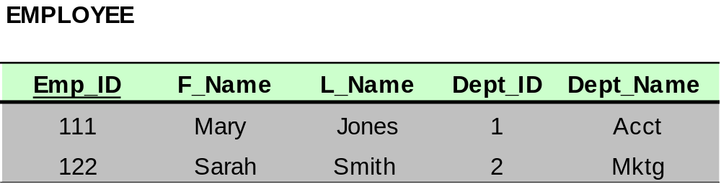
Dependencies: Definitions
Transitive Dependency – when a non-key attribute determines another non-key attribute.
Transitive Dependency

Slide 34
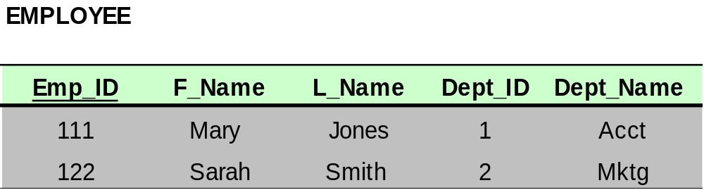
Bringing a Relation to 3NF
Goal: Get rid of transitive dependencies.
Transitive Dependency

Slide 35
Bringing a Relation to 3NF
Remove the attributes, which are dependent on a non-key attribute, from the original relation. For each transitive dependency, create a new relation with the non-key attribute which is a determinant in the transitive dependency as a primary key, and the dependent non-key attribute as a dependent.

Slide 36
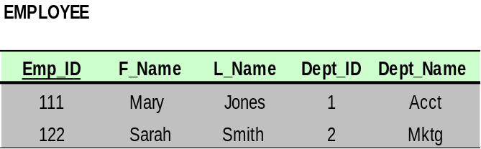
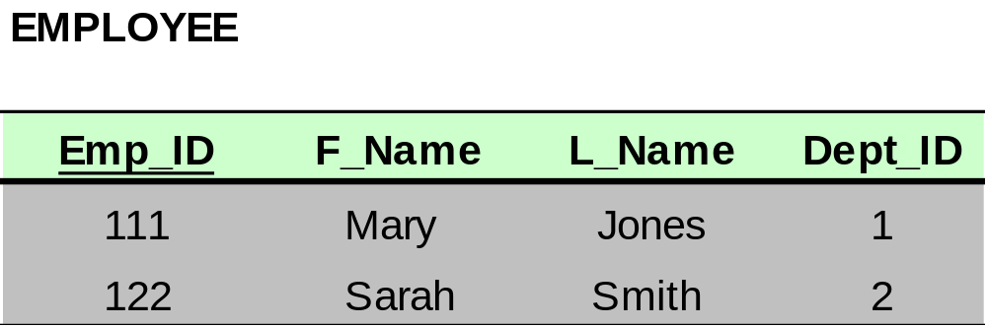
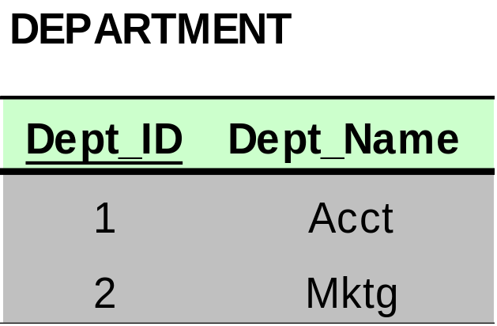
Bringing a Relation to 3NF

Slide 37
Third Normal Form (3NF)
This form dictates that all non-key attributes of a table must be functionally dependent on a candidate key i.e. there can be no interdependencies among non-key attributes.
For a table to be in 3NF, there are two requirements
  The table should be second normal form
  All non-primary fields are dependent on the primary key
  Example (Not in 3NF)
Scheme → {Cid, Cname, DOB, City, pincode, email}
  Key → {Cid}
  {Cid} → {cname,}
  {Cid} → {DOB}
  {Cid} → {pin}
  {Cid} → {email}
  {Pincode} → {City}
    Since pincode is non-key attribute and it determines city, hence not in 3NF
Notes:
In the Book Schema Third Normal Form is violated since a non-key field is dependent on another non-key field and is transitively dependent on the primary key.

Slide 38
3NF - Decomposition
Move all items involved in transitive dependencies to a new entity.
Identify a primary key for the new entity.
Place the primary key for the new entity as a foreign key on the original entity.
Notes:
If there is a table with columns A,B,C with Primary Key (A) and C is dependant on B (B → C) then to be 3NF, the tables become
Table with columns B,C with Primary Key (B)
Table with fields A,B with Primary Key ( A), and Foreign Key (B)

Slide 39
Converting to 3 NF
Old_Scheme → {Cid, Cname, DOB, City, pincode, email}
New Schema{Cid, Cname, DOB , pincode,email}
New Schema { pincode , city}

Slide 40
Convert the following into 3NF
{Sid, Sname, State, Country, age}
{Sid} → {Sname}
{Sid} → {State}
{Sid} → {Country}
{Sid} → {Age}
{State} → {Country}
  Since state is non-prime attribute and it determines county, its not in 3NF

Slide 41
Converted into 3NF
Old_schema {Sid, Sname, State, Country, age}
New_schema {Sid, Sname, State, age}
New_schema { State, Country}

Slide 42
Convert into 3 NF
Schema { id, name, acc_no,bank_code, Bank_name}

Slide 43
Converted into 3 NF
Old_Schema { id, name, acc_no,bank_code, Bank_name}
New_Schema { id, name, acc_no,bank_code}
New_schema {Bank_code, Bank_name}

Slide 44
Verify whether the following is in 3NF?
{Company_name, City, State, ZIP}

Slide 45
Verify whether the following is in 3NF?
{Company_name, City, State, ZIP}
Not in 3NF because, ZIP can determine city and state.
As ZIP is not key-attribute.. Its not in 3NF

Slide 46
Converting into 3NF
Old_Schema{Company_name, City, State, ZIP}
New-Schema{ Company_name, ZIP}
New-Schema{ZIP, City, State}

Slide 47
Boyce-Codd Normal Form (BCNF)
BCNF does not allow dependencies between attributes that belong to candidate keys.
BCNF is a refinement of the third normal form in which it drops the restriction of a non-key attribute from the 3rd normal form.
Third normal form and BCNF are not same if the following conditions are true:
  The table has two or more candidate keys
  At least two of the candidate keys are composed of more than one attribute
  The keys are not disjoint i.e. The composite candidate keys share some attributes
Example 1 - Address (Not in BCNF)
Scheme → {City, Street, ZipCode }
  Key1 → {City, Street }
  Key2 → {ZipCode, Street}
  No non-key attribute hence 3NF
  {City, Street} → {ZipCode}
  {ZipCode} → {City}
  Dependency between attributes belonging to a key
Notes:
The second and third normal forms assume that all attributes not part of the candidate keys depend on the candidate keys but does not deal with dependencies within the keys. BCNF deals with such dependencies.
Under third normal form all non-key columns must be functionally dependent on a candidate key. Under BCNF, even columns that are part of a candidate key must be dependent on another candidate key, if they have a dependency at all.
For most tables third normal form and BCNF are the same. Third normal form does not cover some specific cases for which BCNF was created. Third normal form and BCNF are not same if the following conditions are true:
The table has two or more candidate keys
At least two of the candidate keys are composed of more than one attribute
The keys are not disjoint i.e. The composite candidate keys share some attributes

Slide 48
Boyce Codd Normal Form (BCNF)
Example 2 - Movie (Not in BCNF)
Scheme → {MovieTitle, MovieID, PersonName, Role, Payment }
  Key1 → {MovieTitle, PersonName}
  Key2 → {MovieID, PersonName}
  Both role and payment functionally depend on both candidate keys thus 3NF
  {MovieID} → {MovieTitle}
  Dependency between MovieID & MovieTitle Violates BCNF
Example 3 - Consulting (Not in BCNF)
Scheme → {Client, Problem, Consultant}
  Key1 → {Client, Problem}
  Key2 → {Client, Consultant}
  No non-key attribute hence 3NF
  {Client, Problem} → {Consultant}
  {Client, Consultant} → {Problem}
  Dependency between attributess belonging to keys violates BCNF
Notes:
A management consulting firm has several clients and consultants. A client can have several problems and the same problem can be an issue for several clients. Each consultant specializes in only one problem type (e. g marketing, production) but several consultants could advise on one problem. For each problem, the client is advised by only one consultant.

Slide 49
BCNF - Decomposition
Place the two candidate primary keys in separate entities
Place each of the remaining data items in one of the resulting entities according to its dependency on the primary key.
Example 1 (Convert to BCNF)
  Old Scheme → {City, Street, ZipCode }
  New Scheme1 → {ZipCode, Street}
  New Scheme2 → {City, Street}
Loss of relation {ZipCode} → {City}
  Alternate New Scheme1 → {ZipCode, Street }
  Alternate New Scheme2 → {ZipCode, City}
Notes:
If there is a table with columns A,B,C with Primary Key (A) and C is dependant on B (B → C) then to be 3NF, the tables become
Table with columns B,C with Primary Key (B)
Table with fields A,B with Primary Key ( A), and Foreign Key (B)

Slide 50
Decomposition – Loss of Information
If decomposition does not cause any loss of information it is called a lossless decomposition.
If a decomposition does not cause any dependencies to be lost it is called a dependency-preserving decomposition.
Any table scheme can be decomposed in a lossless way into a collection of smaller schemas that are in BCNF form. However the dependency preservation is not guaranteed.
Any table can be decomposed in a lossless way into 3rd normal form that also preserves the dependencies.
  3NF may be better than BCNF in some cases
Use your own judgment when decomposing schemas

Slide 51
BCNF - Decomposition
Example 2 (Convert to BCNF)
  Old Scheme → {MovieTitle, MovieID, PersonName, Role, Payment }
  New Scheme → {MovieID, PersonName, Role, Payment}
  New Scheme → {MovieTitle, PersonName}
Loss of relation {MovieID} → {MovieTitle}
  New Scheme → {MovieID, PersonName, Role, Payment}
  New Scheme → {MovieID, MovieTitle}
We got the {MovieID} → {MovieTitle} relationship back
Example 3 (Convert to BCNF)
  Old Scheme → {Client, Problem, Consultant}
  New Scheme → {Client, Consultant}
  New Scheme → {Client, Problem}

