Slide 1
Fabric Monitor
Comprehensive Power BI & Fabric Estate Monitoring Supports Azure Commercial, GCC, GCC High

Slide 2
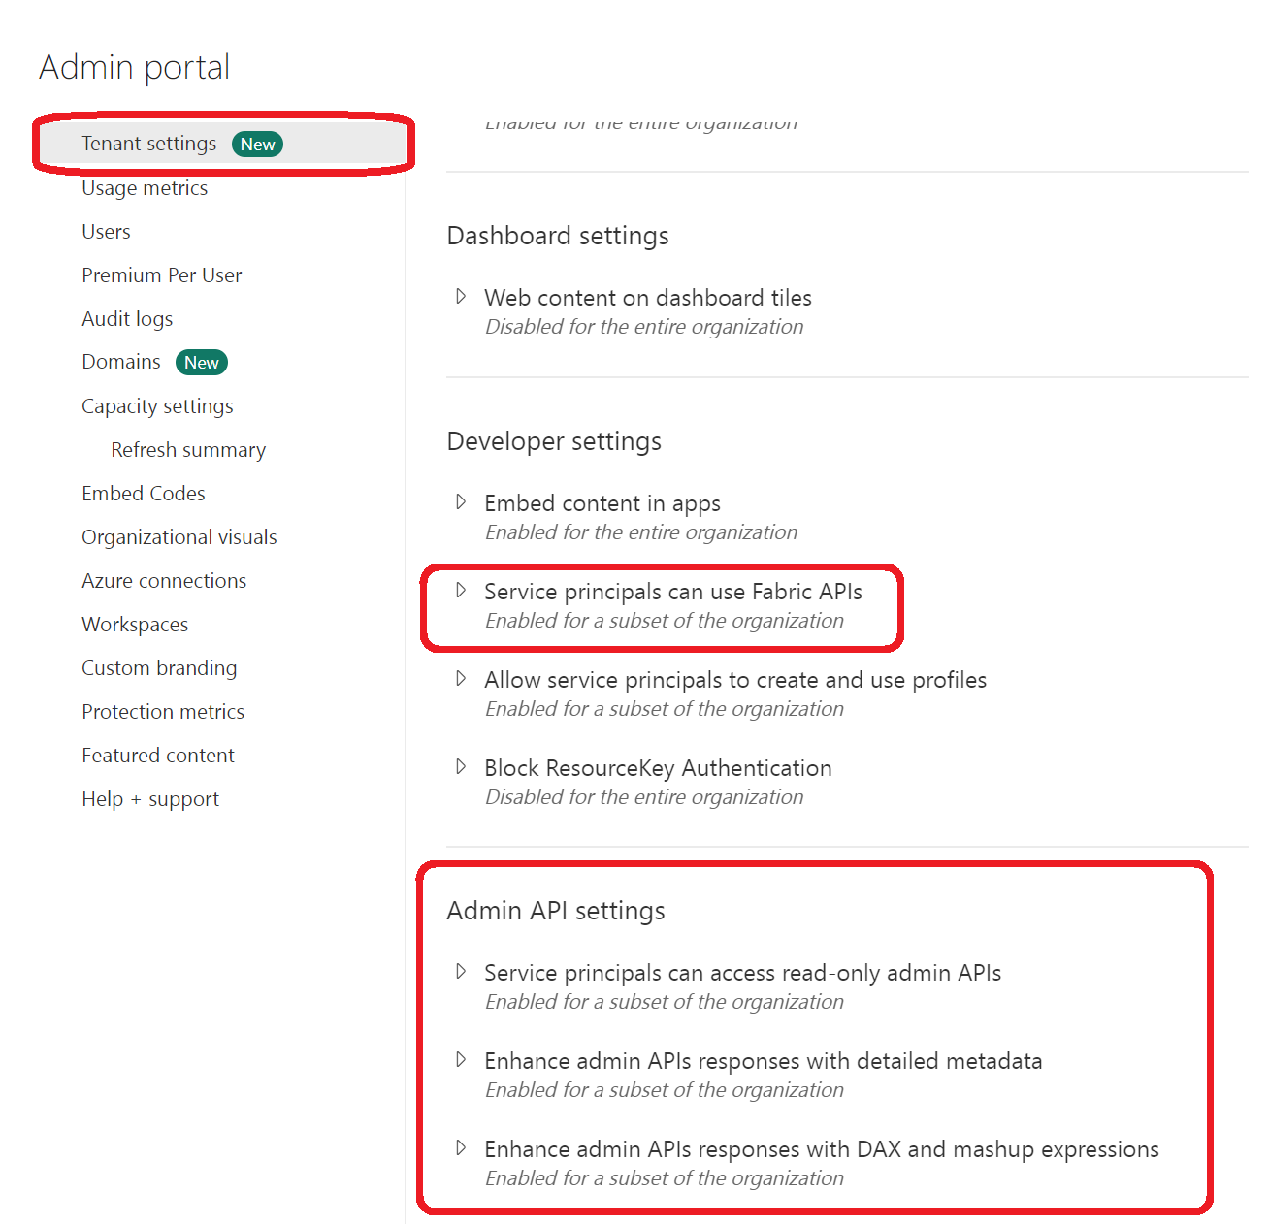
Setup: Admin Portal Configuration
Grant Service Principal permissions in Fabric Admin Portal Enable API access for monitoring and data extraction

Slide 3
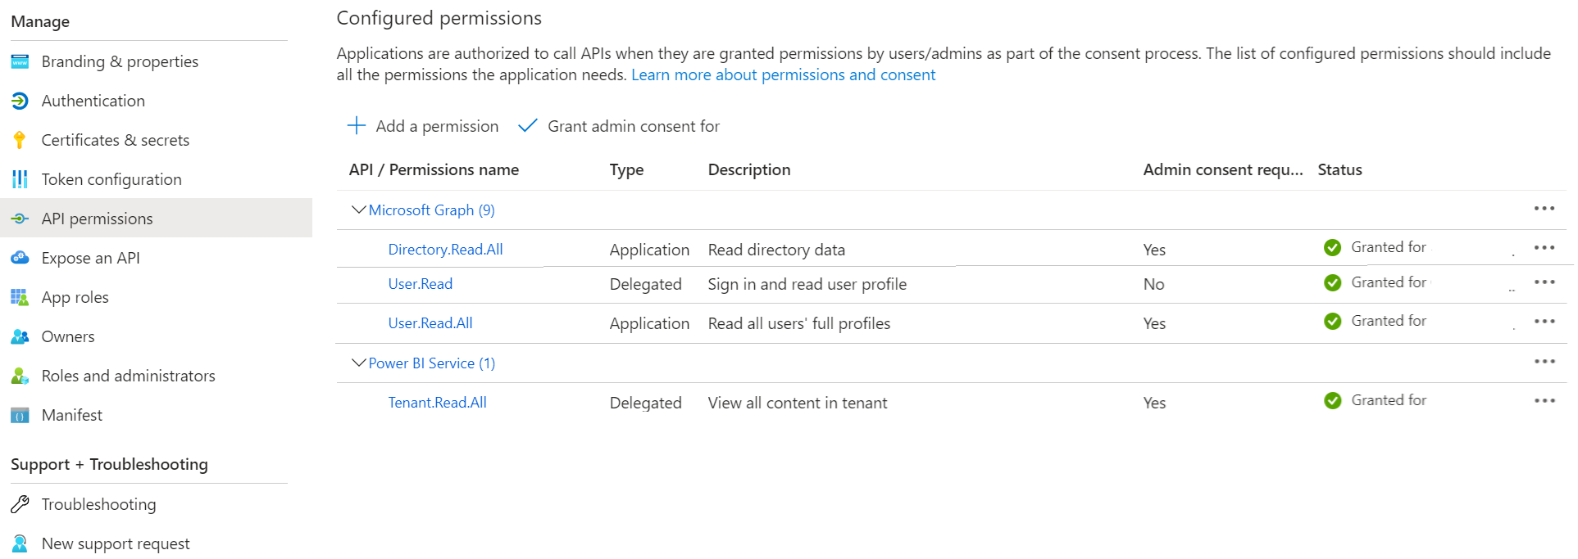
Setup: API Permissions
Configure Graph API and Power BI permissions Application-level permissions for headless monitoring

Slide 4
Monitoring Capabilities
Real-time visibility into your Power BI and Fabric estate

Slide 5
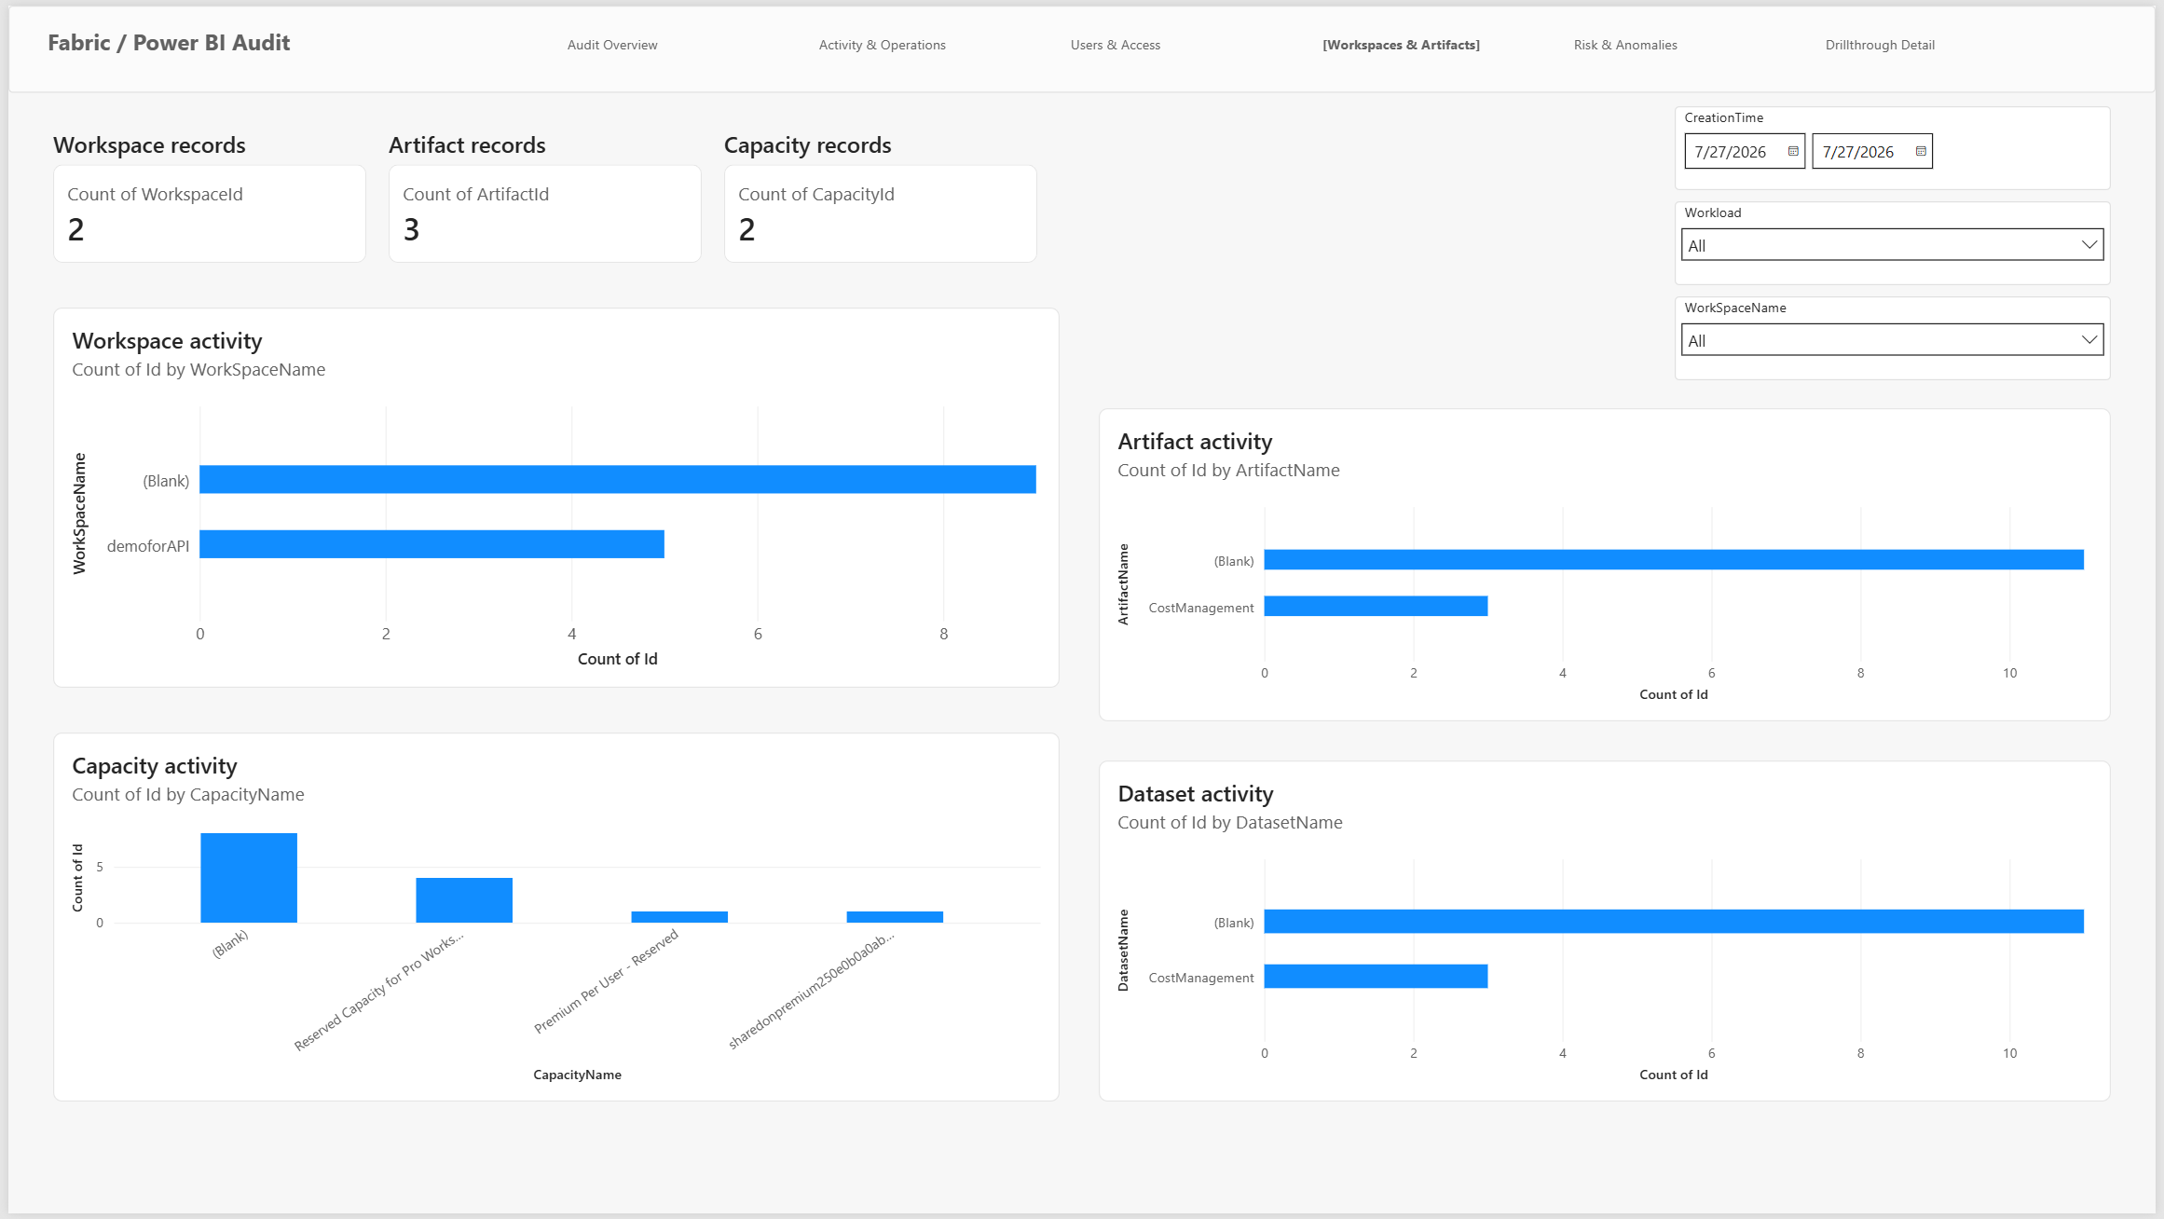
Workspace Inventory
Complete catalog of all workspaces and artifacts Track reports, datasets, dashboards, and dataflows

Slide 6
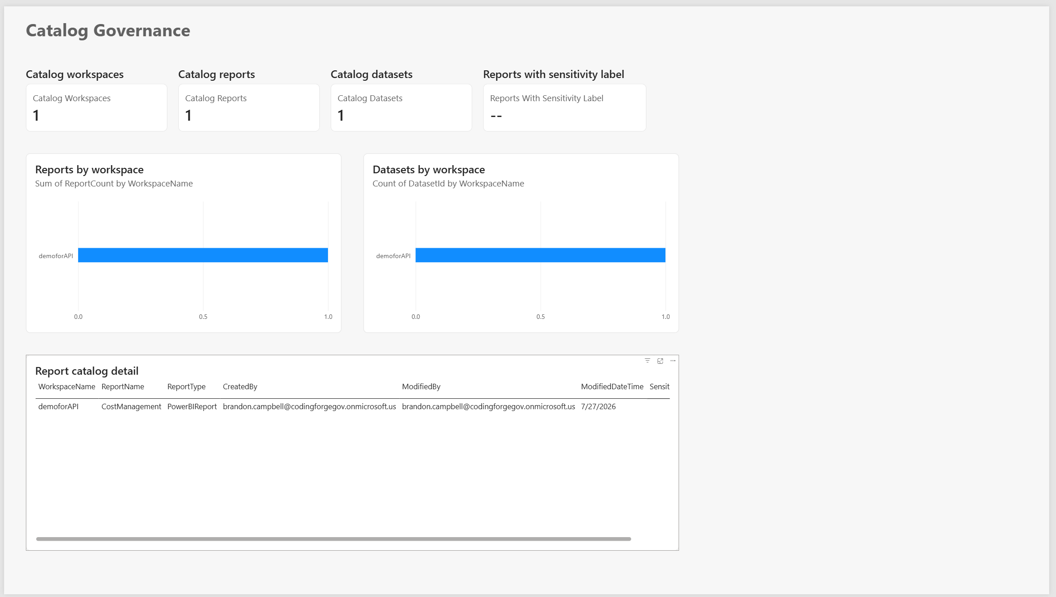
Governance & Classification
Monitor data classification and governance policies Ensure compliance across your enterprise

Slide 7
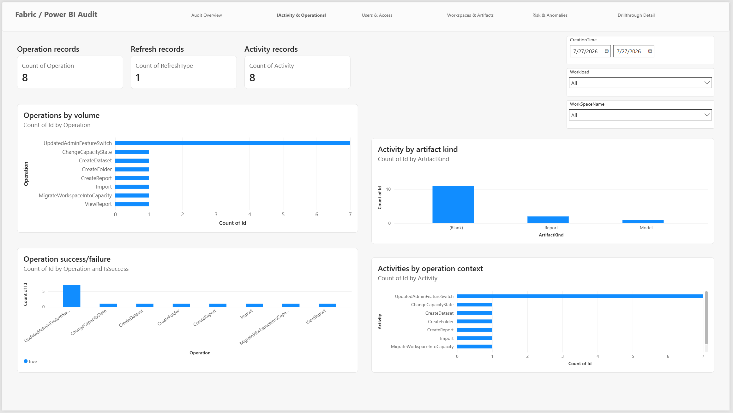
Activity & Operations
Track user activity, refresh operations, and usage patterns Identify trends and monitor platform health

Slide 8
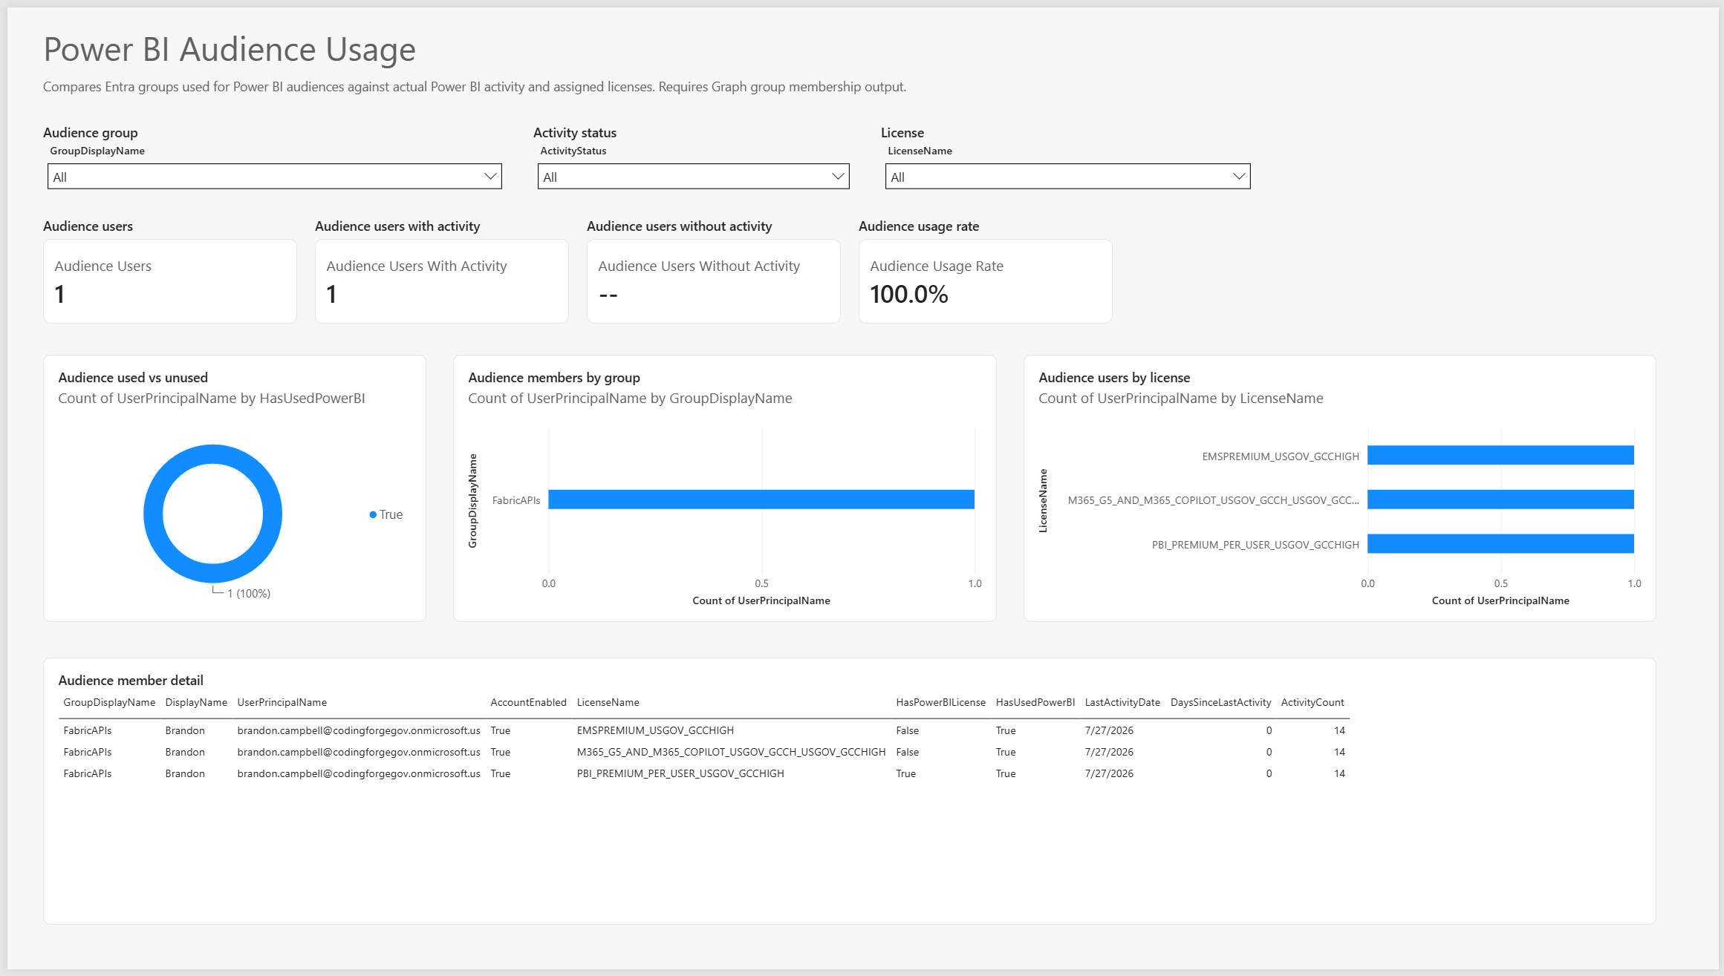
Audience & Usage Analytics
Understand which audiences are consuming content Measure engagement and adoption metrics

Slide 9
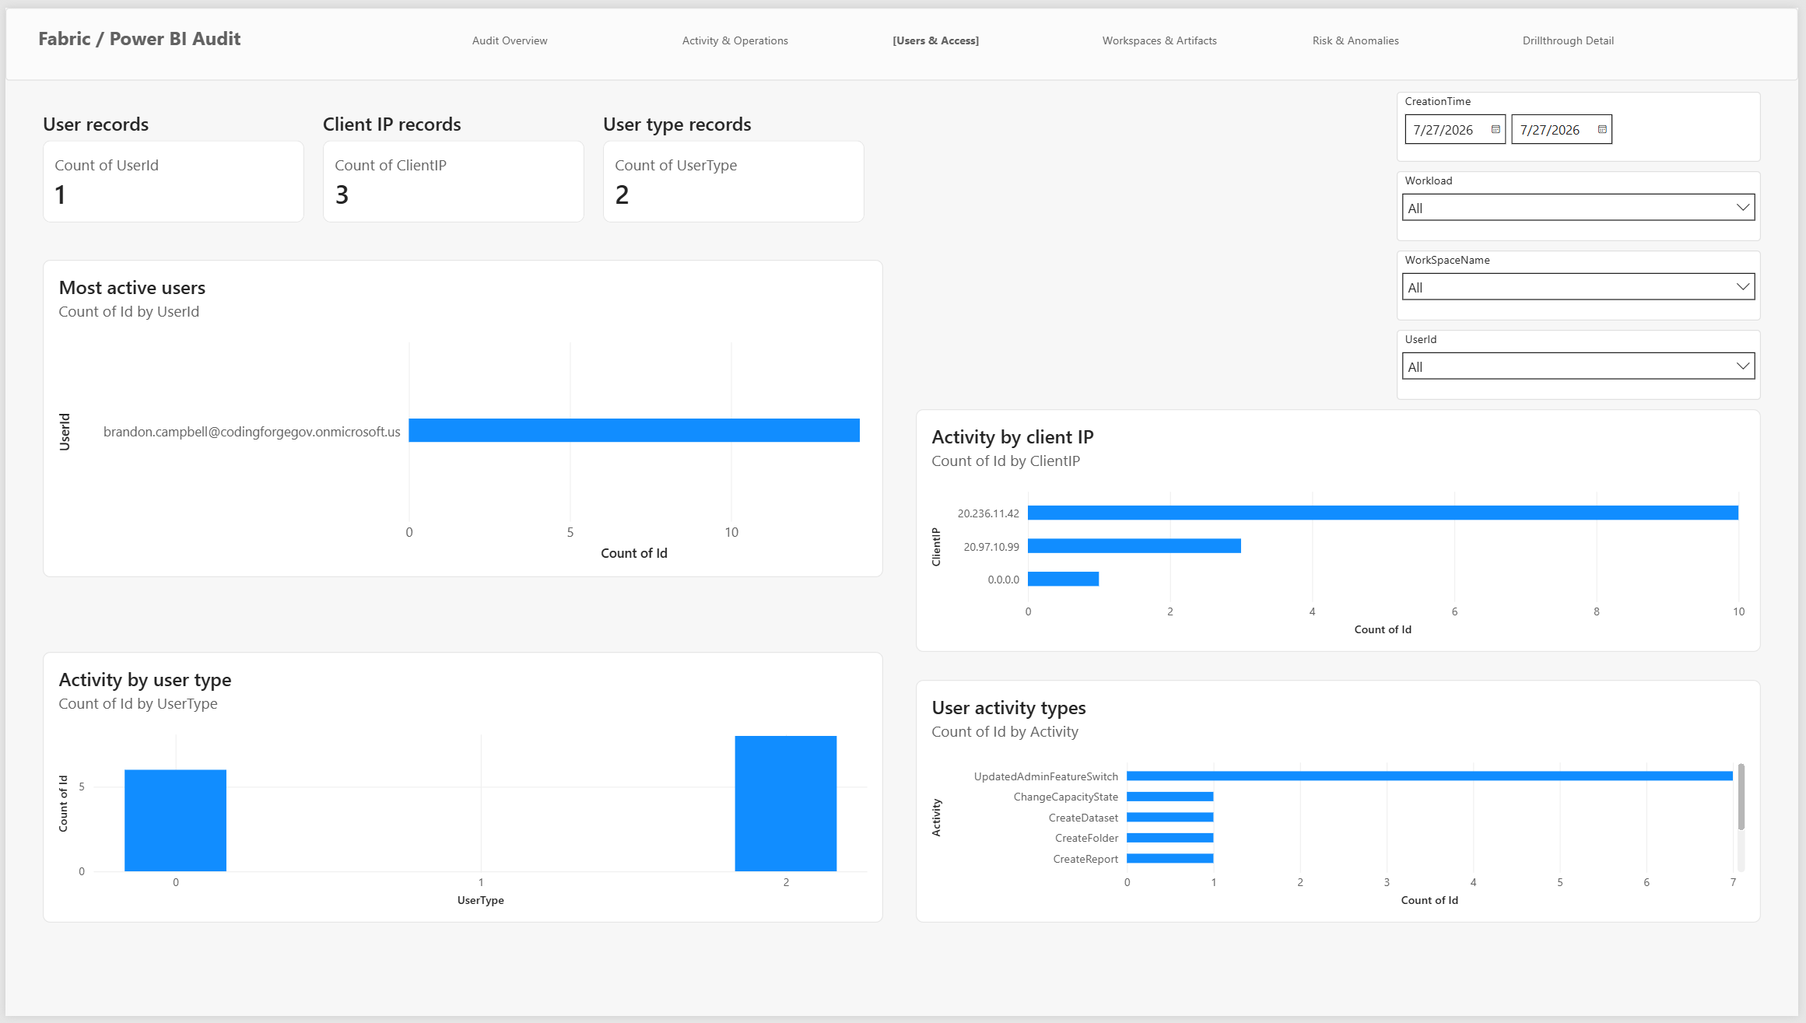
User Access & Security
Monitor user permissions and access levels Ensure proper authorization across workspaces

Slide 10
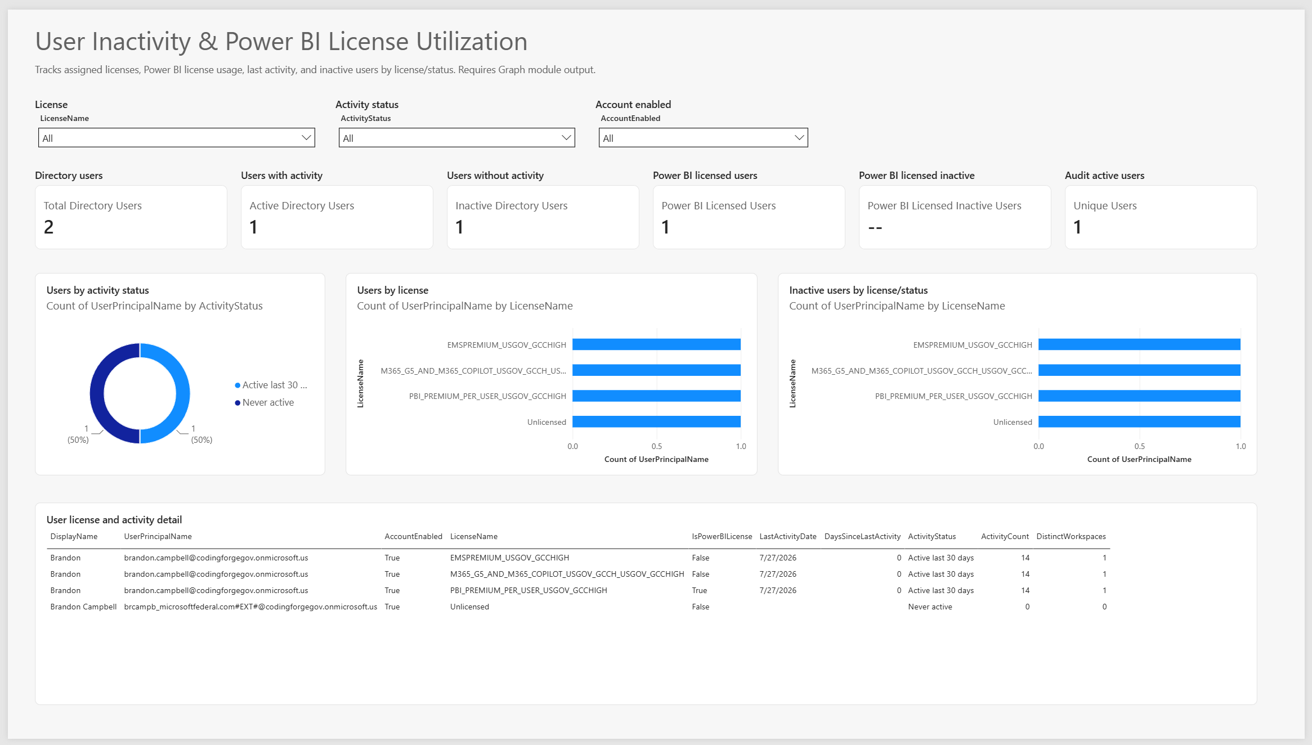
User Inactivity Tracking
Identify inactive users and unused capacity Optimize licensing and capacity allocation

Slide 11
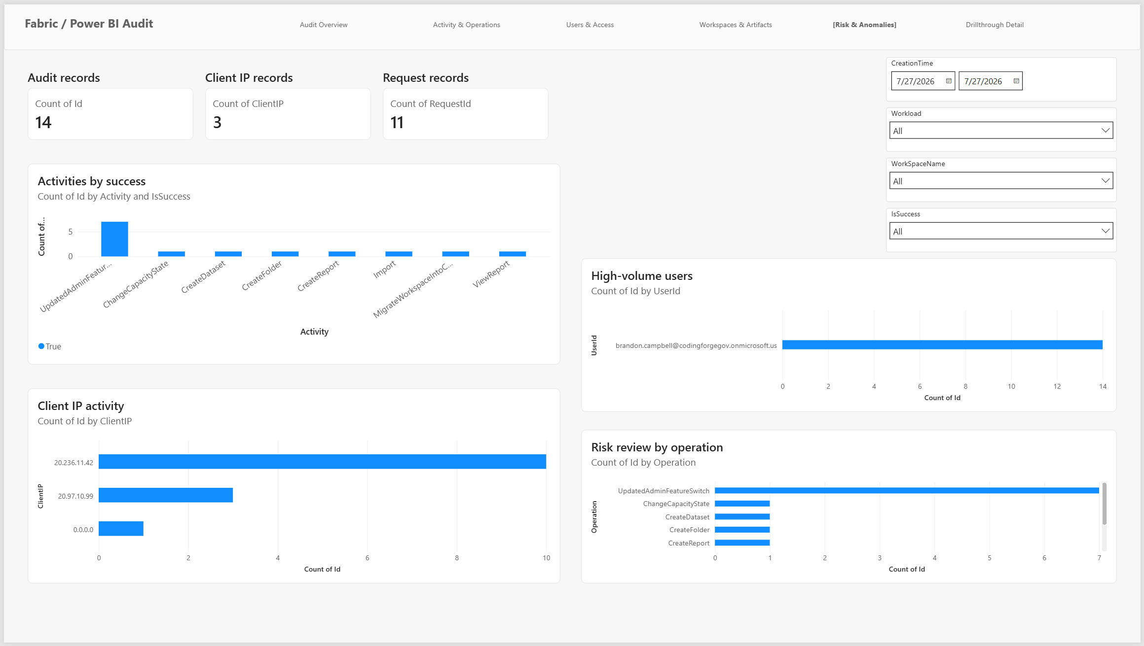
Risk & Anomaly Detection
Detect unusual patterns and potential security risks Proactive monitoring for estate health

Slide 12
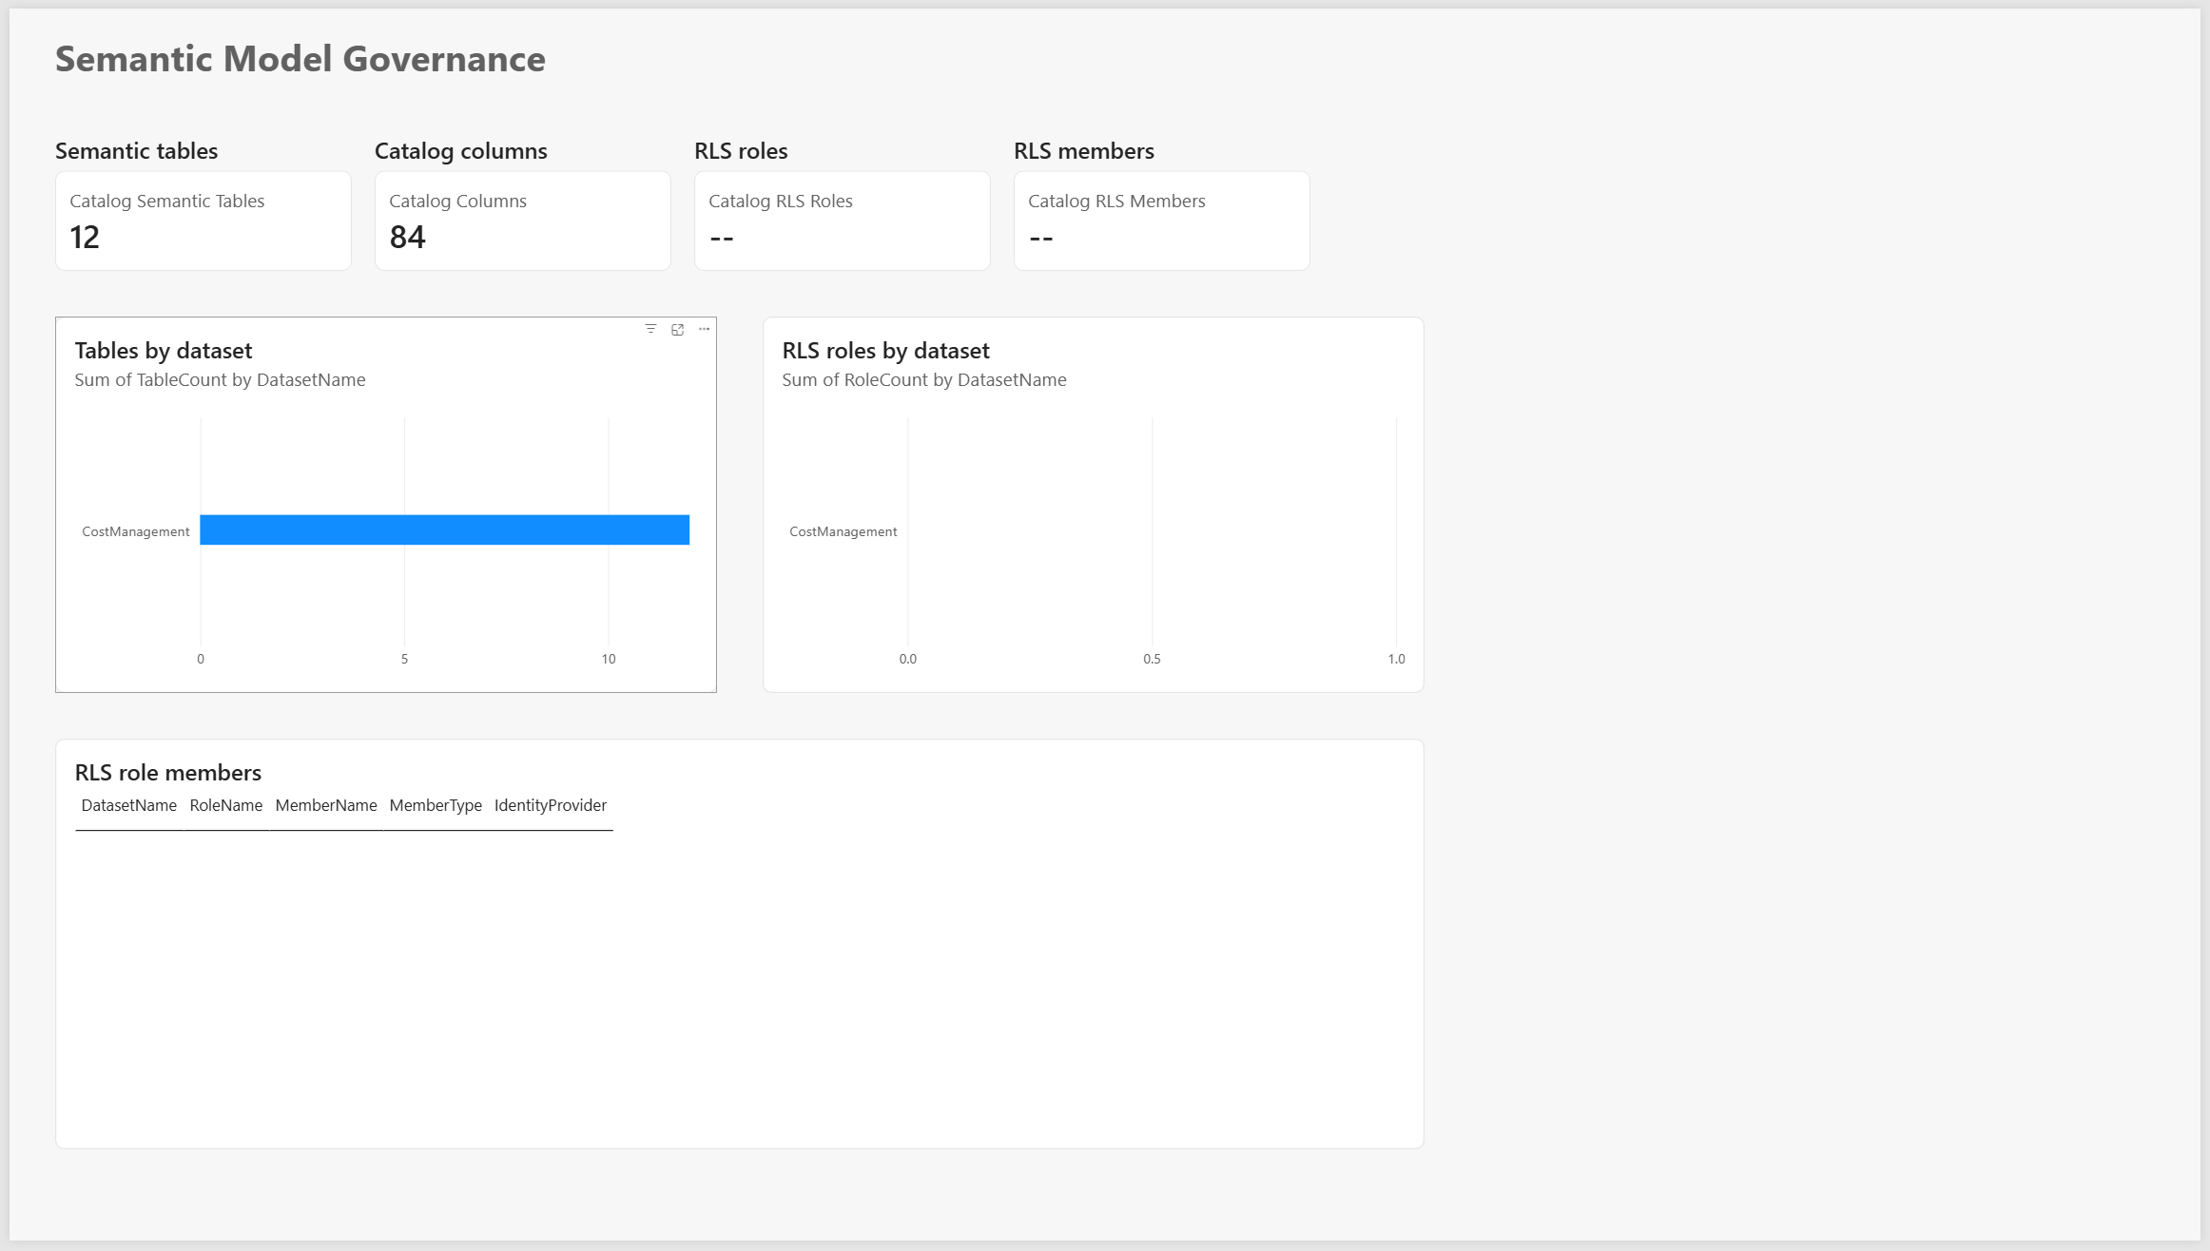
Semantic Model Governance
Monitor data models, dependencies, and quality Track lineage and data governance metrics

Slide 13
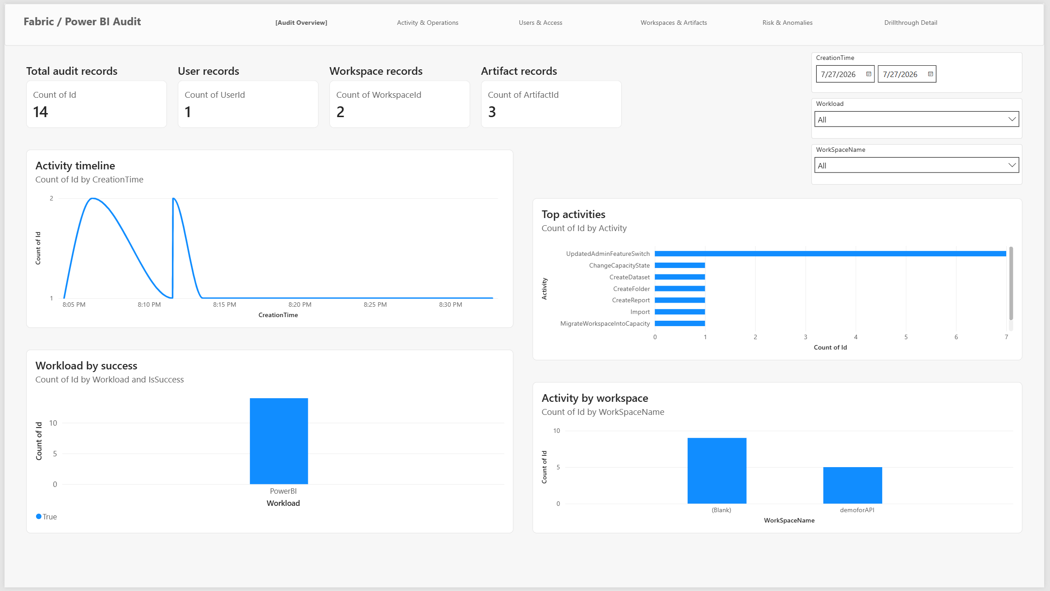
Audit Overview Dashboard
Comprehensive view of all monitoring activities Centralized dashboard for estate oversight

Slide 14
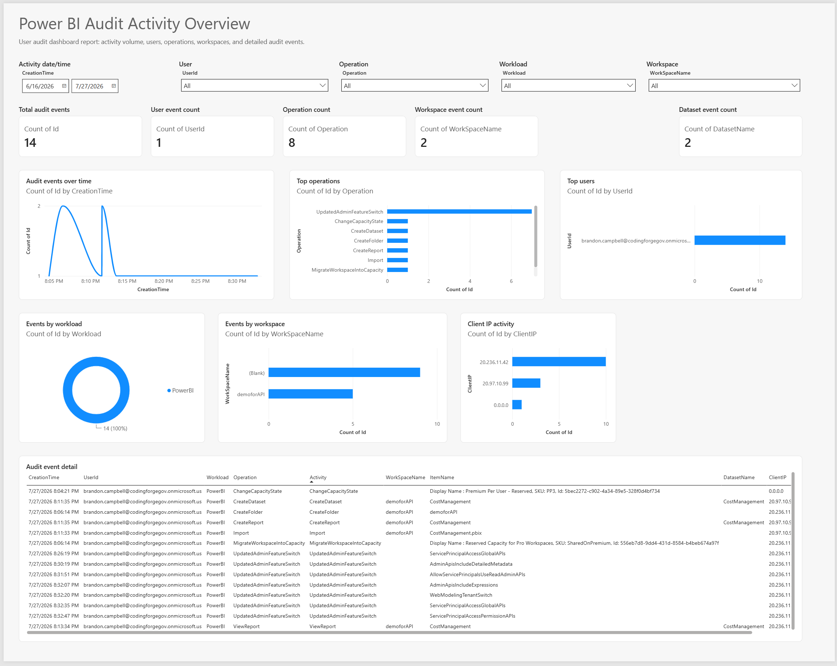
Customer-Facing Audit View
Present insights to stakeholders and leadership Transparent reporting of platform metrics

Slide 15
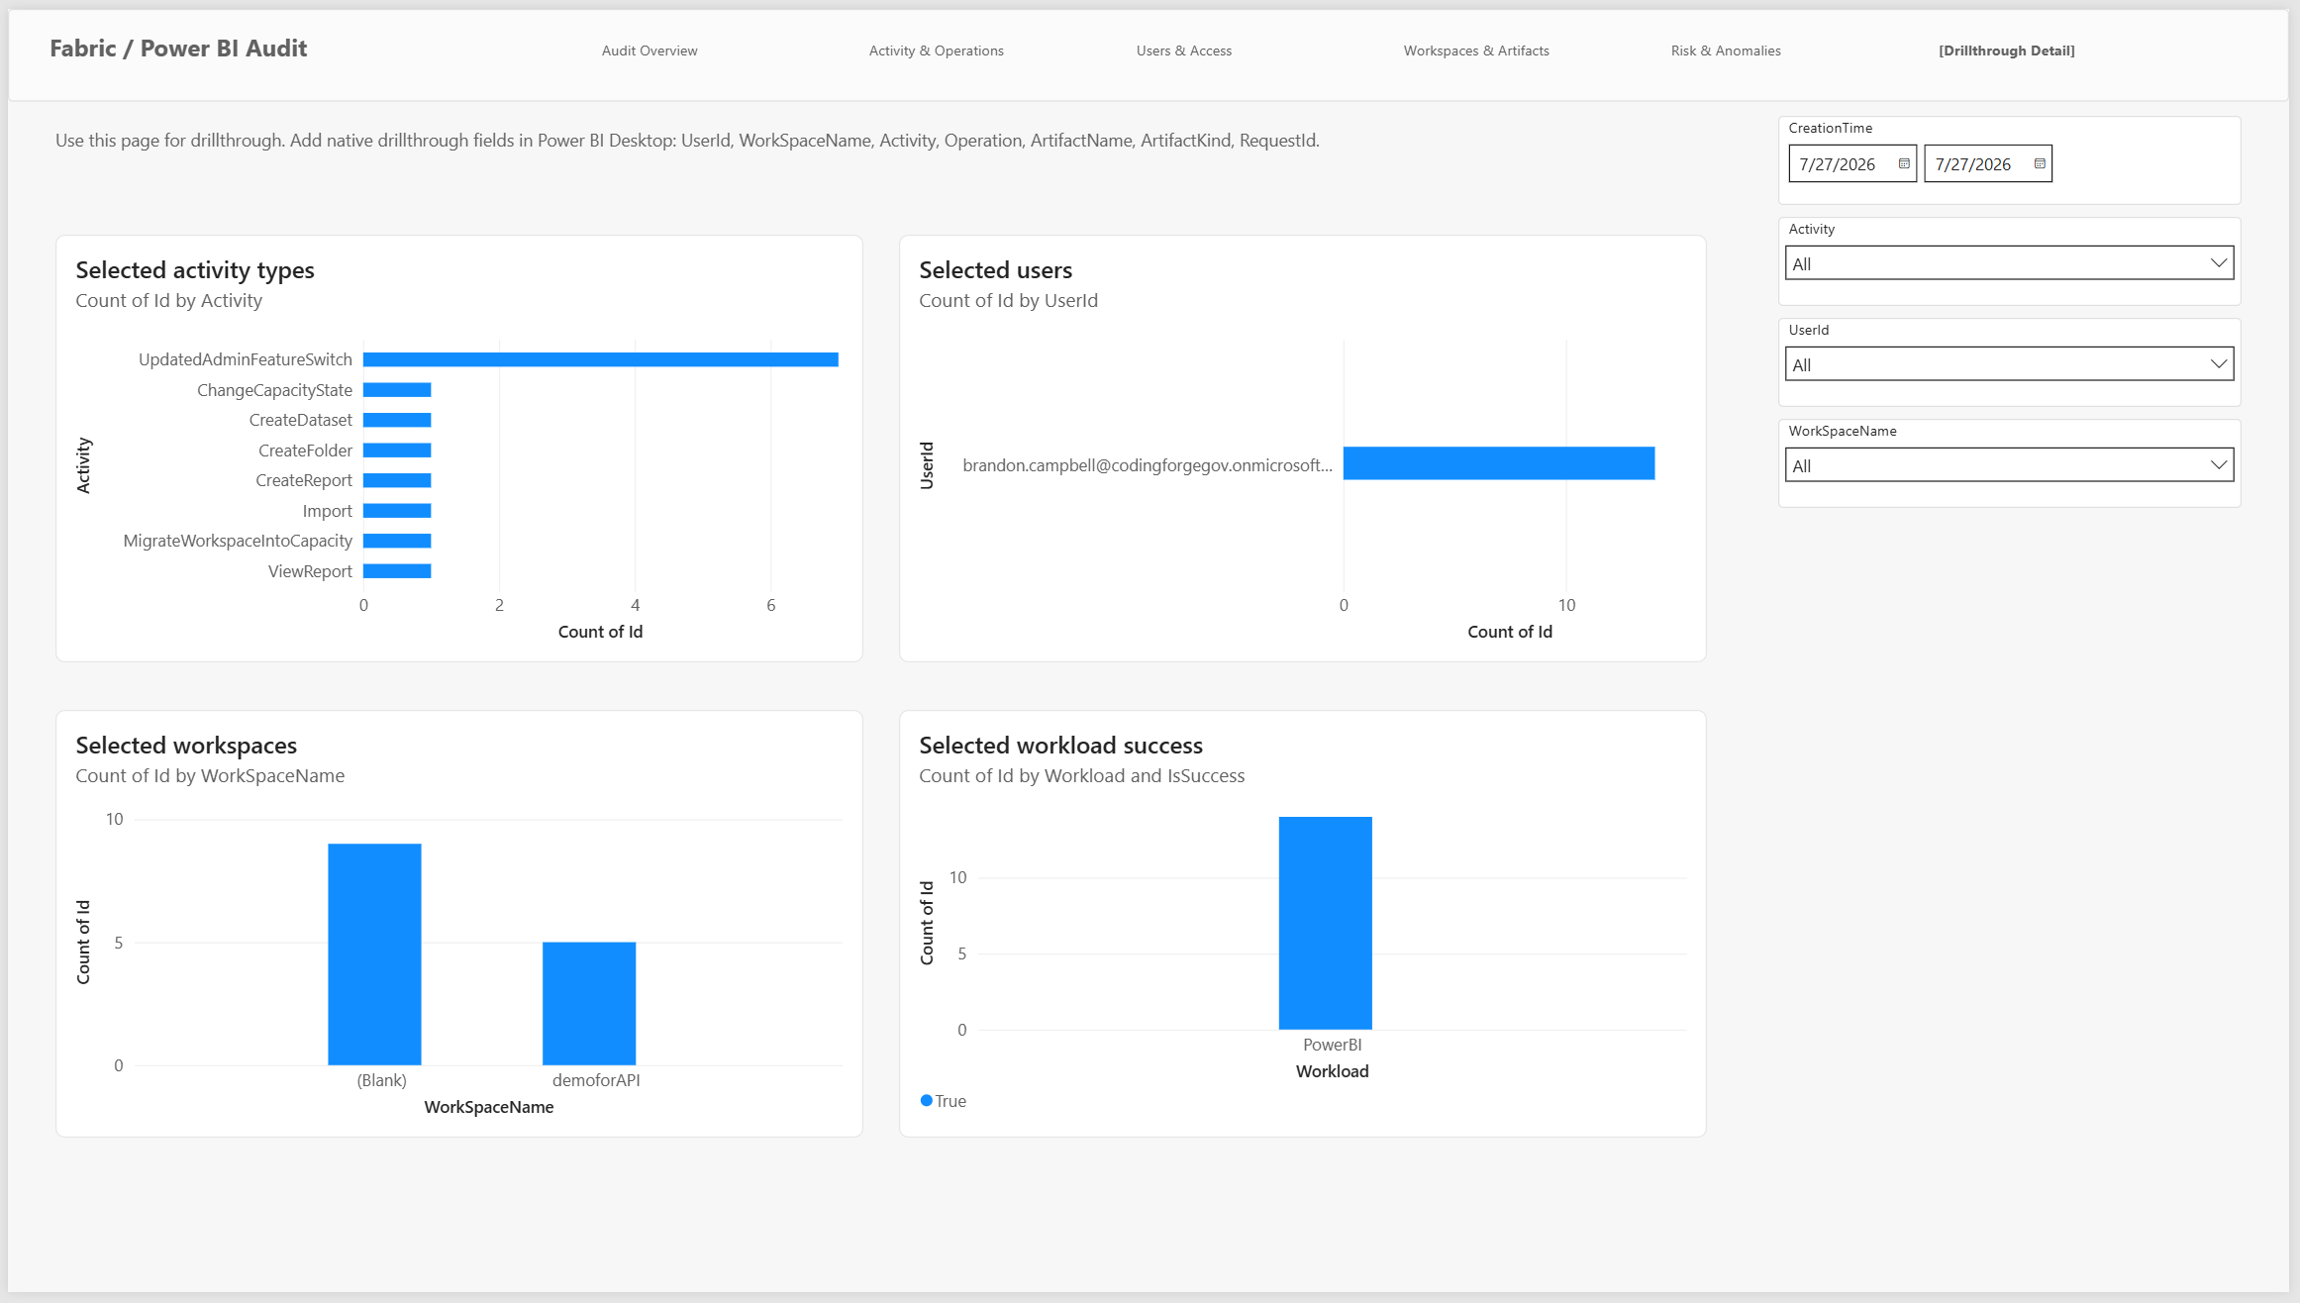
Detailed Drill-Through Analysis
Dive deep into specific items for root cause analysis Understand the 'why' behind the metrics

Slide 16
Multi-Cloud Support
Azure Commercial • GCC • GCC High Seamless monitoring across all government and commercial clouds

Slide 17
Key Benefits
✓ Real-time visibility across entire estate ✓ Governance and compliance monitoring ✓ Usage and adoption analytics ✓ Proactive risk detection

Slide 18
Get Started Today
Deploy Fabric Monitor to gain complete visibility into your Power BI and Fabric environment

