Slide 1
Deeper Power BI Patterns
Teaching guide for advanced lab themes: data prep, modeling, DAX, UX, performance, and security
Trust
Make results explainable
Maintainability
Reduce repeated logic
UX
Guide decisions
Readiness
Validate before production

Slide 2
Why these deeper lessons matter
Advanced patterns are valuable when they improve trust, maintainability, and user decisions.
For authors
Less rework, clearer model structure, easier DAX maintenance, and repeatable delivery patterns.
For users
Reports become easier to navigate, interpret, and trust because assumptions are visible.
For teams
PBIP, validation notes, and governance patterns make collaboration easier.
1
2
3
4
5
Prepare
Clean and stage data
Model
Shape relationships
Measure
Define business logic
Guide
Design interactions
Govern
Secure and operate
02

Slide 3
How the themes build on each other
Each lab theme is a layer in a reliable analytics solution.
1
2
3
4
5
Power Query
Source parameters, staging, functions, error review
Semantic model
Facts, dimensions, dates, relationships
DAX
Measures, calculation groups, rankings
Report UX
Drillthrough, tooltips, field parameters
Production readiness
Performance, security, governance
Instructor message
Do not teach these as disconnected features. Teach them as a chain: each layer makes the next layer easier and safer.
03

Slide 4
Power Query: repeatable data preparation
Students move from one-off cleanup to a predictable data pipeline.
Parameters
Make source paths and refresh windows explicit.
Staging queries
Keep raw, staged, and final load queries separate.
Functions
Reuse cleanup logic instead of repeating UI steps.
Lineage
Preserve source file names so issues can be traced.
Why users care
Cleaner data prep reduces refresh surprises and gives report consumers more confidence in the numbers.
04

Slide 5
Deeper Power Query pattern: error review before removal
Bad rows should be visible before they are filtered out.
1. Detect
Use safe parsing to flag invalid dates, quantities, prices, or missing product codes.
2. Review
Create an err_OrdersReview query with a human-readable DataQualityIssue column.
3. Load valid rows
Create FactOrders from rows where DataQualityIssue is blank.
Reflection prompt
Ask learners: what is the risk of silently removing bad rows? Who needs to know that data was excluded?
05

Slide 6
Semantic model handoff: clean data is not enough
A clean query still needs a model that filters predictably.
Grain
Every fact table needs a clear row meaning.
Keys
PK/FK relationships make filters predictable.
Dates
Role-playing dates prevent ambiguous analysis.
Bridge tables
Multi-valued attributes need controlled paths.
Builds on Power Query
Staged and validated data lets students focus on modeling decisions instead of firefighting source cleanup.
06

Slide 7
Advanced DAX: the measure layer is the contract
Measures translate the model into business meaning.
Base measures
One trusted definition for sales, margin, quantity, and targets.
Branching
Derived measures reuse base measures instead of duplicating logic.
Validation
Test measures in simple visuals before adding complexity.
1
2
3
4
Context
Visual + slicer filters
CALCULATE
Modify context intentionally
Time
Compare periods
Rank
Focus attention
07

Slide 8
Calculation groups: reusable time intelligence
Use SELECTEDMEASURE() to apply one time pattern to many base measures.
What it is
A calculation group stores reusable calculation items such as Current, YTD, Prior Year, and YoY Change.
Why it helps
It reduces duplicated DAX and makes time logic easier to maintain across metrics.
How it builds
Students need a date table, base measures, and context knowledge before this pattern makes sense.
Validation note
Native Desktop authoring, TMDL, XMLA, and external tools should be validated before making this hands-on in customer environments.
08

Slide 9
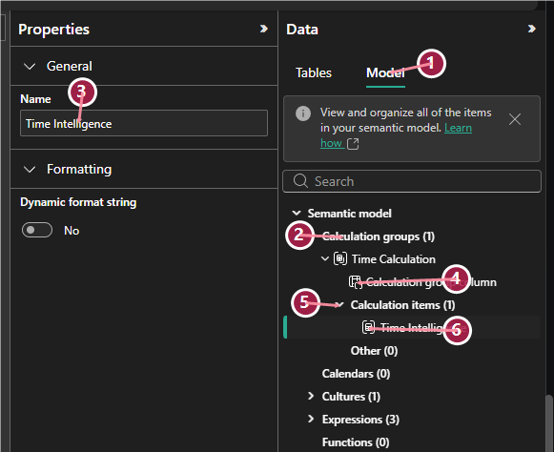
Calculation group authoring view
Use the numbered callouts to connect UI elements to the lab instructions.
Callout flow
1 Model tab → 2 Calculation groups → 3 Name → 4 Column → 5 Items → 6 First item
Instructor prompt
Ask students why calculation groups require explicit measures and why implicit drag-and-drop aggregations are discouraged.
Student check
Can learners explain why one calculation group can apply to Sales Amount and Gross Margin?
09

Slide 10
Report UX: make the report guide the user
Good UX helps users decide what to do next.
Drillthrough
Move from summary to detail.
Tooltips
Add context without clutter.
Bookmarks
Create guided interactions.
Navigation
Make movement intentional.
Accessibility
Make reports usable for more people.
Mobile
Prioritize for smaller screens.
10

Slide 11
Field parameters vs disconnected selectors
Two patterns solve similar user needs in different ways.
Native field parameters
Best when users need to switch actual measures or dimensions in a visual. Power BI creates metadata that visuals understand natively.
Disconnected selector + SWITCH
Best for teaching and custom logic. A slicer filters a disconnected table; DAX reads the selection and returns a measure.
Teaching point
Field parameters are a UX feature. Disconnected selectors are a DAX interaction pattern. Comparing both builds deeper understanding.
11

Slide 12
Deeper challenge: disconnected metric selector
Power Query can create the selector table; DAX makes it interactive.
Build
Create a Metric Selector table with Metric and SortOrder columns.
Measure
Use SELECTEDVALUE + SWITCH to return the selected metric.
Compare
Contrast custom DAX logic with native field parameters.
Reflection questions
Which pattern is easier to create? Which is easier to explain? Which gives more control? What happens to formatting?
12

Slide 13
Performance: improve with evidence
Teach learners to measure before changing the report.
1
2
3
4
Baseline
Use Performance Analyzer
Diagnose
Separate DAX time from visual rendering
Change
Remove noise or rewrite logic
Compare
Document before and after
Why users care
Performance work protects adoption. A report that is slow or unpredictable will not become part of the business workflow.
13

Slide 14
Security: design access intentionally
RLS is not just a checkbox; it is a tested access design.
Static RLS
Simple roles such as East Region teach the filter concept.
Dynamic RLS
Mapping tables connect users to territories or segments.
Testing
View as role and document expected vs. actual results.
Builds on the model
Security depends on correct relationships. If the model is ambiguous, RLS is harder to reason about.
14

Slide 15
Instructor facilitation model
Use the same rhythm for each deeper lesson.
1
2
3
4
5
Introduce
What is the pattern?
Demo
Where is it in Power BI?
Build
Students create it
Validate
Test in a simple visual
Reflect
Compare tradeoffs
Instructor reminder
Keep optional or tenant-dependent features clearly labeled. A conceptual review is better than a broken hands-on lab.
15

Slide 16
Sources: data prep and modeling
Official Microsoft documentation for deeper learning
Power Query M language
https://learn.microsoft.com/powerquery-m/
Query parameters in Power Query
https://learn.microsoft.com/power-query/power-query-query-parameters
Error handling in Power Query
https://learn.microsoft.com/power-query/dealing-with-errors
Star schema guidance
https://learn.microsoft.com/power-bi/guidance/star-schema
Model relationships in Power BI Desktop
https://learn.microsoft.com/power-bi/transform-model/desktop-relationships-understand
16

Slide 17
Sources: DAX and report UX
Official Microsoft documentation for deeper learning
Calculation groups in Power BI
https://learn.microsoft.com/power-bi/transform-model/calculation-groups
DAX SELECTEDVALUE
https://learn.microsoft.com/dax/selectedvalue-function-dax
DAX SWITCH
https://learn.microsoft.com/dax/switch-function-dax
Field parameters
https://learn.microsoft.com/power-bi/create-reports/power-bi-field-parameters
Performance Analyzer
https://learn.microsoft.com/power-bi/create-reports/desktop-performance-analyzer
17

Slide 18
Sources: security and lifecycle
Official Microsoft documentation for deeper learning
Row-level security
https://learn.microsoft.com/fabric/security/service-admin-row-level-security
Power BI Project files
https://learn.microsoft.com/power-bi/developer/projects/projects-overview
TMDL overview
https://learn.microsoft.com/analysis-services/tmdl/tmdl-overview
Power BI guidance documentation
https://learn.microsoft.com/power-bi/guidance/
18

