Slide 1

set

Slide 2
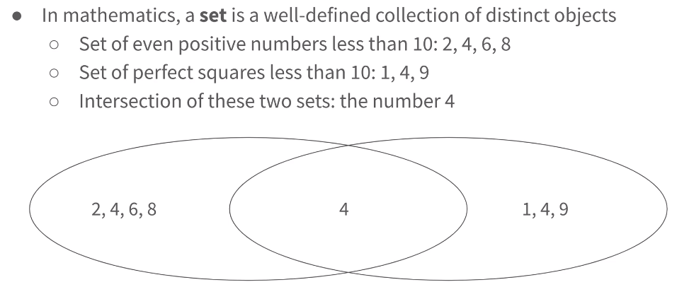
What is set?

Slide 3
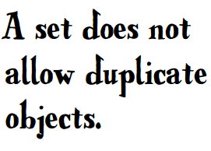
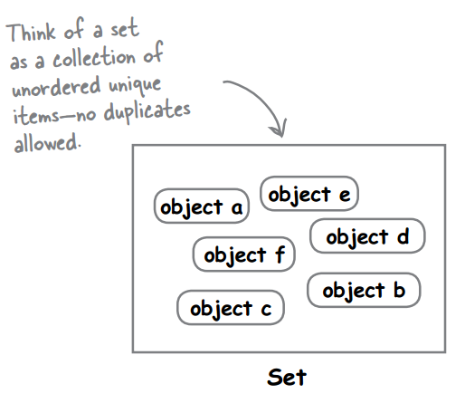
What is set?
无序
不重复

Slide 4
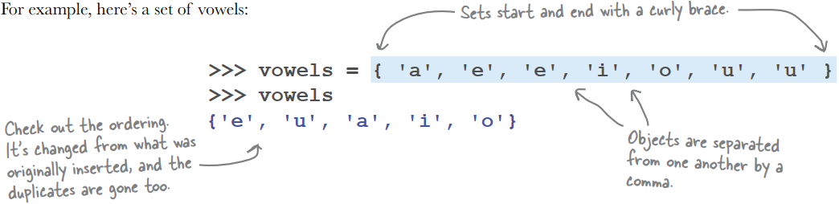
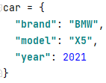
Declaring a set
Both dict and set use curly braces ({}).
Both dict and set use comma (,) to separate their items.
But the item in dict is key / value pair. So dict also needs colon (:)
Still remember how to define a dict?

