Slide 1
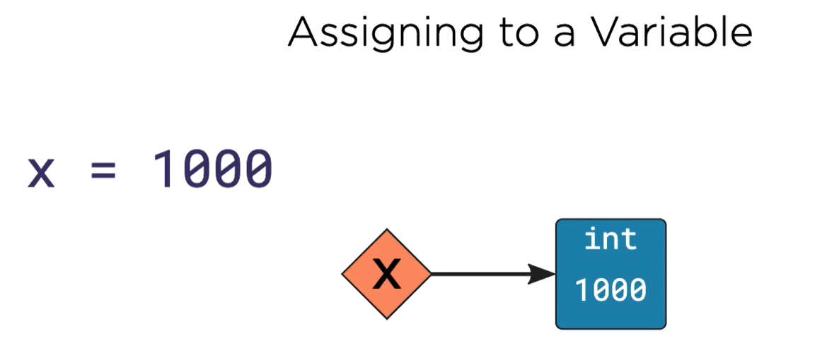
A variable is like a pointer.
The pointer points to a box.
You put the value inside the box.
This box stands for value 1000.

Slide 2
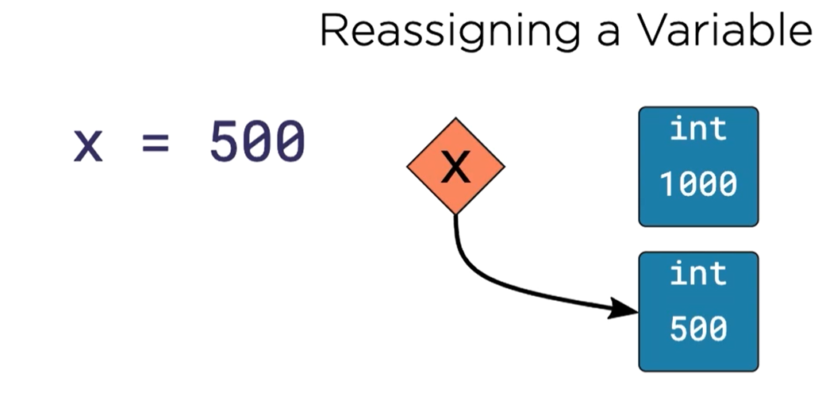
Int is IMMUTABLE!
Python can NOT change 1000 to 500
Python can only create a new box, put 500 in it.
Let point X point to the new box.
Box 1000 becomes trash. Python will throw it away.

Slide 3
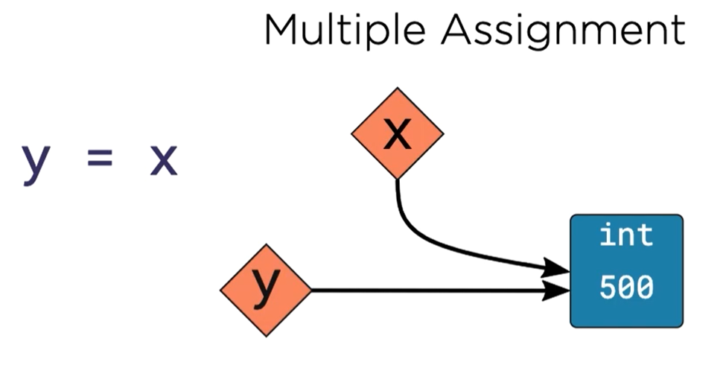
Python creates a new pointer y
Python let the pointer y points to the same box which x points.

Slide 4
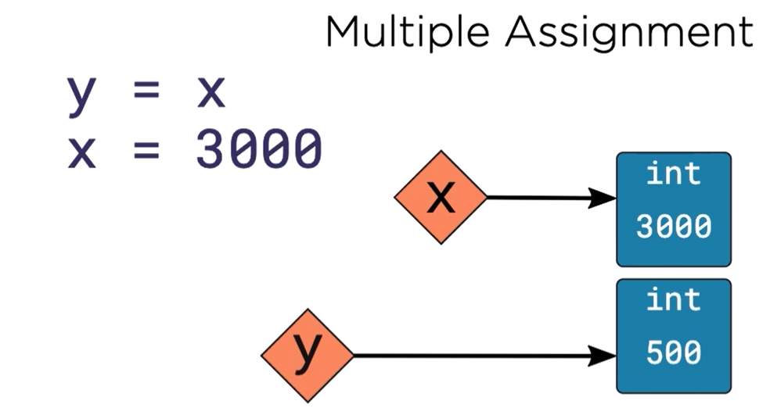
When you assign a new value 3000 to variable x
Python creates a new box, put 3000 in it.
This box stands for value 3000. Python let pointer x points to it.

Slide 5
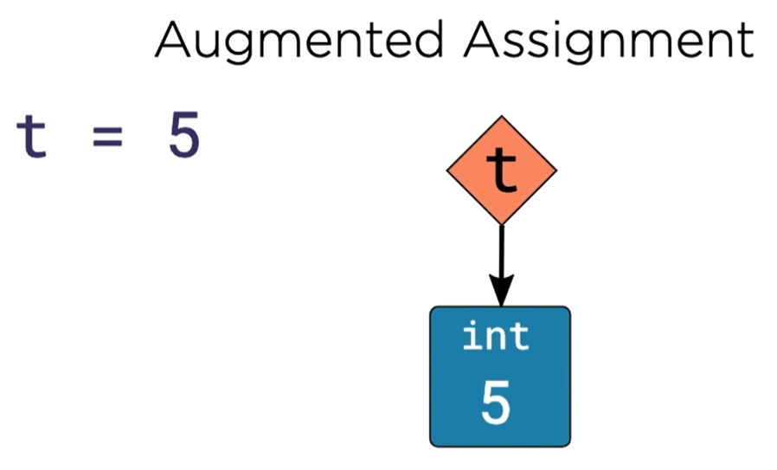
Remember:
Variable t is a pointer.
Value 5 is inside a box.
The pointer points to the box.

Slide 6
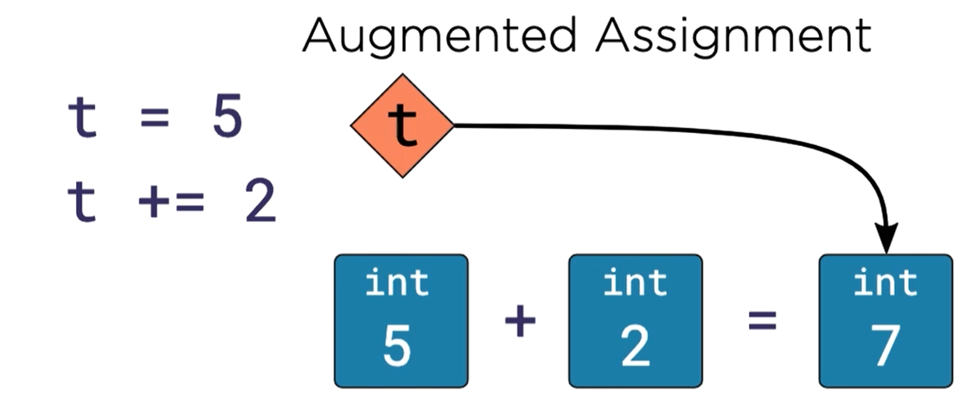
For value 2, python creates a box, put 2 in it.
Python does the math, 5 + 2 = 7.
For value 7, Python creates a box, put 7 in it.
Python let pointer t points to it.
Box 5 and box 2 become trash, Python will throw it away.

Slide 7
Int / float / bool / str are IMMUTABLE.
You cannot change the value inside the box which the pointer points.
You can only let the pointer points to a new box.
But
List is MUTABLE.

Slide 8
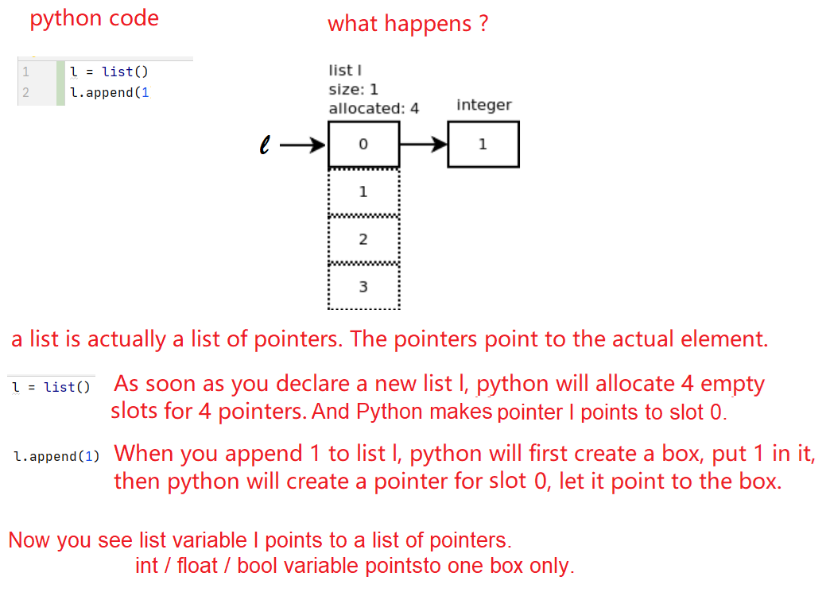

Slide 9
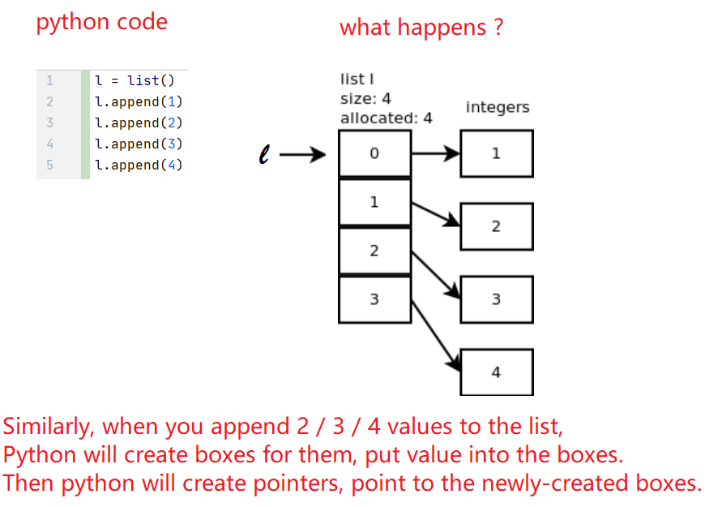

Slide 10
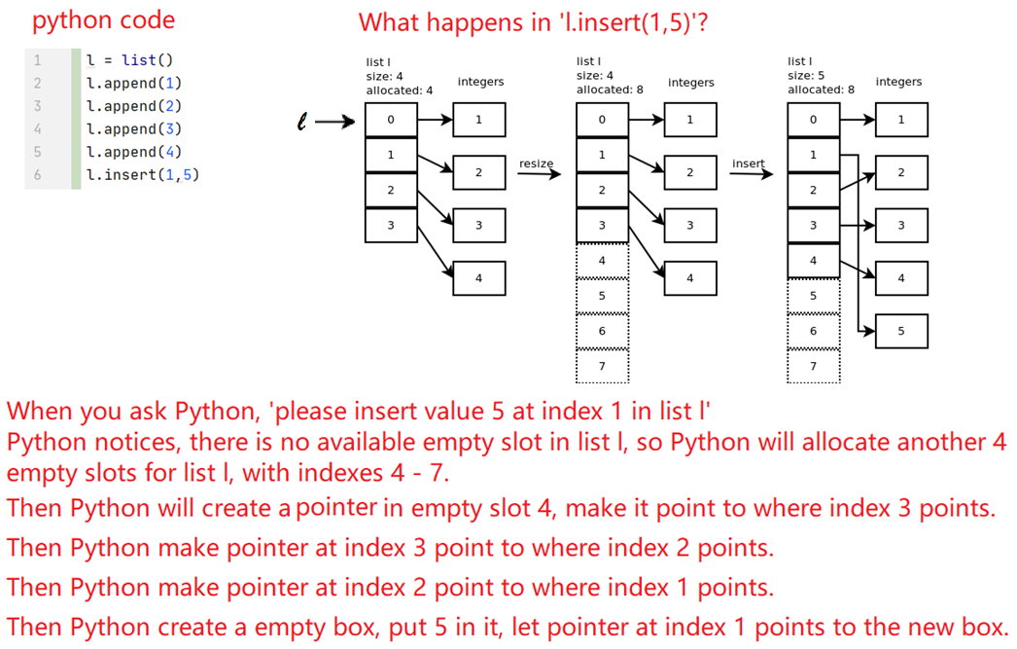

Slide 11
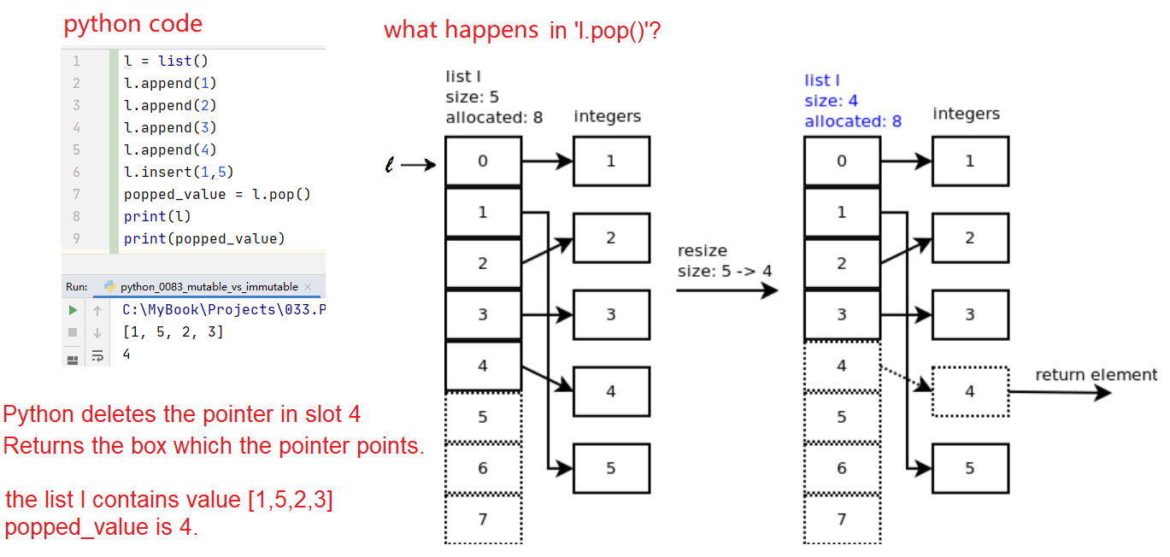

Slide 12
Why list is mutable?
Because list points to a list of pointers.
You can always let the pointers point to something else.
Why int / float / str is immutable?
Because int / float /str points to a box.
You can’t change the value of the box once it is filled.

Slide 13
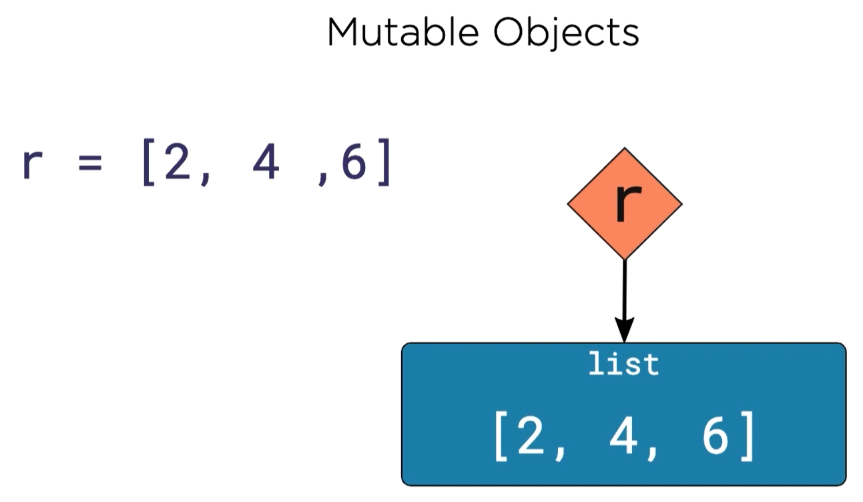
r is a pointer.
Pointer r points to a list of 3 pointers.
Pointer at slot 0 points to a box which contains value 2.
Pointer at slot 1 points to a box which contains value 4.
Pointer at slot 2 points to a box which contains value 6.

Slide 14
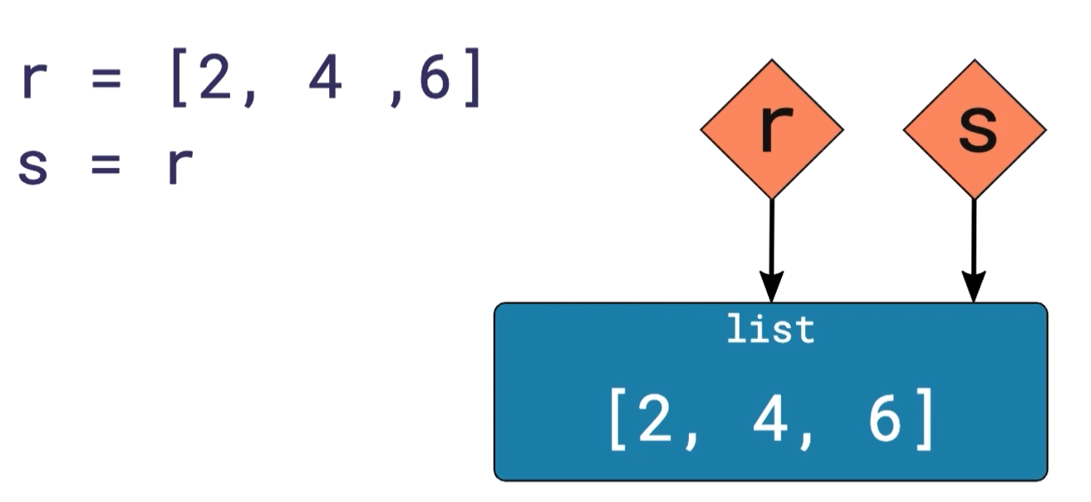
You let pointer s
points to the same list of pointers
which pointer r points.

Slide 15
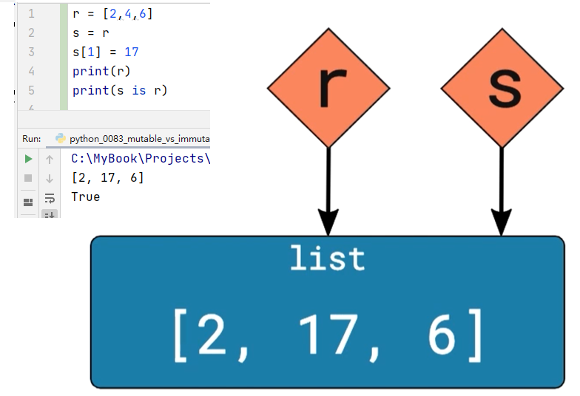
You change pointer at slot 1 to
point to a new box which contains
int value 17.
r and s point to the same list of pointers.
When you change list s, you change list r as well.

Slide 16
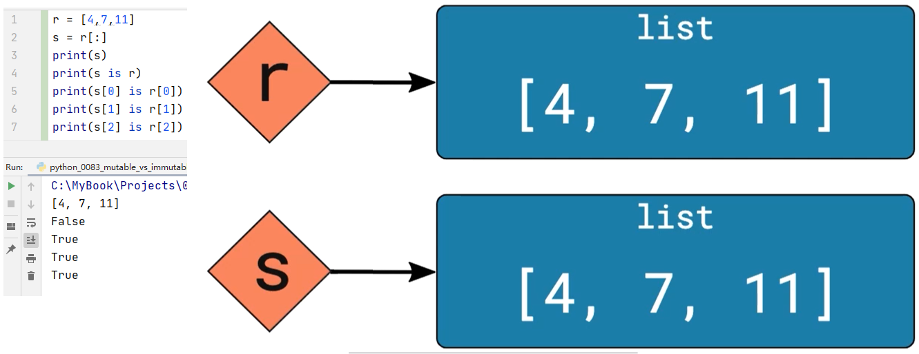
What happens in ‘s = r[:]’ ?
Python creates another list of pointers for s.
Python lets those pointers point to the same boxes as r’s pointers point to.
Notes:
python_0093_mutable_vs_immutable.png

