Slide 1
PASSWORD VALIDATION

Slide 2
Contents
Proposed Frameworks
Design- Flow Diagram, Block Diagram
Junit Testing and Reporting
Negative Scenario
Positive Scenario

Slide 3


Proposed Frameworks
Selenium can be implemented
Depends on Selenium Webdriver
Java
JUnit Testing

Slide 4
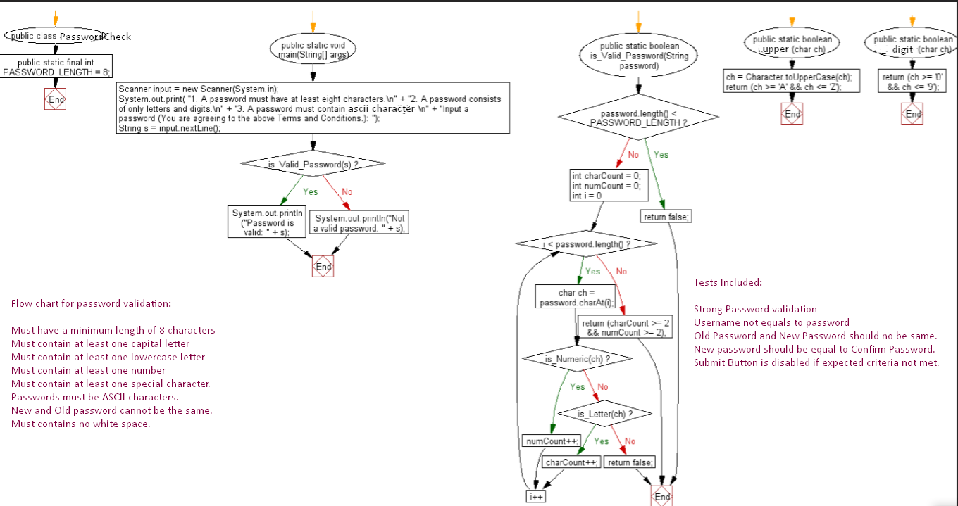
Design- Flow Diagram for Validation Check

Slide 5
Block Diagram- Business Level
BDD
Selenium/Cucumber
Test
Junit4 or TestNG Test
Java/.NET/JavaScript/TypeScript
Business Layer
Functionality Check( Actions, Verification and Rules)
POM(Page object model)
Modules
Resources
Common API to interact with
Helper Classes
Loggers/ Handlers
APAP
WebDriver
Webservices
HTML
Report Generator
Webservice Utilities
We

Slide 6



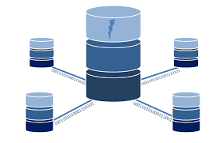
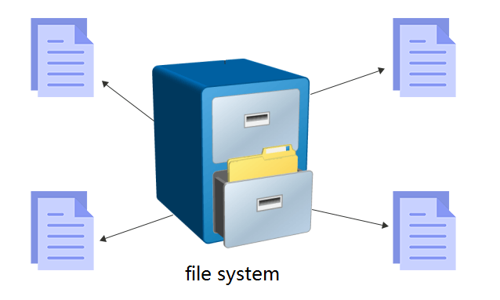

Architectural Diagram
Frontend
Backend
Business Logics in slide 5
Java
SQL Query
JS
TypeScript
Angular
Collect data
Request
Response
Display output
Contains the App logic
Web server
HTML, CSS, Images data
MySQL, PostgreSQL, MongoDB

Slide 7
Test Tools
Frontend
Backend
App Logic
File Server
Database
Git /Jquery Angular [Frontend + JavaScript]
Node.js [Backend + JavaScript]
Google Workspace
SQLite, MySQL or PostgreSQL

Slide 8
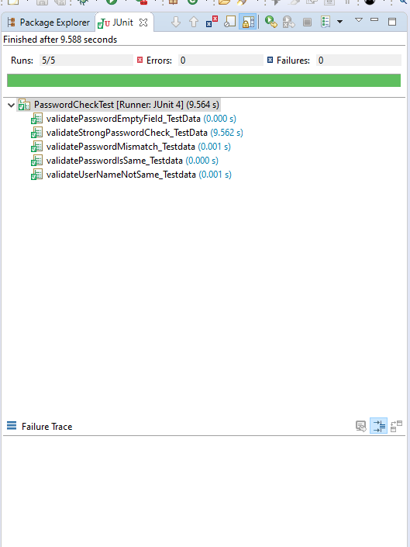
Junit Test Run
Must have a minimum length of 8 characters
Must contain at least one number
Must contain at least one special character.
Passwords must be ASCII characters.( Must contain at least one capital letter and must contain at least one lowercase letter)
New and Old password cannot be the same.
Must contains no white space.

Slide 9
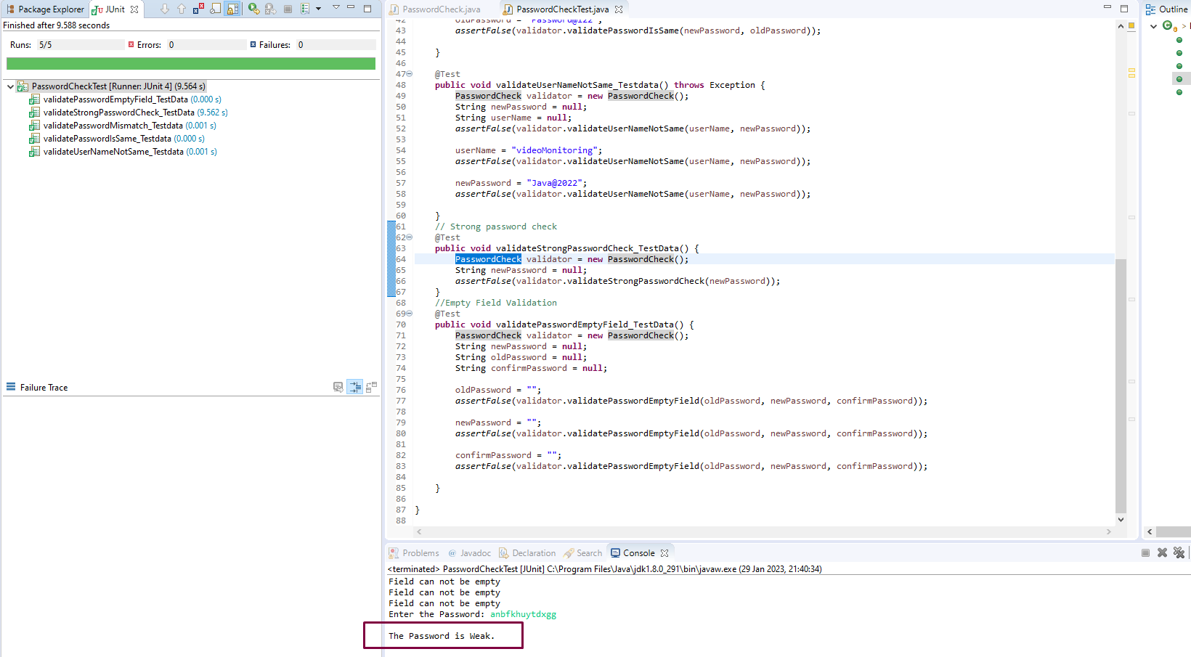
Negative Scenario Testing Junit 4

Slide 10
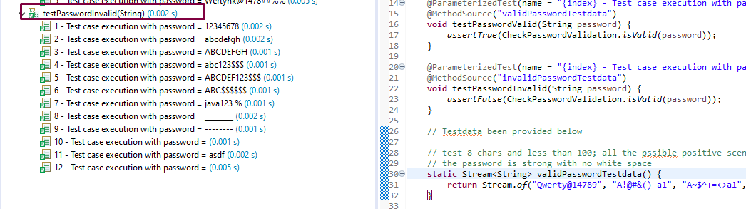
Junit 5

Slide 11
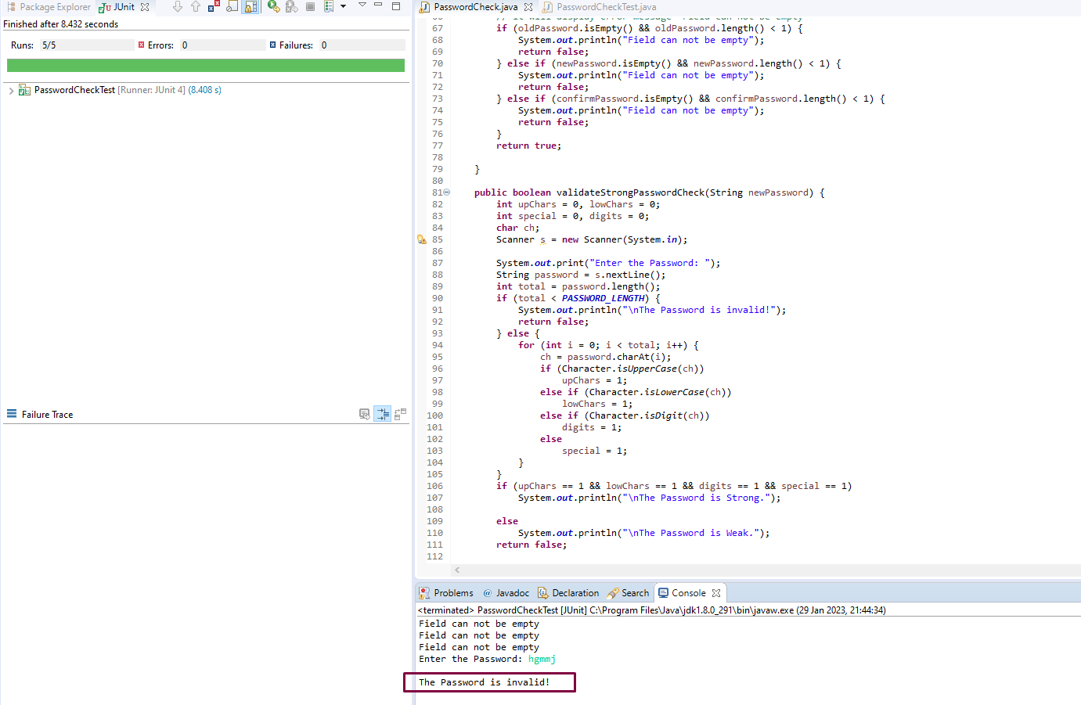

Slide 12
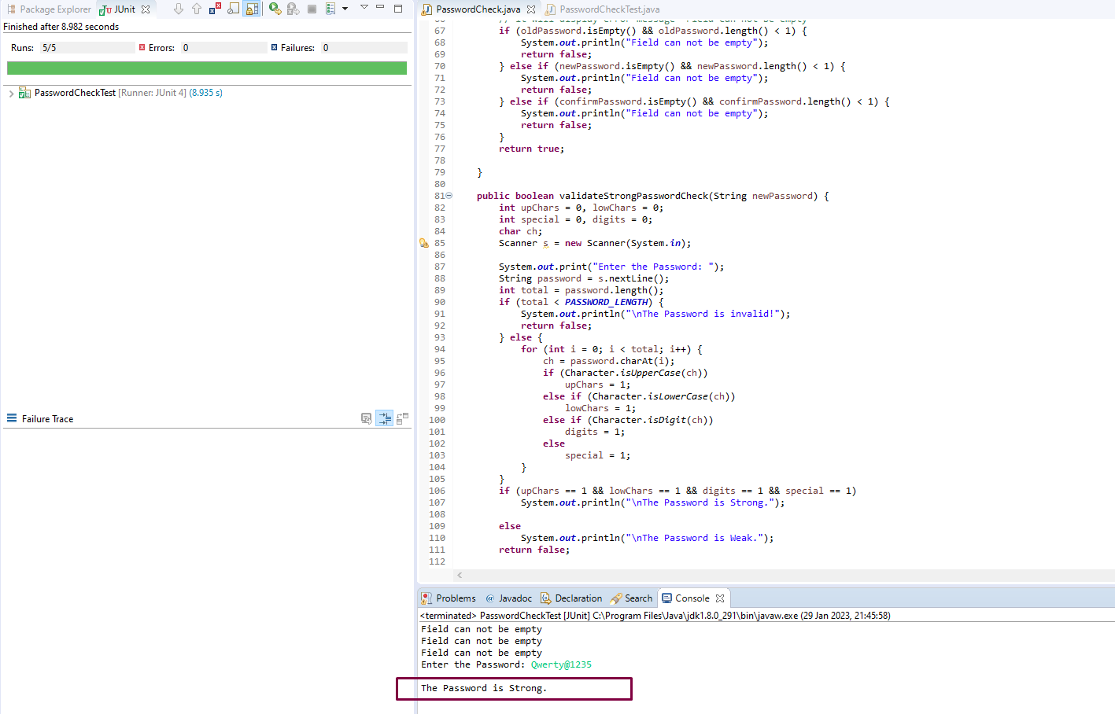
Positive Scenario JUnit 4

Slide 13
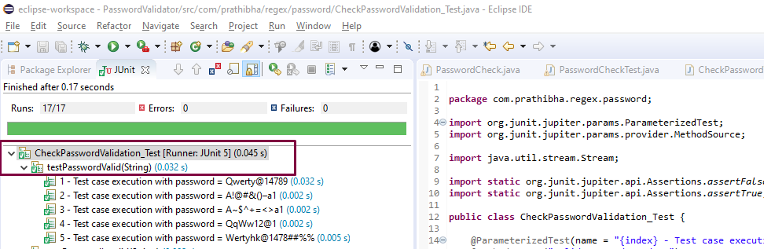
JUnit 5

