Slide 1
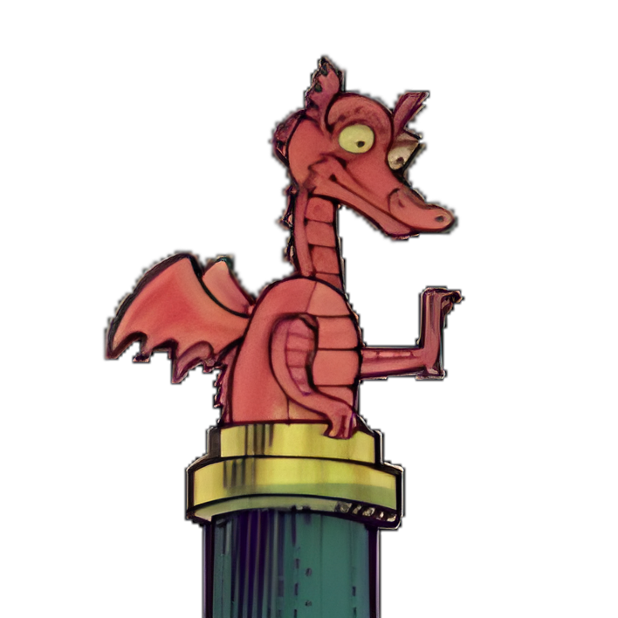
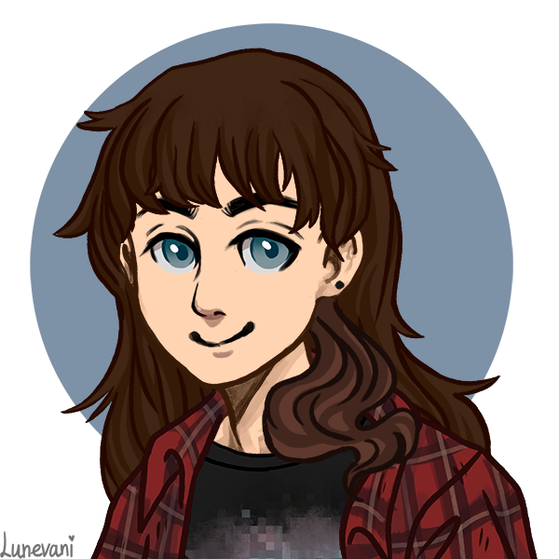
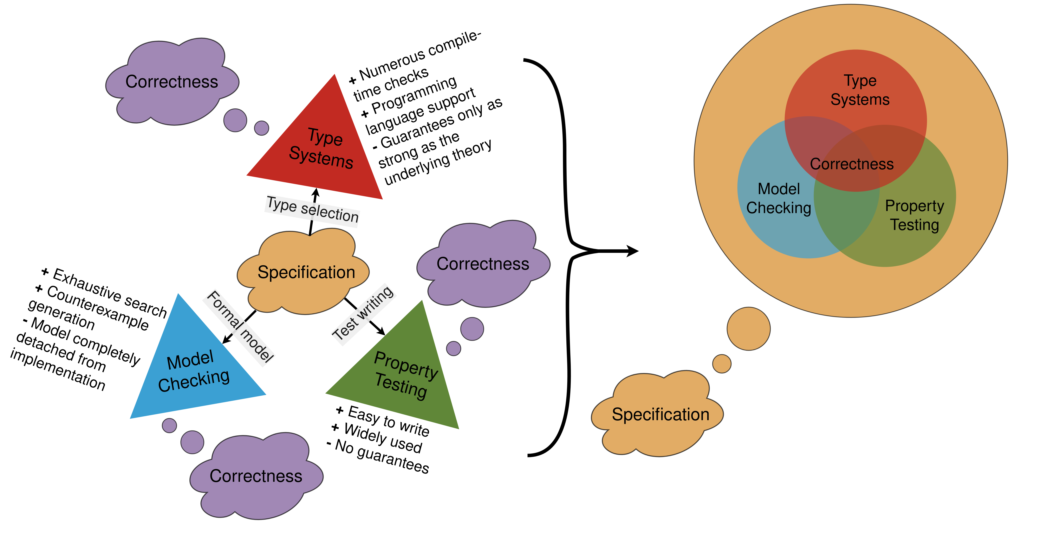



Type systems can help with software correctness, but well-typed programs can go wrong! How do we know we've picked the right types?
PRESENTER
Thomas E. Hansen
Background
Correctness is hard! You can use types to help, but this relies on the programmers choosing the right types for the problem. For example, using Integers for package numbering in a protocol would allow for negative packages.
Existing Methods
Testing – Very cheap There are no formal guarantees.
Type checking – Relatively cheap Relies on correct modelling.
Model checking – Very expensive Models often do not represent the full implementation.
Formal proofs – Very expensive Proof systems tend to be separate from implementation.
The idea
Use termination- and type-checking to reduce the search-space for model checkers, and use model checkers to verify that our chosen types capture the desired behaviour. With tests being used to quickly iterate and gain confidence in the implementation.
THOMAS E. HANSEN, Edwin Brady

