Slide 1
1. Store the data to Point
3. Process Point to ProcessingData
3
1
1
2
2
X | O
 | X | X
X | O | O
X | O
 | X | X
X | O | O
X | O
 | X | X
X | O | O
1
2
1
Label: “positive” / “negative”
Status: -1 1
(“positive” / “negative”)

Slide 2
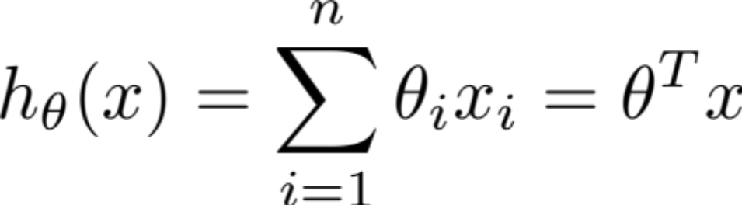
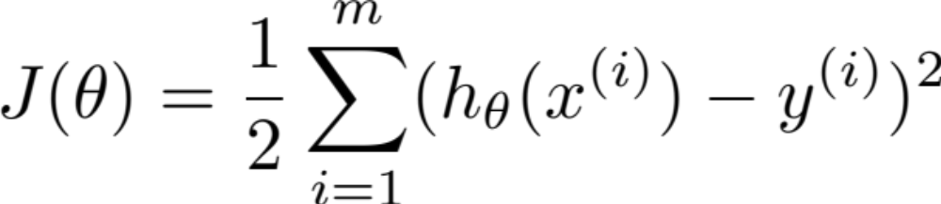
3. Implement the Perceptron
θ_{k} =θ_{k-1} +α( y - h)Χ^{(i)}

Slide 3
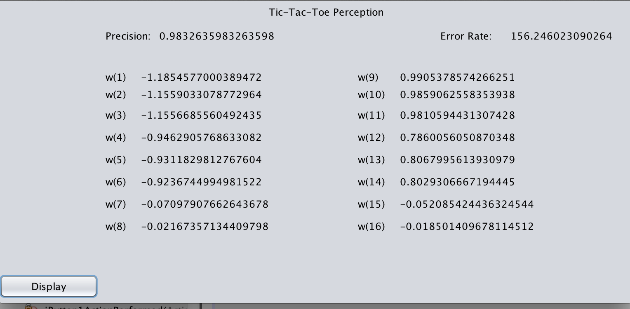
4. Display the window

