Slide 1

BitsNByte
Sardar Patel Institute of Technology
Shipping Route Optimisation

Slide 2
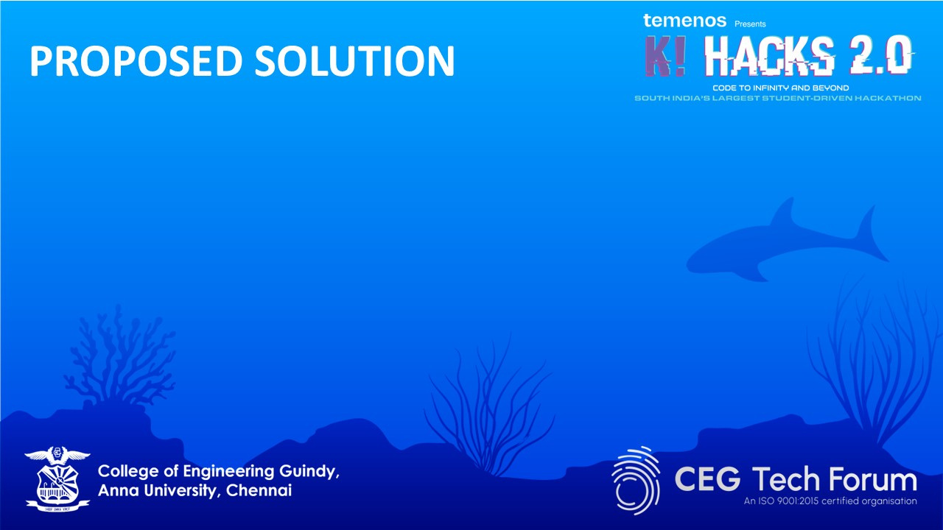
The optimization of sea routes is a complex task that requires considering multiple factors like fuel consumption, time, safety, and weather conditions. By integrating multi-parameter optimization, the system can assess the most efficient paths that balance these elements. Key parameters such as distance, fuel usage, and safety hazards are calculated, ensuring that routes are cost-effective while minimizing risks. Additionally, real-time weather data integration is essential to adjust routes dynamically, avoiding dangerous weather conditions like storms or high winds that could impact the journey.
A significant aspect of the system is its adaptability to different ship types. Vessels have unique specifications such as fuel consumption rates, cruising speeds, and cargo capacities. By tailoring route calculations to these specifications, the system ensures that each ship takes the most efficient path according to its capabilities. This customization helps reduce unnecessary fuel use and time delays, improving overall efficiency.
The system also provides a user-friendly interface that allows operators to input ship details, view live updates, and visualize routes on a map. Alerts notify users of potential changes, such as adverse weather conditions or the need for rerouting, ensuring smooth operation throughout the journey. By combining these features, the system offers an optimized, responsive solution that enhances the efficiency and safety of maritime transport.

Slide 3

The solution architecture for optimizing sea routes is built on a modular design that integrates multiple systems and technologies. At its core, a multi-parameter optimization engine analyzes various factors such as distance, fuel consumption, time, and safety to determine the most efficient route. This engine uses advanced algorithms that consider real-time data from multiple sources like vessel specifications, weather patterns, and ocean currents to calculate the optimal path. The system also supports dynamic updates based on ongoing conditions, ensuring that routes are continuously optimized.
The weather integration module is a critical component of this architecture, incorporating real-time weather forecasts and predictive models. This module continuously monitors weather patterns and provides alerts or reroutes in case of adverse conditions. By leveraging machine learning and historical data, the system predicts potential weather disruptions, allowing ships to avoid hazardous zones and minimize delays. This integration ensures that safety is prioritized alongside efficiency.
The user interface serves as the operational layer, providing real-time visualization and control for ship operators. It includes a dashboard where operators can monitor live route data, input ship specifics, and receive alerts. The interface is designed to be intuitive and responsive, enabling easy navigation and quick decision-making. It seamlessly integrates with other system modules to offer an end-to-end solution for route optimization in maritime transportation.

Slide 4
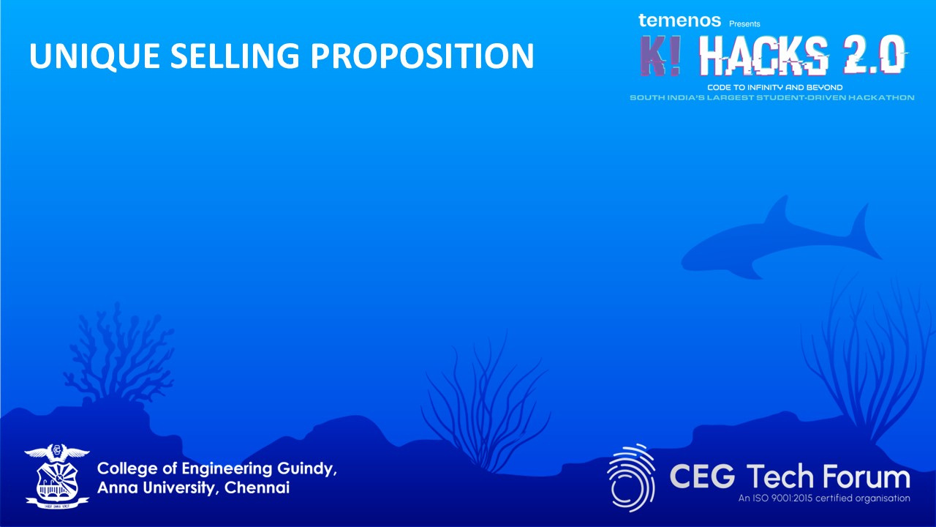
Ship and cargo weight dynamics
Environmental conditions (wind speed, direction, ocean currents)
Land mass avoidance with high-precision geographical data
Vessel-specific characteristics for personalized routing
Optimized fuel consumption based on weight and environmental factors
Reduced travel time through intelligent path planning
Lower environmental impact through efficient routing
Enterprise-grade security with Google authentication and Firebase integration

Slide 5
Significant cost savings through:
Optimized fuel consumption based on weight and environmental factors
Reduced travel time through intelligent path planning
Lower environmental impact through efficient routing
Enterprise-grade security with Google authentication and Firebase integration

Slide 6

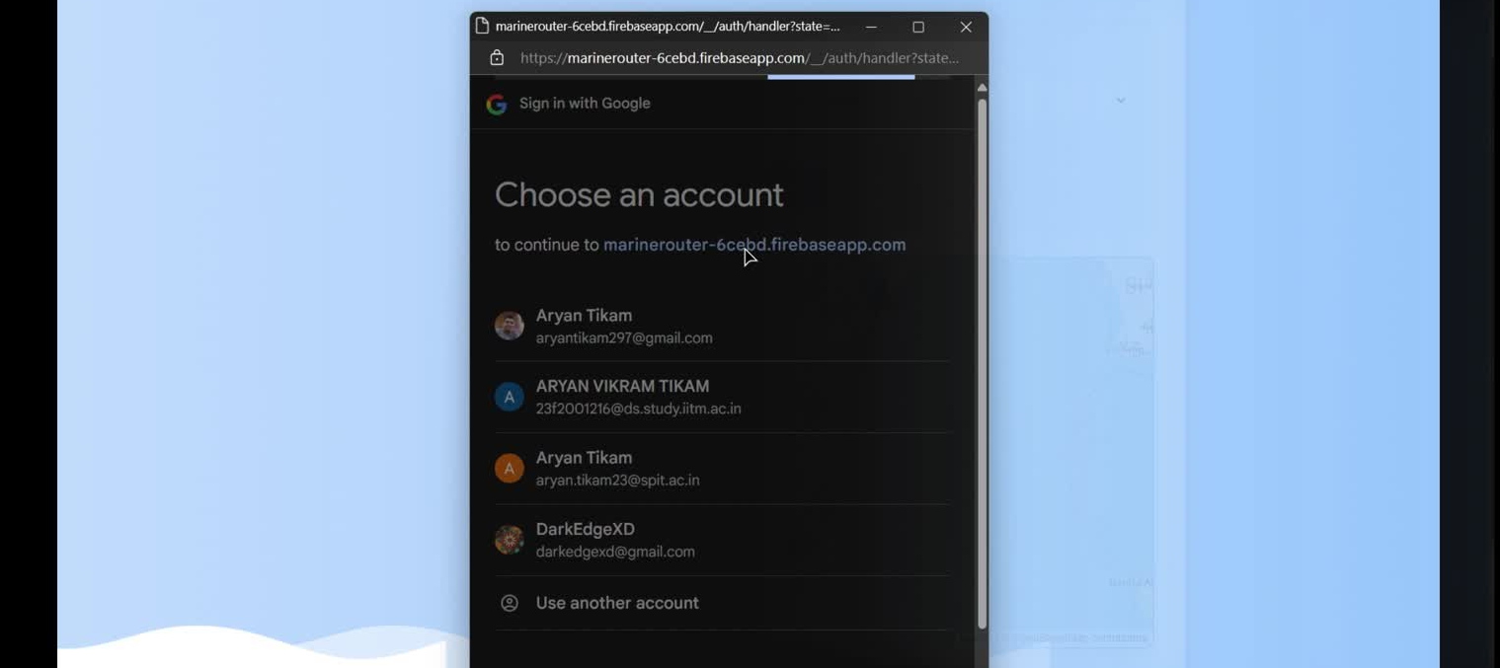

Slide 7
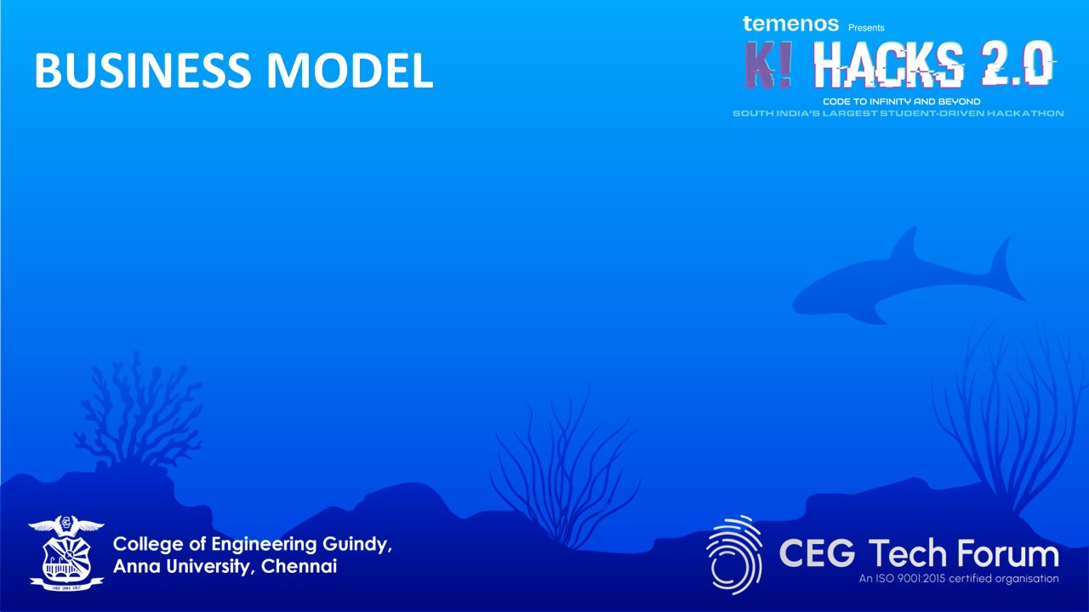
Revenue Streams :
Subscription based access for logistics companies.
API services for integration into existing systems
Consultancy for custom optimization models.
Cost Structure :
Infrastructure : Cloud computing and storage.
Development : Continuous improvement of RL models
Data Licensing : Access to high quality weather and ocean data.

Slide 8

Scalability :
Expand to airways and inland waterways optimization
Offer real-time updates for intermodal shipping
Key Patnerships:
Weather Forecasting Agencies
Enviromental and maritime research organizations
Logistics companies for pilot testing

Slide 9
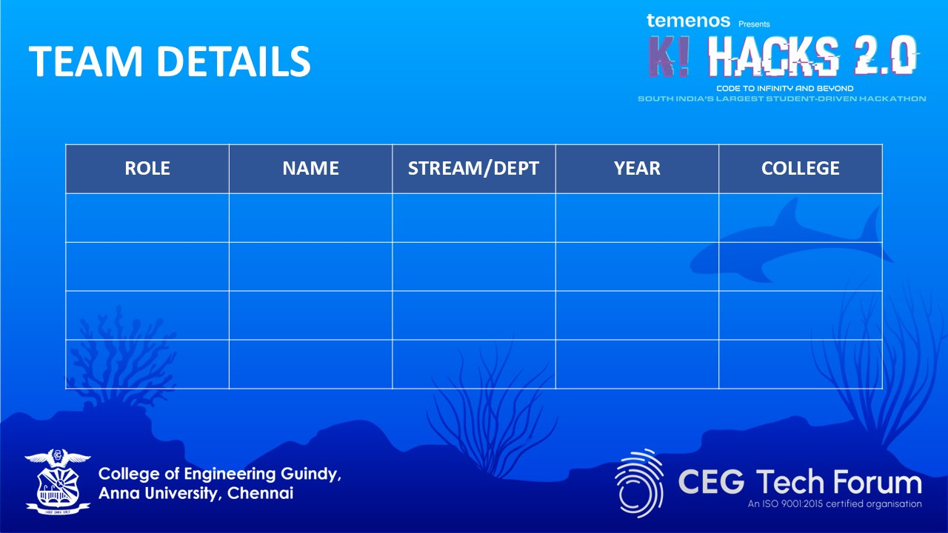
Computer Engineering
Sardar Patel Institute Of Technology
Team Leader
Rishabh Shenoy
2nd Year
Member
Aryan Tikam
Computer Engineering
Sardar Patel Institute Of Technology
2nd Year
Member
Computer Engineering
Sardar Patel Institute Of Technology
Dhruv Shetty
2nd Year

