Slide 1
AVALANCHE BUILDATHON · ONCHAIN FINANCE TRACK
AvaVault Perp
• Turn a rent-collecting property into perpetual-trading margin
• Track: On-chain Finance & Trading
• Status: Working contract prototype + full tests + really deployed on Fuji testnet
AvaVault Perp · Avalanche Buildathon · Onchain Finance Track
1/10

Slide 2
THE PROBLEM
Real-world assets are mostly “dead assets” on-chain
• RWA token holders can mostly only “hold and collect” — poor liquidity, single use
• Perpetual traders need stablecoin / blue-chip margin
• Yield assets must be cashed out first to be used as margin — selling away the upside exposure
AvaVault Perp · Avalanche Buildathon · Onchain Finance Track
2/10

Slide 3
INSIGHT -> SOLUTION
Any DEX pair gives you a programmable price
• Deposit RWA Token -> DEX real-time pricing -> Haircut into margin -> Open perp position
• Reuses the same DEX oracle architecture to value RWA assets live
• No need to sell the RWA token to get trading margin
AvaVault Perp · Avalanche Buildathon · Onchain Finance Track
3/10

Slide 4
TECH FUSION
Three on-chain finance layers, fused into one system
• ORACLE · DEX Oracle — LFJ V1 live quotes via getAmountsOut on-chain pricing
• ASSET · RWA Token — Real-estate rental rights, AccessControl role system
• SETTLEMENT · Perp Vault — Off-chain matching + on-chain net settlement engine
AvaVault Perp · Avalanche Buildathon · Onchain Finance Track
4/10

Slide 5
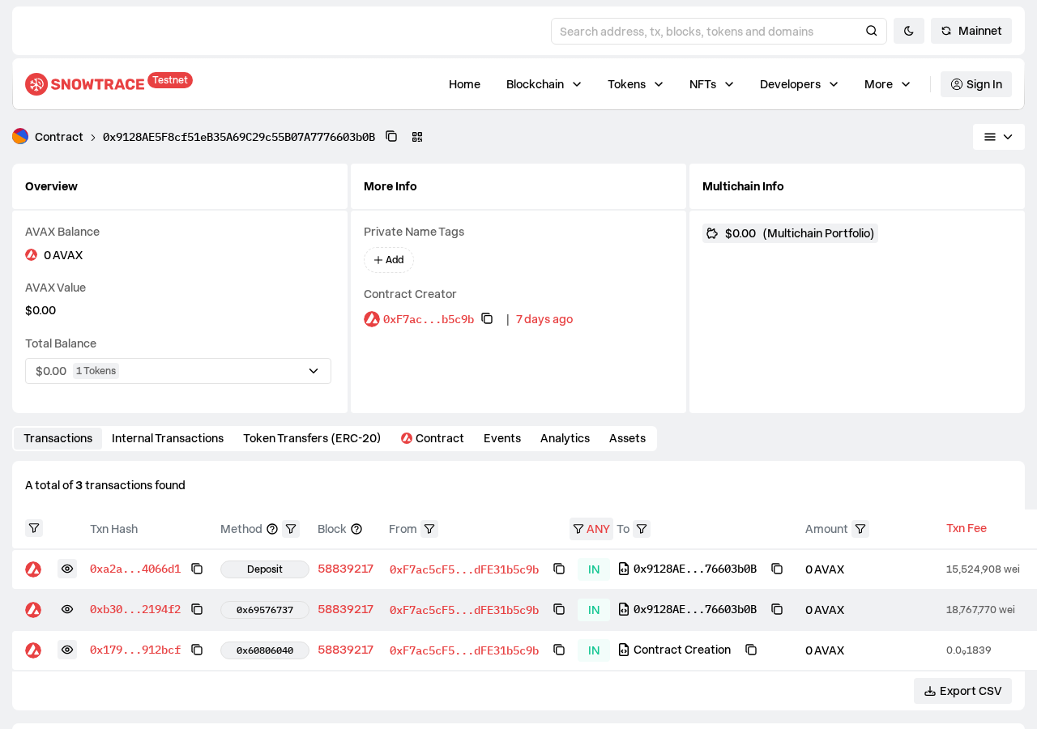
REAL DEPLOYMENT · NOT STAGED
MultiCollateralVault is really deployed on Fuji testnet
Verifiable on Snowtrace: contract creation + 3 real on-chain interactions
AvaVault Perp · Avalanche Buildathon · Onchain Finance Track
5/10

Slide 6
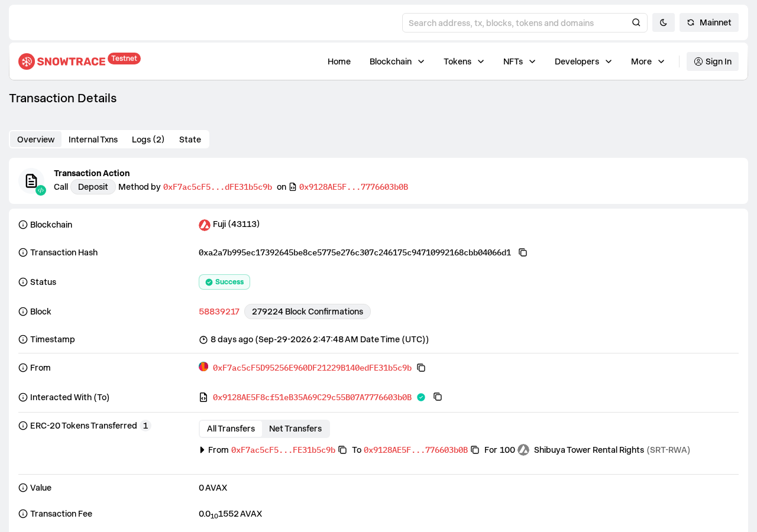
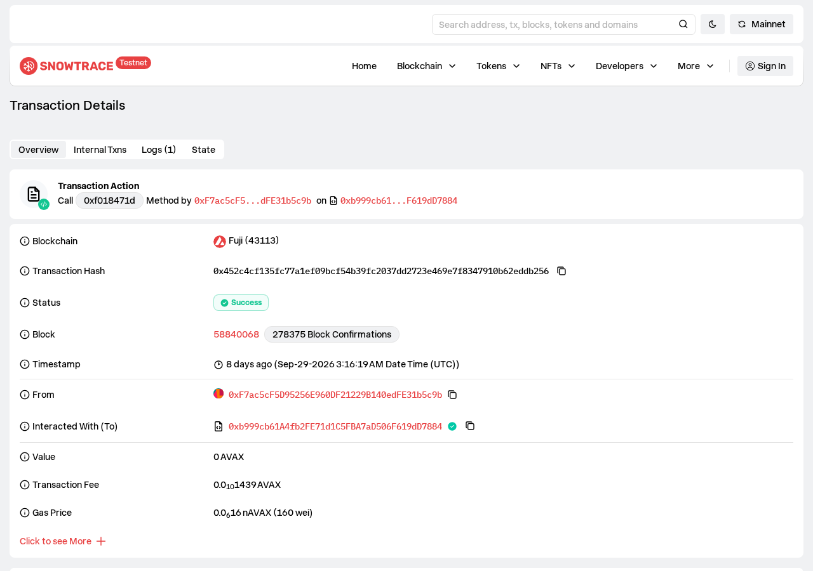
REAL ON-CHAIN TRANSACTIONS
Deposit margin -> signed settlement, fully verifiable
100 RWA tokens really deposited as margin
EIP-712 signed authorization, settled by the operator
AvaVault Perp · Avalanche Buildathon · Onchain Finance Track
6/10

Slide 7
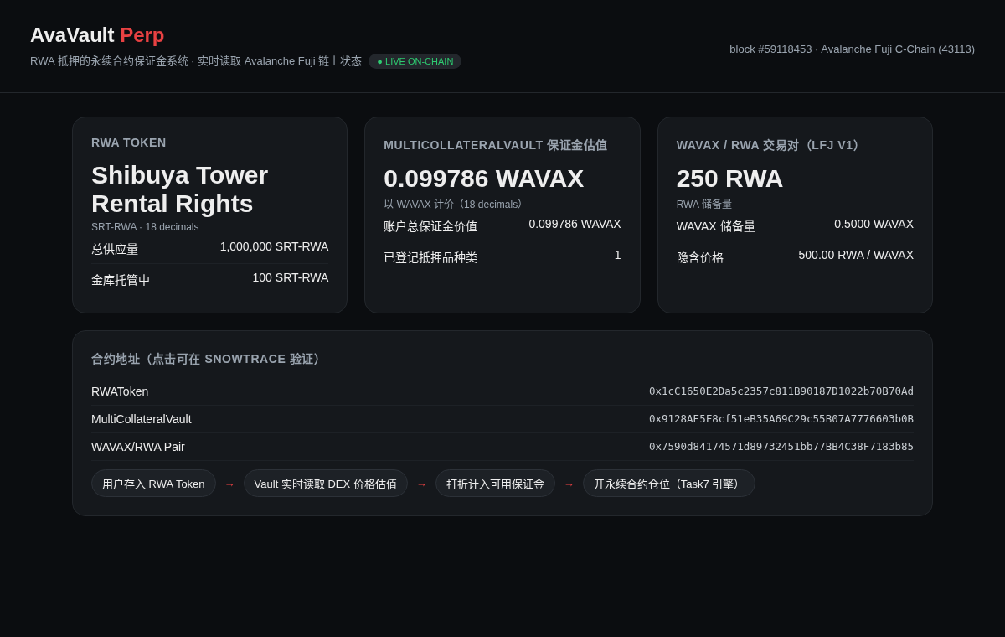
LIVE DASHBOARD
Nothing here is hardcoded
Every refresh re-reads Fuji chain state: supply, vault balance, DEX-reserve valuation
AvaVault Perp · Avalanche Buildathon · Onchain Finance Track
7/10

Slide 8
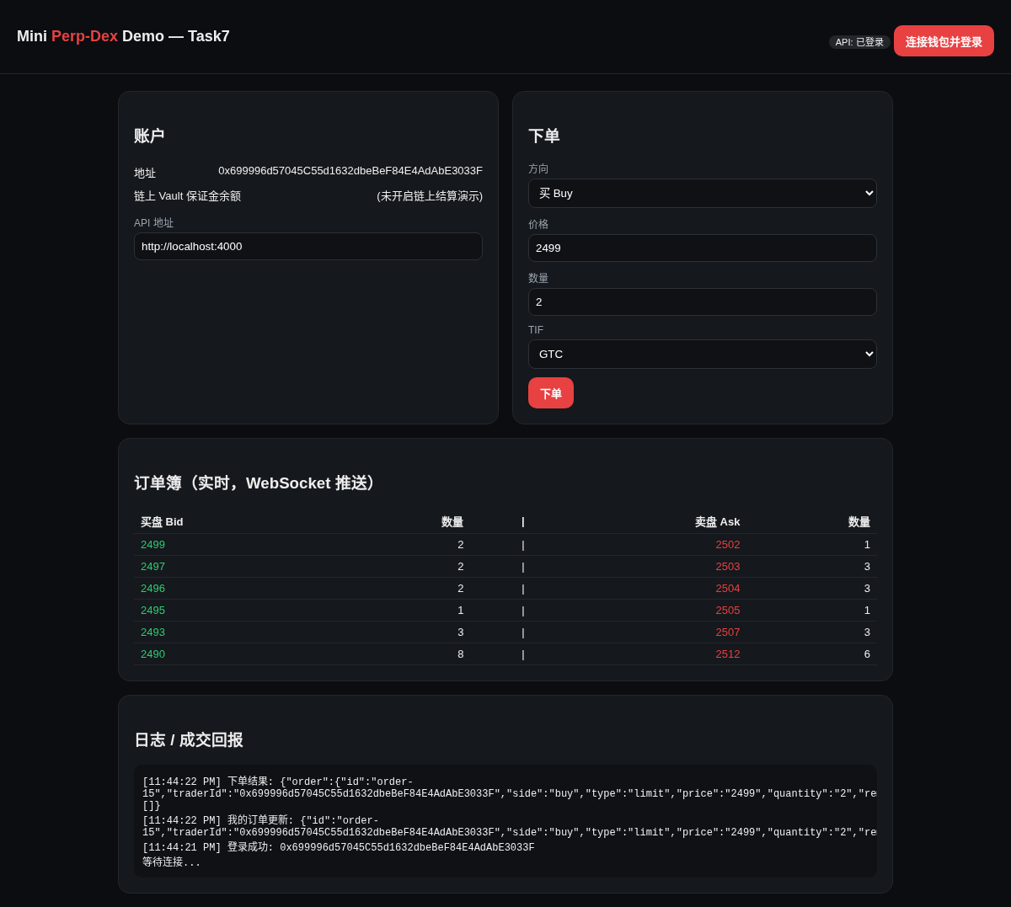
END-TO-END DEMO
The perpetual trading engine, really running
Real signed login - real order book depth - real order fills
AvaVault Perp · Avalanche Buildathon · Onchain Finance Track
8/10

Slide 9
WHY AVALANCHE
Sub-second finality + near-zero gas make this practical
• Real transaction fees: around 0.0001 AVAX
• DEX prices can be read frequently, cheaply
• C-Chain is fully EVM compatible, Solidity reused as-is
AvaVault Perp · Avalanche Buildathon · Onchain Finance Track
9/10

Slide 10
AvaVault Perp
Putting sleeping real-world assets back to work
• GitHub: <put your forked repo link here>
• Track: On-chain Finance
• Thanks for watching - building the next wave of on-chain finance on Avalanche
AvaVault Perp · Avalanche Buildathon · Onchain Finance Track
10/10

