Slide 1
The Translation as Performance: The Case of
Ken Liu and The Three-body Problem
翻译即表演：刘宇昆英译《三体I》研究
答辩学生：马欣然
专业方向：文学翻译研究

Slide 2
01
Research Background and Significance
02
Research Questions and Methodology
CONTENTS
03
Analytical Framework and Case Analysis
04
Major Findings and Limitations

Slide 3
Research Background
and Significance
01

Slide 4
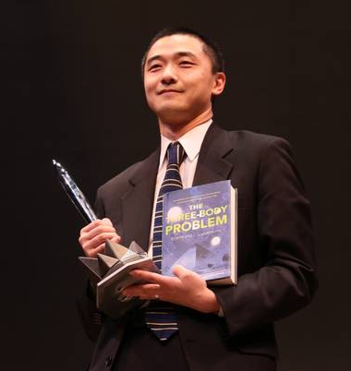
1.1 Research Background
Ken Liu (刘宇昆), the translator of Liu Cixin’s (刘慈欣) Santi series, has played a vital role in making this Chinese science fiction (SF) series accessible to English-speaking audiences and qualified for Hugo Award, the top SF award.
While translation studies have focused on the balance between fidelity and readability of this translated novel, “translation is a performance art”—a perspective frequently highlighted by Ken Liu—remains under-examined.
Therefore, it is interesting to study Ken Liu’s analogy between translation and performance art, to obtain a new understanding of the nature of translation.
Ken Liu receiving the Hugo award on behalf of Liu Cixin

Slide 5
1.2 Significance
The introduction of performance theory to translation studies provide a new perspective to understand the translator’s creativity and subjectivity.
The model of four elements of performance, can provide a reference for future research to study the dynamics between the elements in translation activities and/or introduce more theories of performance studies to supplement the current models in the translation studies.

Slide 6
Research Questions and Methodology
02

Slide 7
2.1 Research Questions
In this study, the author strives to answer the following questions:
  What is Ken Liu’s viewpoint of the translation as a performance art?
  How does Ken Liu’s notion of the translation as performance influence his translation approach of The Three-Body Problem?
  What can be learned about the unique features of translation from Ken Liu’s perspectives on the relationship between the arts of translation and writing?

Slide 8
2.2 Methodology
Ken Liu’s analogies between translation and performance were extracted from his online interviews and comments of over 50,000 words. Relevant literature was read and a descriptive approach was adopted.
01
A contrastive study was conducted between the source text and the corresponding target text of The Three-Body Problem. The text was analyzed within an analytical framework developed from the performance theory, and categorized into the ones inclined to re-create the voice of the original (the script), and the ones inclined to cater for the target reader (the audience).
02
To explore unique features of the translation as performance, a comparative approach was also adopted to explore how Ken Liu, as a writer-translator, views the relationship between the two creative arts of writing and translating.
03
Notes:
The major research methods of this thesis include the literature review, descriptive approach, contrastive studies and textual analysis.

Slide 9
Analytical Framework and Case Analysis
03

Slide 10
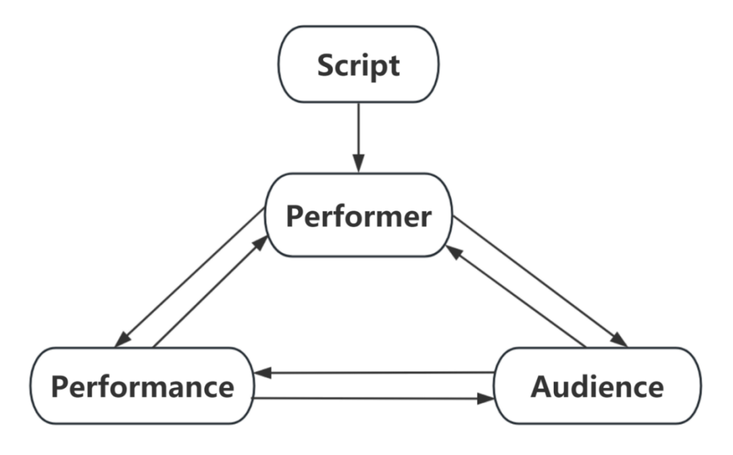
2.2 Analytical Framework
According to Schechner (1985), the dynamics between the elements of performance—the script, the performer, the performance and the audience—can be described by Figure 3-1:
This network resembles the one of elements around translation—the original work, the translator, the translation, and the target readers.
Figure 3.1 The Dynamics between Elements in the Performance
“restored behavior”: performance consists of fragments of behavior that can be rearranged or rebuilt
“rehearsals”: rehearsals serve as a method for ensuring that actions are comprehensible to both their original context and the intended audience

Slide 11
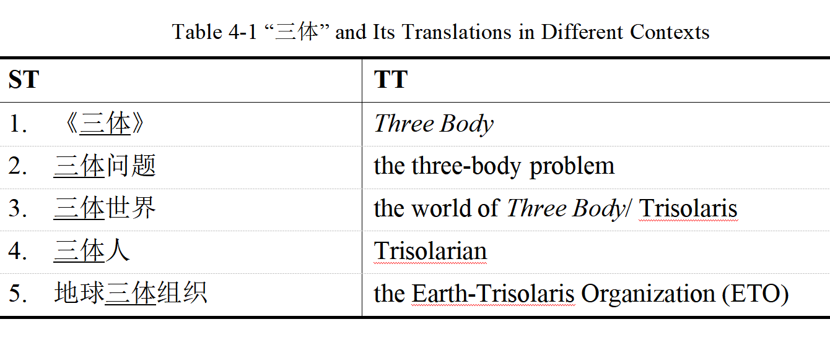
3.2 Case Analysis
3.2.1 Restoration through Rehearsals: Re-creating the Voice of the Author
Ken Liu “sticks to the score as a musician”—strives to be faithful to his own understanding of the original—and limits his improvisations only to necessary occasions. His creative improvisations can be divided into these categories: variations, tone correctives, and error proofreading.
Examples for variations on the same ST: Table 4.1

Slide 12
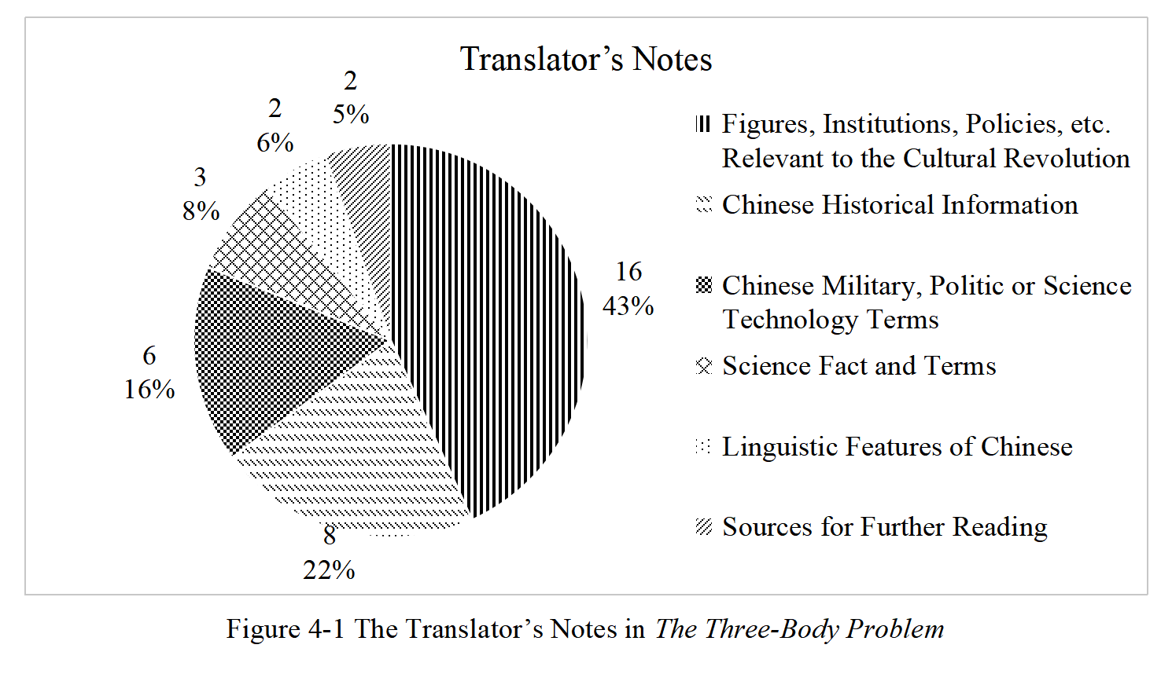
3.2 Case Analysis
3.2.2 The Reader as the Audience to Cater for
According to Ken Liu, “a translator has some duty to educate” especially while translating from a contemporary culture that is subject to stereotypes or misunderstandings. His educational efforts are significantly shown in his footnotes and his in-text interventions. The footnotes can be divided into linguistic footnotes and cultural footnotes.
Figure 4.1 shows the overview of the translator’s footnotes in the translation.

Slide 13
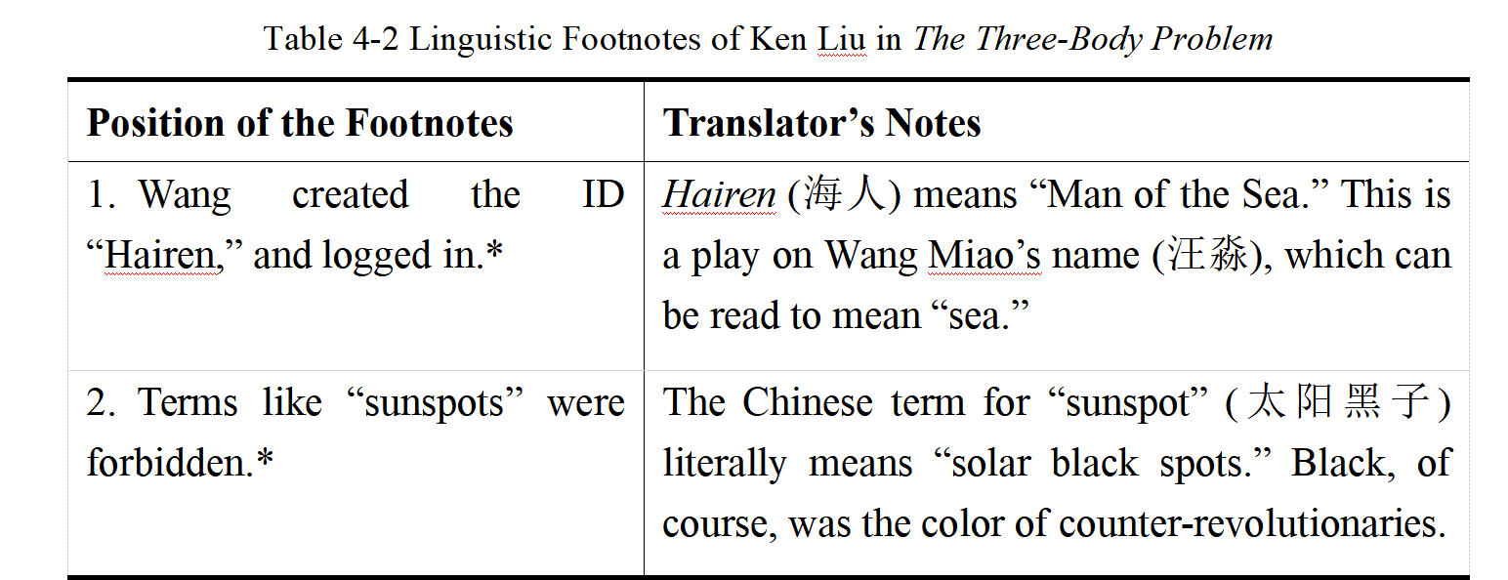
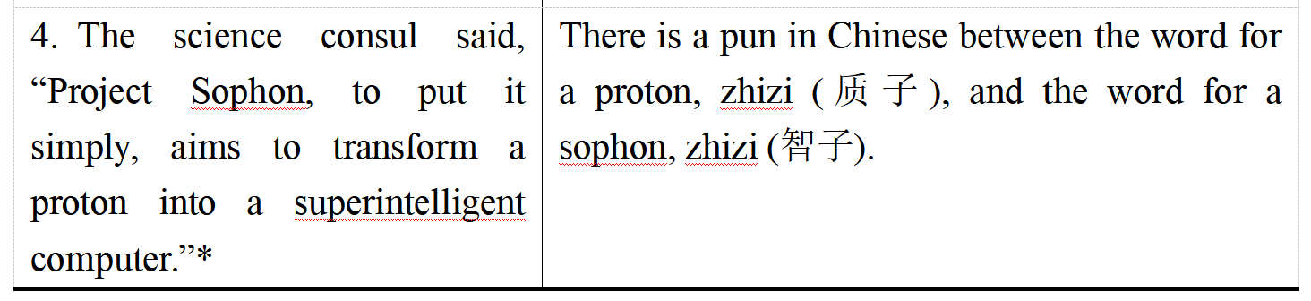
3.2.2 Interaction: the Performer’s Experiences Influence the Performance
3.2.2 The Reader as the Audience to Cater for
Examples for linguistic footnotes: Table 4.2 (partial)

Slide 14
3.3 Ken Liu’s Viewpoints of the Relationship between Translating and Writing in the Light of Performance Theory
Many features of performance are shared with numerous forms of creative writings, including translating and authoring. From Ken Liu’s viewpoints of the relationship between translating and writing, the author explored the special features of the translation as performance.
Arts of Different Natures: Translation, as a performance, involves different creativity and judgment from that required for writing.
Ken Liu’s viewpoints
Interaction: Since a translation is a performance that cannot be isolated from the performer’s life, his translations are prone to be influenced by his own explorations in fiction-making.
Notes:
with the notions of many writer-translator

Slide 15
Major Findings
and Limitations
04

Slide 16
4.1 Major Findings
  Ken Liu’s metaphor between translation and performance likens the original text to a musical score and the translator to a musician. It emphasizes the translator’s role in re-creating with fidelity the author’s voice for a new audience.
  The Three-Body Problem displays Ken Liu’s philosophy of the translation as performance. His reflections as the performer’s “rehearsals,” can be divided into two categories: for re-creating the author’s voice and for the reception of the target reader.
  Liu’s dual identity as a writer-translator offers the chance to examine through the comparison with the art of writing the unique nature of the translation as performance. While writing allows for greater spontaneity, translation requires an extra layer of consciousness and reflexivity. Despite the difference, these two performance arts also interact in writer-translators’ practice.

Slide 17
4.2 Limitations
  Although The Three-Body Problem is an excellent text to study in terms of the richness of translation challenges encountered, it is the first SF novel Ken Liu has translated. This early work may fail to capture possible transformations in his translation philosophy.
  Due to the nature of textual analysis, the case study cannot cover many valuable examples of Ken Liu’s efforts in The Three-Body Problem. More specific instances can be found in other specific studies, such as the studies of paratexts in the novel.
  While performance theory is central to the analysis, the thesis only adopts some of the basic ideas of the theory, which does not fully explore the theory’s potential applications to other areas of translation studies.

Slide 18
THANK YOU FOR LISTENING!
翻译即表演：刘宇昆英译《三体I》研究
答辩学生：马欣然
专业方向：文学翻译研究

