Slide 1
Translation and Dissemination of Chinese Online Literature
from the Perspective of Actor-Network Theory: Taking the
English Translation of Lord of Mysteries
on Webnovel as an Example
行动者网络视域下中国网络文学的译介与传播
——以起点国际平台《诡秘之主》英译为例
答辩人：彭杰敏
学号：20221210031
研究方向：文学翻译研究
Notes:
亮亮图文旗舰店https://liangliangtuwen.tmall.com

Slide 2
1
INTRODUCTION
2
LITERATURE REVIEW
CONTENTS
3
THEORETICAL FRAMEWORK
4
RESEARCH CONTENT
5
CONCLUSION

Slide 3
1.1
Research Rationale
Chinese online literature going global : a focal point of research for the government and society
strategy of Chinese culture “going out”
huge domestic and overseas market
(中国互联网中心信息中心，2025；
中国社会科学院文学研究所，2024）
From a political
perspective
From an economical
perspective
From a cultural and
historical perspective
One of the “Four Cultural Wonders of the World” (解辰巽, 2016) ；
China’s “New Fifth Great Invention” in the cultural field (张颐武, 2018)；
a high point in the 70-year history of Chinese culture “going out”

Slide 4
1.1
Research Rationale
From a research perspective
Currently, although the achievements of Chinese online literature going global are significant,
the process is still in its infancy, and its production and dissemination mechanisms have not
been fully clarified.
Existing research, which takes Webnovel, the largest domestic and official website for Chinese online literature going global, as the research subject, mainly focuses on perspectives such as media technology or cross-cultural communication, with little systematic study on its translation mechanism.
Hence, this paper selects the successful work Lord of Mysteries on Webnovel as a typical case, starting from the perspective of Actor-Network Theory to analyze the translation and dissemination network of Chinese online literature.

Slide 5
1.2
Methodology and Data Collection
Methodology: netnography, a specific set of related data collection, analysis, research practice, where a significant amount of the data collected and participant-observational research conducted originates in and manifests through the data shared freely on the Internet (Kozinets, 2015).
relevant research materials are consulted
Step 1
A Comprehensive Review is formed;
Webnovel — the research platform & online field site
Step 2
the entire translation community of Webnovel is overviewed
Lord of Mysteries — the entry point;
its data collection and filtering are conducted
The data are analyzed and organized based on the research questions and the conceptual framework of ANT
Step 3

Slide 6
1.3
Research Objective and Research Questions
Research Questions
To reveal Webnovel’s translation and dissemination mechanisms.
(1) Which actors are involved in the translation of Lord of Mysteries？
(2) How do these actors interact and collaborate to form a translation network?
(3) What translation and dissemination paradigm does Webnovel adopt?
Research Objective

Slide 7
A Brief Review on Chinese Online Literature and Its Translation
2.1
Previous Translation Studies on Chinese Online Literature
lack a clear theoretical foundation and primarily focus on summarizing the current scenario of Chinese online literature(董子铭, 刘肖, 2017；高纯娟, 2017；鲍娴, 2018；席志武, 付自强, 2018)
adopt theoretical perspectives not primarily centered on translation but rather on the broader theme of the “international dissemination of Chinese online literature”, including communication studies (刘肖, 董子铭, 2017;彭石玉, 张慧英, 2018), media consumption (尤达, 2019), cultural consumption(王璐璐, 2018), and the global media revolution (邵燕君等, 2018)
delve into translation and dissemination from a translation study perspective, conducting either broad or detailed analyses (林玲, 2018; 马孝幸, 赵梦源, 2020; 张莹莹, 2020;张雅雯, 2024)
despite addressing online literature translation and dissemination, there's a notable absence of integration between translation theory and translation practices of online literature(万金, 2017; 阮诗芸, 2019;尹倩,曾军, 2019).

Slide 8
2.2
Previous Studies on Actor-Network Theory in Translation
Previous Studies on Actor-Network Theory in Translation
Theoretical Integration of ANT in Translation Studies
Application of ANT in Translation Case Studies
Buzelin(2005), Chesterman(2006,2012), Tyulenev(2014), Marais (2014) , etc.
黄德先(2006); 邢杰等(2019); 骆雯雁(2022); 王岫庐(2019)；郑剑委(2021)
岑群霞(2016); 张莹(2019);汪宝荣(2020); 刘毅(2021);仲文明,王亚旭(2022);邢杰等 (2023); 詹成,张晗(2023)
Buzelin(2007), Abdallah(2011), Bogic(2010), Munday(2016), Luo and Zheng (2017), Stalling and Schleifer (2020)

Slide 9
2.3
Summary of Previous Studies
Previous Translation Studies On Chinese Online Literature | emphasize macro-level analysis over micro-level investigation a notable shortage of quantitative approaches and a lack of methodological rigor a deficiency in theoretical basis of translation study
Previous Studies on Actor-Network Theory in Translation | remain insufficient focus on classic texts, emerging genres, such as Chinese online literature are relatively overlooked.
This study employs ANT as the theoretical basis to analyze the translation of Lord of Mysteries on Webnovel, trying to figure out the translation and dissemination paradigm of Webnovel.

Slide 10
3.1
Working Definition
Actor-network Theory
Actor
Network
Translation
“may be anything: people, crowds, microbes, machines, ideas, technologies, even fate” (Latour, 1988: 252) .
Network
Translation^{ANT}
It is not “a thing out there”, but functions as a tool to describe the connections among these entities, with emphasis on the process of their “work, movement, flow, and change” (ibid:143)
denotes the process whereby focal actors align their interests and objectives with those of other actors.
Actor

Slide 11
3.1
Working Definition
The four stages of Translation^{ANT}
Problematization | initiates the establishment of actor-network, during which focal actors depict their essence, and identify human and non-human actors relevant to the activity
Interessment | a strategy used by actors to strengthen their relationships with other actors; by giving interests to others, potential competitive dynamics can be dismantled
Enrollment | result from endowing actors with interests
Mobilization | marks the leadership exerted by focal actors to coordinate the entire network alliance for operation

Slide 12
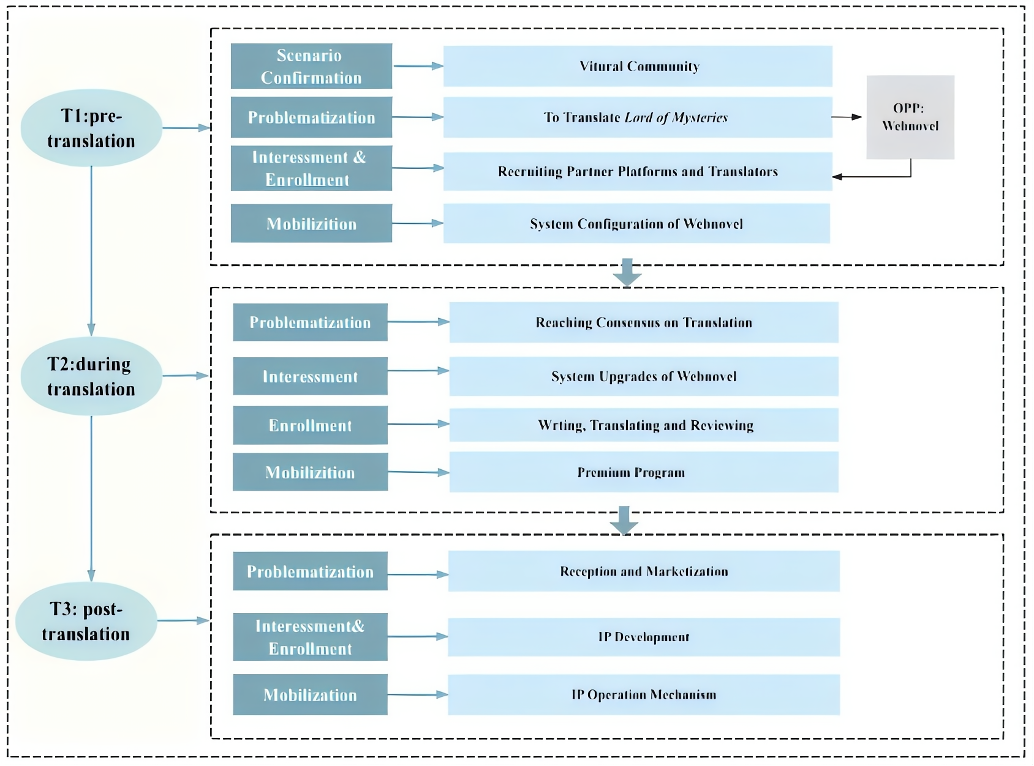
3.2
Analytical Framework

Slide 13
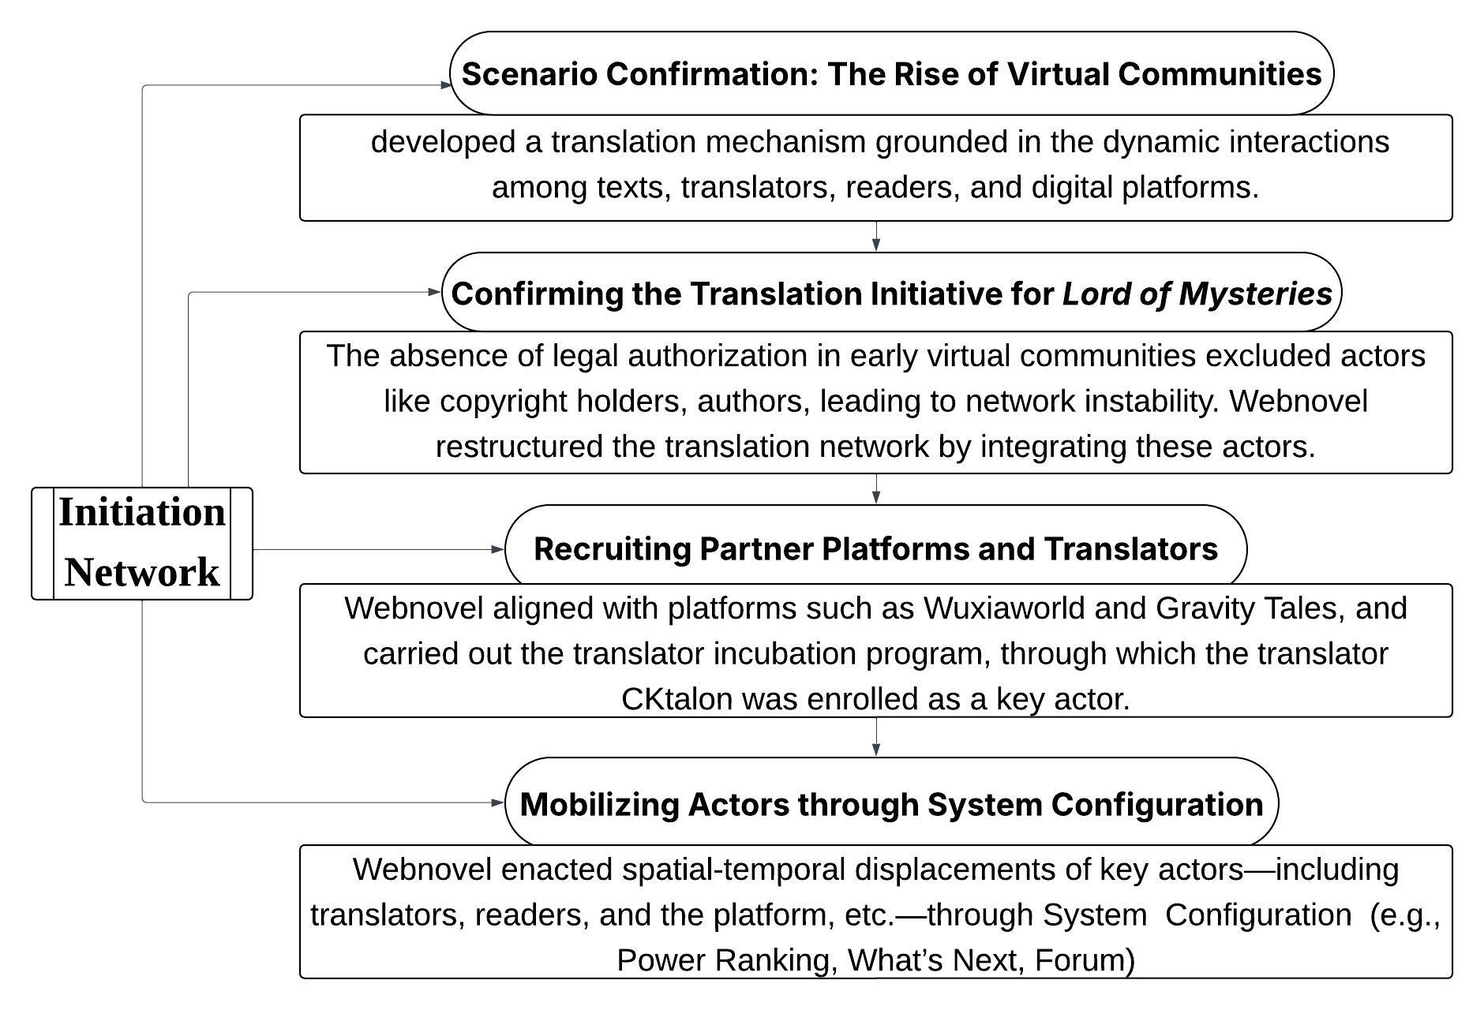
4.1
Initiation Network of Lord of Mysteries

Slide 14
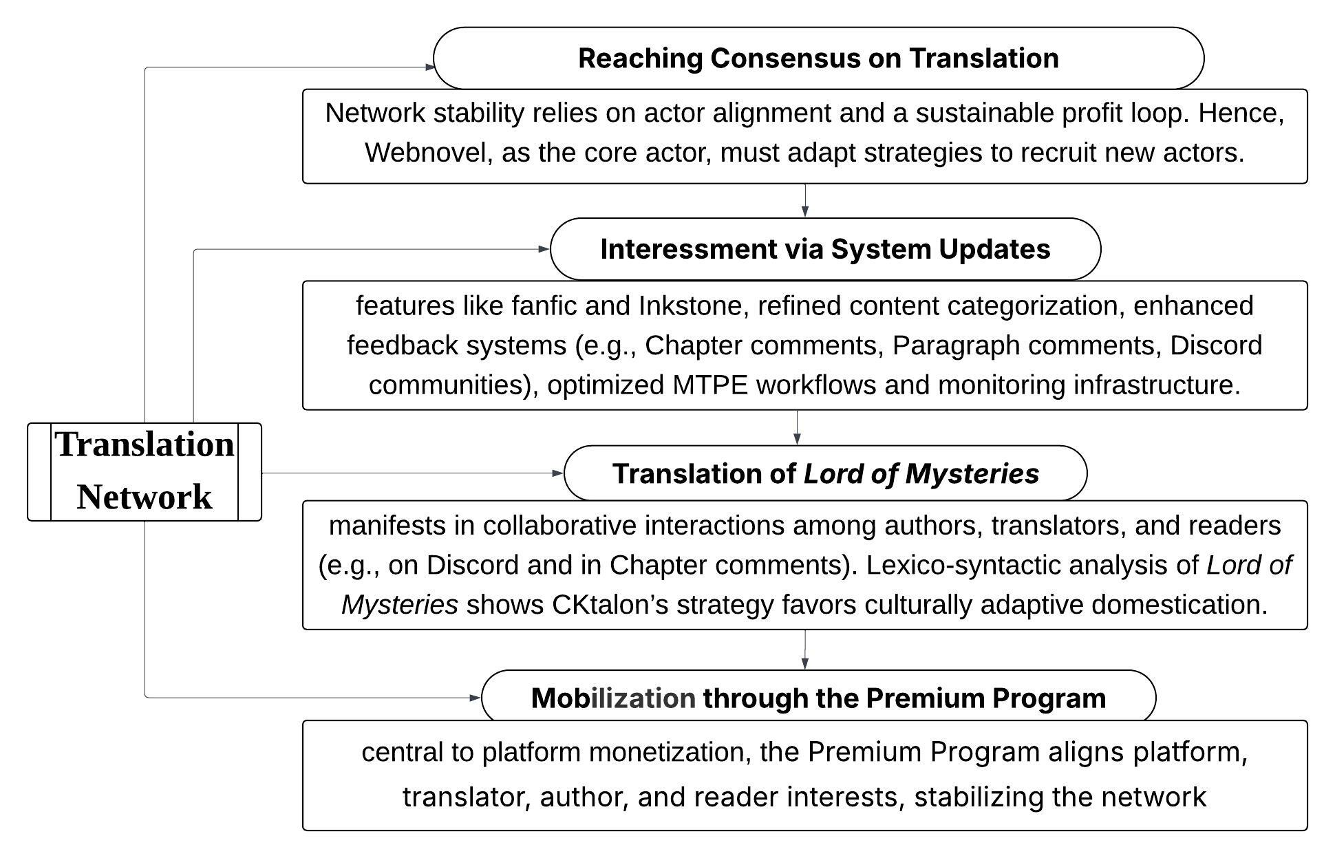
Translation Network of Lord of Mysteries
4.2

Slide 15
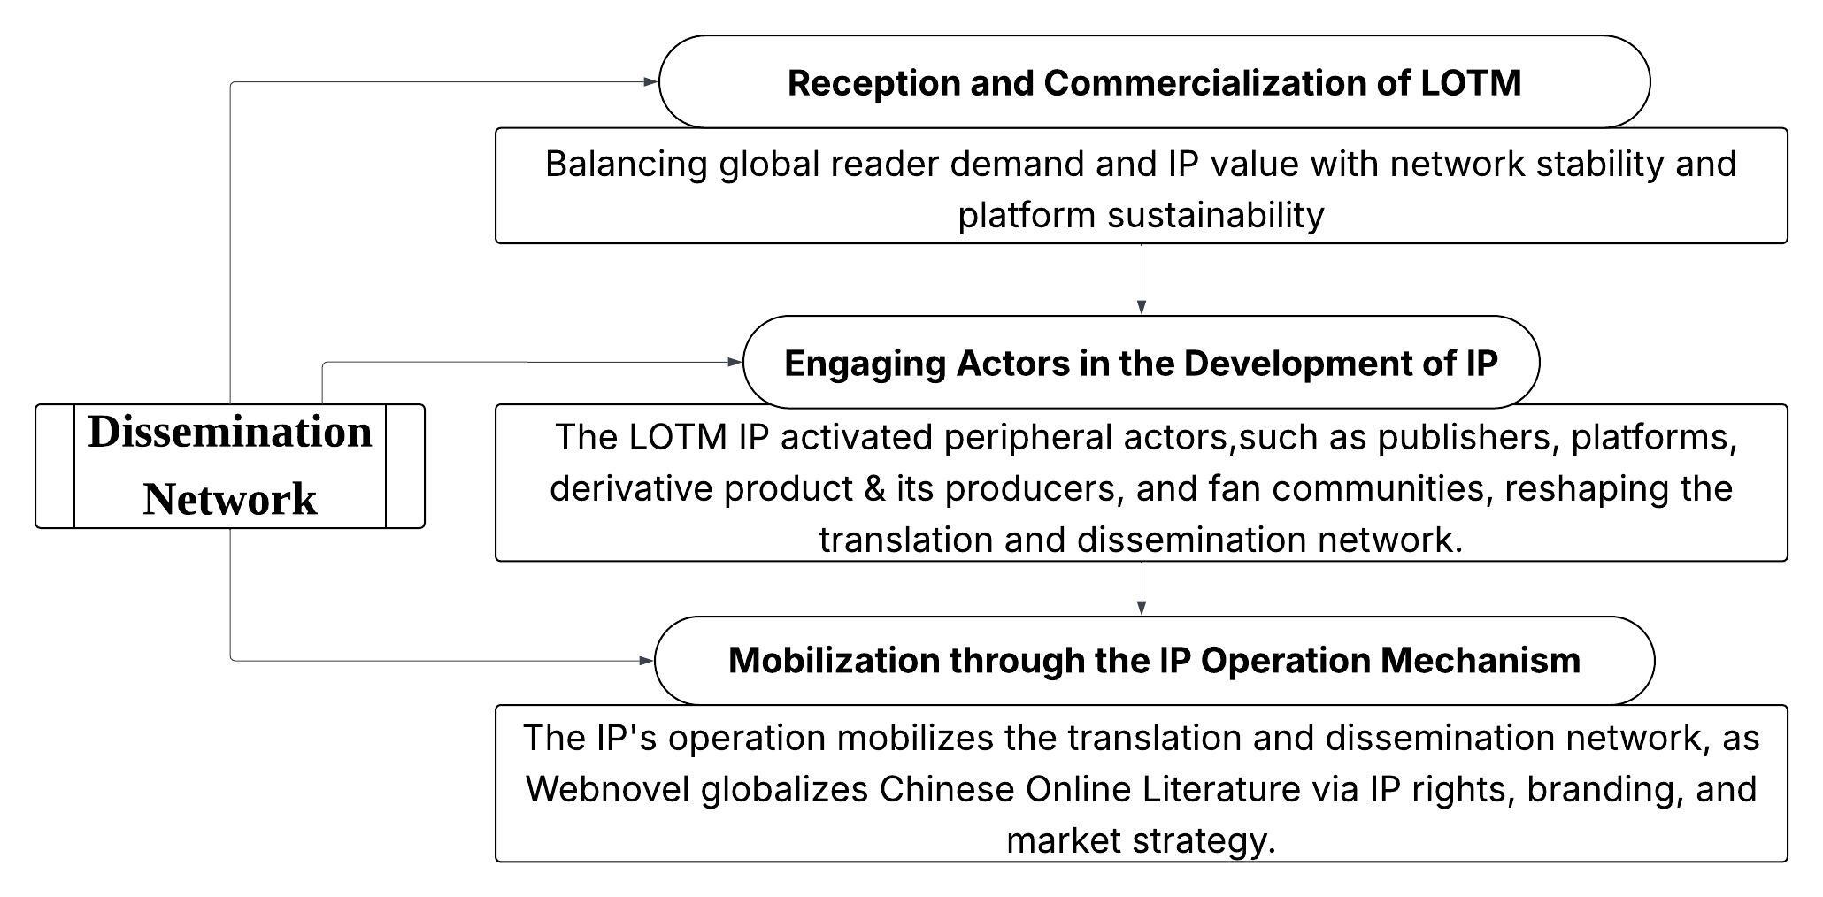
4.3
Dissemination Network of Lord of Mysteries

Slide 16
5.1
Major Findings
Key Actors in the Translation and Dissemination Network
Three types of actors:
1. Human actors within Webnovel’s translation and dissemination network primarily include authors, translators, and readers.
3. The main hybrid actors include Yuewen Group, social platforms, and commercial enterprises
您的内容打在这里，或者通过复制您的文本后，在此框中选择粘贴，并选择只保留文字。您的内容打在这里，或者通过复制您的文本后。
2. Non-human actors primarily include the source text, the translated text, technological systems, UGC, and IP & its derivative transmedia products.
您的内容打在这里，或者通过复制您的文本后，在此框中选择粘贴，并选择只保留文字。您的内容打在这里，或者通过复制您的文本后。

Slide 17
5.1
Major Findings
Network Construction
These actors collectively form a complex cross-cultural communication network. Webnovel have constructed an ecosystem that spans translation production, dissemination, and reproduction, centered on copyright licensing, technological mediation, and management mechanisms.
3. Yuewen Group and Webnovel also act as institutional spokespersons who coordinate resources and rules while commercial companies participate in the reproduction and global dissemination of IPs. IPs and their derivatives transcend textual boundaries to generate diverse forms of media, driving the translation network toward a co-creative value system.
2. Readers are embedded into the platform’s governance logic through participatory mechanisms . Their UGC, produced both on the platform and via social media, contributes to content evaluation and dissemination.
1. not only enhances creative and translational efficiency but also reshapes the labor ecology of both authors and translators.
您的内容打在这里，或者通过复制您的文本后，在此框中选择粘贴，并选择只保留文字。您的内容打在这里，或者通过复制您的文本后。
您的内容打在这里，或者通过复制您的文本后，在此框中选择粘贴，并选择只保留文字。您的内容打在这里，或者通过复制您的文本后。

Slide 18
5.1
Major Findings
Translation-Dissemination Mechanisms
Webnovel has developed a digital translation and dissemination model characterized by a deep coupling of institutional, technological, community, and commercial elements.
Acting as a mediator through systems of governance, technological infrastructure, and capital investment, the platform embeds itself in all key stages—content production and curation, translator organization and output, reader participation and feedback, IP operation, and multi-platform dissemination—thereby driving the standardization and scaling-up of the translation production process.
This “institutionalized model of commercial community translation” marks a paradigmatic shift from textual transfer to the transplantation of cultural ecosystems.
您的内容打在这里，或者通过复制您的文本后，在此框中选择粘贴，并选择只保留文字。您的内容打在这里，或者通过复制您的文本后。
您的内容打在这里，或者通过复制您的文本后，在此框中选择粘贴，并选择只保留文字。您的内容打在这里，或者通过复制您的文本后。

Slide 19
5.2
Limitations
1. Due to constraints of time and content volume, this study is unable to perform a comprehensive textual analysis of the entire translation of Lord of the Mysteries, and instead will provide an overview through the analysis of typical cases.
2. Most of the data presented in the thesis, aside from the compilation of works using software tools, was manually collected by the author through web.archive, relevant social media platforms, and pertinent literature, and thus there may be omissions.

Slide 20
5.3
Implications and Suggestions
Implications
The innovative translation community of Webnovel provides a valuable site for reflecting on professional translation practices, including operational models, industry standards, quality assessment, and translation norms. Through theoretical exploration and empirical research, it inspires new theoretical methodologies for translation studies, with findings offering practical insights for translation practice of Chinese literature and Chinese culture “going out” .
Suggestions
The translation activities of Chinese online literature in cyberspace carry practical and theoretical significance, calling for greater scholarly attention and encouraging more researchers to engage in this field. Moving forward, scholars can further enhance the research content, perspectives, and methodologies employed in studying the translation of Chinese online literature.

Slide 21
References
[1] Abdallah, Kristiina. Quality Problems in AVT Production Networks: Reconstructing an Actor-network in the Subtitling Industry [A]. In Alina Serban, Anna Matamala & Jean-Marc Lavaur (eds). Audiovisual Translation in Close-up: Practical and Theoretical Approaches [C]. Bern: Peter Lang, 2011: 173-186.
[2] Abdallah, Kristiina. Translators in Production Networks. Reflections on Agency, Quality and Ethics [M]. Dissertations in Education, Humanities and Theology, Joensuu: University of Eastern Finland, 2012.
[3] Bogic, Anna. Uncovering the hidden actors with the help of Latour: the ‘making’ of The Second Sex [J]. MonTI. Monografías de Traduccióne Interpretación, 2010, (2): 173-192.
[4] Buzelin, Hélène. Independent publisher in the networks of translation [J]. TTR: Traduction, Terminologie, Rédaction, 2006, 19(1): 135-173.
[5] Buzelin, Hélène. Sociology and Translation Studies [A]. In Carmen Millán-Varela & Francesca Bartrina (eds). The Routledge Handbook of Translation Studies [C]. London: Routledge, 2013: 186-200.
[6] Buzelin, Hélène. Translations “in the making” [A]. In Michaela Wolf & Alexandra Fukari (eds). Constructing A Sociology of Translation[C]. Amsterdam/Philadelphia: John Benjamins, 2007:135-169.
[7] Buzelin, Hélène. Unexpected Allies: How Latour’s Network Theory Could Complement Bourdieusian Analyses in Translation Studies [J]. The Translator, 2005, 11(2): 193-218.
[8] Boll, Tom. Penguin Books and the translation of Spanish and Latin American poetry, 1956-1979 [J]. Translation and Literature, 2016, 25(1): 28-57.
[9] Chesterman, Andrew. A Causal Model for Translation Studies [A]. In Maeve Olohan (ed). Intercultural Fault-lines: Research Models in Translation Studies I. Textual and Cognitive Aspects [C]. Manchester: St Jerome Publishing, 2000: 15-27.
[10] Chesterman, Andrew. Models in translation studies [A]. In Yves Gambier and Luc Van Doorslaer (eds). Handbook of Translation Studies [C]. Amsterdam & Philadelphia: John Benjamins, 2012: 108-114.
[11] Chesterman, Andrew. On explanation [A]. In Anthony Pym, Miriam Shlesinger & Daniel Simeoni (eds). Beyond Descriptive Translation Studies: Investigations in Homage to Gideon Toury [C]. Amsterdam & Philadelphia: John Benjamins, 2008: 363-377.

Slide 22
References
[12] Chesterman, Andrew. Questions in the Sociology of Translation [A]. In João Ferreira Duarte, Alexandra Assis Rosa & Teresa Seruya (eds). Translation Studies at the Interface of Disciplines [C]. Amsterdam and Philadelphia: John Benjamins, 2006: 9-27.
[13] Callon, Michel. Some elements of a sociology of translation: domestication of the scallops and the fishermen of Saint Brieuc Bay [A]. In John Law (ed). Power, Action and Belief: A New Sociology of Knowledge? [C]. London: Routledge, 1986: 196-233.
[14] Latour, Bruno. Reassembling the Social: An Introduction to Actor-Network Theory [M]. Oxford: Oxford University Press, 2005.
[15] Latour, Bruno. The Pasteurization of France [M]. Translated by Alan Sheridan and John Law. Cambridge, Massachusetts & London, England: Harvard University Press, 1988.
Tyulenev, Sergey. Translation as a social fact [J]. Translation and Interpreting Studies, 2014, 9(2): 179-196.
[16] Venuti, Lawrence. The Translator’s Invisibility: A History of Translation (2nd ed) [M]. London: Routledge, 2008.
[17] Wolf, Michaela. Introduction: The emergence of a sociology of translation [A]. In Michaela Wolf & Alexandra Fukari (eds). Constructing a Sociology of Translation [C]. Amsterdam/ Philadelphia: John Benjamins, 2007: 1-36.
[18] 吉云飞. “起点国际”模式与“Wuxiaworld”模式——中国网络文学海外传播的两条道路[J]. 中国文学批评, 2019, (2): 102-108.
[19] 林玲. 从译介学理论看中国网络文学的海外输出——以“盘龙”的海外走红为例[J]. 三峡大学学报(人文社会科学版), 2018, (2): 94-97.
[20] 骆雯雁. 行动者网络理论的“翻译”模式与铭文概念及其对社会翻译学研究的意义[J]. 外语研究, 2022, (3): 86-91.
[21] 骆雯雁. 行动者网络理论在翻译生产述研究中的应用——以亚瑟·韦利英译《西游记》为例[J]. 外语研究, 2020, (2): 84-90.
[22] 刘肖, 董子铭. “一带一路”视野下我国网络文学对外传播研究[J]. 出版发行研究, 2017, (5): 78-81.
刘毅.《射雕英雄传》在西方的译介传播：行动者网络、译者惯习与翻译策略[J]. 解放军外国语学院学报, 2021, 44 (2): 58-65.
[23] 刘毅. 网络文学外译版权输出的角力、变局与前景[J]. 出版发行研究, 2017, (12): 94-97.
[24] 刘毅, 张佐堂. 网络文学中武术文化的译介与传播——以北美网络翻译平台“武侠世界”为例[J]. 西南交通大学学报（社会科学版）, 2018 , (6): 98-104.
[25] 李彦. 中国网络文学在虚拟社区中的译介——基于 Wuxiaworld 的网络志研究[D]. 上海外国语大学, 2019.

Slide 23
References
[26] 马孝幸, 赵梦源. 中国文化 “走出去” 背景下的网文出海研究——以《三生三世十里桃花》外译为例[J]. 新阅读, 2020, (8): 59-62.
[27] 欧阳友权. 重写文学史与网络文学“入史”问题[J]. 河北学刊, 2013, (5): 8-12.
[28] 欧阳友权. 网络文学概论[M]. 北京: 北京大学出版社, 2008.
[29] 王璐璐. 全球文化消费视角下中国网络文学海外传播研究——以 Wuxiaworld为例[J]. 出版发行研究, 2018, (1): 74-78.
[30] 万金. 网络武侠小说在英语世界的传播——以翻译网站Wuxiaworld为例[J]. 东方翻译, 2017, (5): 27-33.
[31] 王岫庐. 行动者网络翻译研究[J]. 上海翻译, 2019, (2): 14-20.
[32] 王岫庐. 行动者网络理论视角下的田汉译剧《沙乐美》研究[J]. 翻译季刊, 2017, (85): 51-70.
[33] 解辰巽. 中国网文与韩国偶像剧等并称为 “世界四大文化奇观”[N]. 北京晨报, 2016-12-20.
[34] 邢杰, 黎壹平, 张其帆. 拉图尔行动者网络理论对翻译研究的效用[J]. 中国翻译, 2019, (5) : 28-36.
[35] 邢杰, 袁婉, 黄静怡. 构建翻译社会生产网络———以英译外交部网站新闻合作项目为例[J]. 燕山大学学报(哲学社会科学版), 2023, 24(1): 44-50.
杨宇. 中国网络文学海外传播的思考——以Wuxiaworld为例[J]. 传播与版权, 2020, (2): 8-10.
[36] 詹成, 张晗. 行动者网络理论视阈下的国家翻译实践研究[J]. 中国外语, 2023, 20(5): 96-102.
[37] 中国互联网信息中心. 第55次中国互联网络发展状况统计报告[R]. (2025-01-17) [2025-02-21]. https://cnnic.cn/n4/2025/0117/c208-11228.html
[38] 中国社会科学院文学研究所.2023中国网络文学发展研究报告[R]. (2024-2-27) [2024-5-21]. http://literature.cass.cn/xjdt/lbt/202402/t20240229_5735756.shtml
[39] 郑剑委. 翻译出版生产中的译者行为体系研究[J]. 解放军外国语学院学报, 2021, (1): 113-120.
[40] 仲伟合, 冯曼. 翻译社会学视角下文化外译研究体系的建构[J]. 外语研究, 2014, (3): 57-62.

Slide 24
THANK YOU

