Slide 1
On the Translation of Wang Wei’s Poems from the Perspective of Systemic Functional Linguistics: A Case Study on Xu Yuanchong’s C-E Translation
系统功能语言学视角下王维诗歌英译研究：以许渊冲译本为例
20221210050 钟铭恩
2025.5.23

Slide 2
01
Introduction
目
录
02
Literature Review
03
Translation as Re-instantiation
04
Analysis
05
Conclusions

Slide 3
01
Introduction

Slide 4
Introduction
Research Objective
To disclose certain features of studies of literary translation based on linguistic theories, this thesis will analyze some phenomena in the translations, aiming to discover the essence and reasons for the translator’s decisions and choices, and revealing the underlying relations in the meaning-making process in the form of translation.

Slide 5
Introduction
Research Questions
This thesis aims to answer the following questions:
1. How does Xu Yuanchong re-instantiate the meaning potential of the ST in the TT?
2. What is the intertextual relation between the ST and TT in general? What are the reasons?
3. What is the text type of Xu Yuanchong’s translation of Wang Wei’s poems from the perspective of re-instantiation?

Slide 6
Introduction
Methodology and Data Collection
Quantitative tools: Online aligner (Tmxmall), CLAWS web tagger, AntConc 4.3.0.
Quanlitative methods: textual analysis & induction
Corpus: Selected Poems of Wang Wei (许渊冲，2021)
Research Design: based on Wang’s (王汐，2016) framework

Slide 7
Introduction
Organization of the Thesis
Chapter One: An overall introduction to the whole thesis.
Chapter Two: Literature review of previous studies on the English translations of Wang Wei’s poems as well English translations at home and abroad.
Chapter Three: Demonstration of the theoretical basis and the analytical framework.
Chapter Four: Analysis of Xu’s English translation
Chapter Five: Conclusions, limitations and implications

Slide 8
02
Literature Review

Slide 9
Literature Review
Previous Studies on Translations of Wang Wei’s Poems
Studies from the Perspective of Aesthetics: Reception Theory (伍小君, 2007); Chan aesthetics and translation aesthetics (舒文譞: 2017); Somaesthetics（身体美学）(李庆本, 2015); aesthetic stimulus-response and subjective intervention (贾玉嘉、刘华文，2022)
Studies from the Perspective of Linguistics: Cognitive Linguistics (蓝纯，2011; 林晶, 2017); Embodied-Cognitive Linguistics (杨运杰, 2021); Palmer’s Cultural Linguistics (张爽, 2008; 文婧, 2013); Transitivity analyses (SFL) (胡媛，2021)

Slide 10
Literature Review
Previous Studies on Translations of Wang Wei’s Poems
Studies from the Perspective of Philosophy: Mixed perspectives (Poetics, Deep Ecology, Taoism and Chan) (陈琳、曹培会，2016); Taoism and Buddism (Chan) (陈琳, 曹培会, 2017; 曹培会, 秦思, 2021); impersonal view of universal things (Taoism) (马瑶, 2018)
Studies from the Perspective of Poetics: 魏家海，2014; 刘思佳，2018; 洪越，2020
Studies from Other Perspectives: Semiotics (江承志, 2015; 刘亚丽, 2018); Hermeneutics (杨柳, 黄劲, 2010); Russian Formalism (唐雪枫, 2015); “Translation Horizon Assessment Model for Classical Chinese Poetry” (吕晖、陈大亮，2022：86)

Slide 11
Literature Review
Previous Practices of Translating Wang Wei’s Poems
Translations in China: Poetry and Prose of the Tang and Song (Yang and Yang, 1984); 100 Wang Wei’s Poems in English Verse (Wang Baotong, 2005); A Complete Edition of Wei Wang’s Poems in Chinese and English with Annotations (Zhao Yanchun, 2020); Selected Poems of Wang Wei (Xu Yuanchong, 2014/2021)
Translations in the West: Cathay (Pound, 1915); Poems by Wang Wei (Walmsley and Chang, 1958); Love and the Turning Year: One Hundred More Poems from the Chinese (Rexroth, 1970); Hiding the Universe: Poems by Wang Wei (Yip, 1972); The poetry of Wang Wei: New translations and commentary (Pauline Yu, 1980); An Anthology of Chinese Literature: Beginnings to 1911 (Owen, 1996) The Selected Poems of Wang Wei (Hinton, 2006); 19 Ways of Looking at Wang Wei (温伯格, 2019); The Poetry and Prose of Wang Wei (Paul Rouzer. 2020)

Slide 12
Literature Review
Summary
Potential for future research on C-E translation of Wang Wei’s poems
A comparative lack of studies on translations by Xu Yuanchong from the perspective of linguistics (e.g. SFL). (The latest theoretical model: targeting the mechanism of changes in meaning on a micro level, and the ST-TT relations on a macro level.)
Connection between language use, language system, language user. (External & internal factors)

Slide 13
03
Translation as Re-instantiation

Slide 14
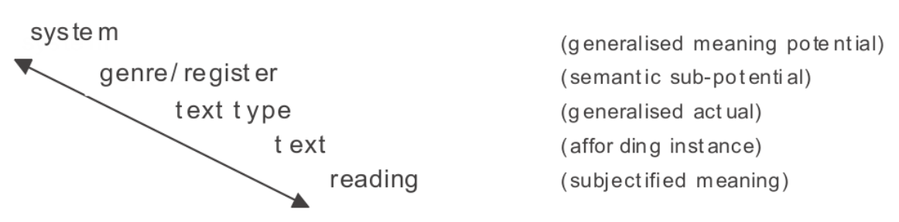
Translation as Re-instantiation
Working Definition
Instantiation: “a scale of generalisation, involving our perspective on inertia and change” (Martin, 2006: 284).
  实例化指概括的程度（a scale of generalization）——涉及人们对静态 （inertia ）与动态（change）采取的态度如对所发生的事情是袖手旁观把握全貌还是逼近事态仔细考察总结归类还是介于二者之间（J.R.马丁，王振华，2008：74）。
  For translation studies, re-instantiation can be defined as “the instance’s reconstruction of the meaning potential of the source instance” (Martin, 2006: 286, in 王汐，2025：89).
Coupling: “the way in which meanings combine -- across strata, metafunctions, ranks, and simultaneous systems (and across modalities, as discussed below).” (Martin, 2010: 19, in Bednarek and Martin, 2010).
Commitment: “the degree of specificity of the meaning instantiated in a text; this has to do with how many optional choices for meaning are taken up and how generally the choices a text subscribes to are instantiated.” (Martin, 2010: 20, in Bednarek and Martin, 2010).

Slide 15
Translation as Re-instantiation
Application of Instantiation and Re-instantiation in Translation Studies
Instantiation: the study on the activisation of meaning potential in the translation of literary work as interlingual re-instantiation (Chang, 2018), explicitation and other kinds of translation shifts (Othman, 2020)
Re-instantiation: GM in the translation of political discourse as interlingual re-instantiation (Chen, Mo and Yang, 2023); translation of ethnography (陈树坤、黄中习，2019) and political discourse (赵晶，2020); model establishment (王汐，2016; de Souza, 2013).

Slide 16
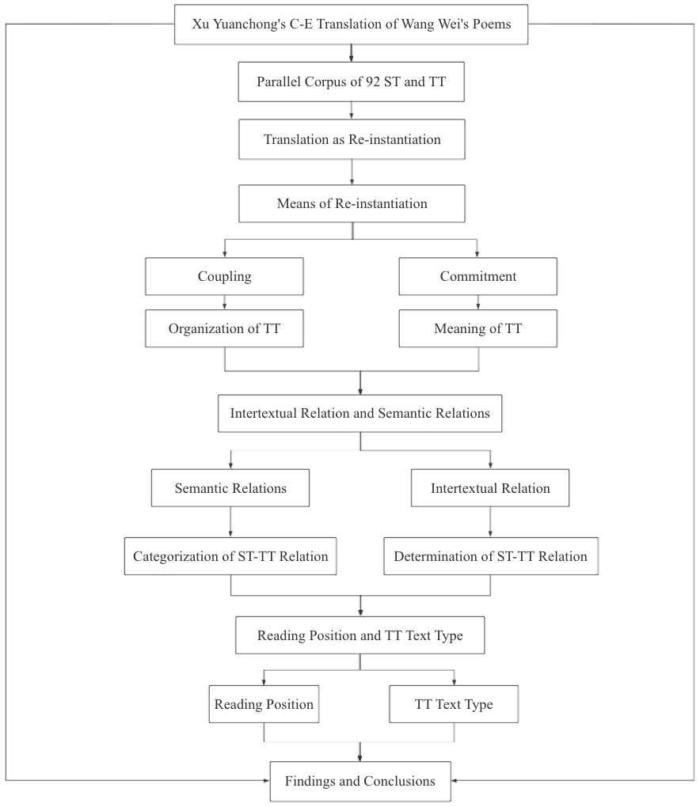
Translation as
Re-instantiation
Analytical Framework

Slide 17
04
Analysis

Slide 18
Coupling: Organization of C-E Translation of Wang Wei’s Poems
ST: 羡君栖隐处，遥望白云端。（《酬比部杨员外暮宿琴台朝跻书阁率尔见赠之作》）
TT: Your hermitage’s an admirable sight, // Viewed from afar, it is atop cloud white. (Reply to Financier Yang on His Visit to the Lute Terrace)
ST: 空山不见人，但闻人语响。（《鹿柴》）
TT: In pathless hills no man’s in sight, But I still hear echoing sound. (The Deer Enclosure)
Coupling: interpersonal meaning and ideational meaning
Nominalization: making the TT more compact as both metafunctions combine.

Slide 19
Commitment: Meanings in C-E Translation of Wang Wei’s Poems
ST: 出洞无论隔山水，辞家终拟长游衍。（《桃源行》）
TT: He left the place and passed over mountains and streams, // But how could he forget the scene of his dear dreams? (Song of Peach Blossom Land)
ST: 白云回望合，青霭入看无。（《终南山》）
TT: When I look back, clouds veil the eye; // When I come near, I see mist flee. (Mount Eternal South)
Ideational commitment: particularization as the major category (addition increasing the delicacy and the amount of meaning potential activated)
ST: 山路元无雨，空翠湿人衣。（《山中》）
TT: Along the path no rain is seen, // My gown is moist with drizzling green. (In the Hills)
ST: 湖上一回首，山青卷白云。（《欹湖》）
TT: He turns to look back from the lake so wide, // But finds hill on hill green, cloud on cloud white. (The Slanted Lake)
Interpersonal commitment: generalization as a typical methodology, increasing comprehensibility.

Slide 20
Semantic Relations: The Categorization of ST-TT Relation
Tentative Categories of Semantic Relations based on Martin (2008), Hood (2008), and de Souza (2010)
Integration of Xu Yuanchong’s methodologies of literary translation (particularization, equalization, generalization) (许渊冲，2003：76).
ST and TT analyzed are listed in Appendix A.
In the sampled cases, particularization is the major type of methodology of literary translation for Xu Yuanchong.
Meanings | General Types | Semantic Relations | Examples
Ideational meanings | Generalization | Hyponomy | man -- driver
 |  | Role/incumbent | the Head Librarian, Ms Andrews -- The librarian
Interpersonal meanings | Equalization and Particularization | Re-instantiation of attitude | getting ahead on the career front -- successful
 |  | Re-instantiation of engagement | just, may -- should, always
 |  | Re-instantiation of graduation | happy - ecstatic
Ideational/interpersonal meanings | Particularization | Lexical Metaphor | make a break -- change
 |  | Infusion/defusion | reassess (=consider + again + evaluatively) -- consider
 |  | Interpersonal grammatical metaphor | I think she is very happy -- Don’t you think she’s happy?

Slide 21
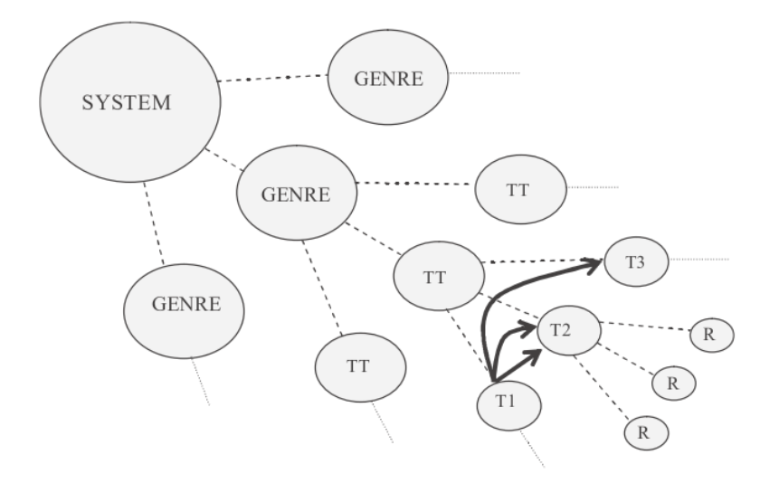
Intertextual Relation: The Determination of ST-TT Relation
“With quotation, the meaning potential of two texts is presented as completely overlapping... With paraphrase, the meaning potential overlaps, but not completely; and with retelling, there is less in common still” (Martin, 2006: 287).
In the previous sections of semantic relations, there are 18 cases falling into the category of paraphrase, and 8 cases, retelling. As a result, the majority of cases belong to the intertextual relation of paraphrase.
To have a more comprehensive view on the ST-TT relation, more aspects (religious concepts; the interaction between Wang Wei and his friends) can be included.
Judging from the research findings from previous sections, the intertextual relation on this level is closer to paraphrase rather than to the other two types (quotation and retelling).

Slide 22
Translator’s Reading Position and Text Type of C-E Translation of Wang Wei’s Poems
“By a tactical reading we refer to a typically partial and interested reading, which aims to deploy a text for social purposes other than those it has naturalised; resistant readings oppose the reading position naturalised by the co-selection of meanings in a text, while compliant readings subscribe to it.” (Martin and White, 2005: 62).
Regarding social purposes, Xu Yuanchong constantly calls on readers to appreciate the lines which includes “For example, we may read the following verse” (许渊冲，2021：III), “We may read two lines from The Dale of Singing Birds” (ibid.: IV), “For instance, we may the following couplet from In the Hills” (ibid.).
Xu (许渊冲，2017：266) quotes a line from Analects, which is “从心所欲不逾矩” (literally “to follow one’s heart without breaking rules”), after which he concludes that “translator is obliged to translate the ST with the best expressions in TL without defying the original meanings”.
With ways of re-instantiation, semantic relations and reading position taken into consideration, it can be concluded that the text type of TT by Xu Yuanchong is tactical.

Slide 23
05
Conclusions

Slide 24
Major Findings
1. How does Xu Yuanchong re-instantiate the meaning potential of the ST in the TT?
It is through different types of coupling that does Xu Yuanchong make the TT’s structure more compact, thus optimizing the organizational pattern of translation.
Ideational commitment: addition and substitution are two major translation techniques increasing the delicacy and the amount of meaning potential activated, which in general fall into the category of particularization.
Interpersonal commitment: generalization is utilized to recreate the interpersonal interactions, so as to give a strong boost to the comprehensibility, and the interactivity between TT and potential readers.

Slide 25
Major Findings
2. What is the intertextual relation between the ST and TT in general? What are the reasons?
The intertextual relation between the ST by Wang Wei and the TT produced by Xu Yuanchong can be defined as paraphrase (on the basis Xu’s methodologies of literary translation and different scholars’ frameworks).
Generalization has been implemented in the re-instantiation of places and participants in ST. As to re-instantiating attitude, engagement and graduation, addition is the major way in the TT. In lexical metaphors and infusion, the metaphorical expressions as typical examples of free translation by the translator have foregrounded the generic features of poems. Interpersonal grammatical metaphor has also been an effective means of activating additional layers of meaning in the TT.

Slide 26
Major Findings
3. What is the text type of Xu Yuanchong’s translation of Wang Wei’s poems from the perspective of ire-nstantiation?
The text type of Xu Yuanchong’s translation of selected Wang Wei’s poems is tactical.
Apart from the features displayed on a textual level, the revelation of translator’s reading position can be supported by paratexts, such as the preface, the annotation of the translation, and other relevant materials that explain translator’s thoughts and methodologies.

Slide 27
Implications
Instantiation and the translation model of re-instantiation proposed and improved by scholars of younger generations can serve as comprehensive analytical frameworks covering textual features, and aspects of individual displayed in the text.
This research may make a response to the various problems in the studies and practice of English translations of classical Chinese poetry via the revelation of new aspects.
This research is a combination of updated western linguistic theories and Chinese literary works.

Slide 28
Limitations
The theoretical basis on this research cannot fully cover the aesthetic elements, especially those correlated with paintings.
Contents of phonology in SFL cannot perfectly correspond to the sounds, rhythms and other similar elements in poetry as a unique genre.
Suggestions for Future Research
Future studies may turn to the sounds and rhythms in the poem, thereby uncovering the organizational pattern of sounds and the effects.
The reception of translations, which is not much reflected in the linguistic model, is worth studying as well.

Slide 29
Thank you for listening

