Slide 1
A Reception Aesthetic Study of the English Translation of Yiju Ding Yiwanju: Exemplified by the Translation of “bushi…ershi…” Contrast Structure
接受美学视角下《一句顶一万句》英译本研究——以“不是……而是……”结构为例
2022级翻译学 刘淼

Slide 2
01
Introduction
目
录
02
Literature Review
03
Research Methodology
04
Case Analysis
05
Conclusion

Slide 3
01
Introduction

Slide 4
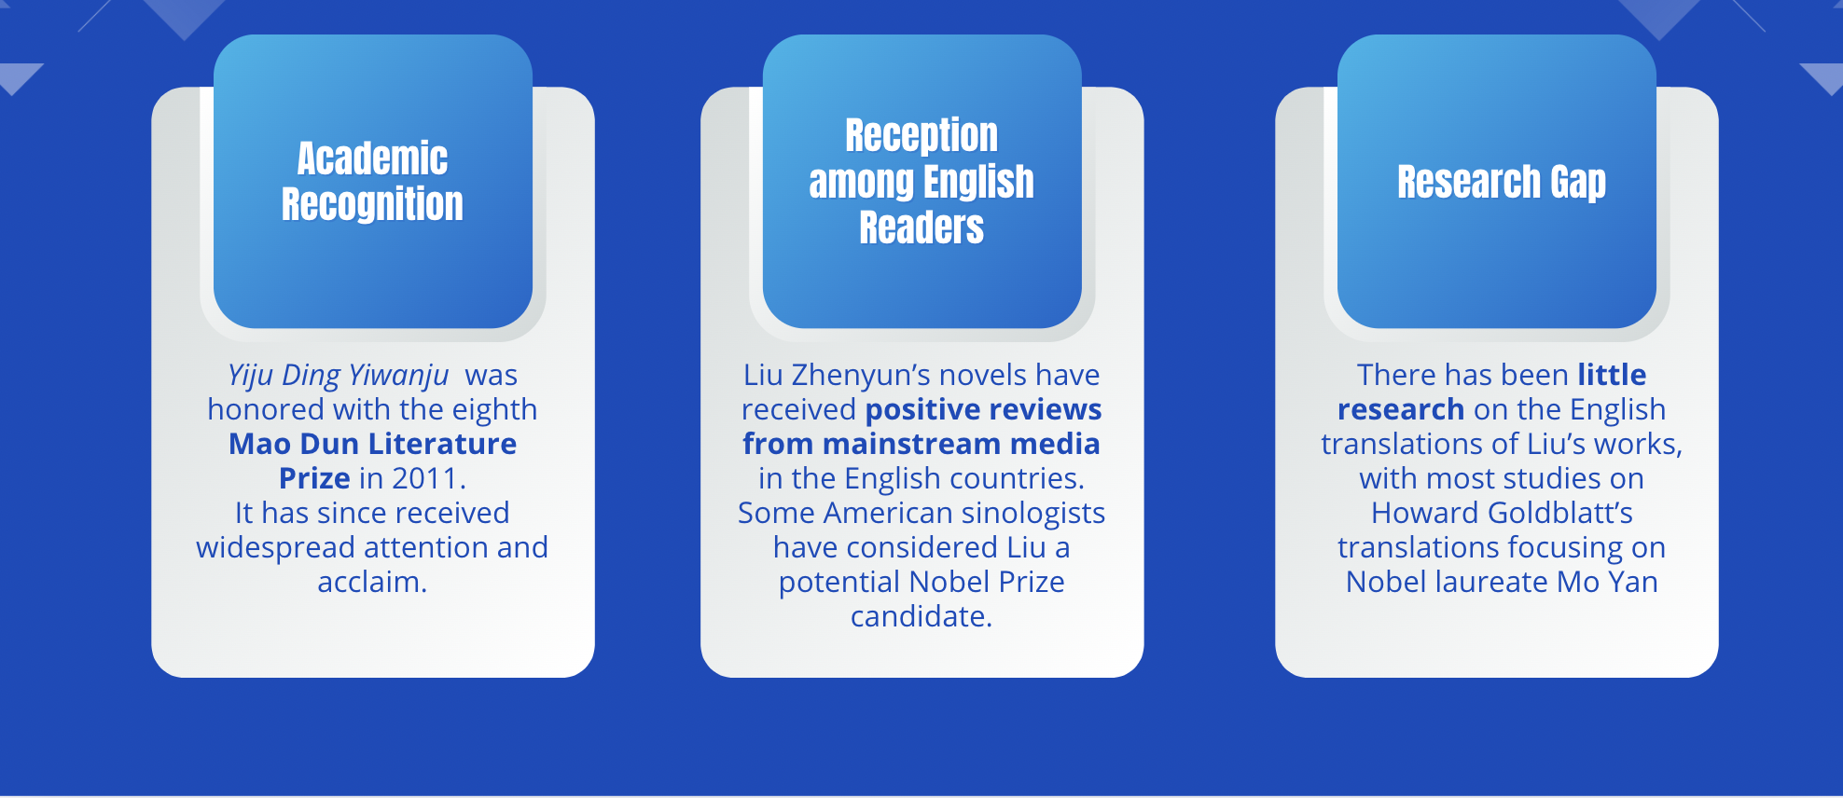
1.1 Research Background
Introduction | Literature Review | Research Methodology | Case Analysis | Conclusion
02

Slide 5
1.2 Research Questions
Introduction | Literature Review | Research Methodology | Case Analysis | Conclusion
(1) What are the linguistic factors that might hinder the comprehension of the Goldblatts’ English translation of Yiju Ding Yiwanju?
(2) How do the Goldblatts’ translation strategies facilitate the novel’s reader acceptance by English readers?
(3) What implication does Goldblatt and Lin’s rendition of Yiju Ding Yiwanju have for English translation of Chinese literature?
02

Slide 6
02
Literature Review

Slide 7
Introduction | Literature Review | Research Methodology | Case Analysis | Conclusion
2.1 Previous Studies on Reception Aesthetics Applied to Translation Studies
research on translator subjectivity;
research on the reception of literary translation;
research on the dissemination effects of non-literary texts;
research on the connotations of literary texts;
practical translation studies.

Slide 8
Introduction | Literature Review | Research Methodology | Case Analysis | Conclusion
2.2 Previous Studies on the Translation of Howard Goldblatt and Sylvia Li-chun Lin
The dispute over the translation strategy of Howard Goldblatt :
domestication | domestication and foreignization
Many scholars believe that Goldblatt most commonly employs domestication. (Benjamin, 1992:81). Song Qingwei（2015） points out that Goldblatt primarily adopts domestication translation strategy. He thinks Goldblatt caters to the reading needs of target language readers, demonstrating a strong market awareness. Hu Anjiang (2010) believes that domestication is evident in almost every translation work by Howard Goldblatt. | Feng (2017) believes that Hu Anjiang’s statement is somewhat ambiguous because any translation work is a hybrid of domestication and foreignization. Based on the analysis of the English translation of Fengru Feitun, Shi (2013) has also refuted Hu Anjiang’s viewpoint, pointing out that foreignization methods are used more frequently. Lu (2015) summarizes Goldblatt’s cultural translation philosophy as “preserving differences while seeking common ground”.

Slide 9
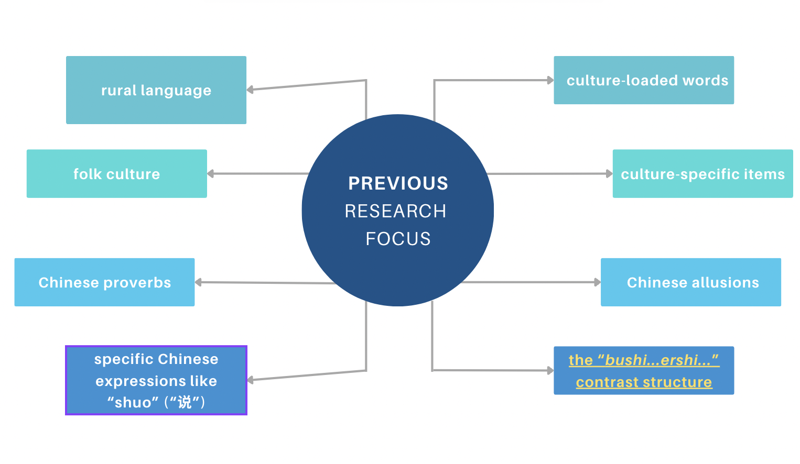
Introduction | Literature Review | Research Methodology | Case Analysis | Conclusion
2.3 Previous Studies on the English translation of Yiju Ding Yiwanju

Slide 10
Introduction | Literature Review | Research Methodology | Case Analysis | Conclusion
2.3 Previous Studies on the English translation of Yiju Ding Yiwanju
title | theory | method
韩子钰.顺应论视域下《一句顶一万句》的英译研究[D].电子科技大学,2022. | Accommodation Theory | By analyzing Western readers’ reviews and the linguistic features of the original novel, the study examined whether translators dynamically adapted to the original text and the target language readers.
赵瑞炎. 基于脚本理论的文化专有项英译考释[D].四川外国语大学,2022. | Script Theory | Utilizing qualitative analysis, cultural-specific items in the text were categorized into five types, and the translation methods employed by translators were analyzed along with the reasons behind them.
黄嘉乐. 《一句顶一万句》乡土语言英译的变异研究[D].广东财经大学,2023. | Variation Theory | The study utilized the Chinese-English texts of folk language as research materials and employed the qualitative research method of “seeking diversity” from the variation theory. It explored the positive significance of variation in translation studies and investigated the mechanism of variation.
邵璐,李伟.刘震云小说在英语世界的翻译与接受[J].南方文坛,2020(06):98-105. |  | Integrating the comprehensive ratings of Liu Zhenyun’s five novels on Goodreads. Shao and Li believe that although the literary value of Liu Zhenyun’s novels is undeniable, their dissemination and presentation in the English-speaking world are relatively monotonous, leaving significant room for improvement in translation and dissemination.

Slide 11
03
Research Methodology

Slide 12
3.1Research Method
Introduction | Literature Review | Research Methodology | Case Analysis | Conclusion
This paper conducts qualitative research, primarily engaging in descriptive and analytical textual studies.
（1）Defining the Key Translation Challenge
（2）Case Analysis
（3）Summary of Reader-Oriented Translation Strategies
Research Process

Slide 13
3.2 Key notions
Introduction | Literature Review | Research Methodology | Case Analysis | Conclusion
Appeal structure:
Blank: unwritten or unspecified parts of a text that are implied or hinted at by the written words.
Indeterminacy: the aspect or part of an object that is not specifically determined. Indeterminacy refers to uncertainty or ambiguity in language, structure, imagery, and theme .
Negation: a good text should break the reader’s familiar expectations while arousing them, that is, it should negate them rather than confirm them or realize them.
Horizon of Expectations: thinking orientations and innate structure formed by the reader’s previous literary reading experience when he reads a piece of work.
Fusion of horizons: a fundamental principle in reception aesthetics which means the merging of the horizon of the literary text and that of the reader.

Slide 14
04
Case Analysis

Slide 15
Introduction | Literature Review | Research Methodology | Case Analysis | Conclusion
4.1 Overall Modifications to Contrast Structure
Literal Translation
Example :
ST: 老裴也是一时怒从心头起，从床上爬起来，拿起砍刀，就要杀人；但不是杀老蔡，而是要到镇上杀她娘家哥。也不是要杀他这个人，是要杀他讲的这些理；也不是要杀这些理，是要杀他的绕；绕来绕去，把老裴绕成了另一个人。（刘震云，2009:21）
TT: With rage building inside, he climbed out of bed, picked up his machete to kill someone, not his wife, but his brother-in-law, and not just him, but his logic; not his logic either, but the twisted reasoning that had turned Pei into a different person. (Glodblatt & Lin, 2018: 22)
(1) Commonality of the “not...but” structure in English
(2) Maintaining logical contrast
(3) Preserving the progression in emotion and logic

Slide 16
Introduction | Literature Review | Research Methodology | Case Analysis | Conclusion
4.2 Modifications to the Former Half of Contrast Structure
Adding Insertions to Emphasize Negation
Example :
ST: 指得上不是说缺钱的时候可以找他们借钱，有事的时候可以找他们办事；而是遇到想不开或想不明白的事，或一个事拿不定主意，可以找他们商量。（刘震云，2009:211）
TT: He could rely on them not because they would lend him money or help him out of a jam. Nothing of the sort. He simply liked the fact that he could run something by them when he could not get over or understand something or make up his mind about what to do. (Glodblatt & Lin, 2018: 227)
(1)An emphatic device, echoing the negation of the previous part.
(2)Preserving a natural flow in English.

Slide 17
Introduction | Literature Review | Research Methodology | Case Analysis | Conclusion
4.3 Modifications to the Latter Half of Contrast Structure
Adding Introductory Phrases for Transition
Example :
ST: 但上个月，牛爱香与小张吹了。两人吹了不是两人谈不下去，而是小张跟牛爱香谈恋爱时，还跟县城广播站一个叫小红的播音员也谈着。 （刘震云，2009:213）
TT: Aixiang had broken up with Zhang the month before, though not because they no longer liked one another. It turned out that, while going out with Aixiang, Zhang was also seeing a radio announcer, Xiaohong, at the county radio station. (Glodblatt & Lin, 2018: 230)
(1) Function Over Form: Interpreting Logical Relationships.
(2) Stylistic Variation and Avoidance of Repetition.
(3) Preservation of Narrative Voice and Tone.
(4) Adaptation to English Rhetorical Expectations.

Slide 18
Introduction | Literature Review | Research Methodology | Case Analysis | Conclusion
4.4 Syntactic Adjustments
Breaking Run-on Sentences into Separate Sentences
Example :
ST: 不让铺面不是跟老熊家有啥过节，而是老汪他爹处事与人不同，同样一件事情，对自己有利没利他不管，看到对别人有利，他就觉得吃了亏。（刘震云，2009:23）
TT: His objection had nothing to do with the Xiong family; it was just that he had a different way of looking at the world. He did not much care if something was good for him; but if it was good for someone else, he would feel that it must be bad for him. (Glodblatt & Lin, 2018: 24)
Source text:
typical of the language’s preference for complex, uninterrupted structures, contains multiple clauses and ideas within a single sentence.
Target text:
clearer, more digestible sentence structures. By splitting the sentence, the translator ensures grammatical clarity and improves readability for English readers.

Slide 19
05
Conclusion

Slide 20
Introduction | Literature Review | Research Methodology | Case Analysis | Conclusion
5.1 Major Findings
5.1.1 Translation Challenges
PART I: LEAVING YANJIN | Chapter | Number of Occurrences
 | 1 | 5
 | 2 | 8
 | 3 | 7
 | 4 | 6
 | 5 | 4
 | 6 | 5
 | 7 | 6
 | 8 | 14
 | 9 | 9
 | 10 | 15
 | 11 | 17
 | 12 | 9
 | 13 | 9
 | 14 | 8
PART II: RETURNING TO YANJIN | Chapter | Number of Occurrences
 | 1 | 10
 | 2 | 2
 | 3 | 1
 | 4 | 9
 | 5 | 10
 | 6 | 6
 | 7 | 11
 | 8 | 8
 | 9 | 8
 | 10 | 10
Table 1: Number of Occurrences of “bushi…ershi…” in Each Chapter
This sentence structure is repeated 197 times throughout the work.

Slide 21
Introduction | Literature Review | Research Methodology | Case Analysis | Conclusion
5.1 Major Findings
Classification | Translation Strategy | Number of Occurrences
Overall Modifications to Contrast Structure | Literal Translation | 30
 | Omission | 37
 | Forming Causal Clauses | 42
 | Using Causal Phrases | 6
 | Conversion of Contrast Structure into Parallel Structure | 1
Modifications to the Former Half of Contrast Structure | Translating Negation as a Choice Relationship | 2
 | Shift of the Negation Modifier | 4
 | Adding Insertions to Emphasize Negation | 1
 | Causal Clauses as Independent Sentences | 3
Modifications to the Latter Half of Contrast Structure | Omitting Adversative Conjunction and Using a New Sentence for Transition | 24
 | Adding Introductory Phrases for Transition | 11
 | Replacing Adversative Conjunction with a Verb Indicating Change | 3
Syntactic Adjustments | Breaking Run-on Sentences into Separate Sentences | 3
 | Converting Multiple Sentences into a Coordinated Compound Sentence | 3
 | Splitting the Negation and Transition into Two Separate Sentences | 15
 | Segmenting and Restructuring Coordinated Sentences | 10
5.1.2 Translation Strategies
Table 2: Strategies Employed

Slide 22
Introduction | Literature Review | Research Methodology | Case Analysis | Conclusion
5.2 Implications
(1) Filling the Research Gap in the Translation of Liu Zhenyun’s Works
This study aims to advance academic attention to the English translation of works by Liu Zhenyun. While the original work has received widespread acclaim, research on its English translations is scarce. Therefore, this thesis seeks to address this gap.
(2) Integrating Reception Aesthetics with Translation Studies
In terms of theoretical inquiry, this thesis combines aesthetics and translation studies, thereby broadening the research perspective on the Chinese literature work Yiju Ding Yiwanju.
(3) Analyzing Translation Strategies of Contrast Structures
On the methodological front, the author analyzes the translation methods and techniques of the contrast structure employed by the distinguished translator Howard Goldblatt and Sylvia Li-chun Lin. This analysis provides valuable insights for future translation studies and practice of Chinese literary works.

Slide 23
Introduction | Literature Review | Research Methodology | Case Analysis | Conclusion
5.3 Limitations
(1) Limited Scope of the Study
Apart from the challenge summarized by the author, there are many other aspects within the book that could hinder reader comprehension, but the author was unable to address them all.
(2）Subjectivity in the Research Method
Since the primary method employed in this research is qualitative analysis, it is greatly influenced by the author’s subjectivity.
Given the scarcity of research on the English translation of this book, the author had limited reference materials, resulting in subjective judgments.
(3) Lack of Established Translation Categories
As no scholars have previously conducted a systematic classification of translation methods of such contrast structures, the author’s categorization of translation strategies and techniques mainly relies on her own summary.

Slide 24
感谢批评与指正！

