Slide 1
The use of prompt engineering: An example
Genre Features:
Variation in performance across different genres
Adaptability to genre-specific conventions
Prompt Scenario 1: simply ask ChatGPT to translate sentence – ask ChatGPT about the specific feature of the genre – ask ChatGPT to translate while paying attention to the specific feature (ChatGPT-4o, Accessed on Jan 17, 2026)

Slide 2
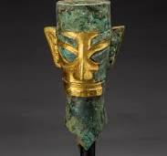
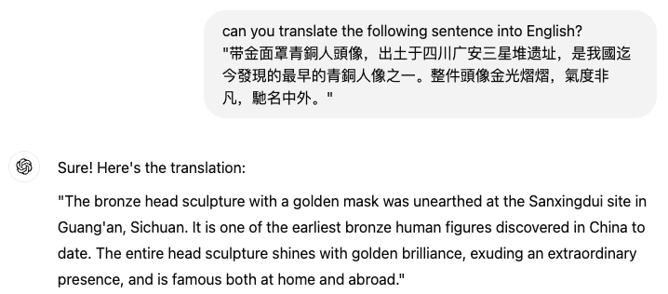

Slide 3
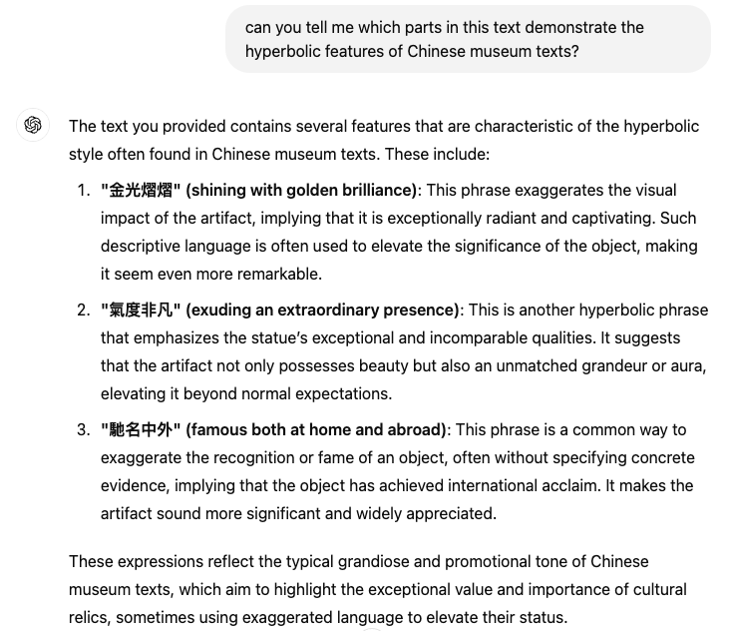

Slide 4
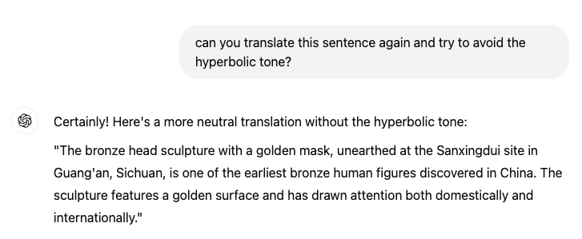

Slide 5
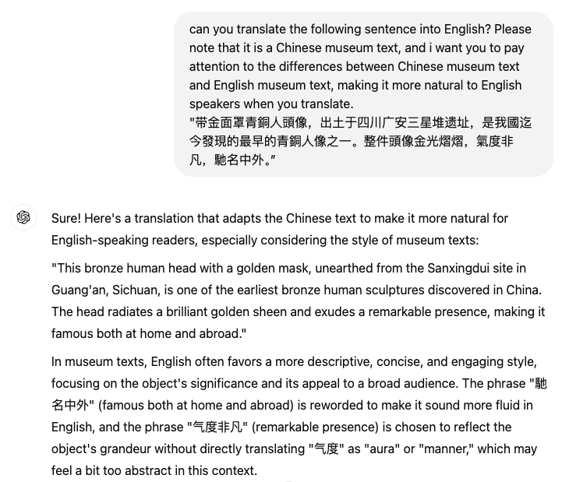
Prompt Scenario 2: ask ChatGPT to translate sentence while paying attention to the genre features (the features were not specified in the prompt) (ChatGPT-4o, Accessed on Jan 17, 2026)

Slide 6
A comparison of three versions
ST: 戴金面罩青铜人头像，出土于四川广汉三星堆遗址，是我国迄今发现的最早的青铜人像之一。整件头像金光熠熠，气度非凡，驰名中外。
DeepL: The bronze head of a man wearing a gold mask, excavated at the Sanxingdui site in Guanghan, Sichuan, is one of the earliest bronze human figures ever found in China. It is one of the earliest bronze figures ever found in China. The entire head is famous in China and abroad for its glittering gold and extraordinary elegance.
ChatGPT: Wearing a golden mask, the bronze statue of a human head was unearthed at the Sanxingdui archaeological site in Guanghan, Sichuan. It is one of the earliest bronze human statues discovered in China. The entire head emits a dazzling golden light, exuding extraordinary grace and gaining fame both domestically and internationally.

Slide 7
My version: The Bronze Head with a Golden Mask, which was unearthed at the Sanxingdui archaeological site in Guanghan, Sichuan Province, is one of the earliest bronze human figures discovered in China to date. The whole figure is widely recognized for its glittering gold mask and its extraordinary craftsmanship.

