Slide 1
Clustering
Dry Beans
Project 2
Khai Kieu
CSC 4850, Fall 2026
Goal: group 13,611 beans by size and shape alone, without the variety label.
Deliverable: a cluster number for every bean, plus code and a report.
Notes:
[Target: about 30 seconds]
Hi everyone, I'm Khai Kieu, and this is Project 2: clustering the Dry Bean dataset. Our objective is to take 13,611 beans, described only by their size and shape measurements, and sort them into seven groups — without ever looking at the variety label. The deliverable is a file that gives every bean a cluster number, plus the code and a short report. I'll cover the data, how we set up the experiment, what we found, and what's left to do.

Slide 2
The data
13,611
samples
16
numeric features
0
missing values
68
exact duplicates, kept
477
rows with extreme values, kept
Every feature was standardized. Area is around 50,000 while ShapeFactor1 is under 0.01, so without scaling the large features would decide everything.
Duplicates and extreme rows stayed in, because every sample needs a cluster and the extremes look like real large or elongated beans.
The Class column was left out of every step.
Notes:
[Target: about 40 seconds]
Each bean is described by 16 numbers, like area, perimeter, axis lengths, roundness, and four shape factors. There are no missing values. We did find 68 exact duplicates and 477 rows with at least one extreme value, and we kept all of them — every bean needs a cluster in the final file, and the extremes look like genuinely big or stretched beans, not errors. The features are on very different scales: area is around 50,000 while ShapeFactor1 is under 0.01. So we standardized everything first, or the big numbers would decide the clusters on their own. The Class column was never used.

Slide 3
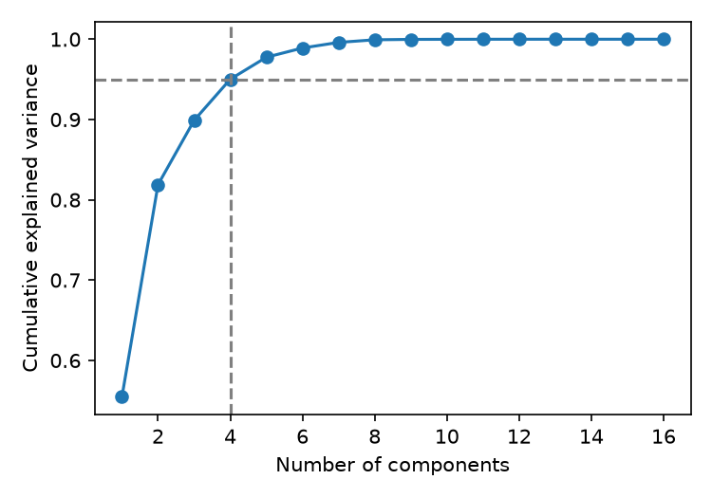
Experimental design
KMeans
standardized features
KMeans
standardized plus 4 PCA components
GMM
standardized features
GMM
standardized plus 4 PCA components
Seven clusters (k = 7) in every configuration.
Stability is the average agreement (ARI) between 10 random seeds.
4 components keep 95.0% of the variance
Notes:
[Target: about 40 seconds]
We used two methods, KMeans and a Gaussian Mixture Model, both set to seven clusters as the assignment requires. For each one we tried two versions: the standardized features alone, and the standardized features followed by PCA. That gives four configurations. For PCA, we kept the smallest number of components that explains 95 percent of the variance — that's four, right where the curve crosses the dashed line. To check stability, we ran every configuration with ten random seeds and measured how much the results agreed, using the adjusted Rand index.

Slide 4
Results by configuration
Method | Features used | Silhouette, own space | Silhouette, standardized space | Stability (ARI)
KMeans | Standardized | 0.309 | 0.309 | 0.9999
KMeans | Standardized plus PCA (4) | 0.328 | 0.308 | 0.9971
GMM | Standardized | 0.290 | 0.290 | 1.0000
GMM | Standardized plus PCA (4) | 0.302 | 0.284 | 0.9974
The highlighted row is the final choice.
PCA barely changed KMeans (ARI 0.94 between the two versions) and slightly lowered GMM quality.
Silhouette scores from different spaces are not comparable, so every result was also scored in the standardized space.
Notes:
[Target: about 45 seconds]
Here are the four configurations. Silhouette tells us how well separated the clusters are, but it's measured in whatever space you cluster in, so the PCA scores of 0.328 and 0.302 can't be fairly compared with the others. We re-scored everything in the same standardized space. In that fair comparison, KMeans on standardized features is best at 0.309, essentially tied with KMeans plus PCA at 0.308, and GMM is lower. Stability is above 0.997 everywhere, so the random seed barely matters. PCA did not clearly help either method.

Slide 5
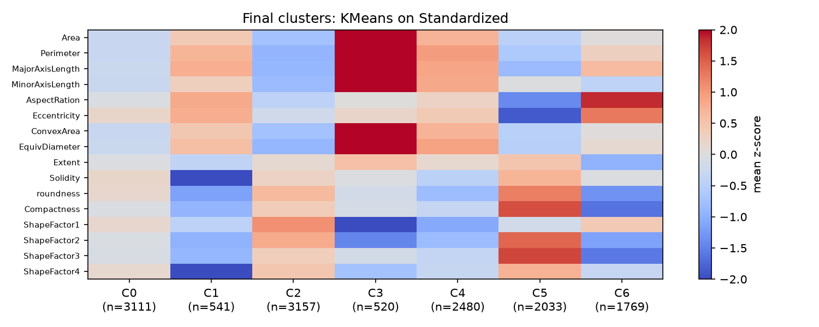
What each cluster looks like
Cluster 3 is very large (520 beans), cluster 5 is small and round, cluster 6 is the most elongated, and cluster 1 has irregular outlines. Clusters 0, 2 and 4 differ mostly in size.
Notes:
[Target: about 40 seconds]
To see what the clusters mean, this heatmap shows each cluster's average for every feature, in standard deviations from the overall mean. Red is above average and blue is below. Cluster 3, with 520 beans, is red on every size feature, so those are the very large beans. Cluster 5 is small and round. Cluster 6 has the highest aspect ratio, so it holds the most elongated beans. Cluster 1 has the lowest solidity, meaning irregular outlines. And clusters 0, 2, and 4 are mostly small, medium, and large versions of a similar shape.

Slide 6
Final choice and next steps
0.309
silhouette score
KMeans on standardized features is the final configuration.
Challenges: silhouette scores from different spaces cannot be compared, and k was fixed at 7, so we cannot test whether 7 is right.
Next steps: the instructor computes ARI against the true labels. We finish the report and README and submit one ZIP by December 4.
0.9999
stability across 10 seeds
7
clusters, from 520 to 3,157 beans
Notes:
[Target: about 60 seconds]
Our final configuration is KMeans on standardized features, with no PCA. It has the best silhouette in the fair comparison, 0.309, near-perfect stability across seeds, and it's the easiest to explain, because we can read the clusters straight from the original measurements.
The main challenges: comparing silhouette scores across different spaces, and the fact that k was fixed at seven, so silhouette can't tell us whether seven is actually the right number. We also can't check against the true varieties ourselves.
For next steps, the instructor will compute the adjusted Rand index against the true labels. On our side, we'll finish the report and README and submit everything in one ZIP by December 4. Thank you — I'm happy to take questions.

Slide 7
How much PCA changes the clusters
KMeans barely changed with PCA (0.94).
GMM changed more (0.72).
Many features are near copies of each other, so PCA can shrink 16 features to 4.
It did not improve cluster quality.
Notes:
[Backup slide, hidden. Not part of the 5 minute talk. Unhide or jump to it if someone asks.]
To see what PCA actually changes, we compared the cluster assignments directly. KMeans with and without PCA agree very strongly, 0.94, so for KMeans, PCA mostly compresses sixteen features into four without changing the answer. GMM changed more, at 0.72. The bottom two bars show that KMeans and GMM agree with each other about 0.8 in both settings, so they find similar but not identical groups. PCA is reasonable here because many features are near copies of each other, but it did not improve the clusters, and it makes them harder to interpret.

Slide 8
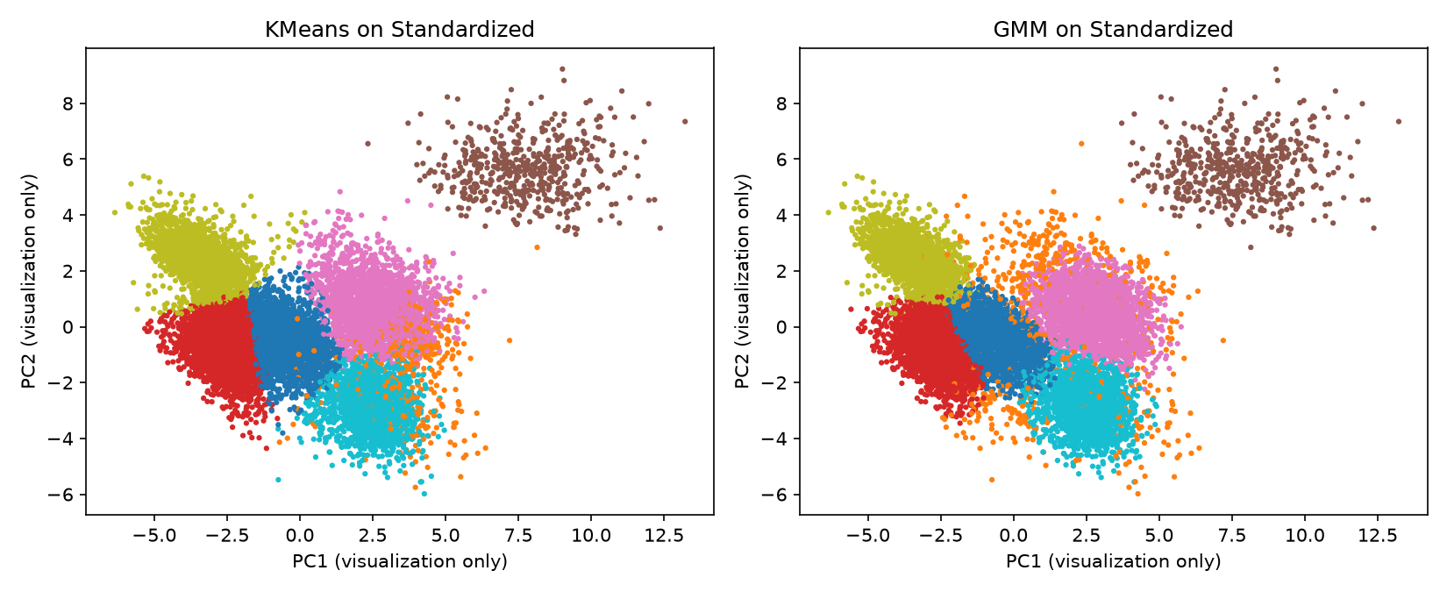
Clusters in two dimensions
This two component PCA is only for drawing. Clustering used all 16 standardized features, so clusters that overlap here may still be separated in the full space.
Notes:
[Backup slide, hidden. Not part of the 5 minute talk. Unhide or jump to it if someone asks.]
This is what the final clusters look like on the first two principal components. This PCA is only for drawing the picture. It is separate from the four component PCA we used as an input to clustering. Two components keep about 82 percent of the variance, so some of the information the algorithm used is missing from this plot. That is why you see overlap in the middle, and clusters that overlap here might still be separated in the full sixteen dimensional space. The group at the top right, the very large beans, is clearly separate. The rest blend into each other rather than being sharply separated.

Slide 9
Cluster sizes and averages
Cluster | Beans | Area | Aspect ratio | Roundness | Solidity | Eccentricity
0 | 3,111 | 44,435 | 1.57 | 0.88 | 0.988 | 0.77
1 | 541 | 65,249 | 1.79 | 0.80 | 0.973 | 0.82
2 | 3,157 | 31,541 | 1.48 | 0.91 | 0.988 | 0.73
3 | 520 | 173,668 | 1.59 | 0.86 | 0.987 | 0.77
4 | 2,480 | 74,020 | 1.65 | 0.83 | 0.985 | 0.79
5 | 2,033 | 39,397 | 1.24 | 0.95 | 0.990 | 0.58
6 | 1,769 | 53,677 | 2.04 | 0.79 | 0.987 | 0.87
Averages in the original units. Cluster 3 has more than five times the area of cluster 2.
Notes:
[Backup slide, hidden. Not part of the 5 minute talk. Unhide or jump to it if someone asks.]
The table tells the same story in the original units. Cluster sizes range from 520 to 3,157 beans. Average area goes from about 31,500 in cluster 2 to over 173,000 in cluster 3, more than five times larger. Aspect ratio and roundness separate cluster 5, the roundest, from cluster 6, the most stretched. Solidity is almost the same everywhere, between 0.985 and 0.99, except cluster 1, which drops to 0.973.

