Slide 1
BDD with Behat
Lukas Žilinskas
2021 08 26
frontit.dk

Slide 2
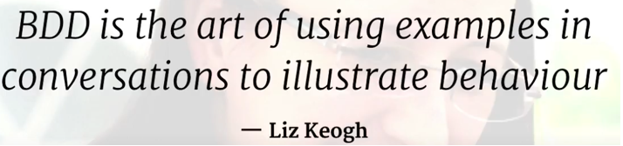
BDD: Short introduction
Behavior Driven Development (BDD) methodology is an extension of Test-Driven Development (TDD). BDD same as in TDD we write tests first and then add application code.
BDD is designed to test an application’s behavior from the end user’s standpoint, whereas TDD is focused on testing smaller isolated fragments of the functionality.

Slide 3
BDD and Behat: What Is It?
Behat is a tool that makes BDD methodology possible to apply to our project. This methodology enforces development software through continuous example-based communication between developers and a business.
Examples are written in a special format called Gherkin.
It allows you to describe software’s behavior without detailing how the behavior will be implemented.

Slide 4
BDD and Behat: Benefits
BDD takes a big focus on paying attention to writing tests of the customer's point of view, using the language of the customer.
BDD tests help to focus on the tests that will not break artificially because implementation has changed, they do that by focusing on what the customer really needs.
Unit testing with Behat.
Possibility of automated browser testing with Mink.
Behat could be used in CI.

Slide 5
Gherkin Language: What Is It, Benefits?
Creates a single vocabulary and process between collaborating technical and non-technical people.
developers
business analysts
QA
project managers
product owners

Slide 6
Gherkin Language: What Is It, Benefits?
Helps enforce firm, unambiguous requirements.
Gherkin is a plain text language with a little extra structure.
It acts as documentation and is the skeleton of your automated tests.
Feature tests which are written in Gherkin can be reused with JS and other languages.

Slide 7
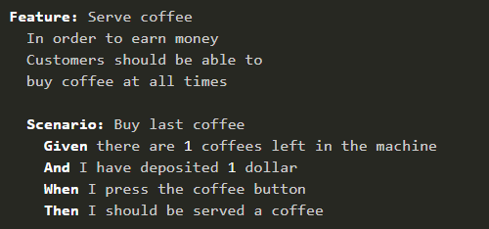
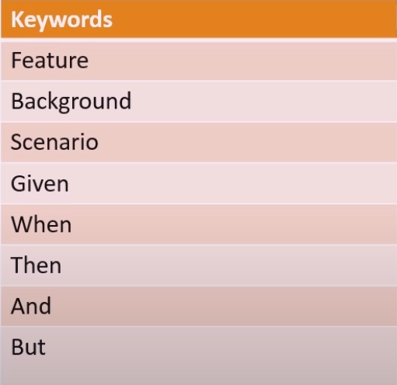
Gherkin Language: Syntax

Slide 8
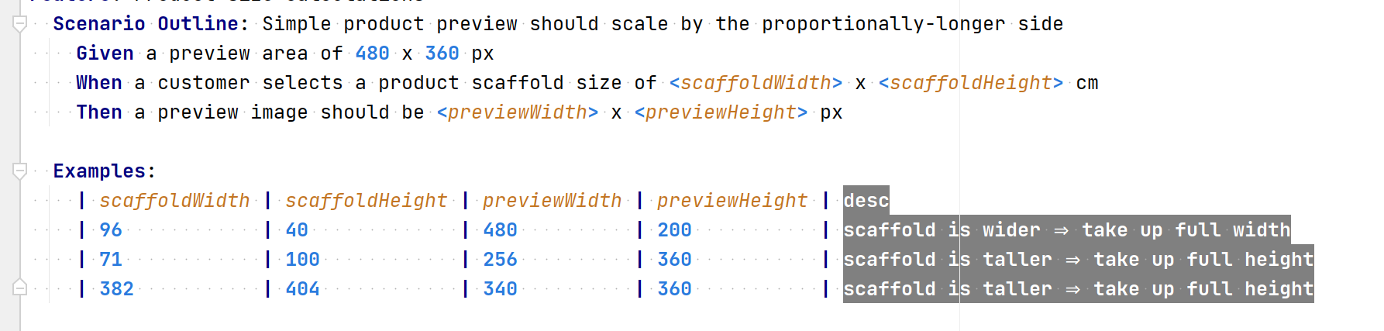
Gherkin Language: Syntax Examples

Slide 9
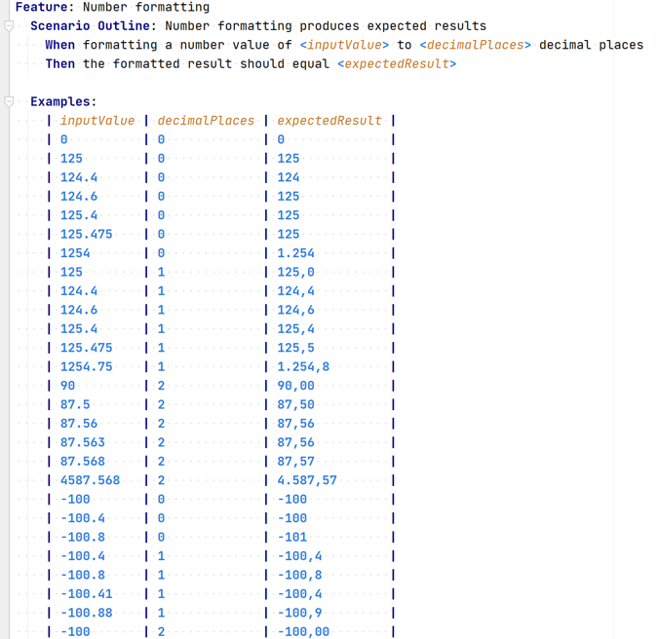
Gherkin Language: Syntax Examples

Slide 10
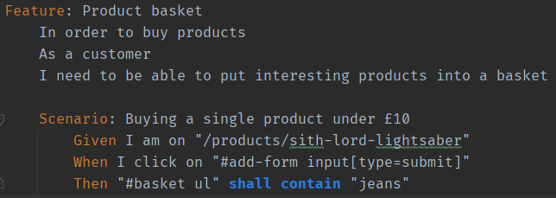
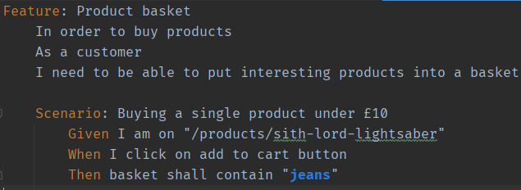
Lock behavior instead of implementation
Avoid the use of technical words like database
Write scenarios imaging you are spectating real user taking actions and capture their behavior
Gherkin Language: Common Mistakes
Bad practice:
Good practice:

Slide 11
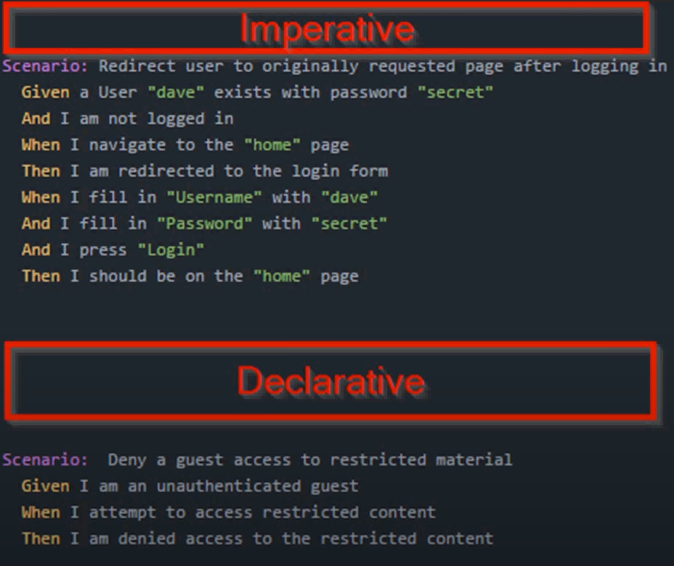
Gherkin Language: Imperative/Declarative styles
Imperative:
More steps
Longer scenarios
More detail on how the test is done
Declarative:
Contains all the needed detail and no more
More easily readable

Slide 12
Behat: Installation and Commands
Laravel installation execute:
composer require laracasts/behat-laravel-extension
After installation for the first time execute:
vendor/bin/behat –init
To run Behat execute:
vendor/bin/behat
To run exact feature execute:
vendor/bin/behat tests/Behat/Features/ProductsBasket.feature
To run exact scenario from the feature execute:
vendor/bin/behat tests/Behat/Features/ProductsBasket.feature:17

Slide 13
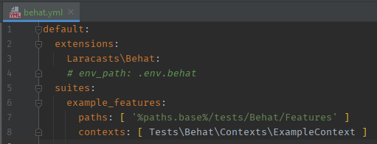
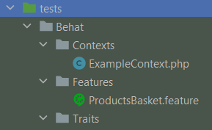
Behat: Configuration & Project Structure

Slide 14
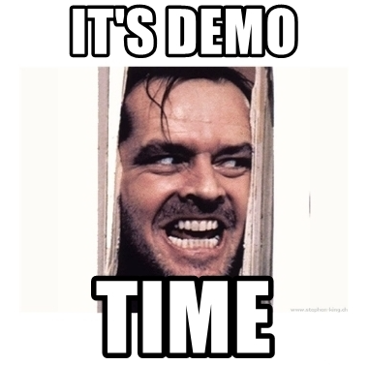

Slide 15
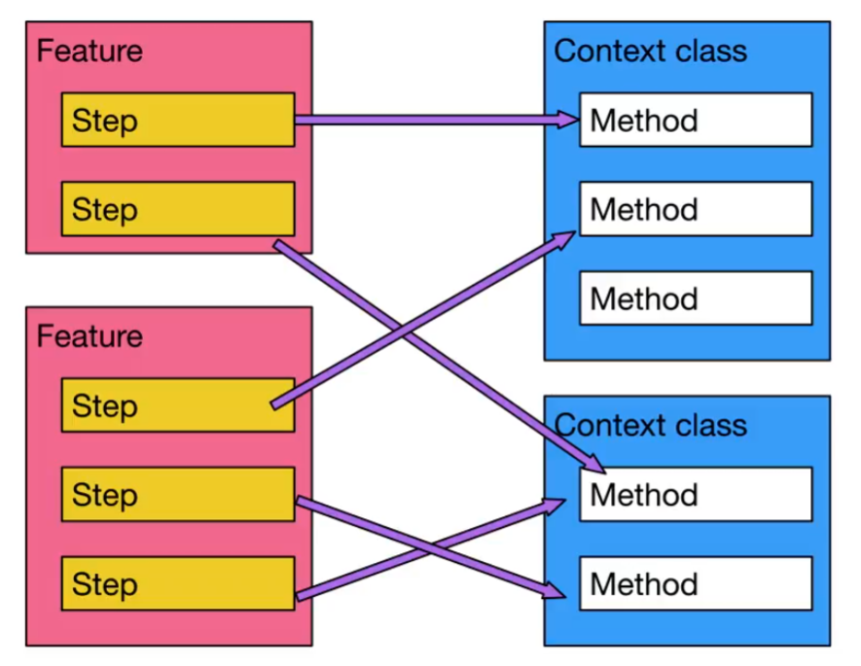
Behat: How does it work?
Behat in its basic form takes feature context files written in Gherkin and maps each step to PHP callback.
Every scenario should be able to be executed alone.
Every feature should be able to be executed alone.
Reason:
Maintainability
Readability

Slide 16
Behat: Mink
A standalone library to use PHP to command a “browser”.
API to send commands to Selenium, Goutte, ZombieJS, and more.
Package allows for BDD tests to be created without actually writing any PHP code.

Slide 17
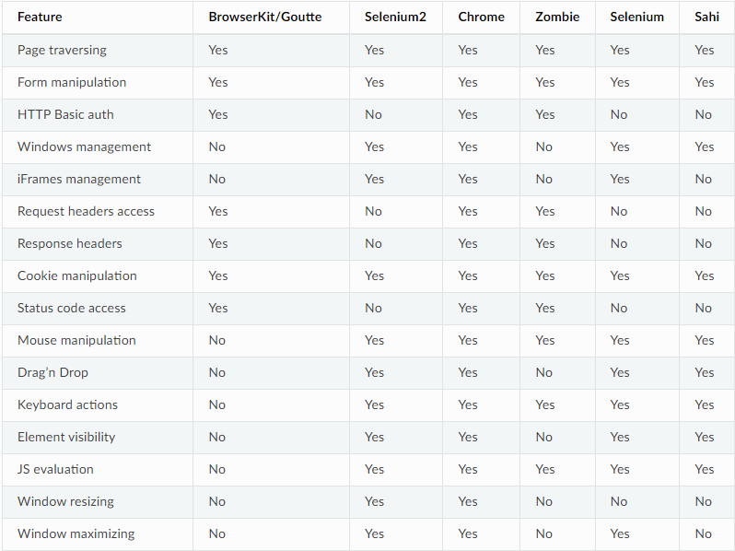
Behat: Mink Drivers

Slide 18


Behat: Tools for Developers and Testers
For developers:
Behat plugin from PHPStorm marketplace
For testers and developers:
Tidy Gherkin chrome extension

Slide 19

Questions?

Slide 20
References
https://docs.behat.org/en/latest/
https://mink.behat.org/en/latest/
https://www.youtube.com/watch?v=4QFYTQy47yA
https://www.youtube.com/watch?v=VS6EEUVZGLE
https://www.youtube.com/watch?v=KP0vpVLatMc
https://www.youtube.com/watch?v=j7RHtNePY3Y
https://www.youtube.com/watch?v=zIXyITCaAww
https://www.youtube.com/watch?v=nrggIRWK6qo
https://www.youtube.com/watch?v=zcbeAl4z20U

