Slide 1
Intro to Data Science & Machine Learning
Ryan Slater

Slide 2
Why Data Science?
What can I learn from data?
Is there a trend or pattern?
Is one piece a predictor of another?
Are there groups of data?
Can I learn some specific thing from data?
Does the data provide enough information to determine this thing?
Is there something bigger hidden in the data?

Slide 3
Dimensionality Reduction

Slide 4
Dimensionality Reduction
Are these really important?
Smaller dimensionality = smaller model
Smaller model =
Faster model
Lower hardware requirement
More ability to expand with more hardware
 | A | B | C | D | E | F
S1 | 10 | 1 | 4 | 11 | 10 | 8
S2 | 16 | 2 | -2 | 2 | 11 | 1
S3 | 0 | 0 | 10 | 3 | 9 | 3
S4 | -4 | 1 | 8 | 18 | 11 | 4
 | A | B | C | D | E | F
S1 | 10 | 1 | 4 | 11 | 10 | 8
S2 | 16 | 2 | -2 | 2 | 11 | 1
S3 | 0 | 0 | 10 | 3 | 9 | 3
S4 | -4 | 1 | 8 | 18 | 11 | 4

Slide 5
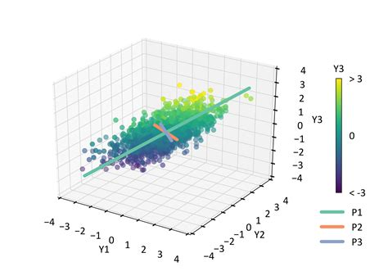
Principal Component Analysis (PCA)
geostatisticslessons.com

Slide 6
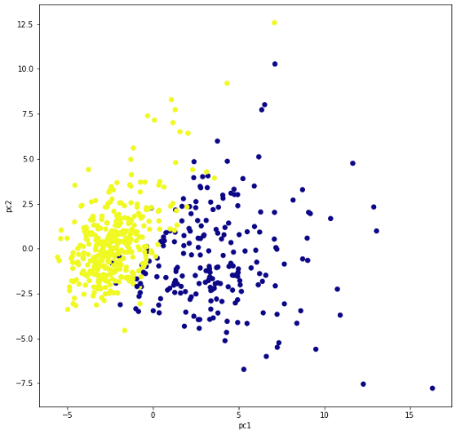
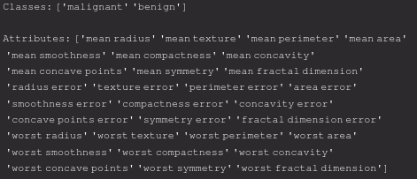
PCA on SKLearn Breast Cancer Dataset

Slide 7
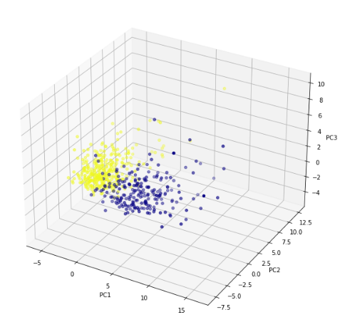
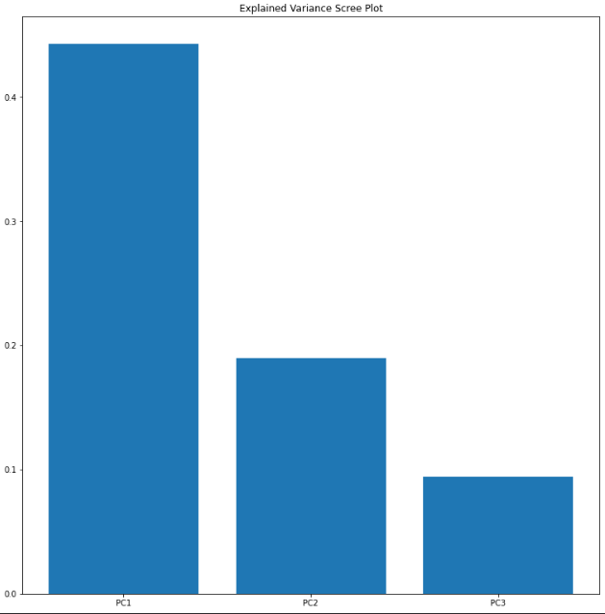
PCA on SKLearn Breast Cancer Dataset

Slide 8
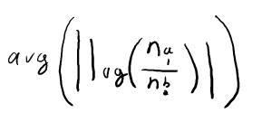
Multidimensional Scaling (MDS)
Similar to PCA, but minimizes distances between pairs of samples instead of maximizing correlations
Using Euclidean distance produces the same plot as PCA
Log fold change popular
No “right” way to compute distances

Slide 9
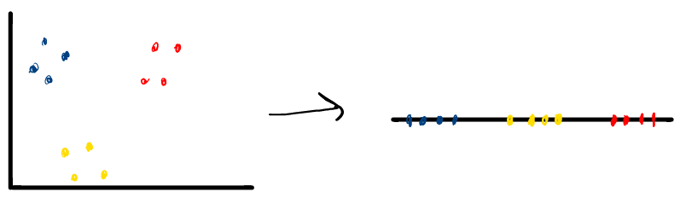
What do we do when projecting to an axis does not work?

Slide 10
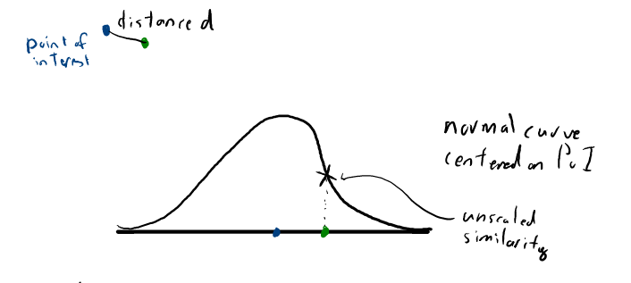
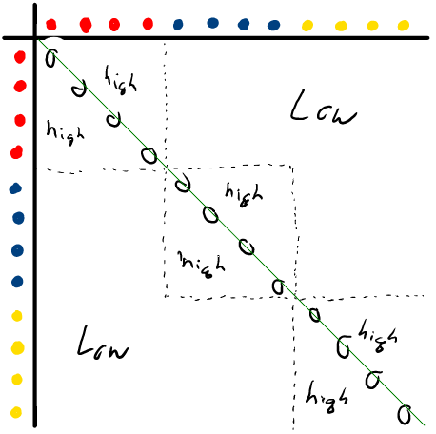
T-Distributed Stochastic Neighbor Embedding (tSNE)
Determine similarity between all points (normal distribution)
Scale similarities
Making the sum = 1 ensures cluster density does not affect future calculations
Create similarity matrix
Randomly project points to number line
Create similarity matrix (t-distribution, helps separate clusters)
Move points towards expected similarity values
Repeat 5-6 until matrices are similar

Slide 11
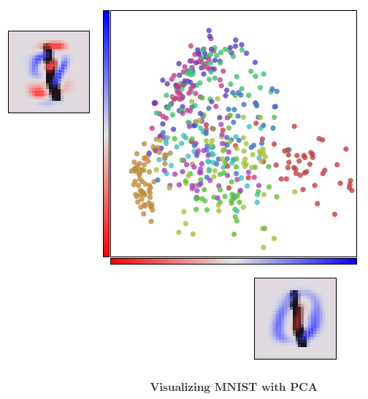
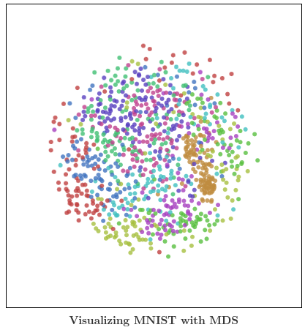
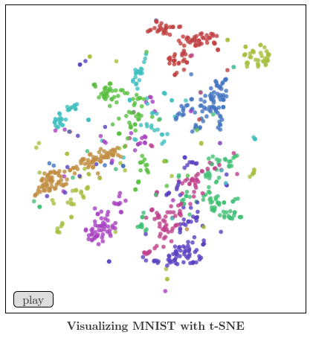
Visualizing MNIST
https://colah.github.io/posts/2014-10-Visualizing-MNIST/

Slide 12
Clustering

Slide 13
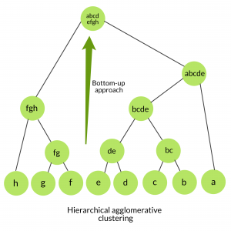
Hierarchical Clustering (Agglomerative)
Make each point a “cluster”
Create distance matrix
Repeat until 1 cluster remains:
Merge the 2 closest clusters
Update distance matrix
Pick any time to stop to get desired number
of clusters
What is a “distance”?
Distance between centroid
Distance between closest points
Distance between furthest points
etc.
https://www.geeksforgeeks.org/ml-hierarchical-clustering-agglomerative-and-divisive-clustering/

Slide 14
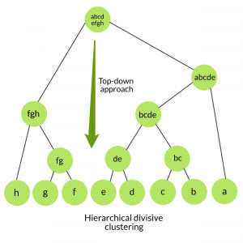
Hierarchical Clustering (Divisive)
Define the entire dataset as a cluster
Repeat until all clusters only have 1 point:
Choose the easiest cluster to split
Use a flat clustering method to split
Pick any time to stop to get desired number
of clusters
https://www.geeksforgeeks.org/ml-hierarchical-clustering-agglomerative-and-divisive-clustering/

Slide 15
K-Means Clustering
Attempts to make intra-cluster points as close as possible, while separating clusters as much as possible
Specify number of clusters K
Randomly select K points as centroids of clusters
For all unclustered points:
Measure distances between point and each centroid
Assign point to nearest cluster
Calculate mean of each cluster
Use these means as centroids of new clusters and repeat steps 3-4
Stop when points stop changing clusters
Repeat whole thing until variance of clusters is reasonable

Slide 16
DBSCAN
Two hyperparameters: epsilon & minimum points
Pick a random point as a starting point
All points within epsilon distance of the starting point become “core points”
All core points add any unclustered point within epsilon of themselves (“border point”) to the cluster
All border points add any unclustered point within epsilon of themselves to the cluster
Repeat until no more points added
If total number of points in the cluster is greater than minimum points, mark points as part of cluster, else ignore work
Repeat 1-5 until all points are clustered

Slide 17
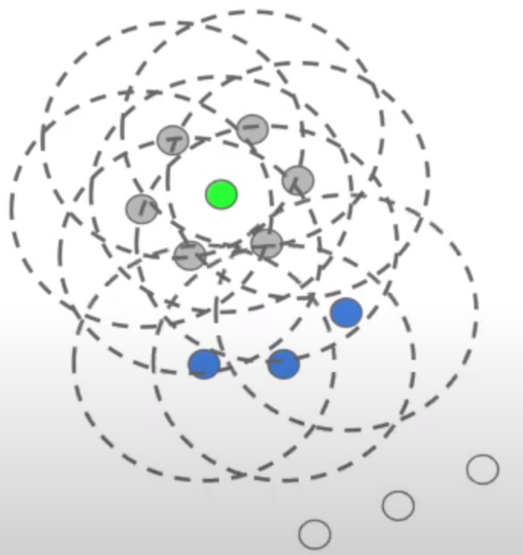
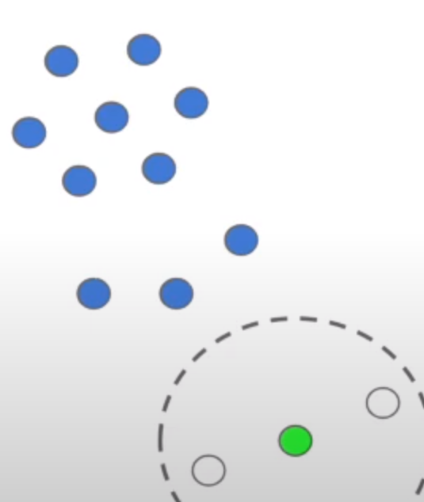
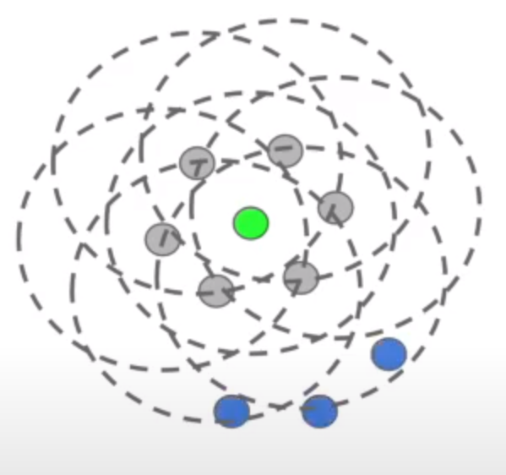
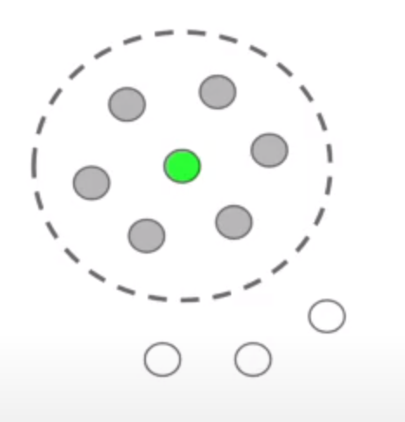
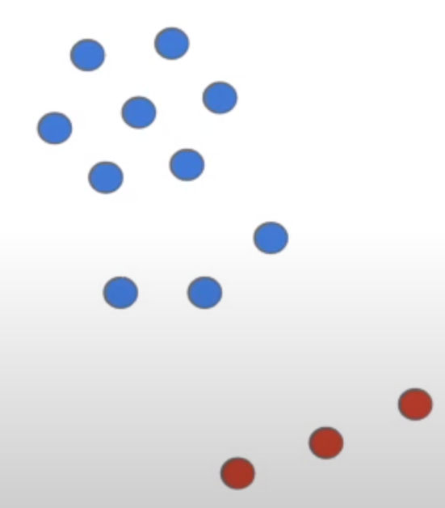
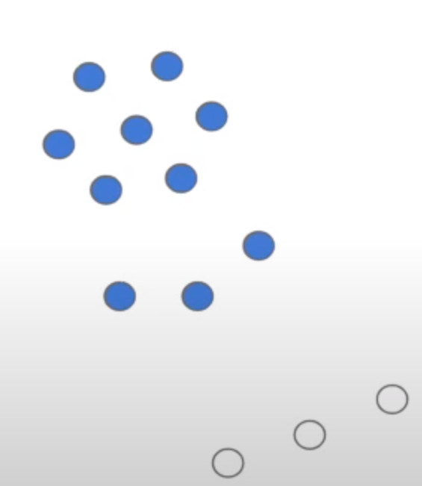
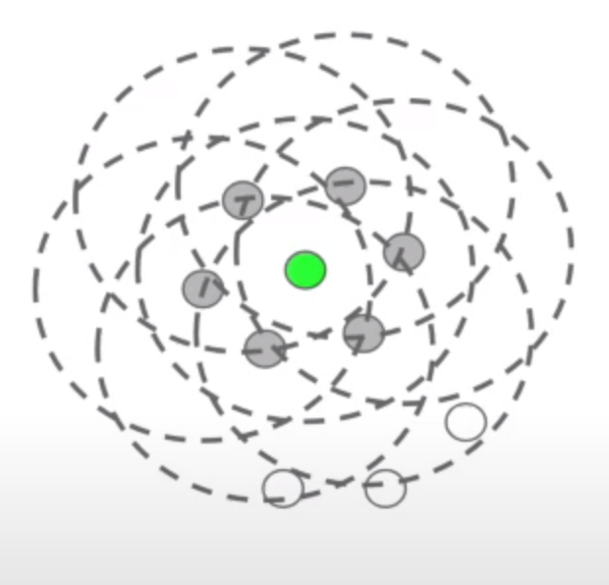
All images from TheDataPost on Youtube - https://youtu.be/_A9Tq6mGtLI

Slide 18
Supervised Learning

Slide 19
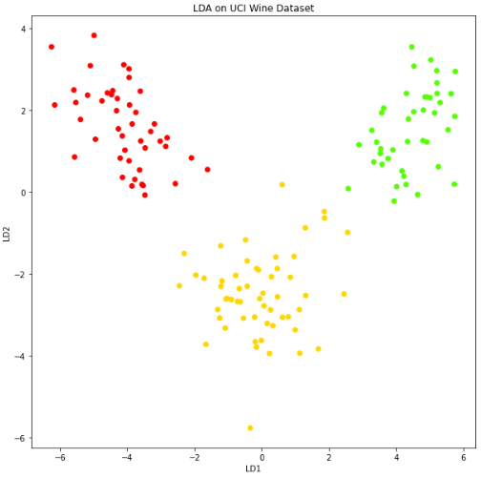
Classification with Linear Discriminant Analysis (LDA)
PCA, but maximizes separability between known
categories instead of maximizing variation

Slide 20
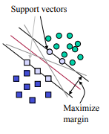
Support Vector Machines (SVMs)
Two parallel “support vectors”
Hyperplanes
Include fringe points
Maximizing margin width maximizes separability
LINEAR SEPARATION
MIT - https://web.mit.edu/6.034/wwwbob/svm.pdf

Slide 21
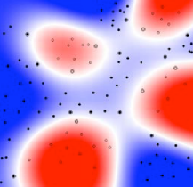
SVM Kernel Functions
Makes nonlinearly-separable data separable by SVM
Cartesian -> polar
Exponential
Polynomial
Gaussian
Radial Basis Function
MIT - https://web.mit.edu/6.034/wwwbob/svm.pdf

Slide 22
Instead of trying method after method and hoping one works, what if we used all of them together???

Slide 23
Ensemble Classifiers
Use a collection of models
Average each prediction or create a vote to determine final classification
Heterogeneous
Homogenous
Bagging - train each model independently and combine results at the end
Boosting - sequential learning makes each model better than its predecessor

Slide 24
Random Forests
Homogeneous
Bagging
Split training by data by N or by D
Collection of decision trees
Recursively ask simple questions to classify data
Simple average in a vote determines final classification output

Slide 25
Experiments with Neural Networks

Slide 26
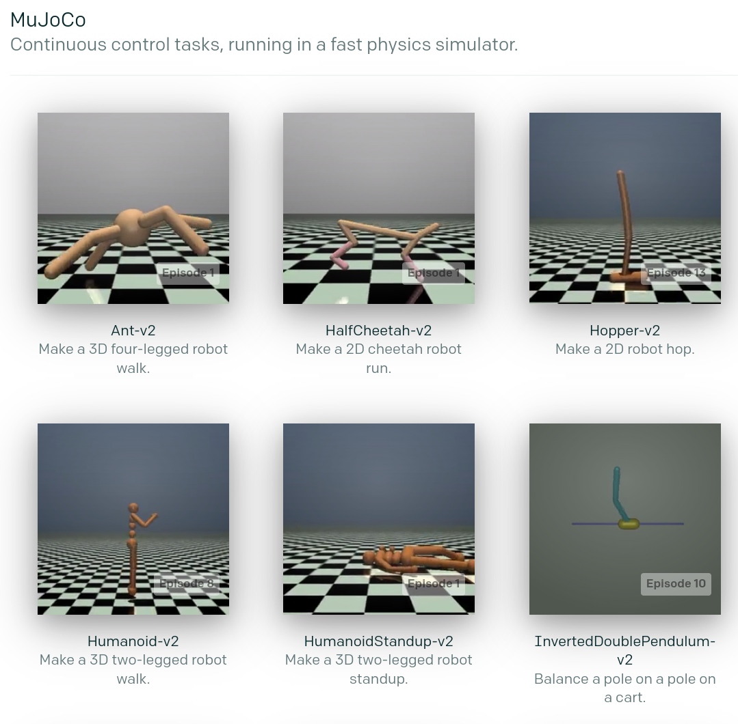
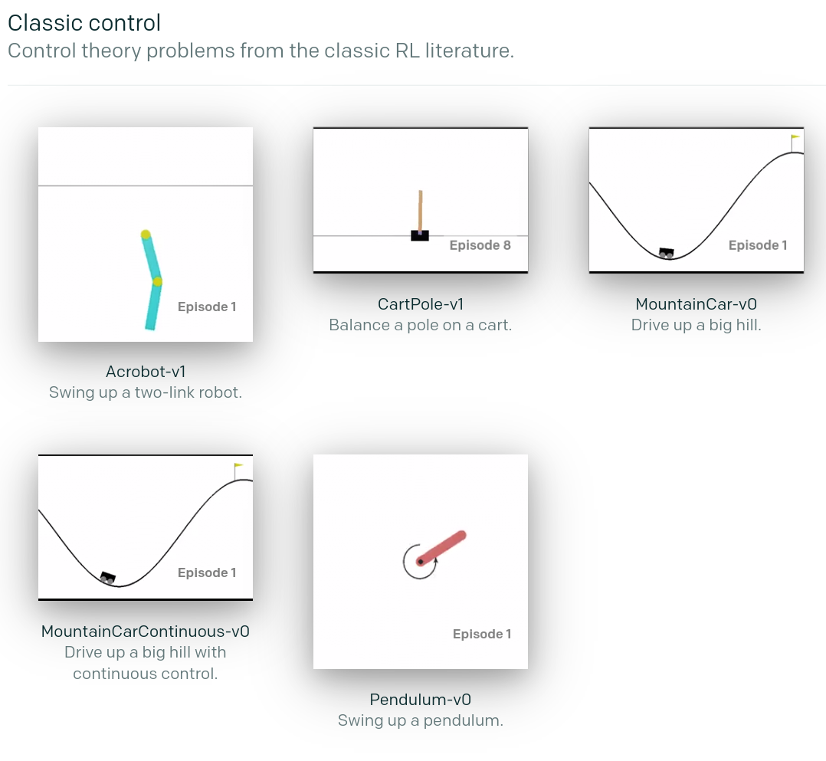
OpenAI - Gym

Slide 27
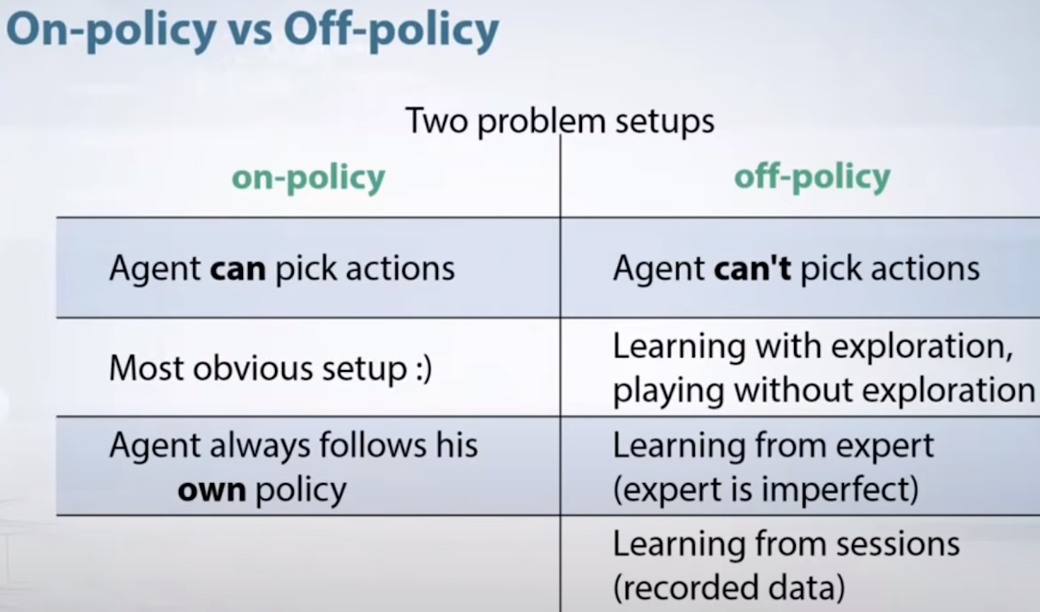
On-Policy vs Off-Policy
Arxiv Insights on Youtube - https://youtu.be/5P7I-xPq8u8

Slide 28
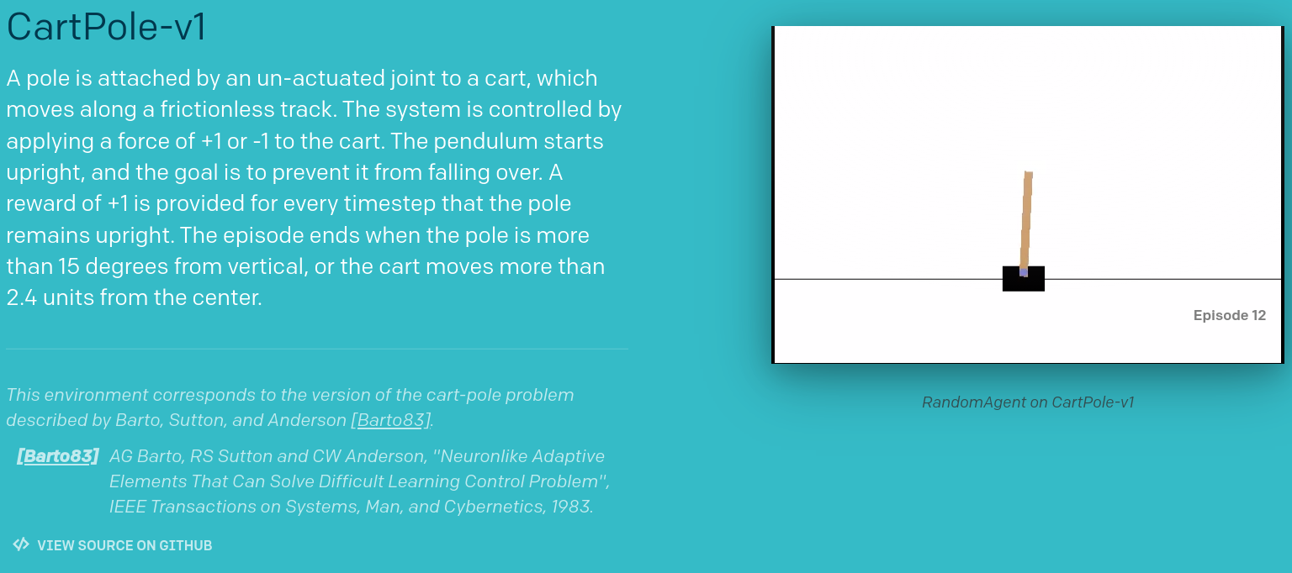
Project 1 - CartPole
Proximal Policy Optimization (PPO)
Small step size to improve stability
Retention of past experiences
Environment completion at a score of 200

Slide 29
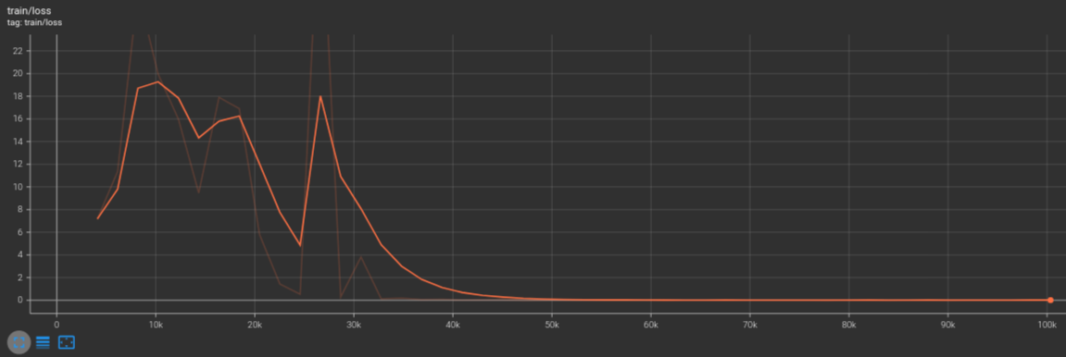
Project 1 - CartPole
Near-perfect performance in ~50k timesteps

Slide 30
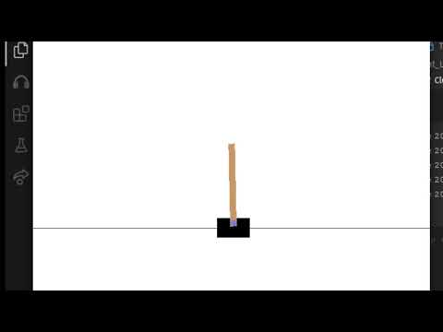

Slide 31
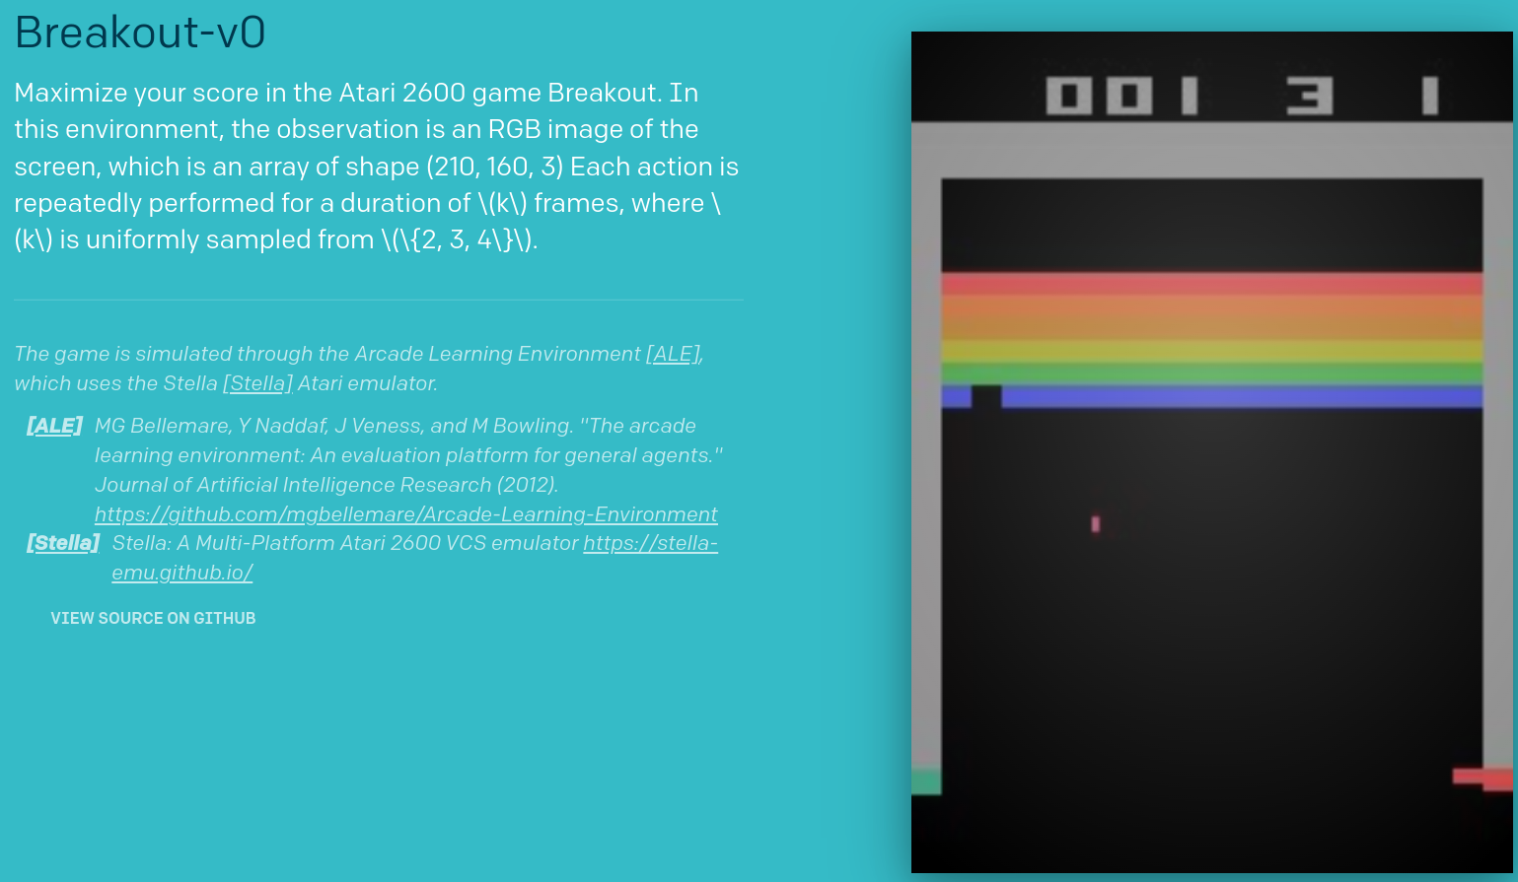
Project 2 - Breakout
Trust Region Policy Optimization (TRPO)
Keeps policy within a “trust region”
Asynchronous Advantage Actor Critic (A3C)
Multiple workers train in parallel environments to update a global value function
Advantage Actor Critic (A2C)
A3C but with only 1 worker
Comparable performance, but significantly faster

Slide 32

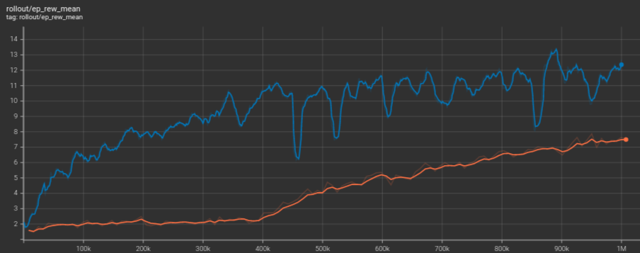
Project 2 - Breakout

Slide 33
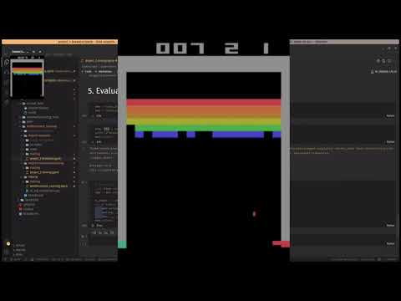
Project 2 - Breakout

Slide 34
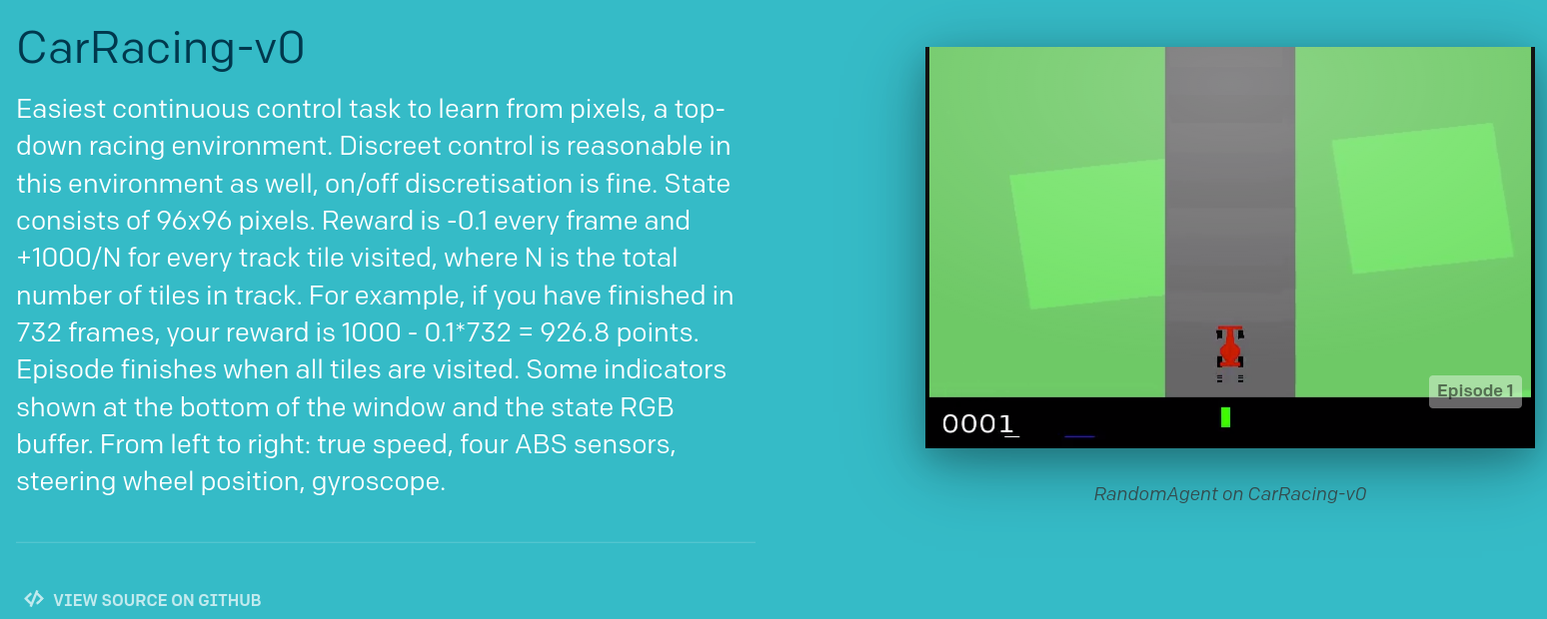
Project 3 - CarRacing

Slide 35
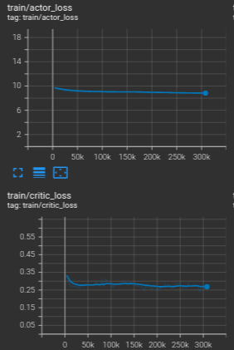

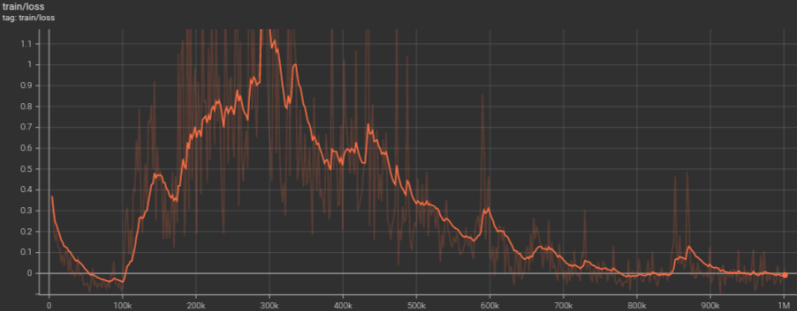
Project 3 - CarRacing

Slide 36
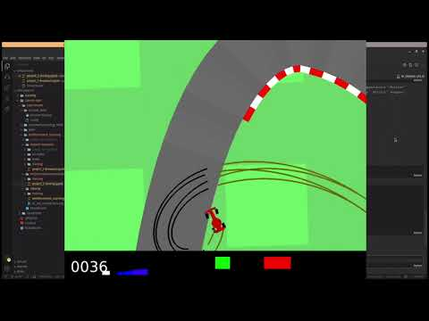
Project 3 - CarRacing

Slide 37
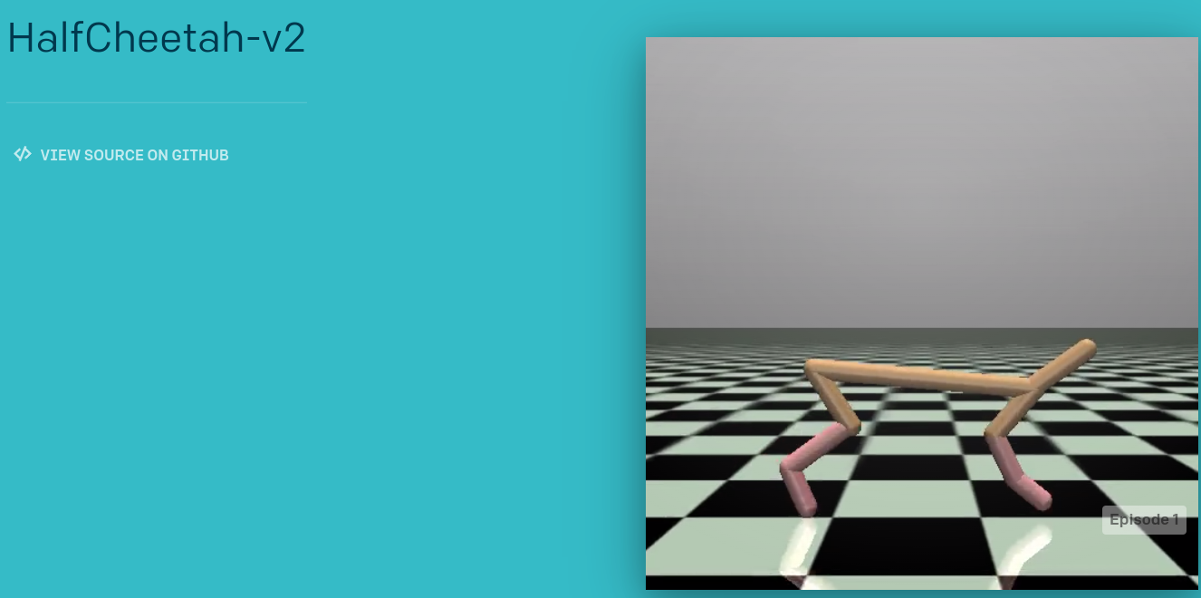
Project 4 - HalfCheetah
Deep Deterministic Policy Gradient (DDPG)
Four neural networks:
Q network
Deterministic policy function
Target Q network
Target policy network
Directly maps states to actions instead of generating a probability distribution (hence, deterministic)
Target networks are time-delayed copies, improve stability
Environment completion at a score of 2,000

Slide 38
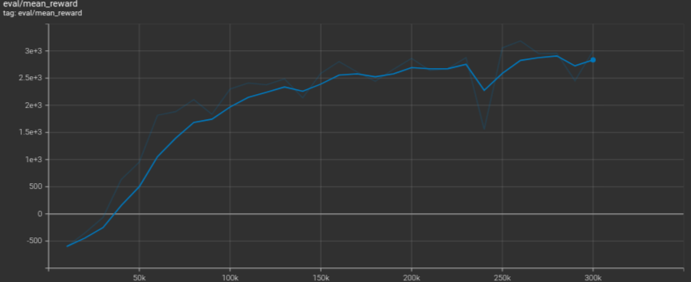
Project 4 - HalfCheetah

Slide 39
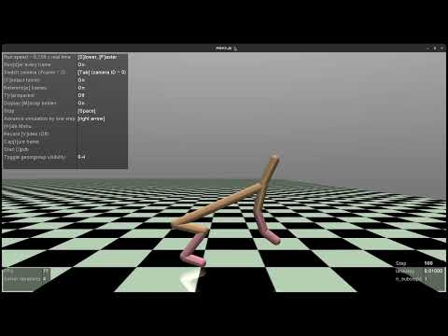
Project 4 - HalfCheetah

