Slide 1
Information Systems Security Winter 2018-19
Instructor: Z. Gu
Notes:
This chapter provides an overview of computer security. We begin with a discussion
of what we mean by computer security. In essence, computer security deals
with computer-related assets that are subject to a variety of threats and for which
various measures are taken to protect those assets. Accordingly, the next section of
this chapter provides a brief overview of the categories of computer-related assets
that users and system managers wish to preserve and protect, and a look at the
various threats and attacks that can be made on those assets. Then, we survey the
measures that can be taken to deal with such threats and attacks. This we do from
three different viewpoints, in Sections 1.3 through 1.5. We then lay out in general
terms a computer security strategy.
The focus of this chapter, and indeed this book, is on three fundamental
questions:
1. What assets do we need to protect?
2. How are those assets threatened?
3. What can we do to counter those threats?

Slide 2
Logistics
Lectures: Mon 9:50-11:25, Wed 8:00-9:35 教7, 408
Lab Sections: Sun 15:55-17:30 曹西503
Website: http://gulaoshi.github.io/
QQ Group: 461902186 (Everyone must join)

Slide 3
Course Topics
Textbook: COMPUTER SECURITY: PRINCIPLES AND PRACTICE, 3rd EDITION, WILLIAM STALLINGS (electronic copy in QQ group)
Reading textbook is recommended, but not strictly necessary
All teaching materials in English
Lecture topics:
Cryptographic Tools; User Authentication; Access Control; Database Security; Malicious Software; Denial-of-Service Attacks; Intrusion Detection; Firewalls and Intrusion Prevention Systems; Buffer Overflow; Software Security; Operating System Security; Trusted Computing and Multilevel Security
Labs:
Based on SEEDLabs, Hands-on Labs for Security Education
http://www.cis.syr.edu/~wedu/seed/Labs_16.04/
Need to download large virtual machine image of Ubuntu Linux (3.5GB)
Available in the QQ group
USB sticks will be provided in Friday’s lab section

Slide 4
Grading Scheme
Final Exam: 60%; Lab sections: 40%
Notes:
This is a note

Slide 5
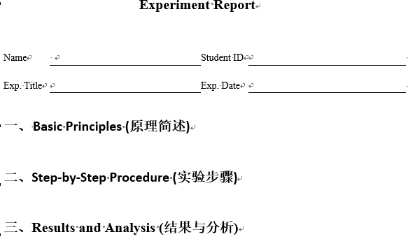
Lab Sections
8 lab sections, 5 points each
Form groups of 1-4 students each
Each group submits a lab report, and everyone in the same group gets the same grade
Lab reports (in either English or Chinese) and source code for Sunday lab is due next Sunday 11:59pm to Email MobileSecurity2014@163.com
If you submit the report on time, and the report is reasonable, you will get the full 5 points
Each late day costs you 1 point!

Slide 6
Final Exam
Exam covers lecture PPTs, not Lab sections;
All questions are multiple choice, single answer
Open book, you can bring any printed materials
When you print out the PPTs, please set 打印—设置—纯黑白，this will print out black letters on white background.

Slide 7
点名政策
理论与实验课均不点名，凭个人兴趣上课，上课提问回答不计分。
实验课可以课外自主完成。

