Slide 1

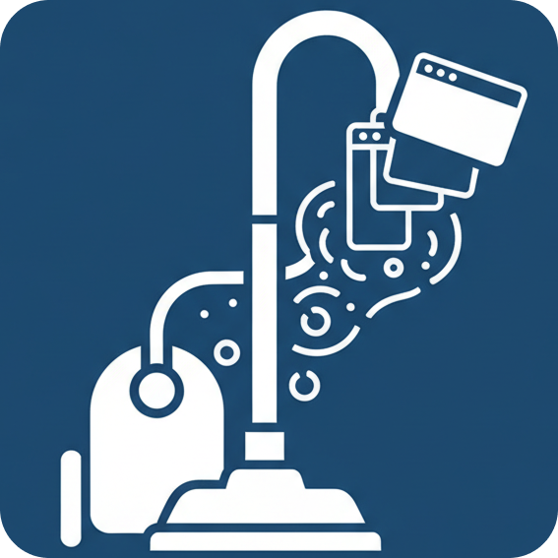
Auto Tab Cleaner
Keep your browser tidy, automatically
✨️ Core Feature
⌛️ Idle Tab Auto-Close
📋️ Restore & Log
🧩 Whitelist Rules

Slide 2
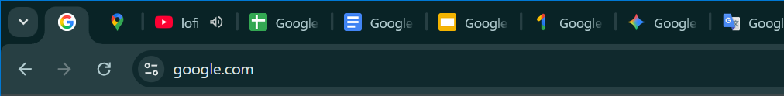
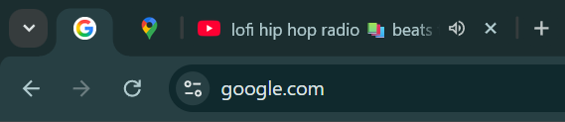
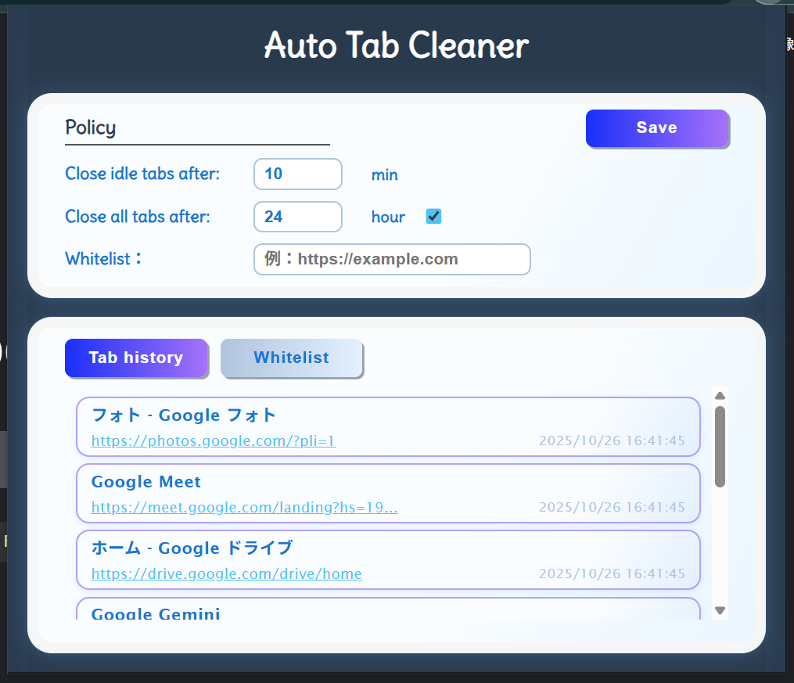
❓️ What it does ?
⏳ Idle Tab Auto-Close
— Closes inactive tabs automatically.
🧠 Smart Preservation
— Keeps key pages open.
💾 Local & Private
— Works entirely on your device.
Pinned!!
Audible♪
10minutes later
Active,Autdible,Pinned tabs are always skipped.
📋 Restore & Log
— Reopen closed tabs anytime.
🧩 Whitelist Rules
— Protect important sites.
⚙️ Custom Timeout
— Set your own idle time.
Idle tabs are deleted after 10min.
ON:Delete Tabs include Whitelist
Click the links,you can restore them.

Slide 3
⏩️ Coming Soon
📦 Tab Vault
— save unread pages for later
🧠 AI Auto-Tagging
— categorize by topic automatically
📊 Browsing Timeline
— visualize where your time goes
☕ Focus Mode & Break Reminders
— boost concentration
🧭 Sidebar Dashboard
— one place for logs & analytics
Feedback is always welcome. Thanks

