Slide 1

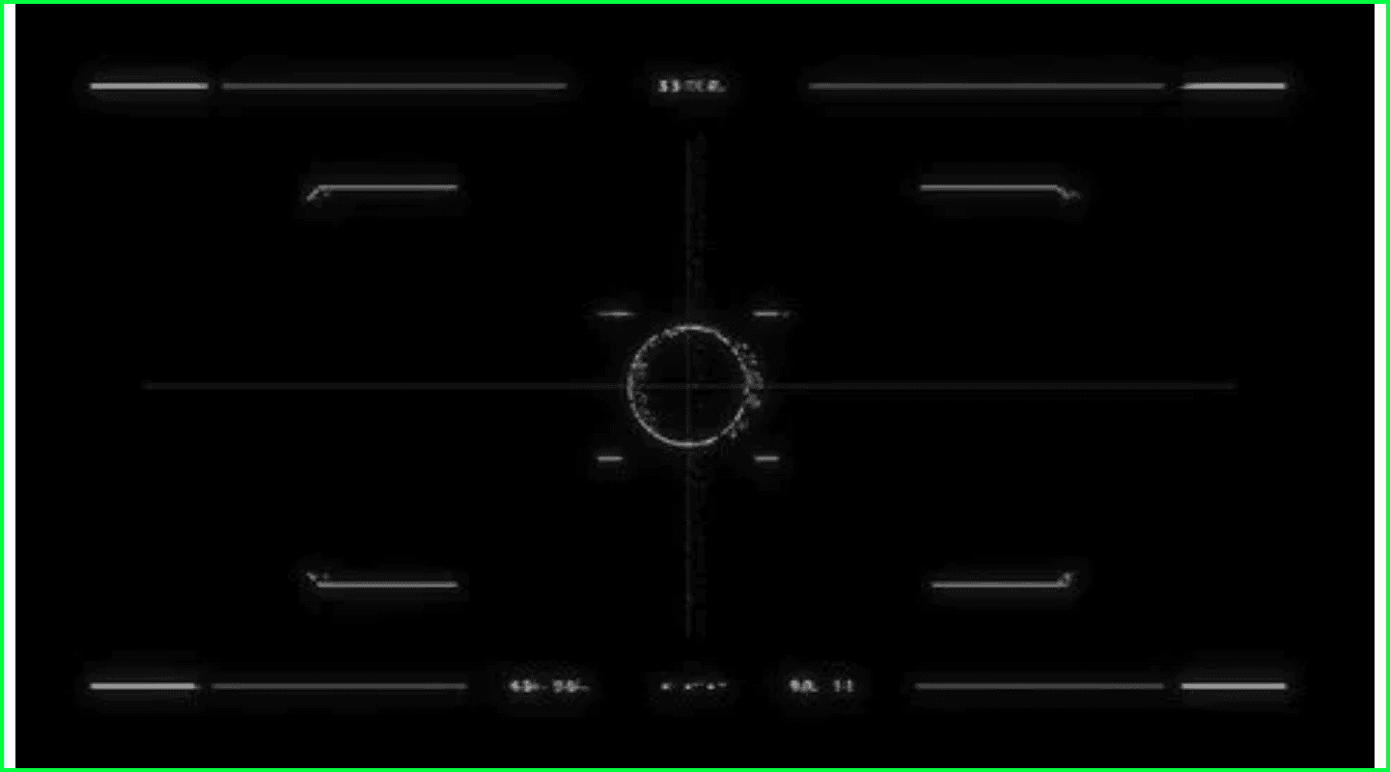
VisionLock
Military-Grade Single Object Tracking System
VisionLock is a sophisticated real-time computer vision application engineered for the high-precision tracking of military ground targets. Utilizing adaptive template matching, the system maintains a consistent target lock across varying environmental conditions.

Slide 2
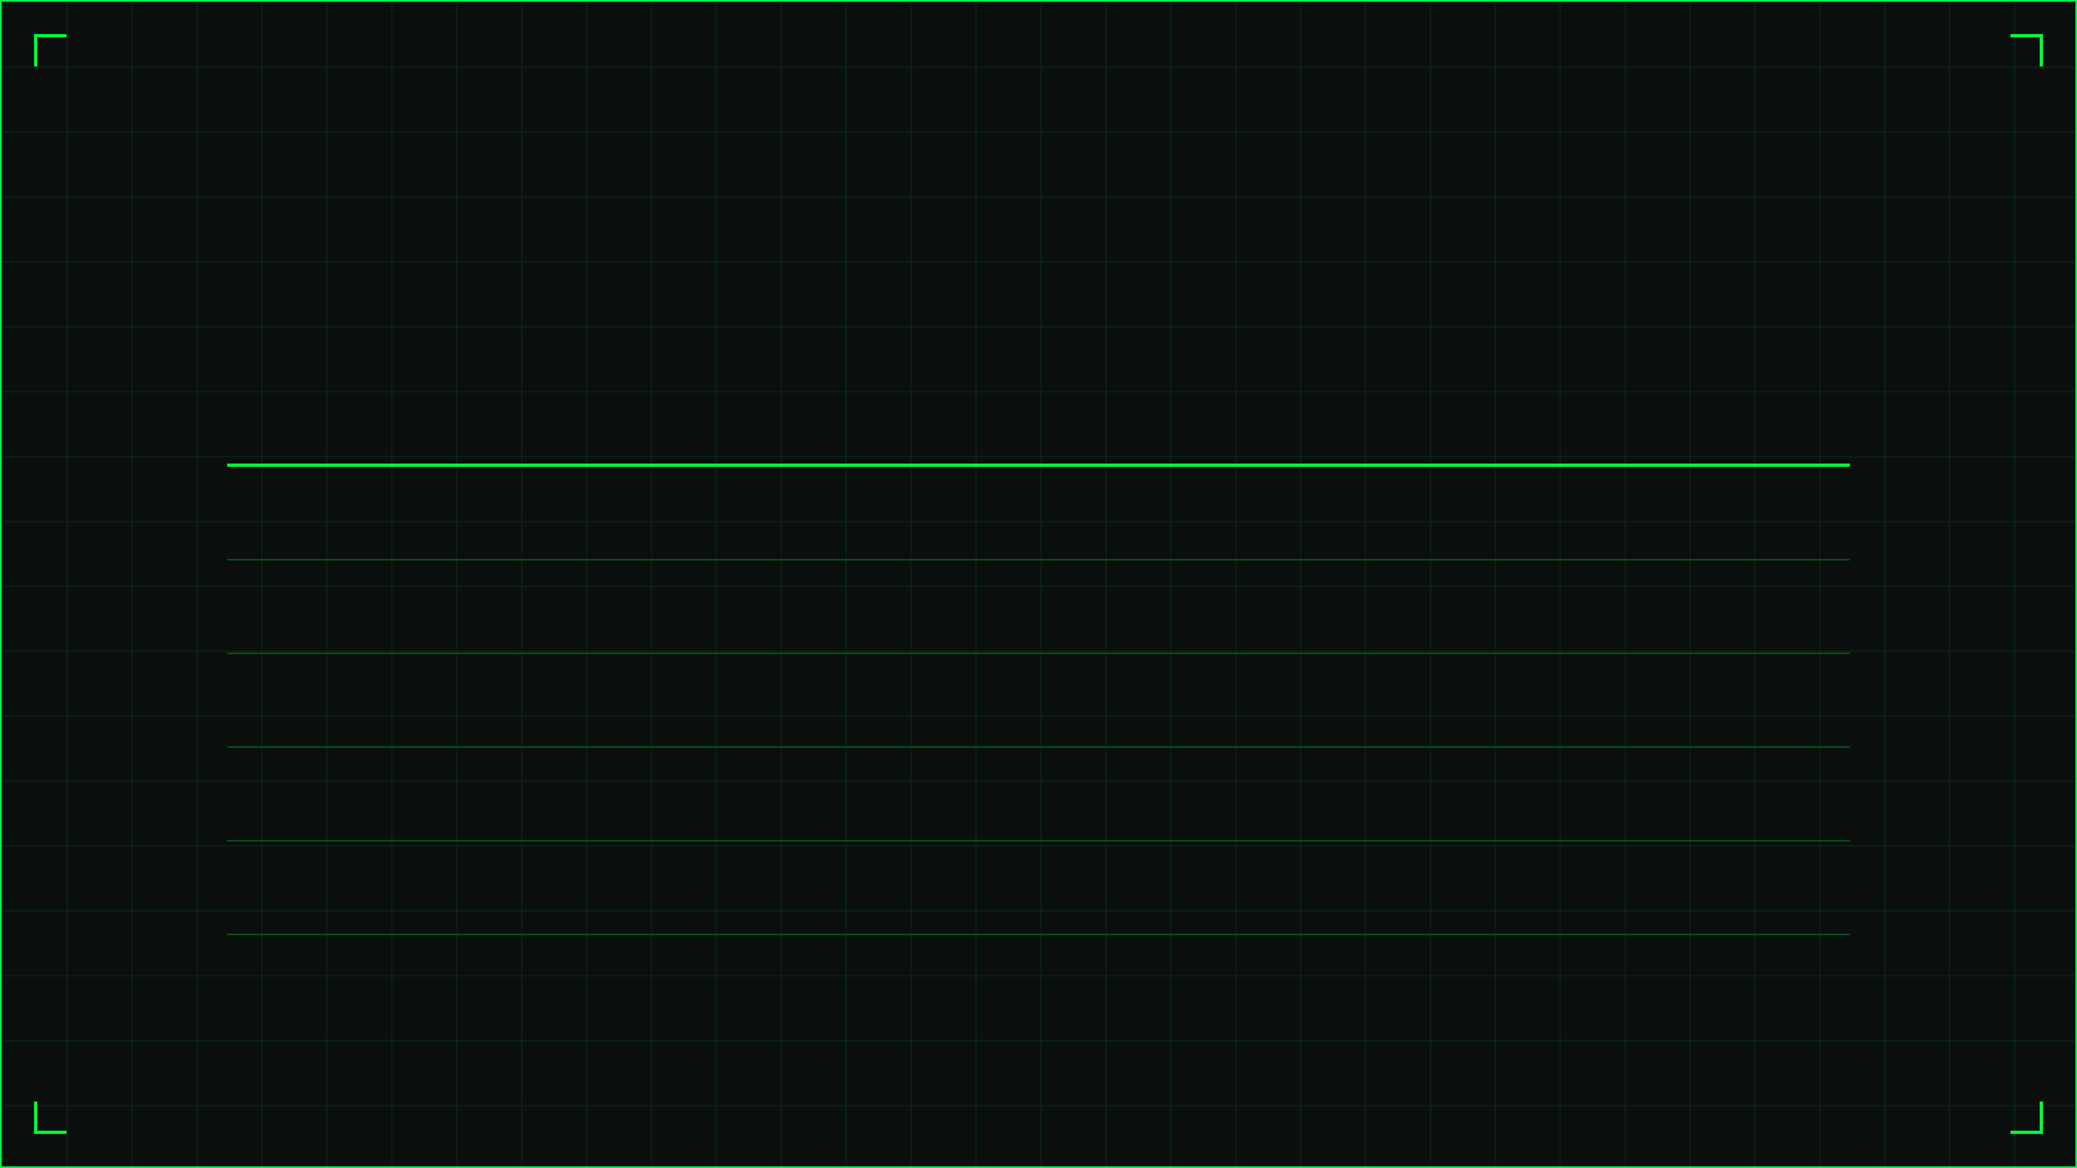
Meet the Development Team
Collaborative Engineering by BSAI Students
Name
ID
Primary Responsibility
Rayyan Ahmed
22F-BSAI-11
Computer Vision Expert
Agha Harris
22F-BSAI-27
It Lead Manager
Irtat Mobin
22F-BSAI-29
ML Expert
Omaid Ejaz
22F-BSAI-45
ML Expert – Content Developer
Wajhi Qureshi
22F-BSAI-50
Web Developer

Slide 3







Core Technology Stack
Leveraging Industry-Standard Python Libraries
OpenCV
Streamlit
The core engine for template matching, video I/O, and rendering tactical overlays on frames.
Provides the modern, web-based interactive UI for target selection and real-time visualization.
NumPy
Matplotlib
Facilitates high-performance pixel-level operations and array manipulations for image processing.
Used to generate the first-frame reference grid for precise coordinate input by the operator.
Python Std Lib
Core Logic
Manages system-level operations including temporary file storage and execution time measurement.
Custom algorithms for adaptive method selection and dynamic search region expansion.

Slide 4



System Architecture & Workflow
From Raw Video to Targeted Intelligence
Phase 01
Phase 02
Phase 03
Phase 04
Input Phase
Initialization
Processing
Output Phase
The operator initiates the process by uploading raw video data for analysis.
System extracts the first frame and prepares the tracking environment.
Real-time analysis loop applies adaptive tracking to each frame.
Final generation of processed video with tactical HUD overlays.
> Upload MP4/AVI/MOV
> Define Target ROI
> Extract Frame 0
> Generate Ref Grid
> Template Matching
> Adaptive Search
> Render Tactical HUD
> Export MP4 Video

Slide 5

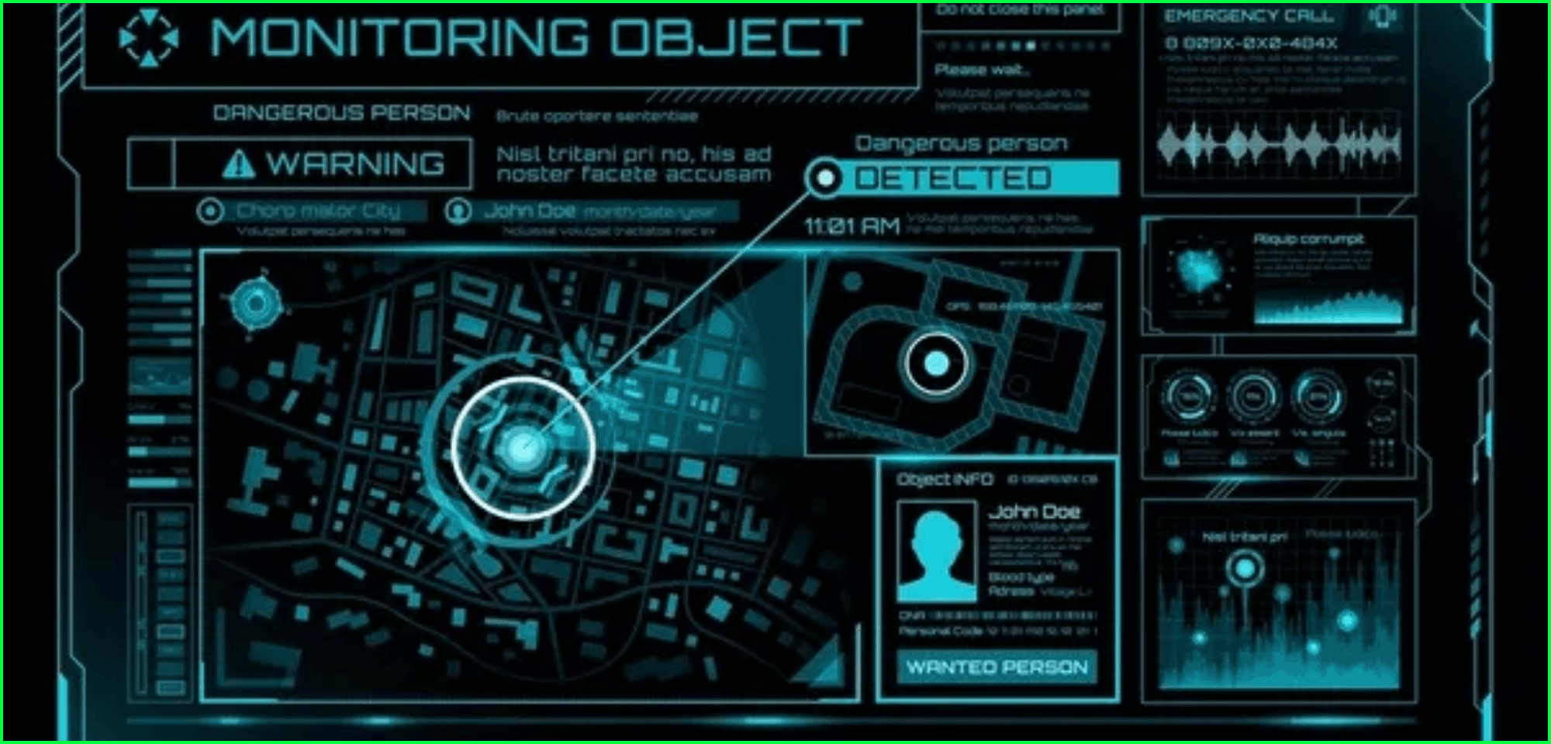
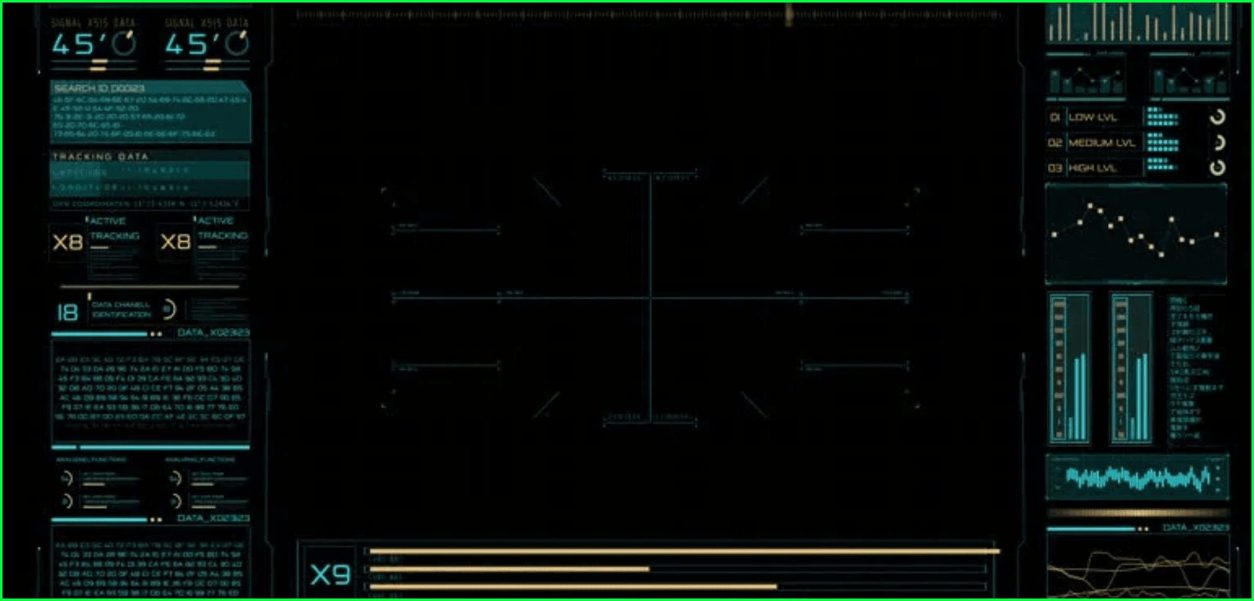
Interactive User Interface
Designed for Tactical Precision and Ease of Use
Dynamic Sidebar
Houses essential project documentation, developer credentials, and technical specifications for quick reference.
Reference Grid System
Generates a pixel-accurate grid overlay on the first frame to assist operators in precise target coordinate selection.
Military Aesthetic
Utilizes a dark color palette with high-contrast indicators to ensure maximum visibility in tactical environments.

Slide 6

Adaptive Template Matching
The Engine Behind the Target Lock
Dynamic Method Selection
Condition
Logic Applied
VisionLock intelligently switches between matching algorithms based on the visual characteristics of the target. By analyzing the standard deviation of the template, the system optimizes for either correlation accuracy or squared difference precision.
Std Dev < 140
TM_CCOEFF_NORMED
Std Dev ≥ 140
TM_SQDIFF_NORMED
Mean > 65
Bitwise Inversion
Contrast Optimization
Every 10 Frames
Template Refresh
To maintain tracking in high-brightness scenarios, the system monitors the mean pixel intensity. If the template is too bright, it is dynamically inverted to enhance feature contrast against the background.

Slide 7

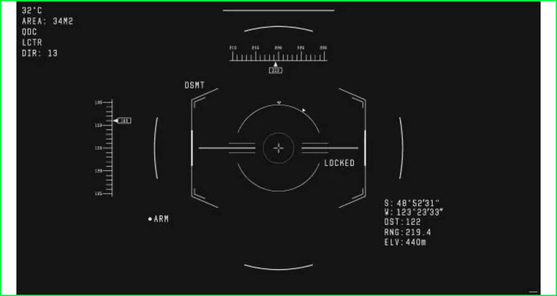
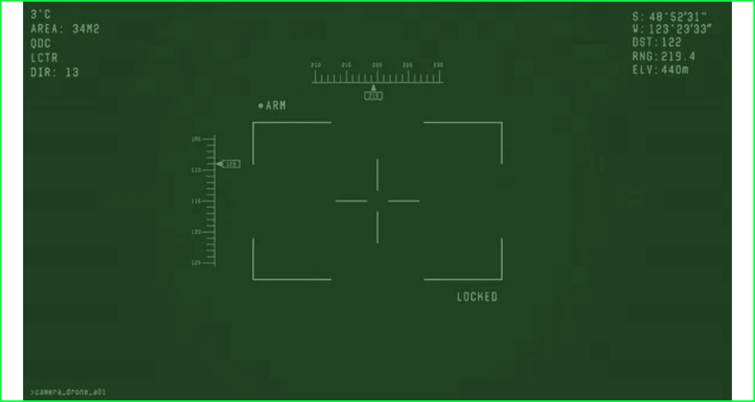
Robust Tracking Logic
Maintaining Lock in Challenging Environments
VisionLock employs sophisticated logic to maintain a target lock even when conditions become challenging. The system requires a minimum confidence score to confirm a match; if this threshold is not met, the search area expands dynamically to re-acquire the target.
Parameter
Value
Function
Confidence Threshold
0.55
Minimum score for match confirmation
Search Expansion
80 - 150px
Dynamic window for target re-acquisition
Template Update
10 Frames
Refresh rate for target appearance changes

Slide 8

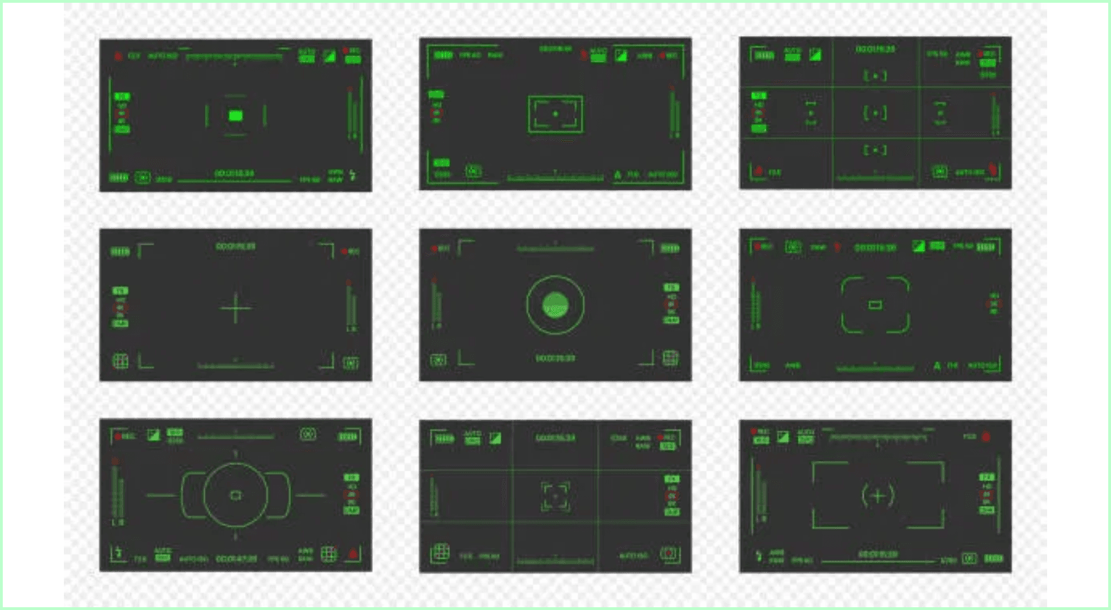
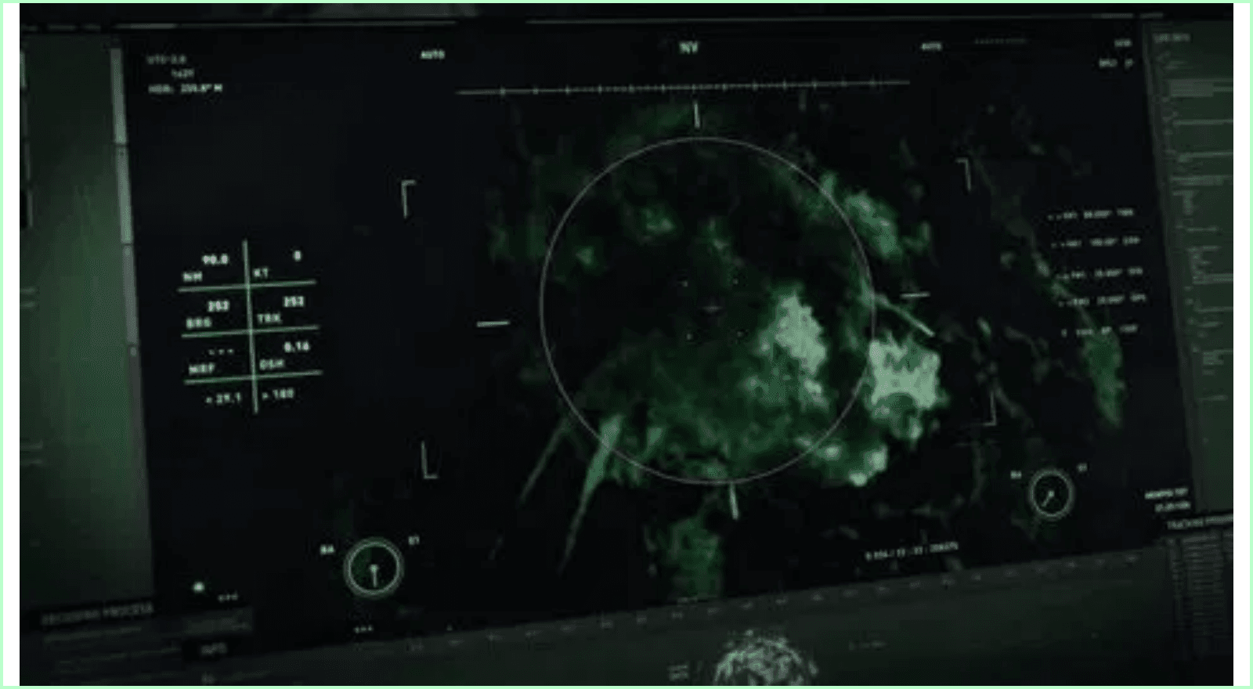
Target Lock Visualization
Military-Grade HUD and Indicators
Indicator
Representation
Purpose
Bounding Box
Red Rectangle
Frames and isolates the tracked target in real-time.
Tactical Overlays
Crosshair & Circle
Simulates precise aiming for FPV drone operations.
Status Text
Tactical Messaging
Confirms target lock and provides system status updates.
Performance
Real-time FPS
Monitors system efficiency and processing speed.

Slide 9




Performance Optimization
Real-Time Processing & Resource Efficiency
Search Region Limiting
Grayscale Processing
By focusing analysis on a localized window around the last known position, the system avoids the computational cost of scanning entire frames.
Reduces the computational workload by 66% by performing template matching operations on single-channel grayscale images instead of RGB.
Efficient I/O
Memory Management
Utilizes OpenCV's high-performance VideoWriter with 'mp4v' encoding to ensure rapid frame serialization and video generation.
Implements temporary file handling for large video uploads, preventing system memory exhaustion and ensuring stable operation.

Slide 10



Use Cases and Applications
Beyond the Classroom: Real-World Potential
Defense & Recon
Security Systems
R&D Foundation
Applied to drone surveillance for tracking ground vehicles from aerial platforms. Ideal for reconnaissance missions and tactical monitoring of enemy movements in hostile environments.
Provides a foundation for automated monitoring systems that lock onto specific moving objects in restricted zones, enhancing perimeter security and threat detection capabilities.
Serves as a robust platform for developing more complex AI-driven target identification systems and simulating FPV drone operations for advanced military personnel training.

Slide 11

Future Enhancements
Scaling VisionLock for Next-Gen Requirements
Enhancement
Description
Expected Benefit
Deep Learning
Integration of YOLO or Siamese Networks for feature extraction.
Improved handling of target occlusion.
Multi-Targeting
Expanding the system to track multiple objects simultaneously.
Enhanced situational awareness.
GPU Acceleration
Utilizing CUDA cores for high-speed parallel processing.
Ultra-high-speed tracking performance.
Cloud Scaling
Deployment to distributed cloud environments for remote access.
Centralized processing and accessibility.

Slide 12
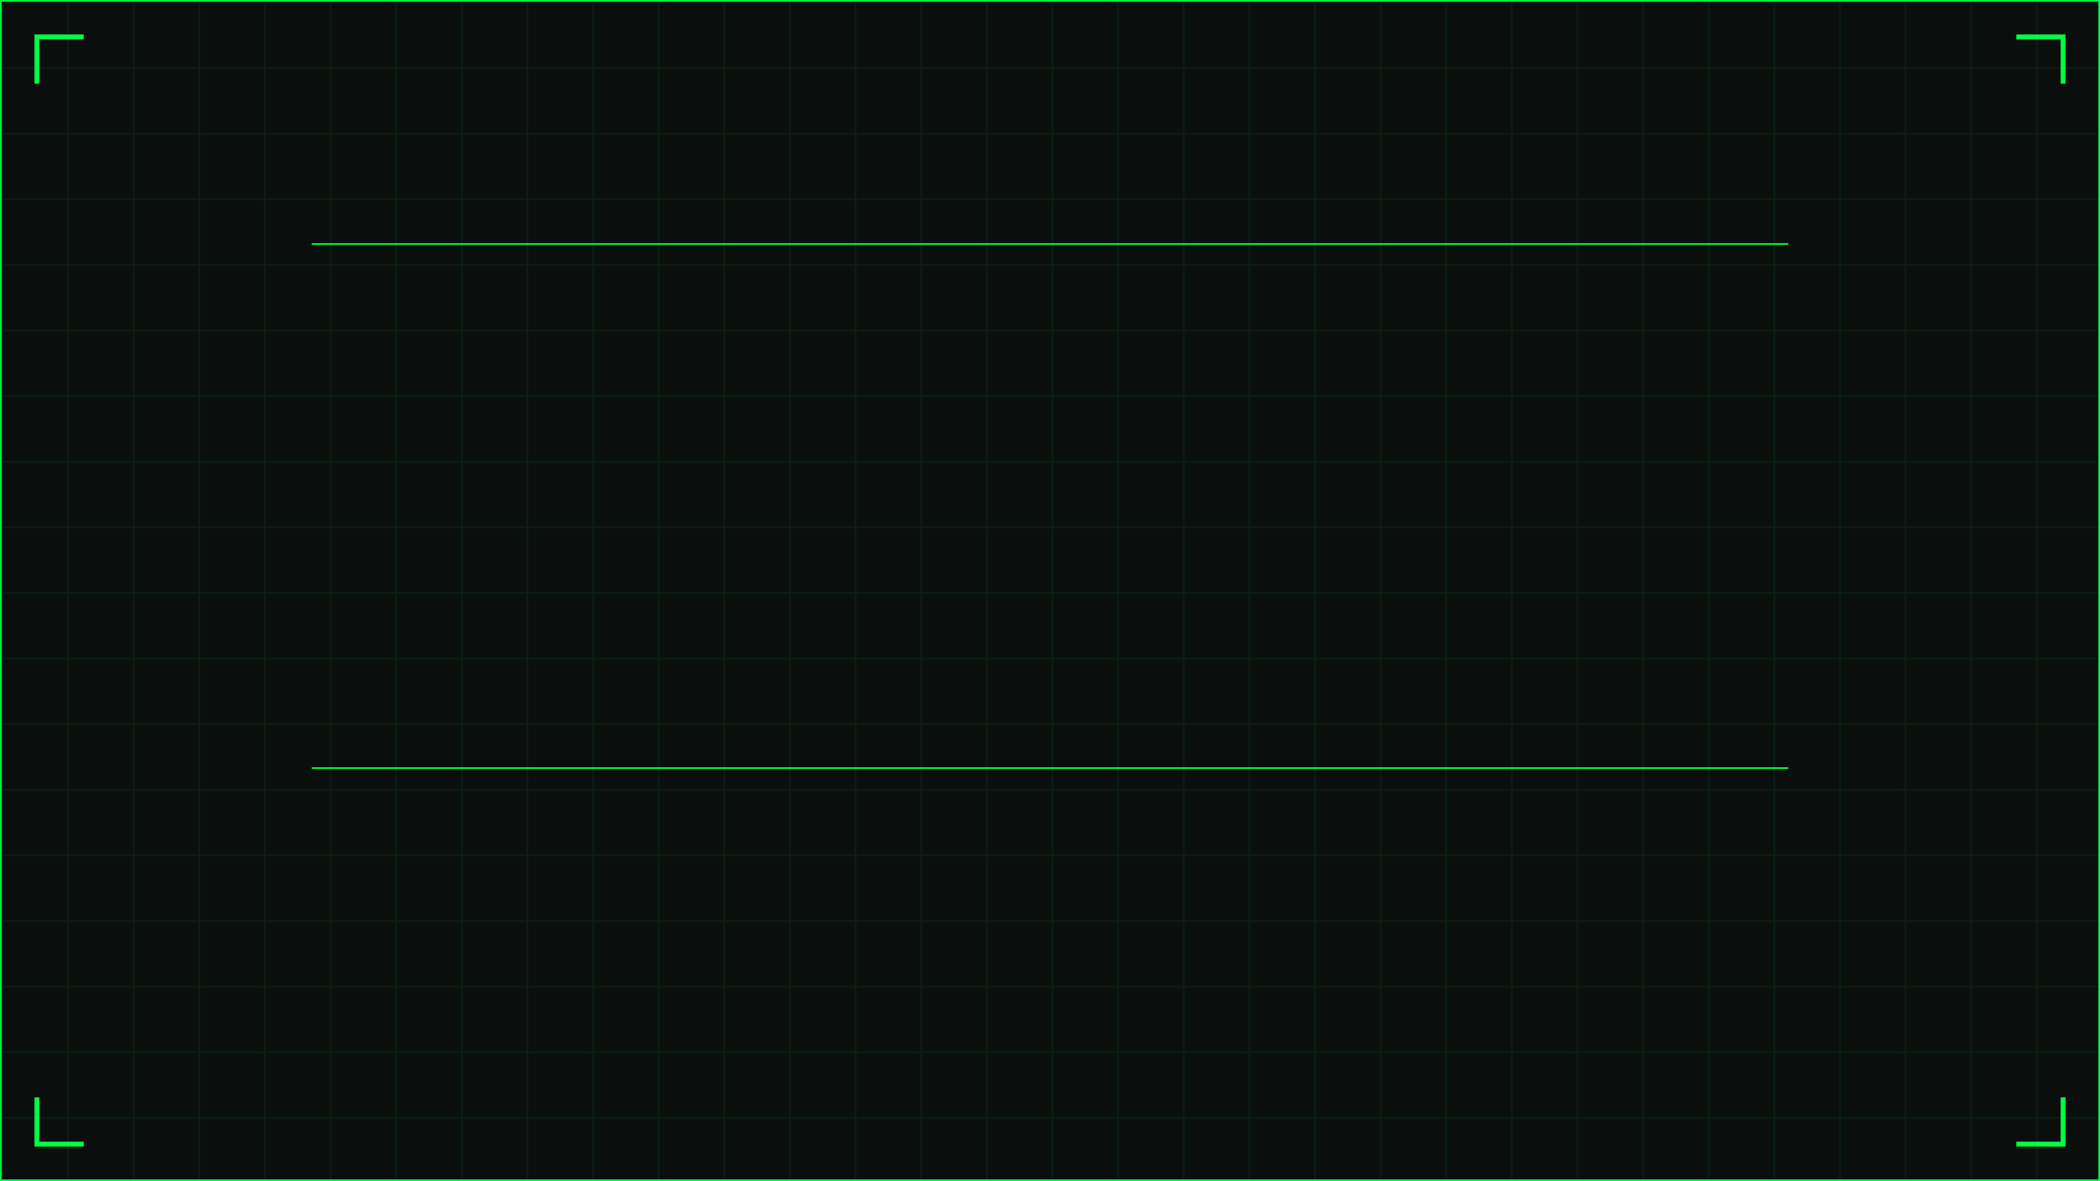
Conclusion & Summary
VisionLock stands as a successful proof of concept for a military-grade single object tracking system. By effectively combining the power of OpenCV with the interactivity of Streamlit, the development team has created a robust framework for tactical computer vision applications.
The project demonstrates that through adaptive matching methods and dynamic search strategies, reliable tracking can be achieved in a variety of scenarios, providing a solid foundation for future advancements in automated target acquisition.
Mission Complete: Target Locked

